Slide 1
Write docs like a software developer using the Linux toolchain
Alec Clews
@alecthegeek
Linux Users of VIC, April 2018

Slide 2
Based on a presentation at LCA 2018
Generate API docs
"Old Skool"
Notes:
The specifics of what I do probably won't work for you. But hopefully this will encourage you to "get tooled up" on your own docs.

Slide 3
More information
https://github.com/alecthegeek/doc-api-old-skool
Long form article with the details and further reading
Working example
These slides and demo scripts
Notes:
The specifics of what I do probably won't work for you. But hopefully this will encourage you to "get tooled up" on your own docs.

Slide 4
What's my story?
I help developers use APIs with
Training
Support and
Documentation
And it's just me…
This is the why, who and how of the documentation
(PS I also use the same tools to write blog posts and magazine articles)
Notes:
I create documentation
I need to be nimble and move on

Slide 5
I work for PaperCut
We are successful so
Customers need to connect our stuff to their other stuff
We can't do it all
So we provide various APIs
We want our customers to be successful with our APIs

Slide 6


WHY?
AND
You Want Everyone to Use It!
Notes:
What is success?
People using your API!
People putting solutions live!

Slide 7

How?
Make it USEFUL
AND
Make it EASY
with GREAT DOCS
Notes:
Create some useful content to help your community use your API
Helps stop
Pissed off users
Greater support overhead

Slide 8
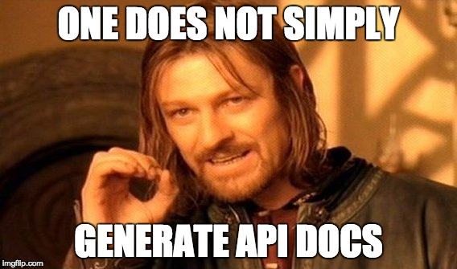
Notes:
Running Javadoc, or something similar, does not create good docs
I'm here to show how we can do much better.
Some of the problems
A few simple examples -- re xml-rpc examples no types, not faults
No complete solutions -- hard to understand the lifecycle of an API app, no template example to get developer started
Things getting out of date
A wall of text -- remember that a picture is worth a thousand words!
Badly written text
Hard to update

Slide 9

Who are we doing this for?
Basically we are talking to strangers!
Notes:
But assume
They don't speak or read the same language as we do
They don't know the same things we do (e.g. my examples are in Java but by partner uses js -- so my example needs to be easy to understand)
They don't use the same tools we do.

Slide 10

Frack!
Documentation is hard work!
Creating good content takes
effort and ongoing care.
Notes:
Often gets "forgotten" -- We are too busy creating working code DAMMIT!
Just throw up the API method definitions and a couple of simple unit tests, it's all good (Hint, no it isn't)

Slide 11
But I have Swagger* to do all this for me!
API references are valuable and necessary
but they are they final chapter, not the 1st
Don’t give a context (why, when, when not, etc)
Often not technology agnostic
Makes it harder to see
  the complex scenarios
  how to handle errors
* Insert of the name of your favourite doc gen tool here

Slide 12

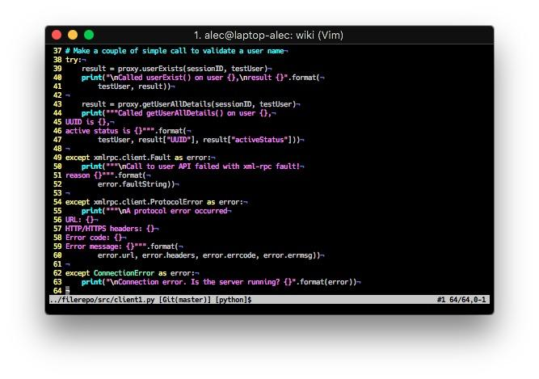
Making Better Docs
⇐ Use Pictures
Create & Show real code ⇒
Notes:
Don't! Instead
Use Pictures. A picture is worth a thousand words
Show complete code solutions. Complete working solutions => Gives users confidence they can do it. Give a template to get something going quickly.
Small code fragments only take your users so far.

Slide 13

When you use words
Keep
It
Simple
Stupid!
Robb Murray rmurray@mankatofreepress.com
Notes:
When you do write words remember to KISS! -- Keep it Simple Stupid
Short, simple, sentences with simple words, correctly spelled
Avoid idioms
Use lots of white space and bullet lists
The internet has a lots of information on how to write technical words
Go To Heidi's Friday talk "Writing Workshop for Devs"

Slide 14
Keep the doc CURRENT
"Writing your docs once and then never touching them again is basically the same thing as planting a garden in the start of the season and then just leaving it alone and hoping it grows beautiful with nothing invasive, no weeds, nothing bad.
Sure you might have a few things that are still there at the end of the season, just like some parts of your docs will still be accurate even if you don't update them.
But abandoned documentation, just like an abandoned garden, will get more and more inaccurate and even dangerous to its users as time goes on.
Treat reports of difficulty with your docs or inaccuracy in them as seriously as you treat reports of dead plants or dangerous infrastructure in a garden that you want to keep welcoming and beautiful.''
E. Dunham at GitHub Universe, October 2017

Slide 15
So what did I do about it?
Treat docs the same as code!
Fix bugs
Add new features
Re-factor
Automatic builds
Cross Platform support
Don't Repeat Yourself
"Everything" is text and under version control
Notes:
Same principle as "Infrastructure as code"
DRY Principle, Andy Hunt

Slide 16

The Policy Times
Notes:
Automation makes things less painful and faster. It's easier to keep it current and fix things
Automate all the things
Image creation
Text formatting
Format conversion
Content creation
Including code

Slide 17
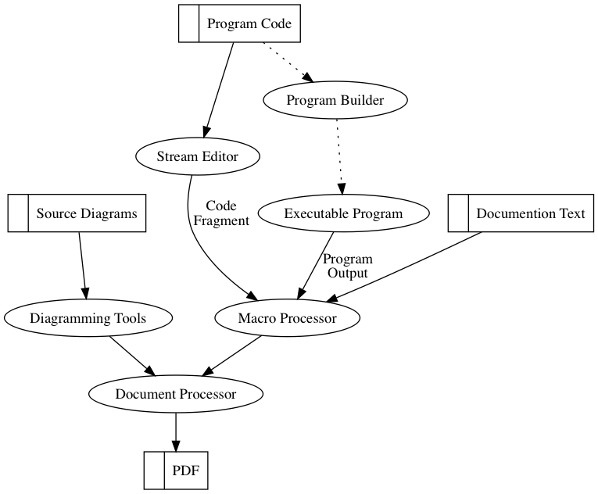
Notes:
I have a buld workflow and I use tools!

Slide 18
My Current Doc Tool Chain
Pandoc
  Plantuml
  Graphviz
M4
  Bash/Sed/Python etc.
Make
But use your own tools and work flow
Notes:
It evolves

Slide 19
Markdown and Pandoc
Markdown is a simple text formatting language.
  Examples use Pandoc specific Markdown (gdm) as input
Pandoc converts Markdown into publication formats
  e.g Github Markdown, HTML or PDFs

Slide 20


Slide 21
GNU M4
Old School! Developed in 1977
It’s a text filter
  Copies input to output
  But modifies content in response to macro directives in the the input

Slide 22
What sort of transformations can M4 Do?
Insert text from another file
  e.g. insert source code into our docs
Replace one string with another (maybe longer) string – A Macro
  e.g. apply additional formatting to blocks of text
Macros with arguments (like functions)
Run a shell command and insert the output
  Generate content dynamically at publication time
Other miscellaneous functions
  Simple arithmetic, conditional and looping control, changing output destinations & string handing

Slide 23
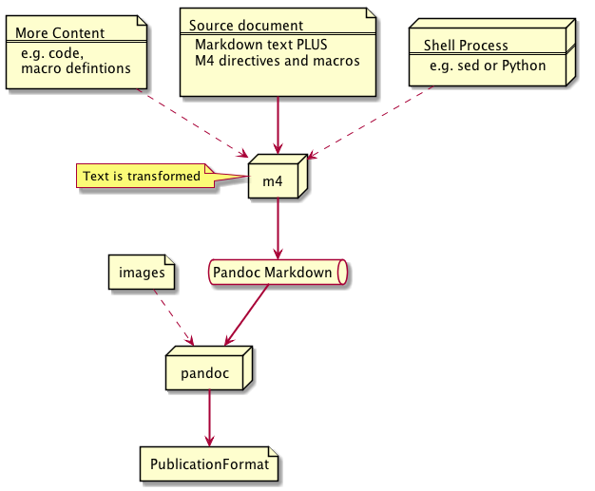

Slide 24
Simple M4 demo.
Let’s add extra content to our example doc
  Include XML source file into the doc
m4_include([[demo2.xml]])
Notes: I always
  Put m4_changequote([[, ]]) at the top of my file – it makes quoting easier
  Run m4 with the -P option so that all bulletins start with m4_
  Define all macros names to start m4_

Slide 25
Demo 2

Slide 26
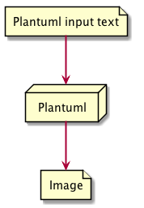
Creating images Plantuml (and others)

Slide 27
Demo 3

Slide 28
More M4 magic
Add code working fragments to the docs at publication time
But why?
  Don’t repeat yourself
  If you fix the code then you docs get fixed as well
  You don’t make typos or copy and paste errors

Slide 29
Demo 4

Slide 30
Something a little more complicated...
m4_syscmd([[for i in \
$(sed -nEe '/server.register_function/\
s/^.+server.register_function\(([^)]+)\)/\1/p' \
../filerepo/src/server.py)
do
/bin/echo -n '* `'$i'()` -- '
/bin/echo $(python3 -c "import sys
sys.path.insert(0,\"../filerepo/src\")
import server
print(server.$i.__doc__)")
done]]
)

Slide 31
Publication
Target any format
Make is fast and easy
Demo5

