Slide 1
Open Source Collaboration
with Git and GitHub
Alec Clews

Slide 2
Credit
Some slides based on presentation by Nick Quaranto http://xrl.us/benbdq

Slide 3
Agenda
Intro to Version Control + DVC
Details of Git
Practice using Git locally
Intro to GitHub
Practice using distributed Git

Slide 4
Version Control Systems
Records changes to files over time
Stops changes being lost
Scales to handle many people making many changes to many files
Core component of Configuration Management => Software Engineering

Slide 5
VC provides
Record of historical changes
  Forensics/problem solving
  Compliance
Multiple changes
  Teams
  Features
  Flexibility
Change control

Slide 6
Versions
Each time a change is added to the 'repo' the version number is incremented
Key questions
  Why was a new version created?
  What changes did the version introduce?
Historically version numbers also used to identify branches: BAD

Slide 7
Branch
Parallel development (need not be concurrent)
Team A works on feature X, Team B works on feature Y
Branch Y and branch X separate the lines of development
Merging is an issue

Slide 8
Other key terms
Change Log
Work area
Repository
Tags
Commit bit
Strict vs. permissive locking

Slide 9
Basic Workflow
Identify version to receive change
Create a branch for change?
Check out version from repo to work area
Hack/Hack/Test/Test....
Check in/Commit from work area to repo

Slide 10


Slide 11
I'm an egoistical bastard, and I name all my projects after myself.
First Linux, now git.
-Linus Torvalds

Slide 12

1. Fast

Slide 13

Local
2. Local

Slide 14
Git as a DVCS
Tool like SVN has 1 repo
DVCS every dev has a copy of the repo
All repos are technically equal
But always one or more 'central' repos

Slide 15

The Staging Area

Slide 16

3. Cheap Branching

Slide 17

Branching

Slide 18

Distributed
4. Distributed

Slide 19
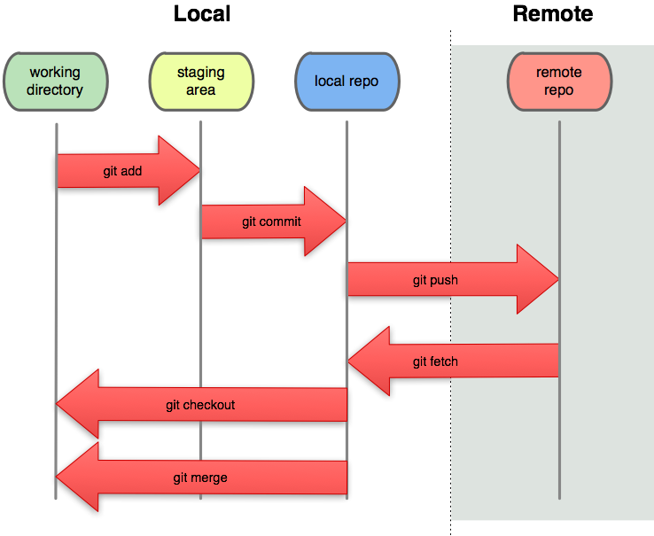
Local vs. Remote

Slide 20
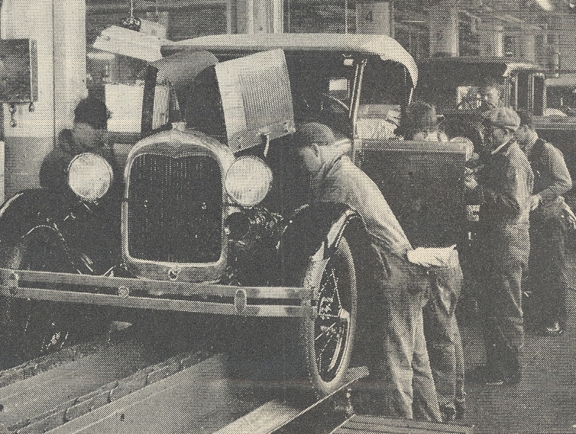
Any Workflow
6.Many Workflows

Slide 21
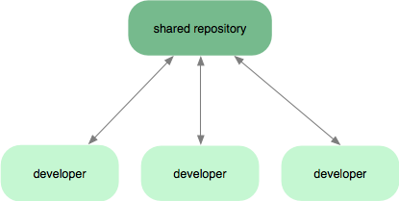
Centralized

Slide 22
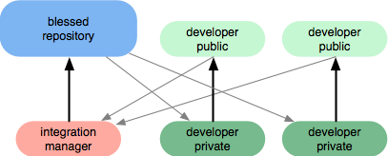
Integration Manager

Slide 23
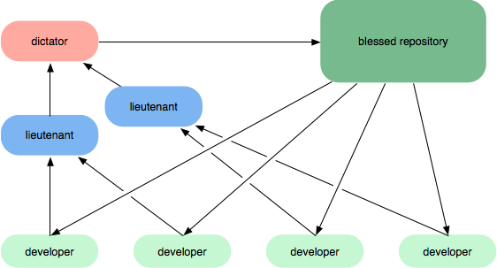
Benevolent Dictator

Slide 24

Failboat.
It’s not perfect.

Slide 25
The downsides
Complexity
Windows FTL
IDE support (but see egit/Eclipse, Vim, Emacs and GUIs)‏
Frequent releases
  Cygwin: may have to build yourself
  Ubuntu: use Git PPA

Slide 26


Slide 27


Slide 28

Now with git goodness as well

Slide 29
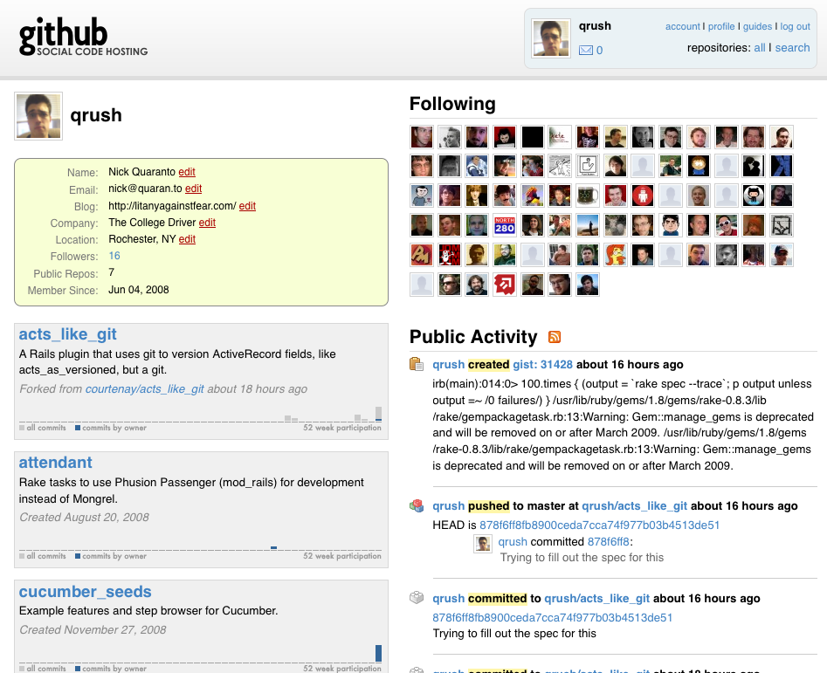

Slide 30
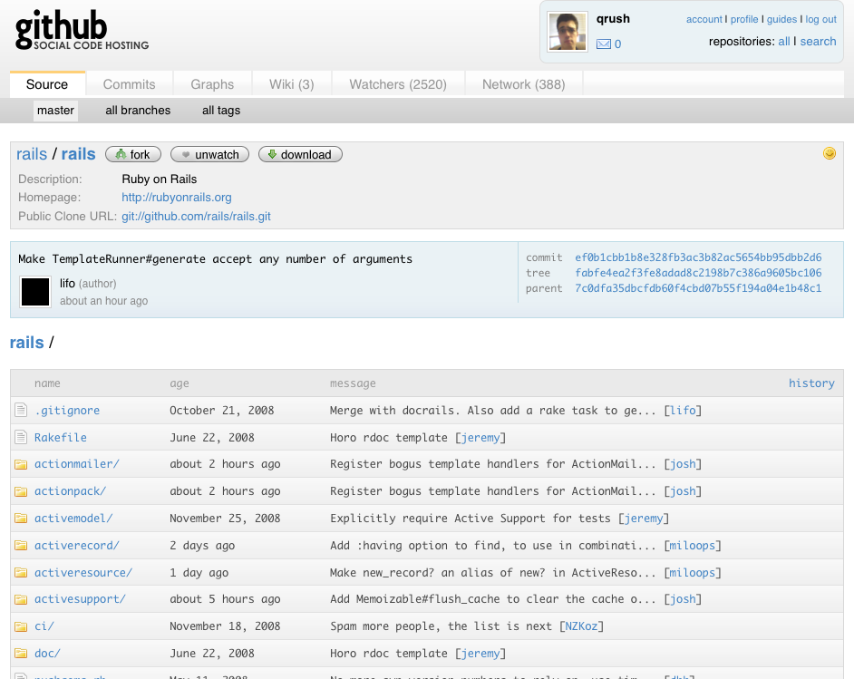

Slide 31
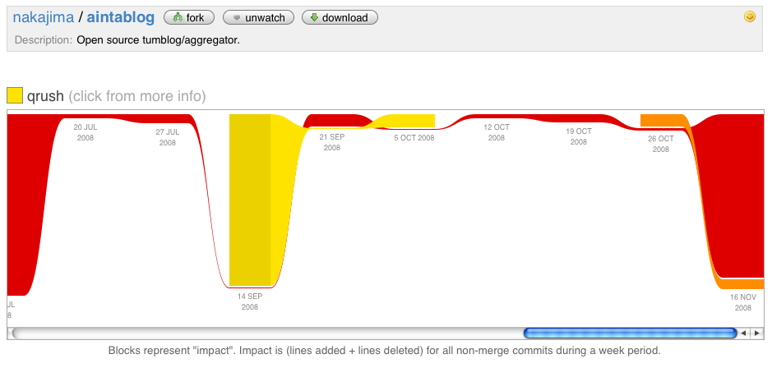

Slide 32
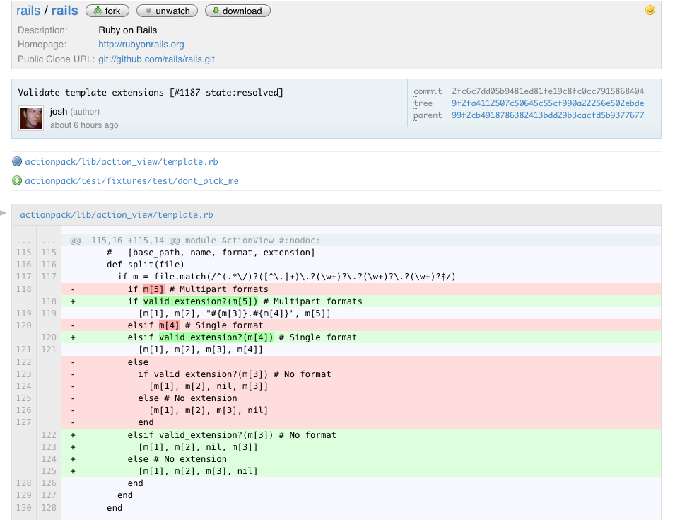

Slide 33
How to Contribute
Fork a repository at GitHub
Clone and connect your local repository
Branch, Write tests, implement functionality
Commit local changes
Push your changes to your fork
Make a pull request
Profit!!

Slide 34

Demo

Slide 35
Hints and Tips
Source git completions file via .bashrc to use git auto complete and branch name in prompt (kudos to Toby)
Set a global .gitignore file
git config --global \ merge.exludesfiles ~/.gitignore
Define a couple of global aliases for checkout and branch

Slide 36
Hints and Tips contd
Use ‘git update-index --stdin’ as part of a pipe to add a lot files or filter files names (c.f. git add)
Override global settings (e.g. email) in .git/config
Use ‘git commit --allow-empty’ to perform empty commit (rare corner case)

Slide 37
Example custom merge driver
Define a new merge driver in .git/config
Define file patterns that use new merge driver
See gitattributes(5)

Slide 38
custom merge driver contd
In .git/config
[merge "overwrite"]
name = overwrite using cp
driver = cp %B %A
#recursive = defaults to driver

Slide 39
custom merge driver contd
In .git/info/attributes
  NB No space around ‘=‘
* merge=overwrite

Slide 40
git log
http://git-scm.com
http://whygitisbetterthanx.com
http://delicious.com/alecclews/git

