Slide 1
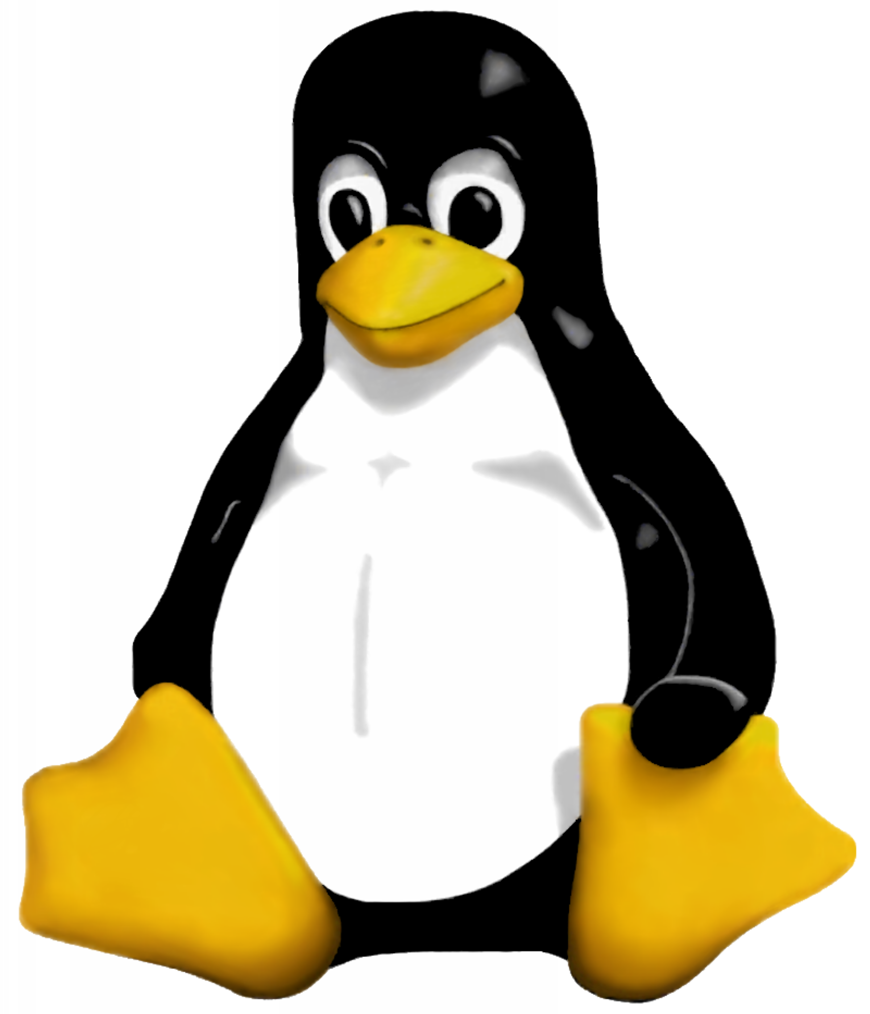

Novice Python Programming Workshop
Alec Clews
t: @alecthegeek
b:http://alecthegeek.wordpress.com

Slide 2
Introduction
Audience:
Novice Linux users who have never programmed
Objectives
Write and debug at least one simple program
Want to do more
Know where to go next

Slide 3
Short time
Limited material
Simplifications
No OO
Not covering most data types or features

Slide 4
Motivation to program
Intellectual pastime
Better understanding of world around us
Professional Interest
  New job
  Better conversations
Solve a problem

Slide 5
Why Python?
Clean and simple syntax
Real language
Powerful libraries
Used for desktop, web applications, data munging, computer management and all manner of good things
Notes:
ipython -pylab
x = randn(10000)
hist(x, 100)

Slide 6
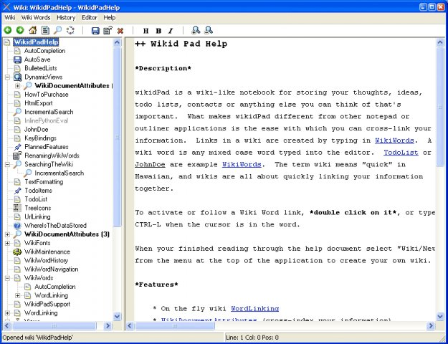
Python Example Desktop App

Slide 7
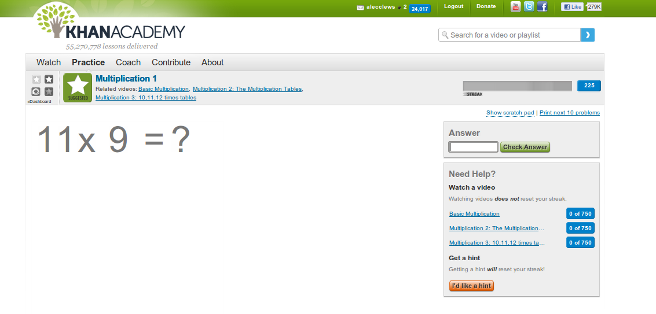
Example Python Web App

Slide 8
Other language options?
  Go http://golang.org/
    Lower level modern language
  Scratch http://scratch.mit.edu/
    Programming visually

Slide 9
Python Versions
Python 2.7
  Modern and supported
Python < 2.7
  More widely used
Python 3.x
  Current bleeding edge

Slide 10
Lots of Material
Official Python Tutorial
http://docs.python.org/release/2.7.1/tutorial/index.html
Dive Into Python
http://diveintopython3.org/
Think Python
http://www.greenteapress.com/thinkpython/
Learn Python the hard way
http://learnpythonthehardway.org/index
Google Python Class
http://code.google.com/edu/languages/google-python-class/
MIT Open Courseware
http://ocw.mit.edu/courses/electrical-engineering-and-computer-science/6-00-introduction-to-computer-science-and-programming-fall-2008/
Python Wiki Book
http://en.wikibooks.org/wiki/Python_Programming

Slide 11
Progamming at the terminal
ls to list directory contents
mkdir to create a directory
rm to delete a file
gedit to edit a (possibly new) file

Slide 12
Supporting Tools
Editor
  Gedit or Kate
  Vim or Emacs
  Jedit (X Platform)
Version Control
  Needs another workshop
  Mercurial
  Git
  Bizaar
  SVN

Slide 13
Next Steps and Resources
Finish the exercises
Scratch your own itch
Attend Melbourne Python Group
Join a Project. e.g:
  Try Ardiuno and Python
  Help the Khan Academy

Slide 14
Hello World
Using Python IDLE
Hello World Example

Slide 15
Programming Overview
  Statements
    Arithmetic
    Input
    Output

Slide 16
Variables
A box to store numbers and characters e.g.
x = 2
y = 3
answer = x+y
print(answer) 5

Slide 17
Type
String “Alec”
Numeric float 123.4
Integer 123
Bool true or false
Complex numbers
List
Other Types
  Tuples
  Dictionary

Slide 18
Assignment
Forest of values

Slide 19
raw_input()
print("Please tell me your name")
Please tell me your name
name = raw_input()
Alec
print("hello " + name)
hello Alec

Slide 20
Exercise 1
Using IDLE create some Python statements that prompt for a name and output a greeting with the name appearing somewhere
Calculation and expressions
  +-*/
  ()

Slide 21
Exercise 2
Take Exercise 1. Add prompt for age and display number of days lived at last birthday (assume no of leap years is age divided by 4)
Extension: Prompt for DOB and calculate days lived as at today

Slide 22
More Concepts
Structured Data
Decisions

Slide 23
Scripts
  Chmod + #! line

Slide 24
Exercise 3
  Take Exercise 1 or 2 and turn into a script file that will run from the command line

Slide 25
Loops
  while
  for

Slide 26
Package Code into reusable hunks
  def

Slide 27
Exercise 4

Slide 28
Exercise 5

