Slide 1

資料結構 Data Structure
Chap.04 Linked Lists
2020 Spring

Slide 2

陣列(Array)
陣列(array)由一連串的索引(index)和值(value)構成
對每個索引index，必有一個相關聯的值value
如果可能的話，盡量使用連續空間的記憶體
減少存取時間

Slide 3
Pointers (1/5)
考慮下列一連串依字母順序排序的三個字英文單字，以at為結尾： (bat, cat, sat, vat)
If we store this list in an array
Add the word mat to this list
move sat and vat one position to the right before we insert mat.
Remove the word cat from the list
move sat and vat one position to the left
Problems of a sequence representation (ordered list)
從陣列中任意的插入/刪除非常浪費時間
浪費空間

Slide 4
Pointers (2/5)
using linked representation a.k.a Linked List
資料不用連續空間，而是可任意放在記憶體中
儲存下一個element的位置，以此作為正確存取資料的方式
Thus, associated with each list element is a node which contains both a data component and a pointer to the next item in the list. The pointers are often called links.
資料
指標
資料
指標
資料
指標

Slide 5
Pointers (3/5)
C provides extensive supports for pointers.
Two most important operators used with the pointer type :
& the address operator
* the dereferencing (or indirection) operator
Example:
If we have the declaration:
int i, *pi;
then i is an integer variable and pi is a pointer to an integer.
If we say:
pi = &i;
then &i returns the address of i and assigns it as the value of pi.
To assign a value to i we can say:
i = 10; or *pi = 10;
i
資料
pi
指標

Slide 6
Pointers (4/5)
Pointers can be dangerous
Using pointers: high degree of flexibility and efficiency, but dangerous as well.
不使用時請將所有指標指向NULL.
Another: using explicit type cast when converting between pointer types.
Example:
pi = malloc(sizeof(int));/*assign to pi a pointer to int*/
pf = (float *)pi; /*casts int pointer to float pointer*/
In many systems, pointers have the same size as type int.
Since int is the default type specifier, some programmers omit the return type when defining a function.
The return type defaults to int which can later be interpreted as a pointer.

Slide 7
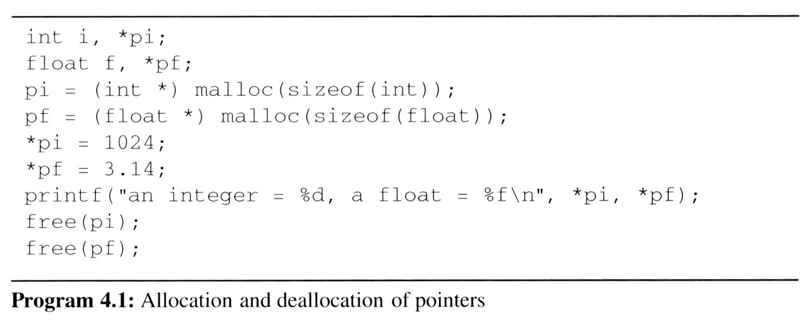
Pointers (5/5)
Using dynamically allocated storage(動態分配記憶體)
When programming, you may not know how much space you will need, nor do you wish to allocate some vary large area that may never be required.
C provides heap, for allocating storage at run-time.
You may call a function, malloc, and request the amount of memory you need.
When you no longer need an area of memory, you may free it by calling another function, free, and return the area of memory to the system.
Example:
Request memory
Free memory

Slide 8
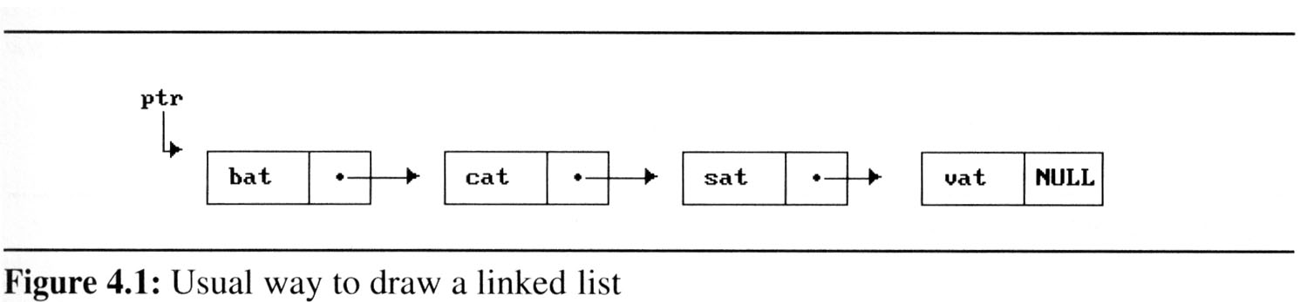
Singly Linked Lists (1/15)
Linked lists are drawn as an order sequence of nodes with links represented as arrows (Figure 4.1).
The name of the pointer to the first node in the list is the name of the list. (the list of Figure 4.1 is called ptr.)
Notice that we do not explicitly put in the values of pointers, but simply draw allows to indicate that they are there.

Slide 9
Singly Linked Lists (2/15)
The nodes do not resident in sequential locations
The locations of the nodes may change on different runs
ptr
. . .
Null
Link Field
Node
Data Field
chain

Slide 10
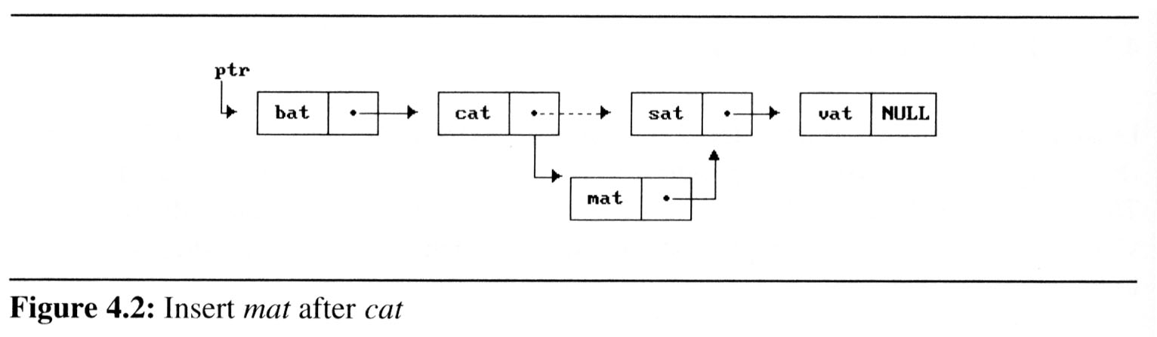
Singly Linked Lists (3/15)
Why it is easier to make arbitrary insertions and deletions using a linked list?
To insert the word mat between cat can sat, we must:
Get a node that is currently unused; let its address be paddr.
Set the data field of this node to mat.
Set paddr’s link field to point to the address found in the link field of the node containing cat.
Set the link field of the node containing cat to point to paddr.

Slide 11
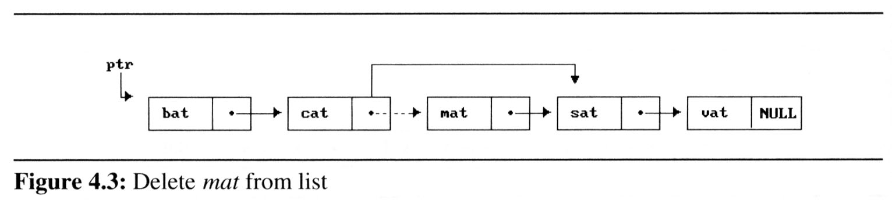
Singly Linked Lists (4/15)
Delete mat from the list:
We only need to find the element that immediately precedes mat, which is cat, and set its link field to point to mat’s link (Figure 4.3).
We have not moved any data, and although the link field of mat still points to sat, mat is no longer in the list.

Slide 12
Singly Linked Lists (5/15)
We need the following capabilities to make linked representations possible:
Defining a node’s structure, that is, the fields it contains. We use self-referential structures, discussed in Section 2.2 to do this.
Create new nodes when we need them. (malloc)
Remove nodes that we no longer need. (free)

Slide 13
Singly Linked Lists (6/15)
2.2.4 Self-Referential Structures
One or more of its components is a pointer to itself.
typedef struct list { char data; list *link; }
list item1, item2, item3; item1.data=‘a’; item2.data=‘b’; item3.data=‘c’; item1.link=item2.link=item3.link=NULL;
Construct a list with three nodes
item1.link=&item2;
item2.link=&item3;
malloc: obtain a node (memory)
free: release memory
a
b
c

Slide 14
Singly Linked Lists (7/15)
Example 4.1 [List of words ending in at]:
Declaration
typedef struct list_node, *list_pointer;
typedef struct list_node {
char data [4];
list_pointer link;
};
Creation
list_pointer ptr =NULL;
Testing
#define IS_EMPTY(ptr) (!(ptr))
Allocation
ptr=(list_pointer) malloc (sizeof(list_node));
Return the spaces:
free(ptr);

Slide 15
Singly Linked Lists (8/15)
e -> name ⇨ (*e).name
strcpy(ptr -> data, “bat”);
ptr -> link = NULL;
address of
first node
ptr data
ptr link
•
b a t \0 NULL
ptr
Figure 4.4:Referencing the fields of a node(p.142)

Slide 16
Singly Linked Lists (9/15)
Example 4.2 [Two-node linked list]:
typedef struct list_node *list_pointer;
typedef struct list_node {
int data;
list_pointer link;
};
list_pointer ptr =NULL;
Program 4.2: Create a two-node list
list_pointer create2( )
{
/* create a linked list with two nodes */
list_pointer first, second;
first = (list_pointer) malloc(sizeof(list_node));
second = (list_pointer) malloc(sizeof(list_node));
second -> link = NULL;
second -> data = 20;
first -> data = 10;
first ->link = second;
return first;
}
#define IS_FULL(ptr) (!(ptr))
When returns NULL if there is no more memory.
ptr
10
•
20
NULL

Slide 17
Singly Linked Lists (10/15)
Insertion
Observation
insert a new node with data = 50 into the list ptr after node
ptr
10
20
NULL
node
50
temp

Slide 18
Singly Linked Lists (11/15)
Implement Insertion:
void insert(list_pointer *ptr, List_pointer node)
{
/* insert a new node with data = 50 into the list ptr after node */
list_pointer temp;
temp=(list_pointer)malloc(sizeof(list_node));
if(IS_FULL(temp)){
fprintf(stderr, “The memory is full\n”);
exit(1);
}
temp->data=50;
temp
50

Slide 19
Singly Linked Lists (12/15)
if(*ptr){ //nonempty list
temp->link = node->link;
node->link = temp;
}
else{ //empty list
temp->link = NULL;
*ptr = temp;
}
}
ptr
10
20
NULL
node
50
temp

Slide 20
Singly Linked Lists (13/15)
Deletion
Observation: delete node from the list
ptr trial node
10
50
20
NULL
ptr trial node
10
50
20
NULL
ptr
10
20
NULL

Slide 21
Singly Linked Lists (14/15)
Implement Deletion:
void delete(list_pointer *ptr, list_pointer trail, list_pointer node)
{
/* delete node from the list, trail is the preceding node ptr is the head of the list */
if(trail)
trail->link = node->link;
else
*ptr = (*ptr)->link;
free(node);
}
ptr trial node
10
50
20
NULL

Slide 22
Singly Linked Lists (15/15)
Print out a list (traverse a list)
Program 4.5: Printing a list
void print_list(list_pointer ptr)
{
printf(“The list contains: “);
for ( ; ptr; ptr = ptr->link)
printf(“%4d”, ptr->data);
printf(“\n”);
}

Slide 23
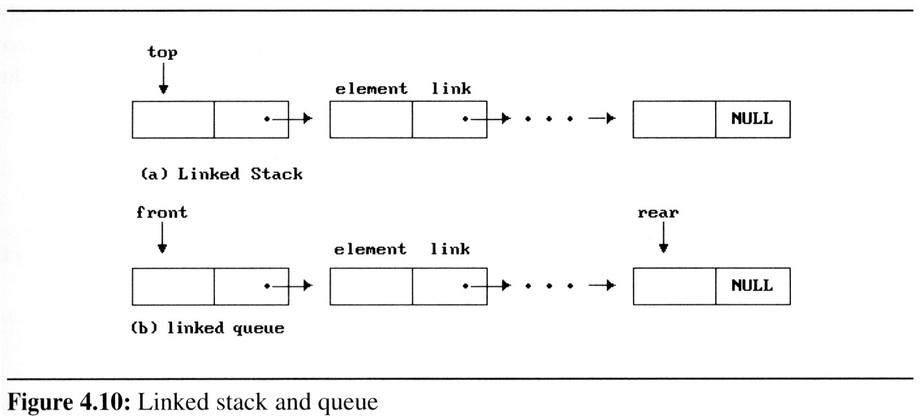
Dynamically Linked Stacks and Queues (1/8)
When several stacks and queues coexisted, there was no efficient way to represent them sequentially.
循序(sequential)很難管理多個stack or queue
Notice that direction of links for both stack and the queue facilitate easy insertion and deletion of nodes.
Easily add or delete a node form the top of the stack.
Easily add a node to the rear of the queue and add or delete a node at the front of a queue.

Slide 24
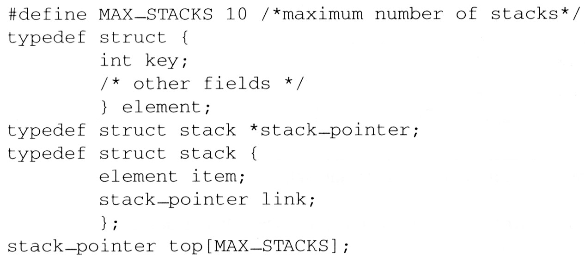
Dynamically Linked Stacks and Queues (2/8)
Represent n stacks
Stack
top
item
link
link
...
NULL

Slide 25
Dynamically Linked Stacks and Queues (3/8)
Push in the linked stack
void add(stack_pointer *top, element item){
/* add an element to the top of the stack */ Push
stack_pointer temp = (stack_pointer) malloc (sizeof (stack));
if (IS_FULL(temp)) {
fprintf(stderr, “ The memory is full\n”);
exit(1);
}
temp->item = item;
temp->link = *top;
*top= temp;
}
temp
item
link
top
link
link
...
NULL

Slide 26
Dynamically Linked Stacks and Queues (4/8)
Pop from the linked stack
element delete(stack_pointer *top) {
/* delete an element from the stack */ Pop
stack_pointer temp = *top;
element item;
if (IS_EMPTY(temp)) {
fprintf(stderr, “The stack is empty\n”);
exit(1);
}
item = temp->item;
*top = temp->link;
free(temp);
return item;
}
temp
top
item
link
link
link
...
NULL

Slide 27
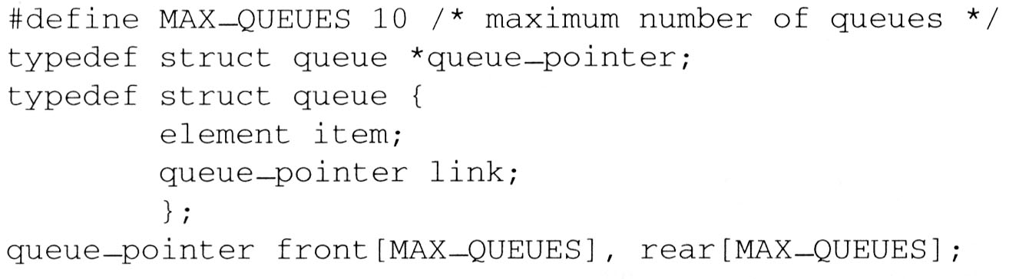
Dynamically Linked Stacks and Queues (5/8)
Represent n queues
Queue
front
item
link
Delete from
link
...
Add to
rear
NULL

Slide 28
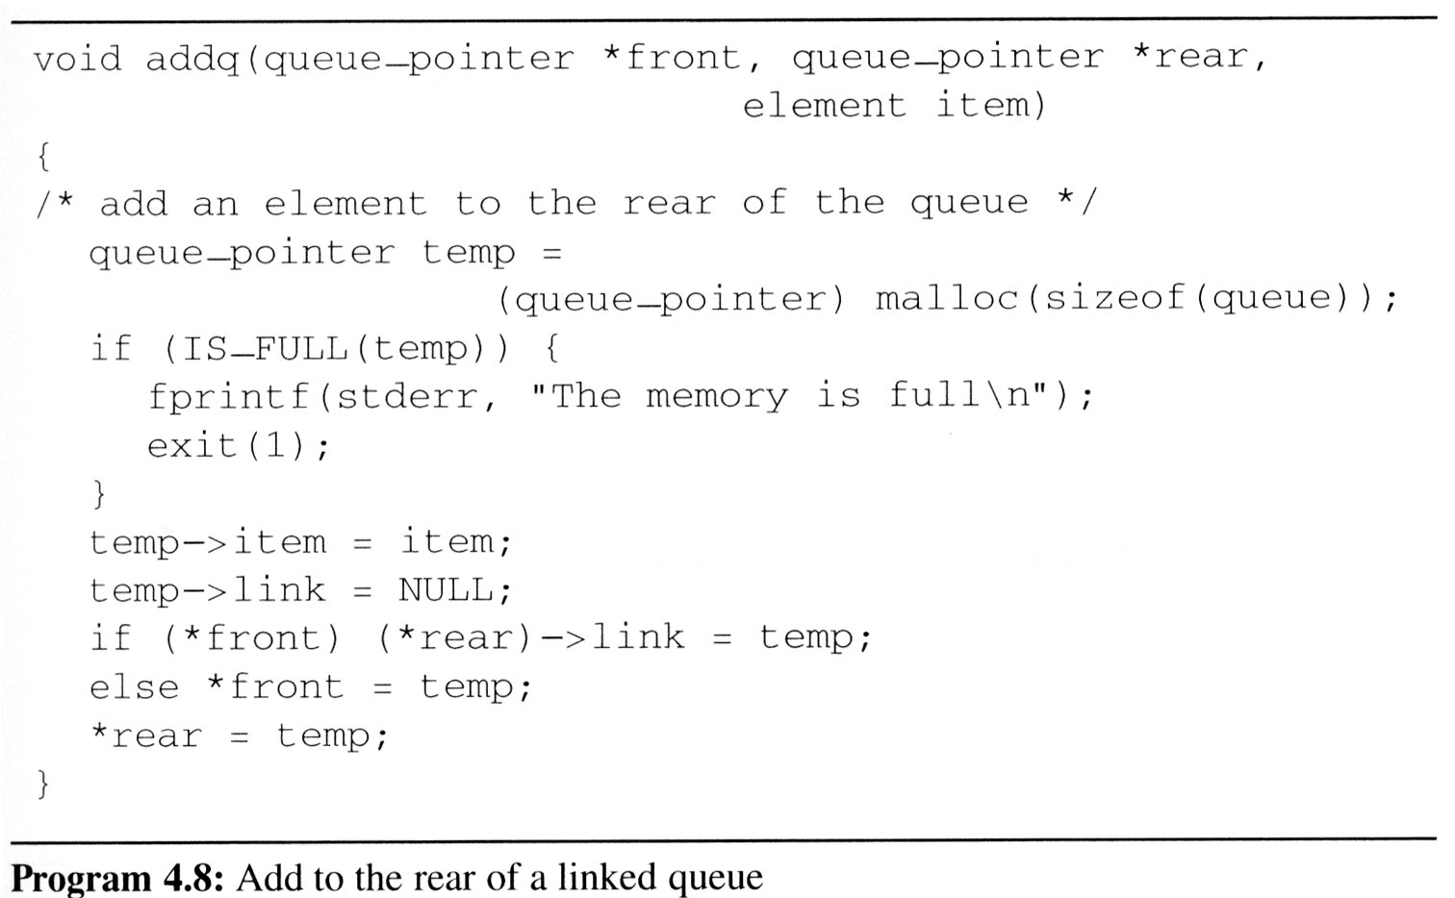
Dynamically Linked Stacks and Queues (6/8)
enqueue in the linked queue
front
link
link
...
rear
NULL
temp
item
NULL

Slide 29
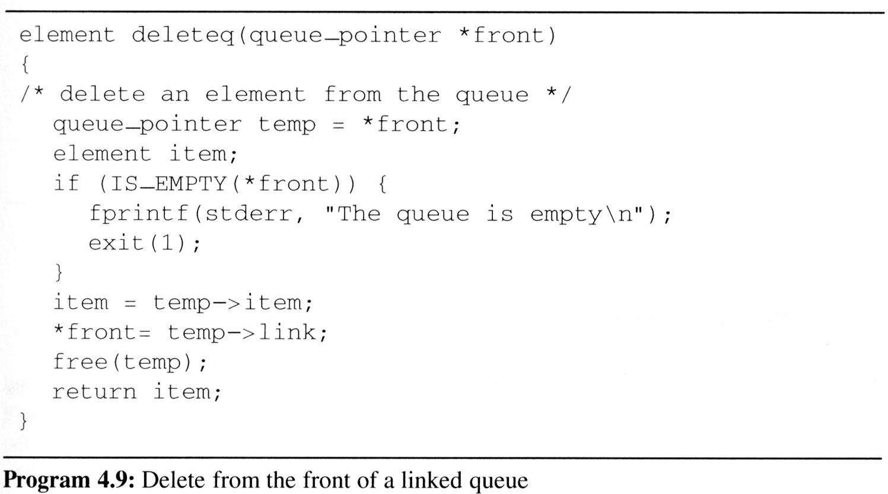
Dynamically Linked Stacks and Queues (7/8)
dequeue from the linked queue (similar to push)
temp
front
item
link
link
link
...
rear
NULL

Slide 30
Dynamically Linked Stacks and Queues (8/8)
The solution presented above to the n-stack, m-queue problem is both computationally and conceptually simple.
We no longer need to shift stacks or queues to make space.
Computation can proceed as long as there is memory available.

Slide 31
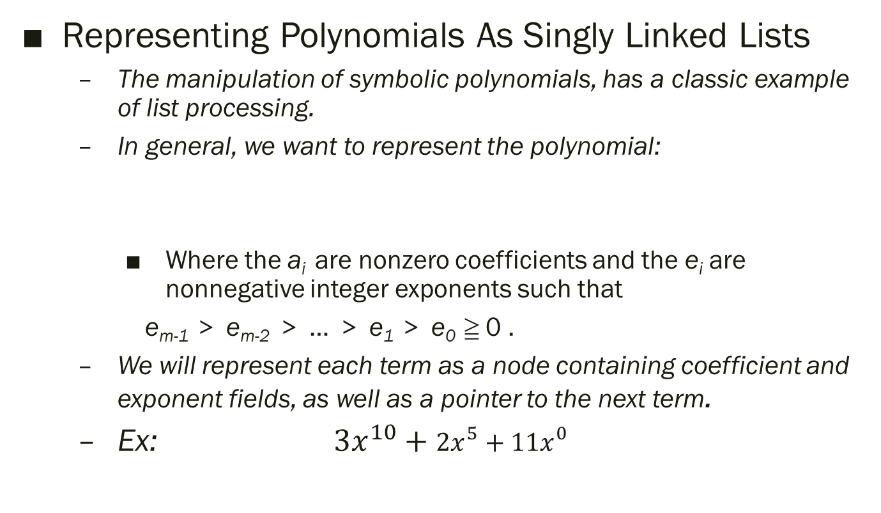
Polynomials (1/9)
Representing Polynomials As Singly Linked Lists
The manipulation of symbolic polynomials, has a classic example of list processing.
In general, we want to represent the polynomial:
Where the a_{i} are nonzero coefficients and the e_{i} are nonnegative integer exponents such that
e_{m-1} ＞ e_{m-2} ＞ … ＞ e₁ ＞ e₀ ≧ 0 .
We will represent each term as a node containing coefficient and exponent fields, as well as a pointer to the next term.
Ex: ${3x}^{10}+{2x}^{5}+{11x}^{0}$
3
10
指標
2
5
指標
11
0
指標

Slide 32
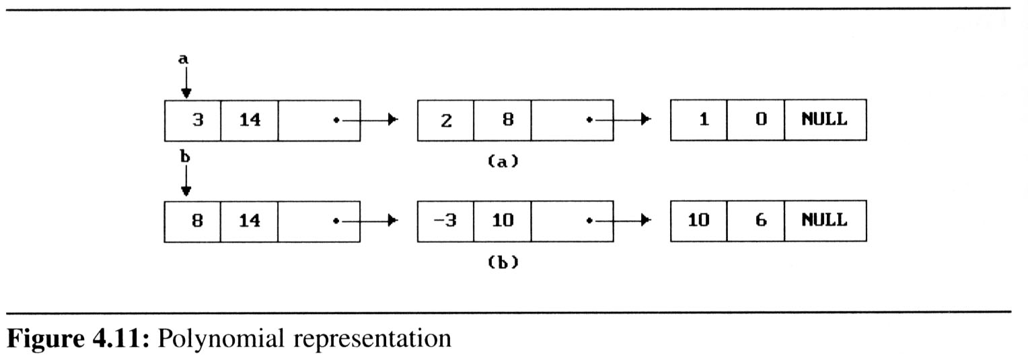
Polynomials (2/9)
Assuming that the coefficients are integers, the type declarations are:
typedef struct poly_node *poly_pointer;
typedef struct poly_node {
int coef;
int expon;
poly_pointer link;
};
poly_pointer a,b,d;
Draw poly_nodes as:
coef | expon | link
3
10
指標
2
5
指標

Slide 33
2
100
指標
2
5
指標
3
10
指標
2
5
指標
11
0
指標
Adding Polynomials
To add two polynomials,we examine their terms starting at the nodes pointed to by a and b.
If the exponents of the two terms are equal
add the two coefficients
create a new term for the result.
If the exponent of the current term in a is less than b
create a duplicate term of b
attach this term to the result, called d
advance the pointer to the next term in b.
We take a similar action on a if a->expon > b->expon.
Figure 4.12 generating the first three term of d = a+b (next page)

Slide 34
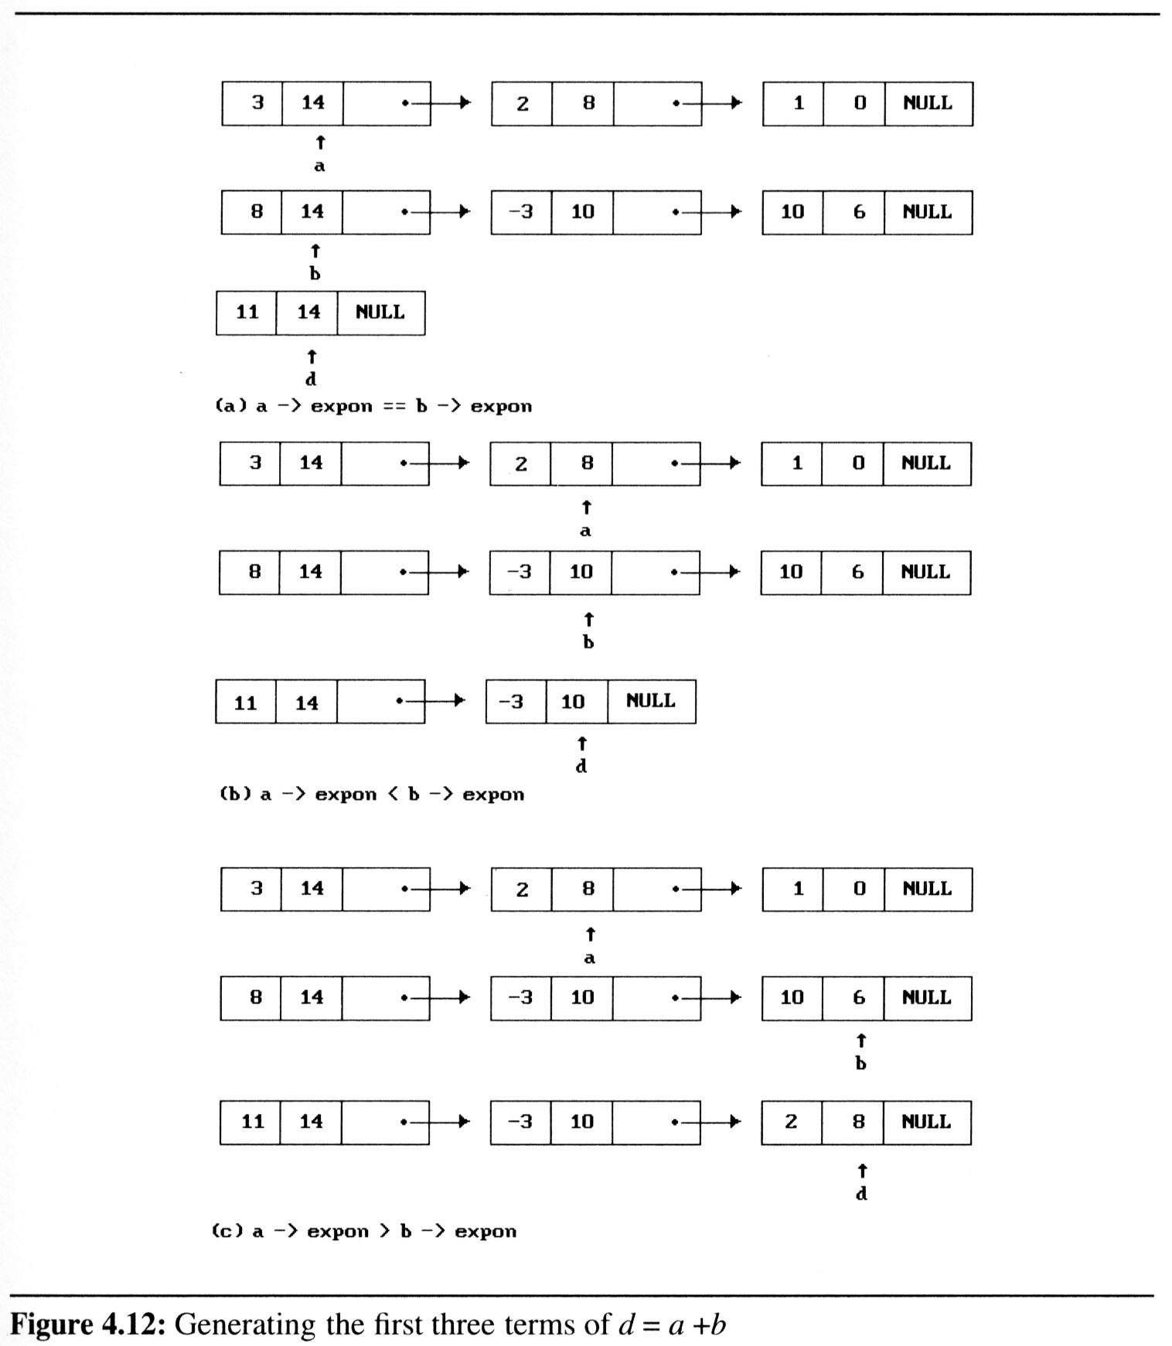
Polynomials (4/9)

Slide 35
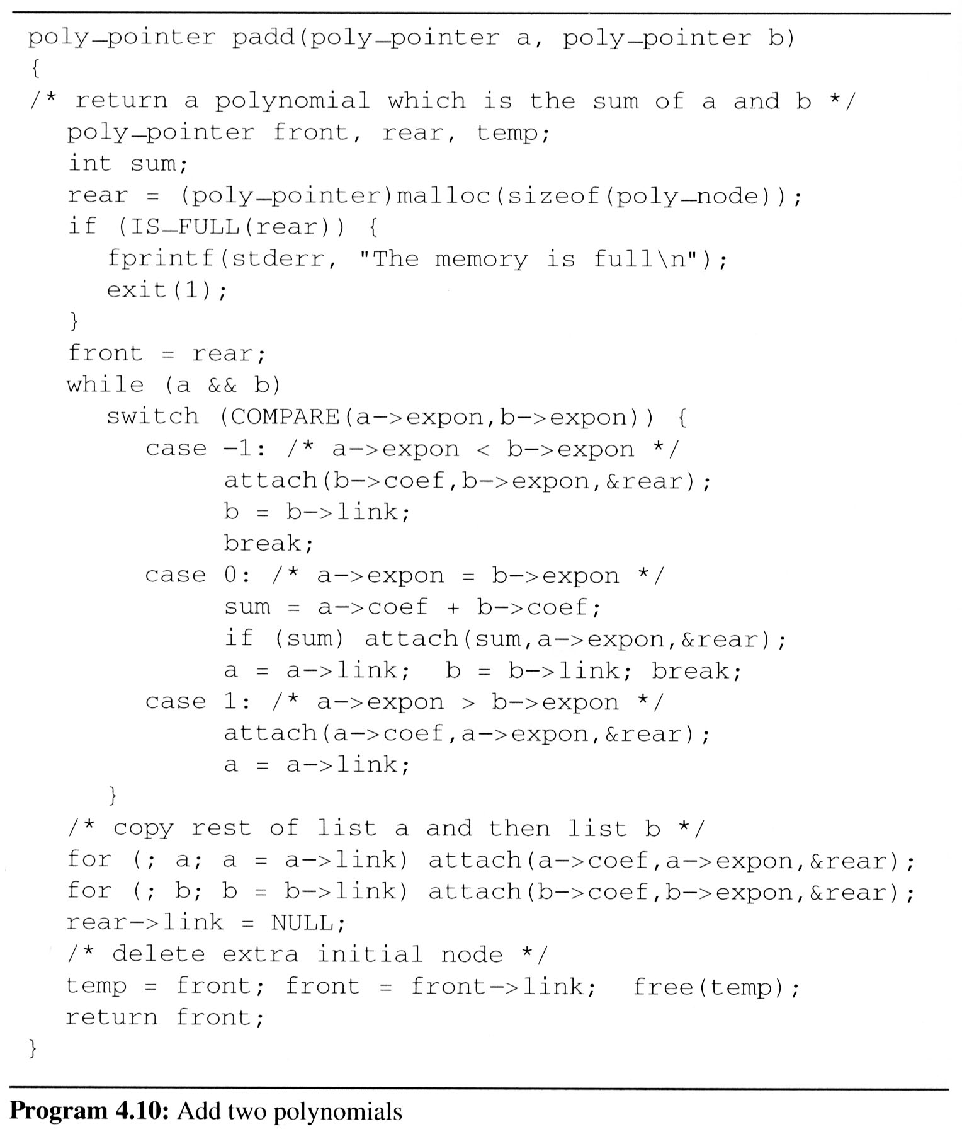
Polynomials (5/9)
Add two polynomials

Slide 36
Polynomials (6/9)
Attach a node to the end of a list
void attach(float coefficient, int exponent, poly_pointer *ptr){
/* create a new node with coef = coefficient and expon = exponent, attach it to the node pointed to by ptr. Ptr is updated to point to this new node */
poly_pointer temp;
temp = (poly_pointer) malloc(sizeof(poly_node));
/* create new node */
if (IS_FULL(temp)) {
fprintf(stderr, “The memory is full\n”);
exit(1);
}
temp->coef = coefficient; /* copy item to the new node */
temp->expon = exponent;
(*ptr)->link = temp; /* attach */
*ptr = temp; /* move ptr to the end of the list */
}
ptr
link
temp
Link..?

Slide 37
Polynomials (7/9)
Analysis of padd
coefficient additions 0 ≤ additions ≤ min(m, n) where m (n) denotes the number of terms in A (B).
exponent comparisons extreme case: e_{m-1} > f_{m-1} > e_{m-2} > f_{m-2} > … > e₁ > f₁ > e₀ > f₀ m+n-1 comparisons
creation of new nodes extreme case: maximum number of terms in d is m+n m + n new nodes summary: O(m+n)

Slide 38
Polynomials (8/9)
A Suite for Polynomials
e(x) = a(x) * b(x) + d(x)
poly_pointer a, b, d, e;
...
a = read_poly();
b = read_poly();
d = read_poly();
temp = pmult(a, b);
e = padd(temp, d);
print_poly(e);
read_poly()
print_poly()
padd()
psub()
pmult()
temp is used to hold a partial result.
By returning the nodes of temp, we
may use it to hold other polynomials

Slide 39
Polynomials (9/9)
ptr
temp
Erase Polynomials
erase: frees the nodes in temp
void erase (poly_pointer *ptr){
/* erase the polynomial pointed to by ptr */
poly_pointer temp;
while ( *ptr){
temp = *ptr;
*ptr = (*ptr) -> link;
free(temp);
}
}
temp
link
link
link
…

Slide 40
Chain (1/3)
Chain:
A singly linked list in which the last node has a null link
Operations for chains
Inverting a chain
For a list of length ≧1 nodes, the while loop is executed length times and so the computing time is linear or O(length).
...
NULL
lead
invert
×
...
NULL
lead

Slide 41
Initial：
下一個要反轉的對象
Invert (到中間的時候)…
指到前面去了
所以我需要：
一個指向現在要處理反轉的對象的指標：Now(類似於課本的middle)
一個指向前一個處理的對象的指標：Prev(類似於課本的Trail)
一個指向下一個要被處理的對象的指標：Next(類似於課本的Lead)
2.Prev=Now
1.Now->list=Prev
3.Now=Next
4.Next=Next->List
Prev
Now
Next

Slide 42
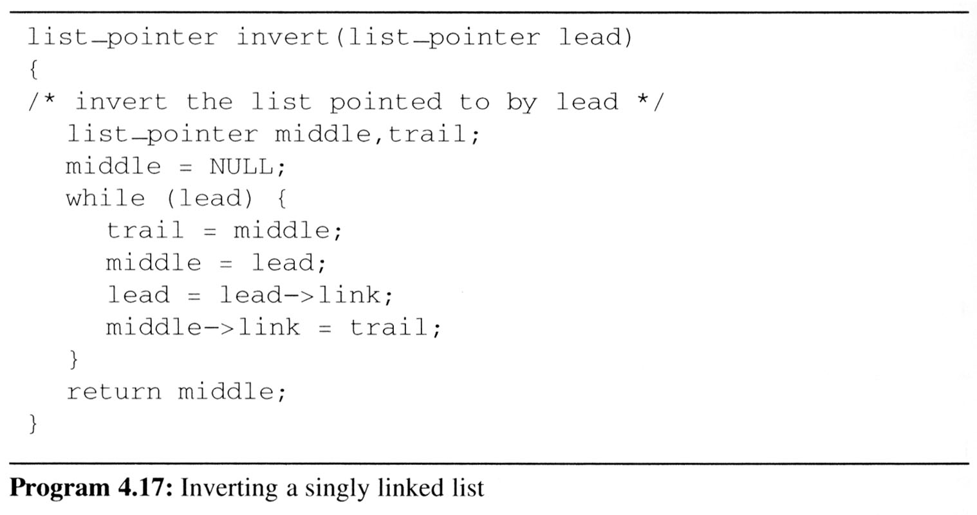
Chain (2/3)
Two extra pointers
Trial：指向目前的尾巴(後一個)
middle：中間要被反轉的
trial
middle
middle
trial
lead
lead
NULL
...
NULL

Slide 43
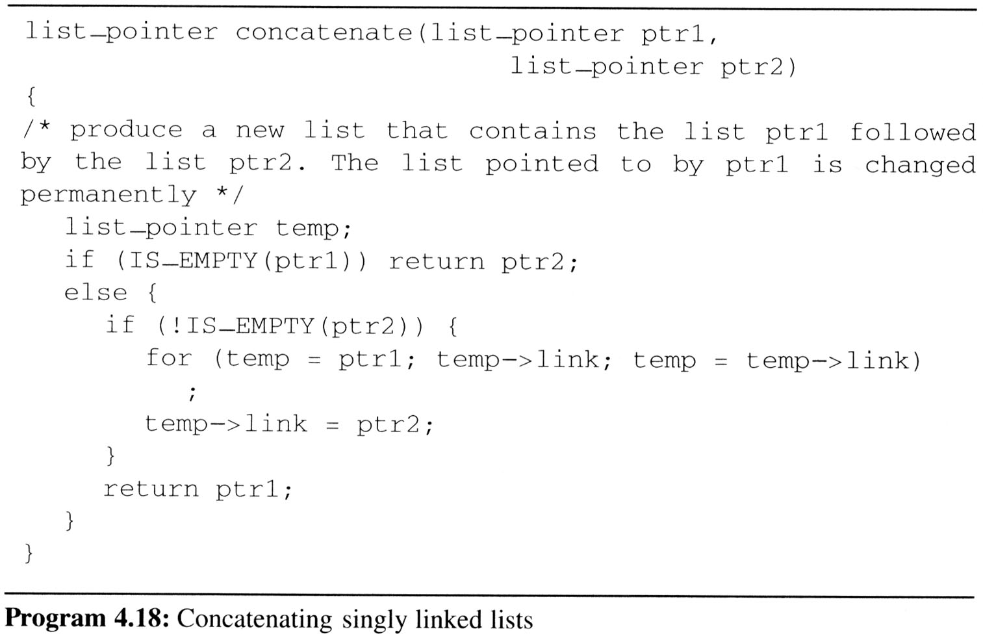
Chain (3/3)
Concatenates two chains
Concatenates two chains, ptr1 and ptr2.
Assign the list ptr1 followed by the list ptr2.
O(length of list ptr1)
temp
NULL
NULL
ptr1
ptr2

Slide 44
Circularly Linked Lists (1/10)
Circular Linked list
The link field of the last node points to the first node in the list.
Example
Represent a polynomial ptr = 3x¹⁴+2x⁸+1 as a circularly linked list.
ptr
3 | 14
2 | 8
1 | 0

Slide 45
Circularly Linked Lists (2/10)
Maintain an Available List
Free/Malloc浪費時間，很多時候我們釋放了node但可能之後又會需要用到新增node
我們改寫一個有效率的消除，建立一個可以使用(available)的ordered node list(=chain)
Instead of using malloc and free, we now use get_node (program 4.13) and ret_node (program 4.14).
...
avail
NULL
List of freed nodes

Slide 46
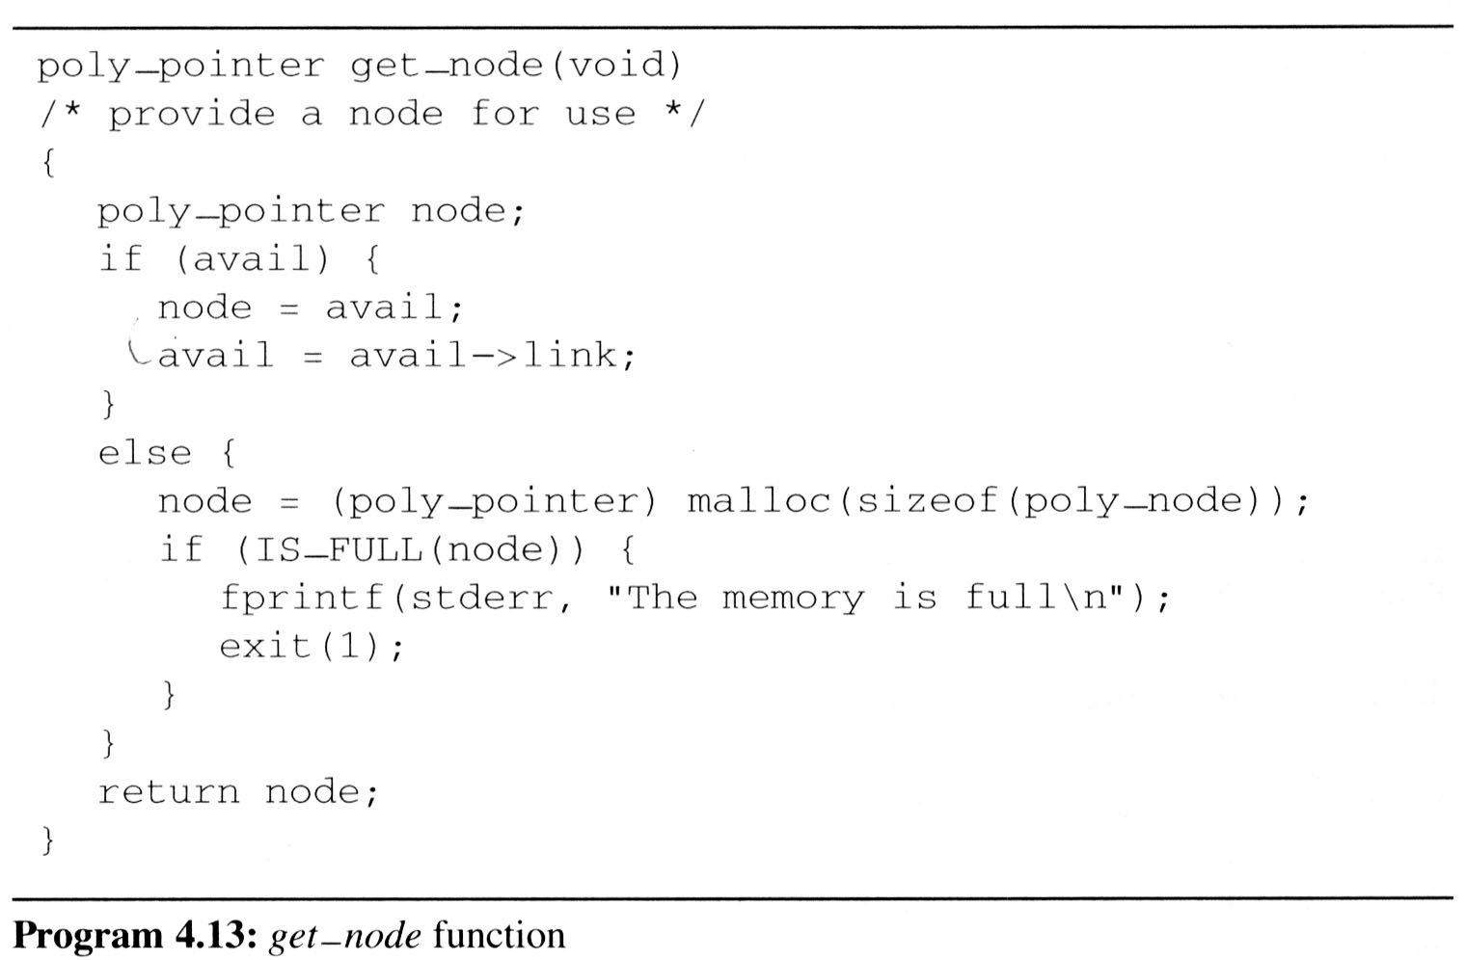
Circularly Linked Lists (3/10)
Maintain an Available List (cont’d)
When we need a new node, we examine this list.
If the list is not empty, then we may use one of its nodes.
Only when the list is empty we do need to use malloc to create a new node.

Slide 47
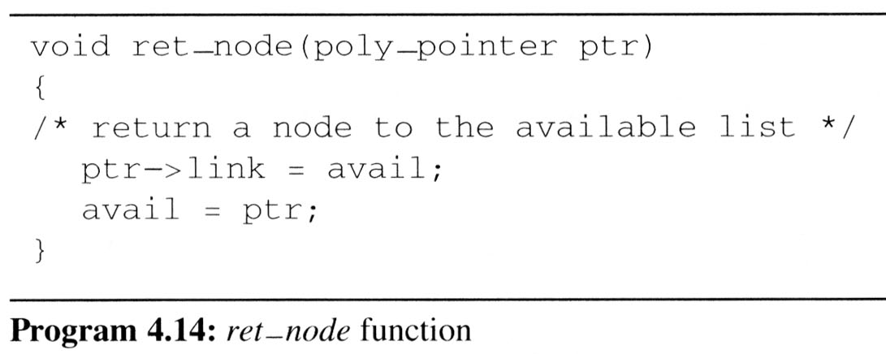
Circularly Linked Lists (4/10)
Maintain an Available List (cont’d)
Insert ptr to the front of this list
Let avail be a variable of type poly_pointer that points to the first node in our list of freed nodes.
Henceforth, we call this list the available space list or avail list.
Initially, we set avail to NULL

Slide 48
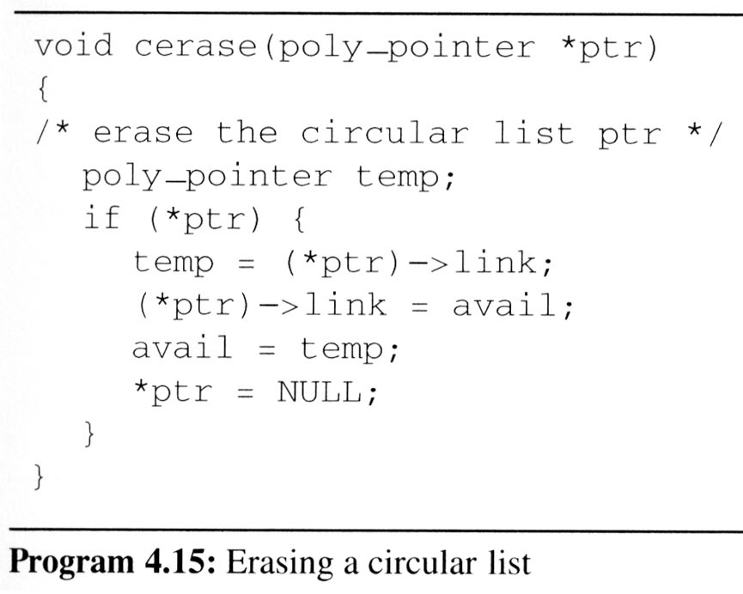
Circularly Linked Lists (5/10)
Maintain an Available List
Erase a circular list in a fixed amount (constant) of time O(1) independent of the number of nodes in the list using cerase
ptr
•
•
• • •
•
temp
avail
•
•
• • •
NULL
紅色link所連接而成的 chain

Slide 49
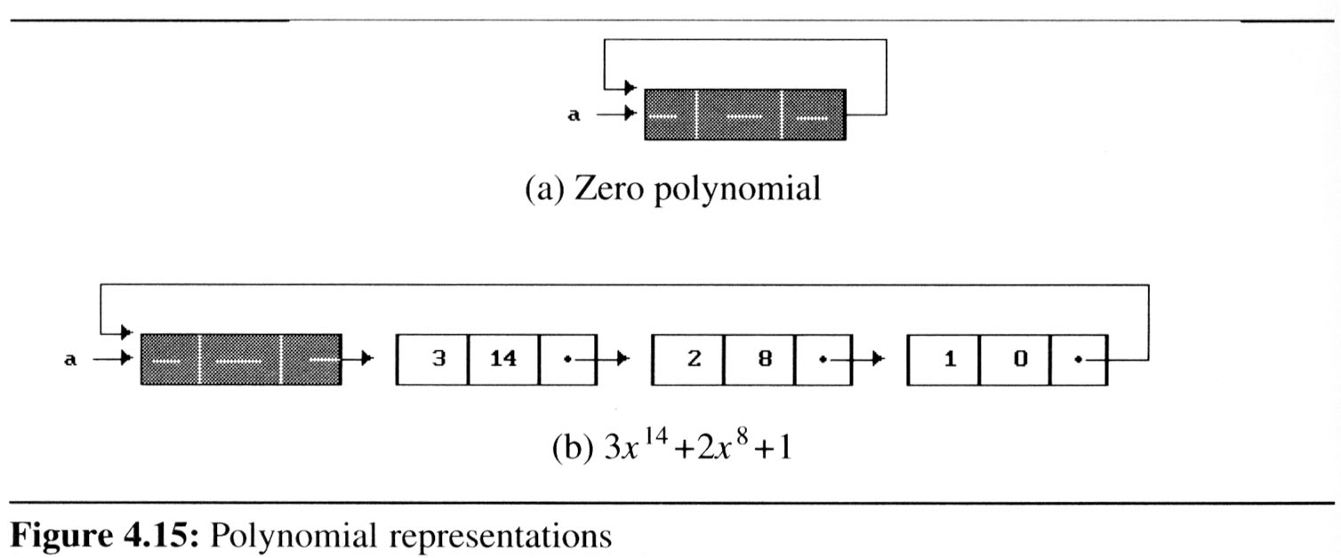
Circularly Linked Lists (6/10)
We must handle the zero polynomial as a special case. To avoid it, we introduce a head node into each polynomial
each polynomial, zero or nonzero, contains one additional node.
The expon and coef fields of this node are irrelevant.
Why ?
So !

Slide 50
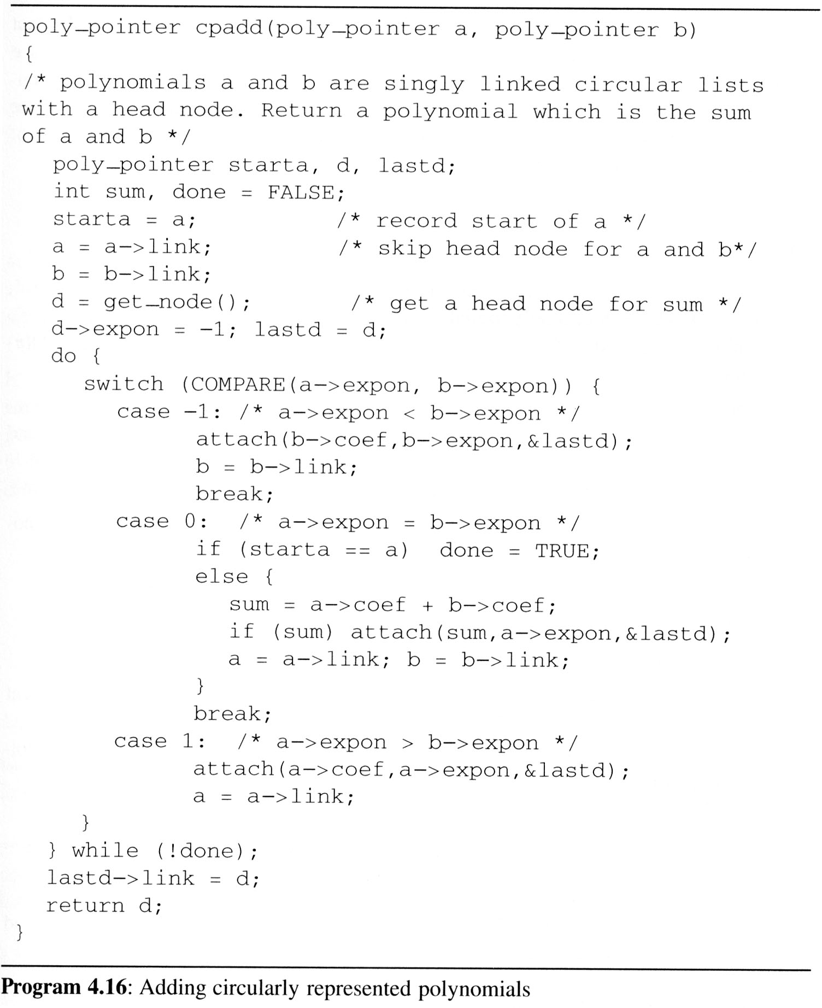
Circularly Linked Lists (7/10)
For fit the circular list with head node representation
We may remove the test for (*ptr) from cerase
Changes the original padd to cpadd
/* head node */
/*a->expon=-1, so b->expont > -1 */
/* link to the first node */

Slide 51
Circularly Linked Lists (8/10)
Operations for circularly linked lists
Question:
What happens when we want to insert a new node at the front of the circular linked list ptr?
Answer:
move down the entire length of ptr.
Possible Solution:
ptr
x₁
x₂
x₃
x₁
x₂
x₃
ptr

Slide 52
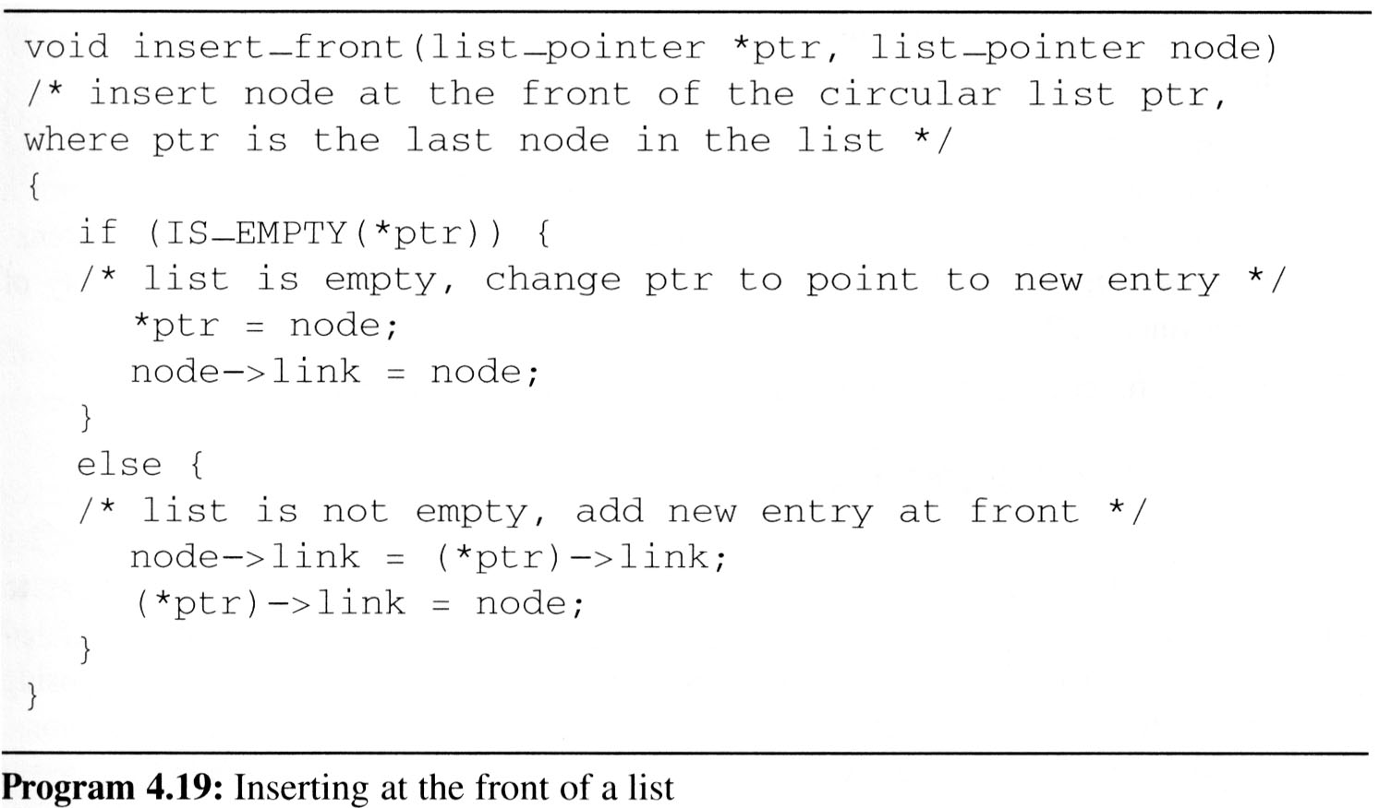
Circularly Linked Lists (9/10)
Insert a new node at the front of a circular list
To insert node at the rear, we only need to add the additional statement *ptr = node to the else clause of insert_front
x₁
x₂
x₃
ptr
node

Slide 53
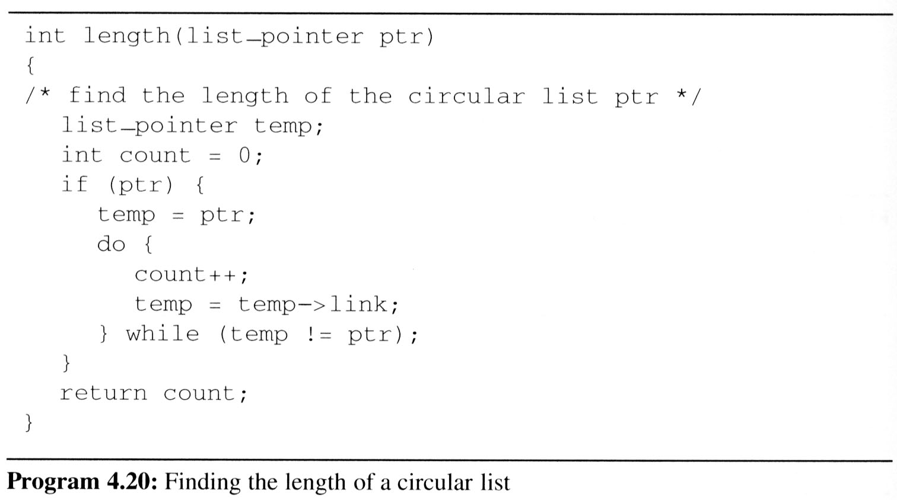
Circularly Linked Lists (10/10)
Finding the length of a circular list

Slide 54
Equivalence Relations (1/6)
Reflexive Relation
for any polygon x, x ≡ x (e.g., x is electrically equivalent to itself)
Symmetric Relation
for any two polygons x and y, if x ≡ y, then y ≡ x.
Transitive Relation
for any three polygons x, y, and z, if x ≡ y and y ≡ z, then x ≡ z.
Definition:
A relation over a set, S, is said to be an equivalence relation over S iff it is symmertric, reflexive, and transitive over S.
Example:
“equal to” relationship is an equivalence relation

Slide 55
Equivalence Relations (2/6)
Example:
if we have 12 polygons numbered 0 through 11
0 ≡ 4, 3 ≡ 1, 6 ≡ 10, 8 ≡ 9, 7 ≡ 4, 6 ≡ 8, 3 ≡ 5, 2 ≡ 11, 11 ≡ 0
we can partition the twelve polygons into the following equivalence classes:
{0, 2, 4, 7, 11};{1, 3, 5};{6, 8, 9,10}
Two phases to determine equivalence
First phase: the equivalence pairs (i, j) are read in and stored.
Second phase:
we begin at 0 and find all pairs of the form (0, j). Continue until the entire equivalence class containing 0 has been found, marked, and printed.
Next find another object not yet output, and repeat the above process.

Slide 56
Equivalence Relation (3/6)
Program to find equivalence classes
void main(void){
short int out[MAX_SIZE];
node_pointer seq[MAX_SIZE];
node_pointer x, y, top;
int i, j, n;
printf(“Enter the size (<=%d) ”, MAX_SIZE);
scanf(“%d”, &n);
for(i=0; i<n; i++){
/*initialize seq and out */
out[i] = TRUE; seq[i] = NULL;
}
/* Phase 1 */
/* Phase 2 */
}
#include <stdio.h>
#define MAX_SIZE 24
#define IS_FULL(ptr) (!(ptr))
#define FALSE 0
#define TRUE 1
typedef struct node *node_pointer;
typedef struct node {
int data;
node_pointer link;
};

Slide 57
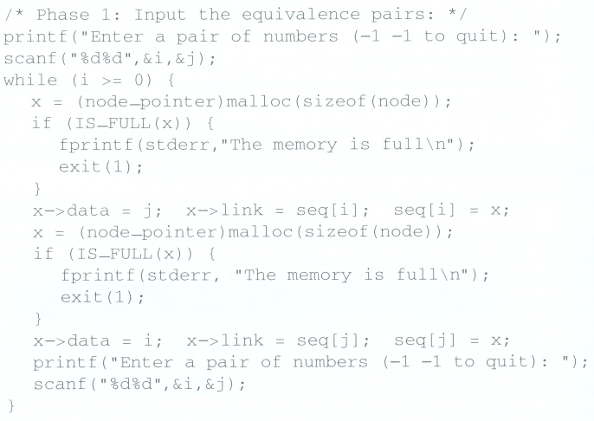
Equivalence Relations (4/6)
Phase 1: read in and store the equivalence pairs <i, j>
[0]
11
4
NULL
[1]
3
NULL
[2]
11
NULL
[3]
5
1
NULL
[4]
7
0
NULL
(1)
(2)
[5]
3
NULL
Insert x to the top of lists seq[i]
[6]
8
10
NULL
[7]
4
NULL
[8]
6
9
NULL
[9]
8
NULL
[10]
6
NULL
Insert x to the top of lists seq[j]
[11]
0
2
NULL
0 ≡ 4, 3 ≡ 1, 6 ≡ 10, 8 ≡ 9, 7 ≡ 4, 6 ≡ 8, 3 ≡ 5, 2 ≡ 11, 11 ≡ 0

Slide 58
Equivalence Relations (5/6)
Phase 2:
begin at 0 and find all pairs of the form <0, j>, where 0 and j are in the same equivalence class
by transitivity, all pairs of the form <j, k> imply that k in the same equivalence class as 0
continue this way until we have found, marked, and printed the entire equivalent class containing 0

Slide 59
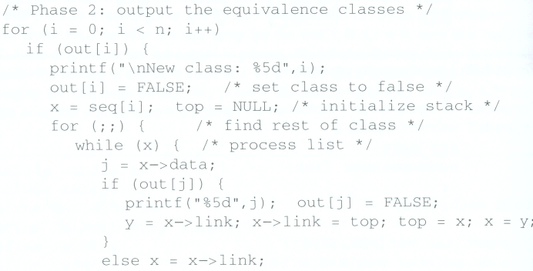
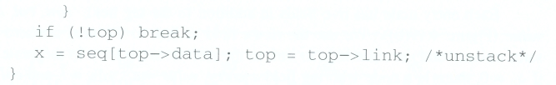
Equivalence Relations (6/6)
x
y
[0]
[1]
[2]
[3]
[4]
[5]
[6]
[7]
[8]
[9]
i=
1
0
j=
11
4
7
0
4
0
2
11
[10]
[11]
Phase 2
top
out:
[0]
11
4
NULL
[1]
3
NULL
[2]
11
NULL
[3]
5
1
NULL
[4]
7
0
NULL
[5]
3
NULL
[6]
8
10
NULL
[7]
4
NULL
[8]
6
9
NULL
[9]
8
NULL
[10]
6
NULL
[11]
0
2
NULL
New class: 0
11
4
7
2

Slide 60
Doubly Linked Lists (1/4)
Singly linked lists pose problems because we can move easily only in the direction of the links
Doubly linked list has at least three fields
left link field(llink), data field(item), right link field(rlink).
The necessary declarations:
typedef struct node *node_pointer;
typedef struct node{
node_pointer llink;
element item;
node_pointer rlink;
};
...
NULL
?
ptr

Slide 61
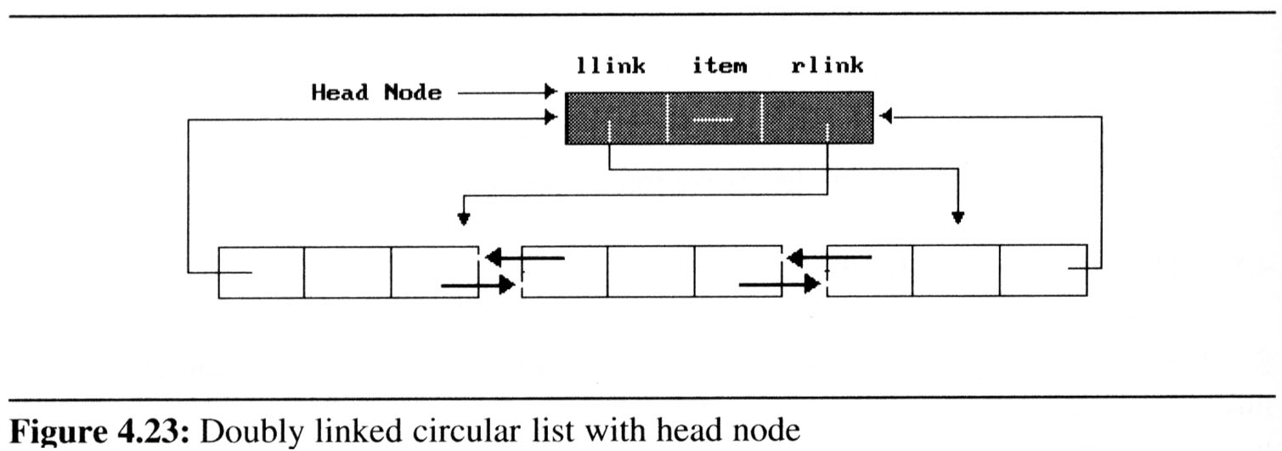
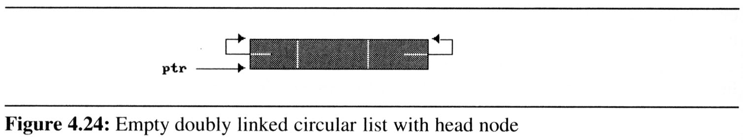
Doubly Linked Lists (2/4)
Sample
doubly linked circular with head node: (Figure 4.23)
empty double linked circular list with head node (Figure 4.24)
suppose that ptr points to any node in a doubly linked list, then:
ptr = ptr -> llink -> rlink = ptr -> rlink -> llink

Slide 62
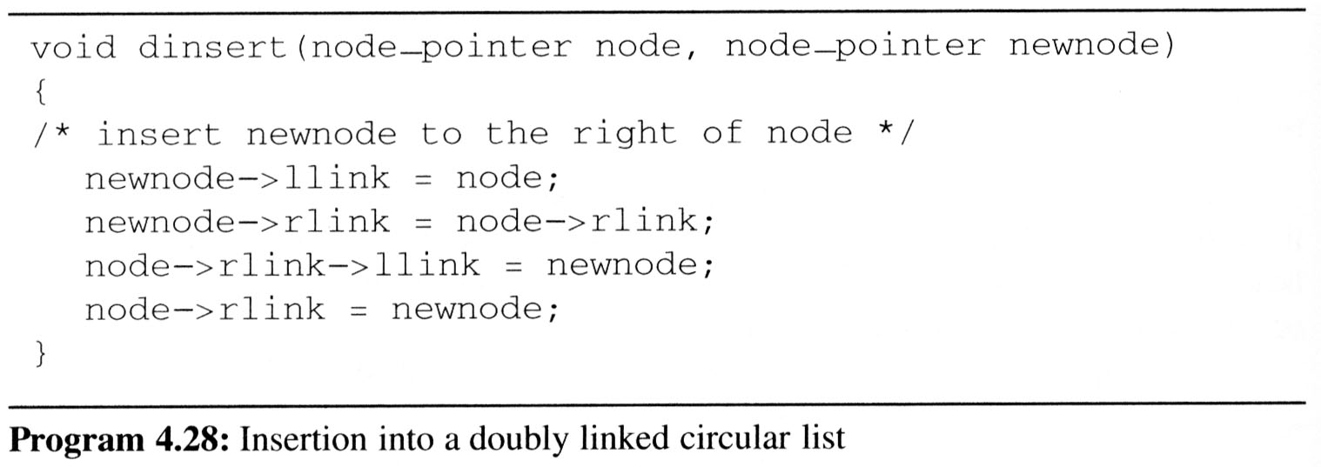
Doubly Linked Lists (3/4)
Insert node
Head node
node
llink item rlink
New node

Slide 63
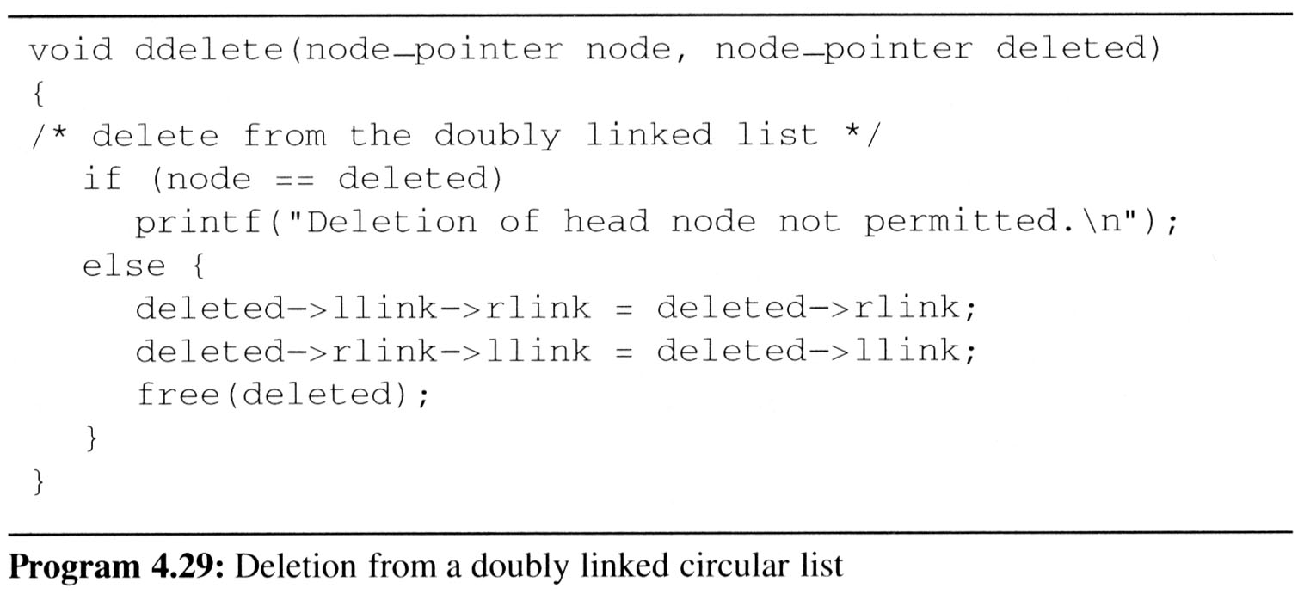
Doubly Linked Lists (4/4)
Delete node
Head node
llink item rlink
deleted node

