Slide 1
Generative AI as General-Purpose Technology: A panel data analysis of European productivity and industrial output (2011–2024)
By Alaeddine Khallid
Thesis Advisor: Boyko Amarov

Slide 2
Structure of thesis
01
02
03
04
Chapter 1
Chapter 2
Chapter 3
Literature Review
Data and Methodology
Empirical Results
Chapter 4
Conclusion

Slide 3
Research question
This thesis aims to examine the immediate impact of the "ChatGPT shock on the European labor market. By asking the question did industries with high exposure to generative AI become more efficient, producing the same output with fewer workers? Or did they expand, increasing both output and employment?
Hypothesis :
H1: The Displacement Hypothesis
Generative AI acts primarily as a labor-substituting technology. Therefore, high-exposure industries will experience a rise in labor productivity driven by a reduction in labor demand (job losses)
H2: The Expansion Hypothesis
Generative AI acts as a labor-complementing technology that lowers production costs. Therefore, high-exposure industries will experience a 'Scale Effect,' leading to significant growth in Real Output and a net increase in Labor Demand.

Slide 4
Data sets
AI Exposure Scores (Source: Felten et al., 2021): The foundational metric is the AI Occupational Exposure (AIOE) index, which links 52 human abilities (from O*NET) to ten specific AI applications.
Labor Force Structure (Source: Eurostat LFS): Employment counts by occupation (ISCO-08) and economic activity (NACE Rev. 2) for European countries.
Productivity Metrics (Source: Eurostat National Accounts): Real Gross Value Added (Chain-linked volumes, 2010 reference) and Total Hours Worked by industry and year.
Cross walk SOC to ISCO Nace rev 2

Slide 5
Formulating AI industry exposure
The granular US SOC codes were mapped to the International Standard Classification of Occupations (ISCO-08). To ensure robust matching, we aggregated detailed occupations into the 9 Major ISCO-08 Groups (1-digit level).
Group 1: Managers
Group 2: Professionals
Group 3: Technicians and Associate Professionals
Group 4: Clerical Support Workers
Group 5: Service and Sales Workers
Group 6: Skilled Agricultural, Forestry and Fishery Workers
Group 7: Craft and Related Trades Workers
Group 8: Plant and Machine Operators and Assemblers
Group 9: Elementary Occupations

Slide 6


The final AI Industry Exposure (AIIE) index for industry i in country c is constructed as a weighted average of the occupational exposure scores. The weights are determined by the share of workers in each occupational group within that specific industry.
Before inserting felten ai scores they were normalized to a 0-1 scale as follows:
Where :
Emp = number of workers of occupation 0 in that industry
TotalEmp = number of workers in that industry
S = normalized score
Filter 2022 weights : we utilize 2022 weights instead of post 2022 data , because the post data would already reflect the firm reaction to AI

Slide 7
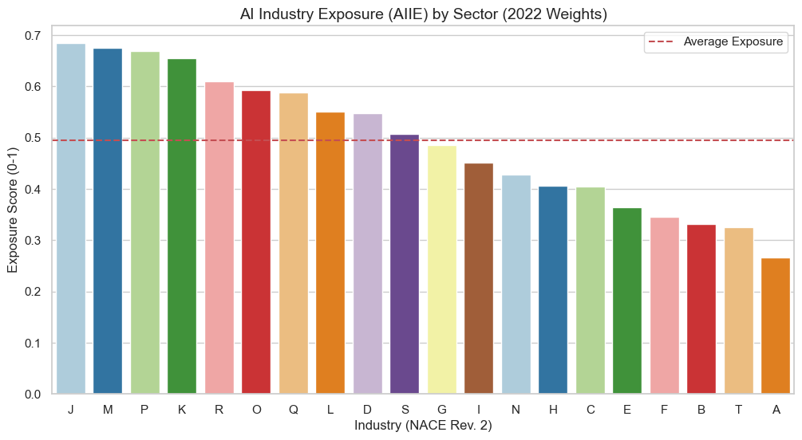
J = Information and communication
M = Professional, scientific and technical activities
P = Education
K = Financial and insurance activities
R = Arts, entertainment and recreation
O = Public administration and defense; compulsory social security
Q = Human health and social work activities
L = Real estate activities
D = Electricity, gas, steam and air conditioning supply
S = Other service activities
G = Wholesale and retail trade; repair of motor vehicles and motorcycles
I = Accommodation and food service activities
N = Administrative and support service activities
H = Transportation and storage
C = Manufacturing
E = Water supply; sewerage, waste management and remediation activities
F = Construction
B = Mining and quarrying
T = Activities of households as employers
A = Agriculture, forestry and fishing
Validating the AI industry exposure variable

Slide 8

Outcome variable : labor productivity
Real GVA : gross value added in Chain-Linked Volumes (Millions of Euros).
Total hours worked : Thousands of Hours

Slide 9
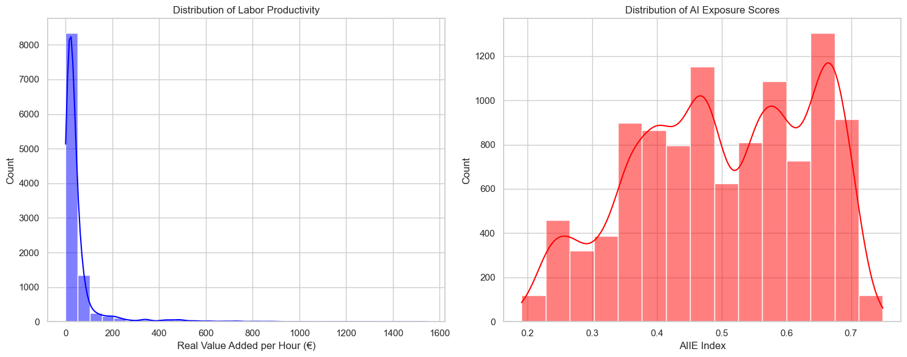
Distribution of the variables

Slide 10
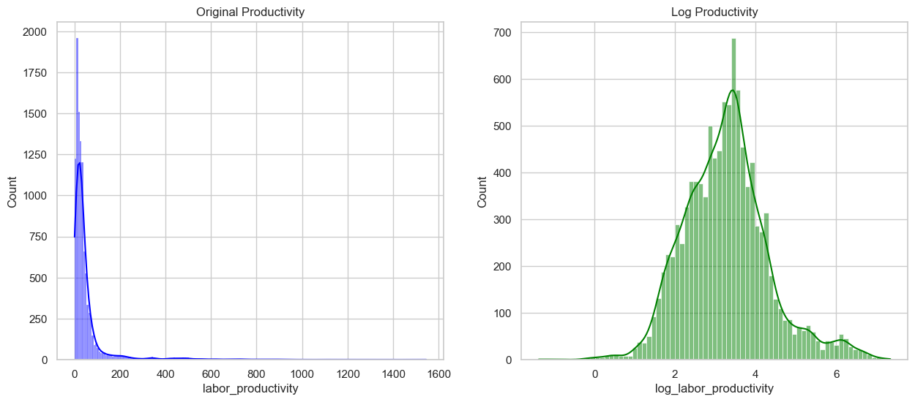
Log transformation for Labor productivity

Slide 11
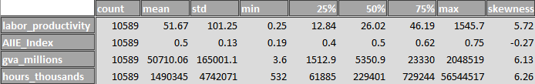
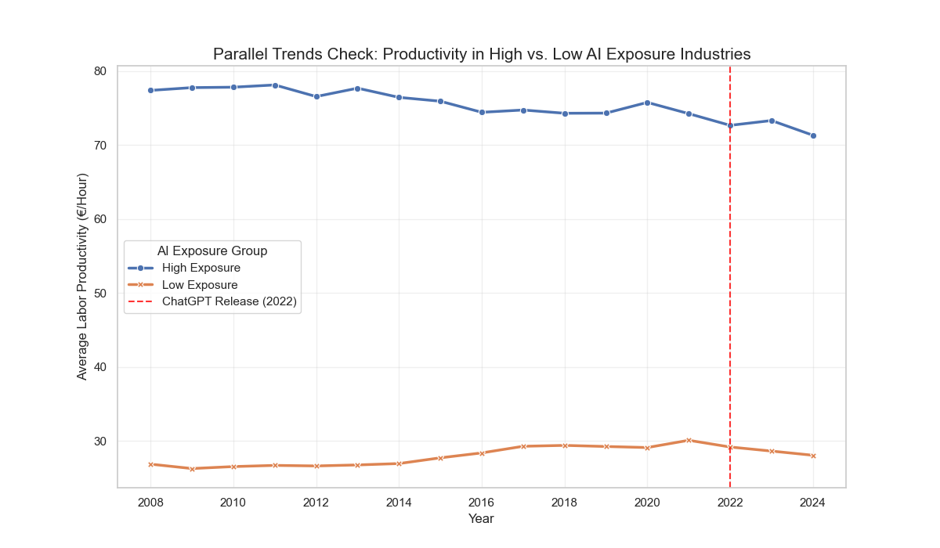
Descriptive statistics
The validity of the difference in difference (DiD) estimator relies on the assumption that, in the absence of the treatment, high and low exposure industries would have followed similar productivity trends.

Slide 12
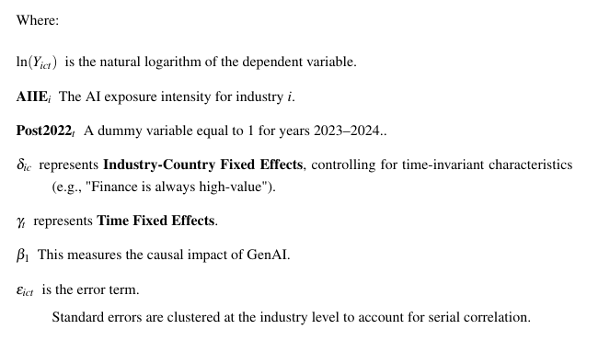

Model formula :

Slide 13
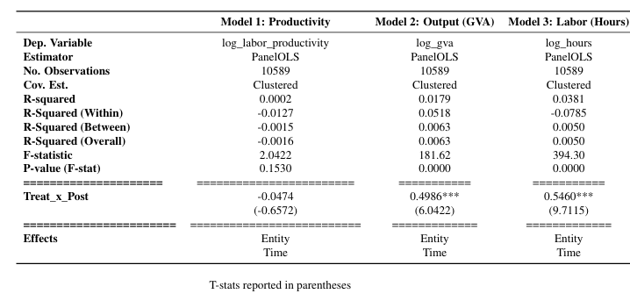
Models Table:

Slide 14
Interpretation model 2
Following the 2023 shock, industries with higher AI exposure experienced a massive relative increase in real economic output.
Interpretation model 3
High-AI industries significantly increased their labor demand.
Results interpretation
This explains the null result in the baseline model. Since both the numerator (Output) and the denominator (Hours) grew at nearly identical rates about 50% ,the ratio (Productivity) remained flat.

Slide 15
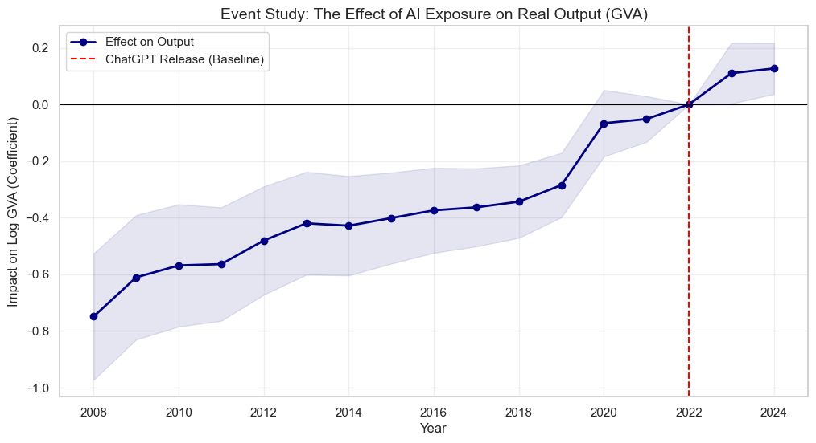
Event study plot
The figure shows an upward slope in the coefficient trend from 2008 to 2022 although it was expected to be a flat line hovering at about "0.0" meaning industries with high AI exposure were already growing faster than other industries long before ChatGPT even existed.

Slide 16
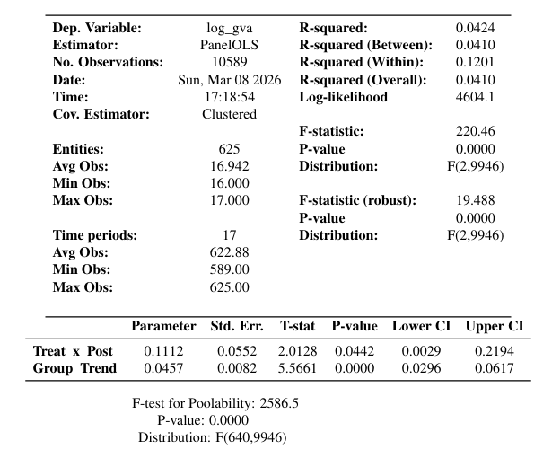
Robustness check model
Interpretation:
even after we mathematically removed the fact that tech always grows faster, there is still a statistically significant boost of about 11.1% in output that we can possibly attribute to the post 2022 ai shock
Group trend interpretation: coefficient is 0.0457 and significant, meaning high Ai industries do naturally grow about 4.6% faster than low AI industries every year

Slide 17
Conclusion :
No "Displacement Effect": Found no statistical evidence of technological unemployment or sudden "hyper-efficiency" (shedding workers) following the 2023 ChatGPT shock.
The "Scale Effect" Dominates: High-AI exposure industries (IT, Professional Services) experienced a statistically significant boom in both real output and labor demand.
Expansion Over Substitution: European firms are using GenAI to expand capacity and create new tasks, rather than simply cutting costs.
Policy Implication: Regulators should shift focus from "defensive job protection" to supporting growth (skills training, digital infrastructure) to address skilled labor shortages.

Slide 18
Limitations:
Short Post-Treatment Period (2023–2024): The data captures only the immediate shock. General Purpose Technologies often follow a "J-Curve“ efficiency spikes and potential displacement may still materialize years later.
Industry-Level Aggregation: Sector-wide data may mask firm-level heterogeneity (large tech firms expanding while smaller, less adaptable firms contract).
Static AI Exposure Index: The model relies on a fixed 2022 occupational exposure snapshot, but GenAI capabilities are evolving rapidly.
Future Research: Future studies should analyze the quality of this new labor and revisit the data in 3–5 years to test for delayed efficiency growth.

