Slide 1
CI/CD

Slide 2
What is CI/CD?
Continuous integration is a coding philosophy and set of practices that drive development teams to frequently implement small code changes and check them in to a version control repository
Continuous deployment is about creating infrastructure as code, deploy the artifacts created and tested in the CI process, apply smoke tests, promote to production

Slide 3
Benefits of CI/CD
Try to reduce at minimum human interaction in the deployment process
A good pipeline definition can reduces costs in a significant way
CICD helps you to “Fails fats”, which means that errors in the code can be found in the pipeline and will be alerted before gets into production or client testing environment
It helps the team to be able to recover from a failed build or test within ten minutes
Automated way to rollback changes if something goes out of the scope

Slide 4
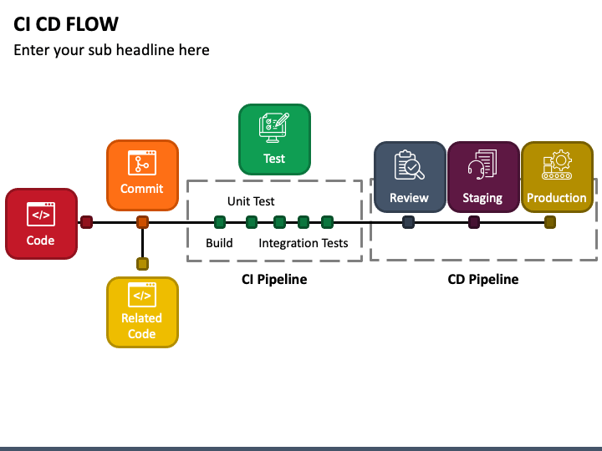
CI/CD flow

Slide 5
Conclusions
Developing a CI/CD pipeline is a standard practice for businesses that frequently improve applications and require a reliable delivery process. Once in place, the CI/CD pipeline lets the team focus more on enhancing applications and less on the details of delivering it to various environments.

