Slide 1

MOUNTAIN CAR PROBLEM
University of Trieste: Department of Engineering and Architecture
Presented in the book "Reinforcement Learning" by Richard S. Sutton e Andrew G. Barto.
COURSE: Learning-based control
Professor: Salvato Erica
Project carried out: Di Santo Alessandro

Slide 2
INTRODUCTION
TASK: drive a car to the top of a steep mountain road.
PROBLEM: the gravitational force is greater than the maximum force the engine can apply, so the agent cannot achieve the goal by accelerating forward alone.
SOLUTION: the agent will have to learn how to climb the opposite slope, to accumulate enough energy in order to reach the goal.

Slide 3

STATE SPACE AND ACTIONS
State Space:
Action Space:

Slide 4

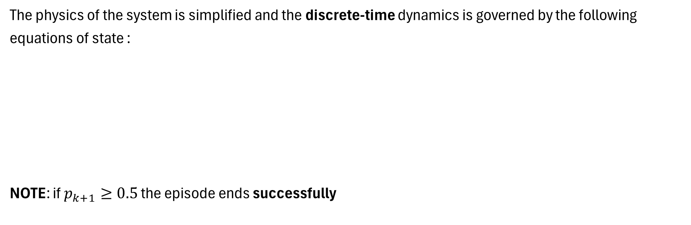
DYNAMICS OF THE SYSTEM
The physics of the system is simplified and the discrete-time dynamics is governed by the following equations of state :
NOTE: if $p_{k+1}≥0.5$ the episode ends successfully

Slide 5
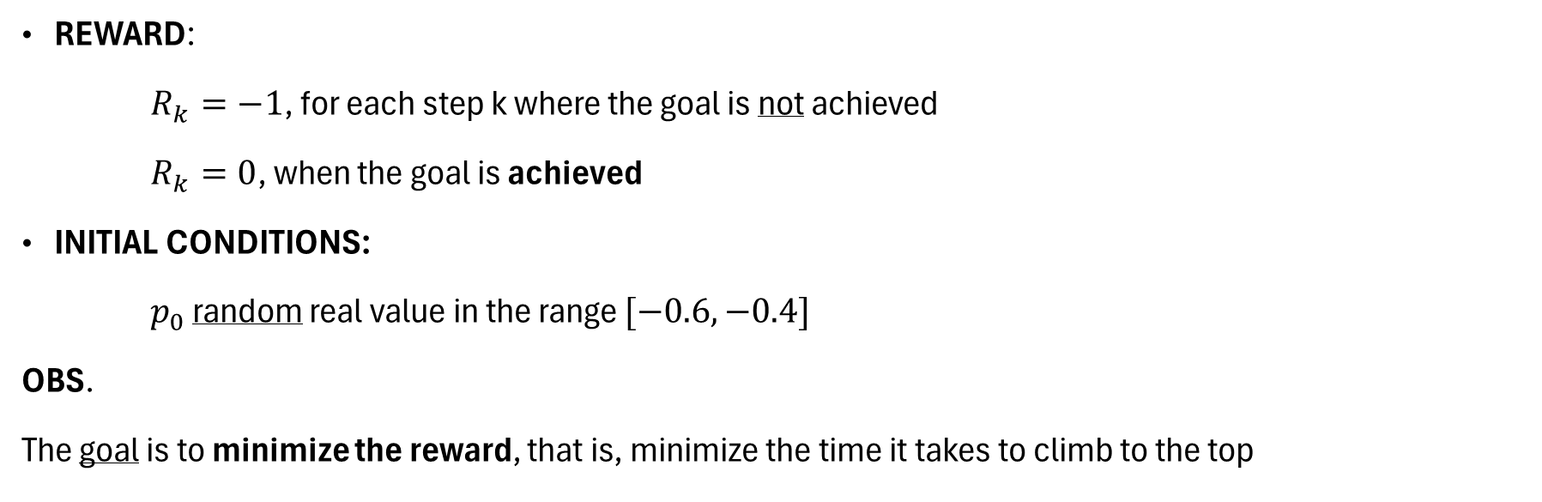
REWARD AND INITIAL CONDITIONS
REWARD:
$R_{k}=−1$, for each step k where the goal is not achieved
$R_{k}=0$, when the goal is achieved
INITIAL CONDITIONS:
$p_{0}$ random real value in the range $[−0.6, −0.4]$
OBS.
The goal is to minimize the reward, that is, minimize the time it takes to climb to the top

Slide 6
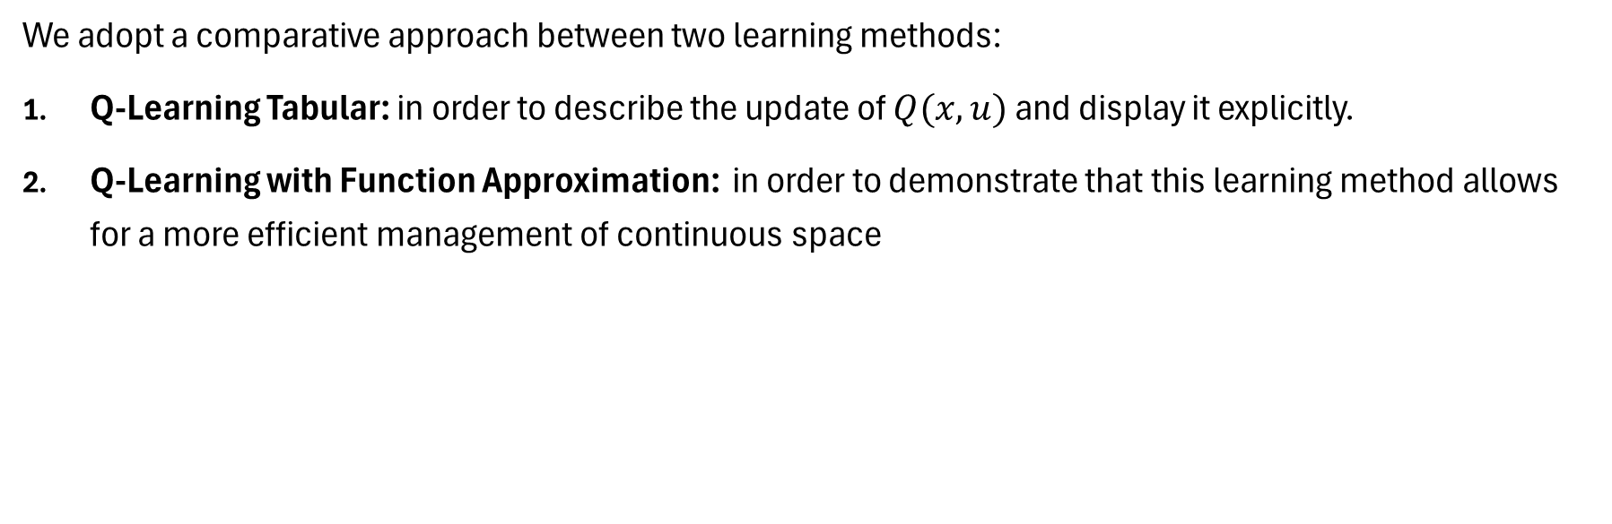
RESOLUTION STRATEGY
We adopt a comparative approach between two learning methods:
Q-Learning Tabular: in order to describe the update of $Q(x,u)$ and display it explicitly.
Q-Learning with Function Approximation: in order to demonstrate that this learning method allows for a more efficient management of continuous space

Slide 7
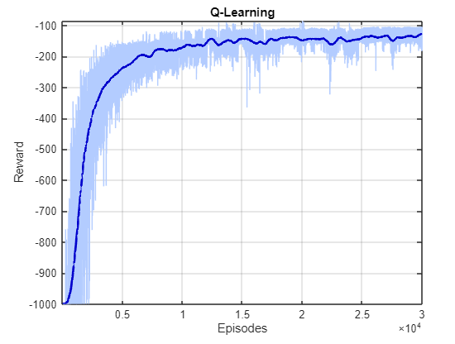
Q-LEARNING TABULAR
Once the system parameters have been defined, we have:
discretized the continuous state space
applied the Q-Learning Algorithm
plotted the results obtained

Slide 8
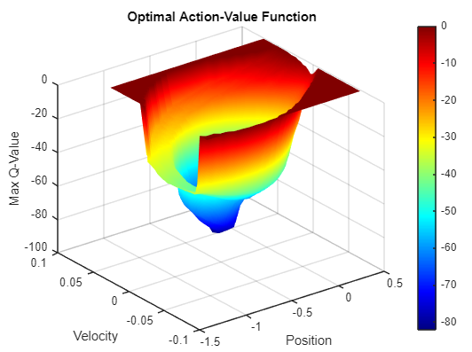

Q-LEARNING TABULAR - 3D display
This display of the $Q_{optimal}\left(x,u\right)$ shows us how «good» a given state is in relation to achieving the final goal.
OBS.
Valley (blue zone): coordinates Position between $[−0.5, 0]$
Left Wall: coordinate Position $−1.2$

Slide 9
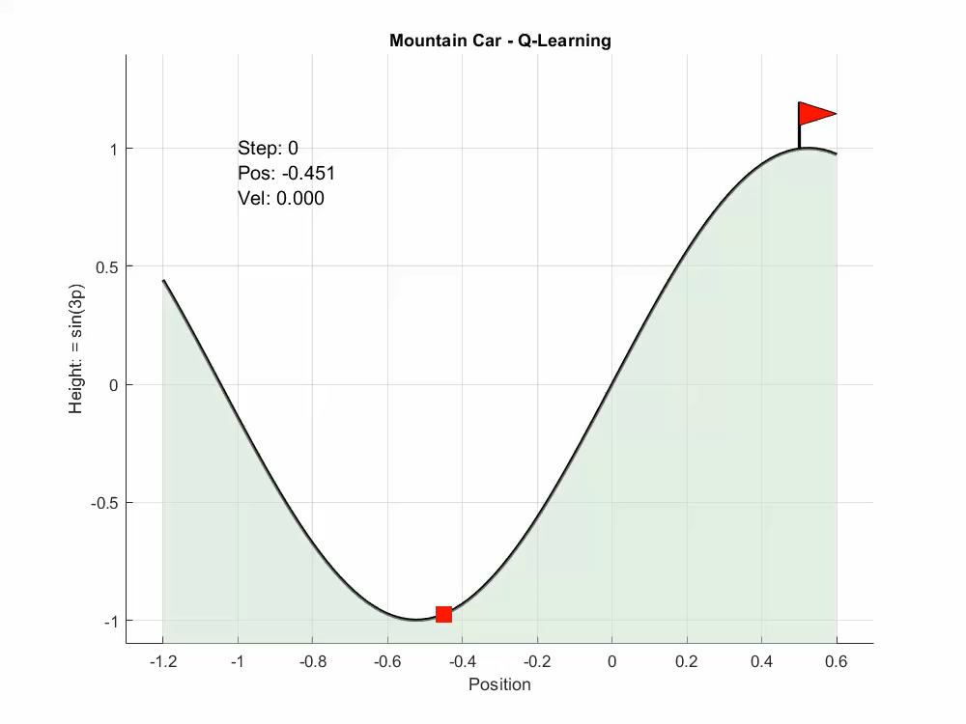
Q-LEARNING TABULAR - Test
We tested our agent on a 1000-step episode.
Video animation shows us that our agent has learned and is able to complete the task assigned to him: goal achieved in 152 steps.

Slide 10
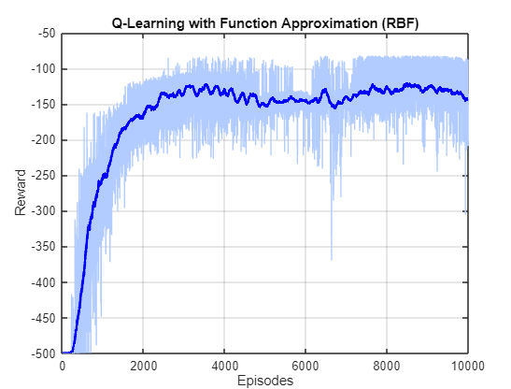

Q-LEARNING WITH FUNCTION APPROXIMATION
We want to cover 2D space with Gaussian functions, so:
let’s define a grid of centers
we calculate the widths ($σ_{i}$) of the BF
we perform the Q-Learning Algorithm with RBF
let's plot the results

Slide 11
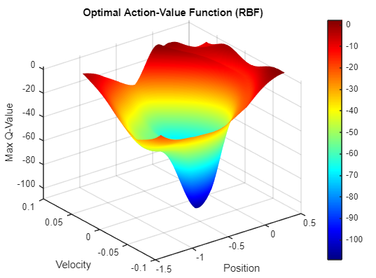
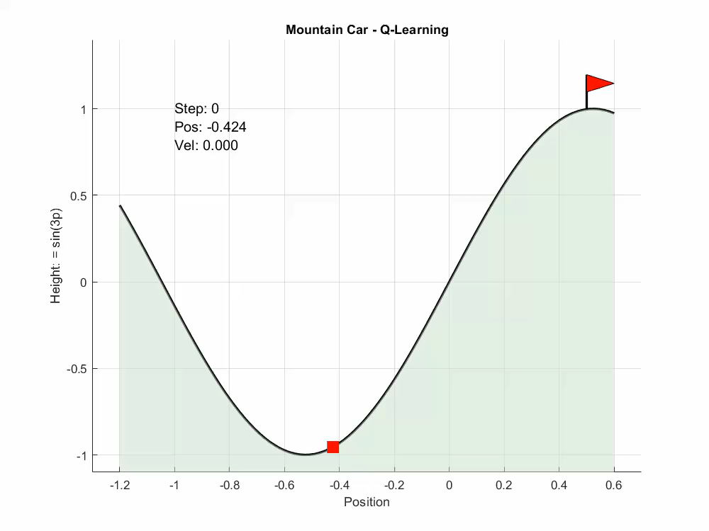

Q-LEARNING WITH RBF - 3D display and Test
As done for the Q-Learning Tabular we show :
3D Display of the optimal ${\hat{Q}}_{θ}(x,u)$
Video Animation representing a 500-step episode

Slide 12
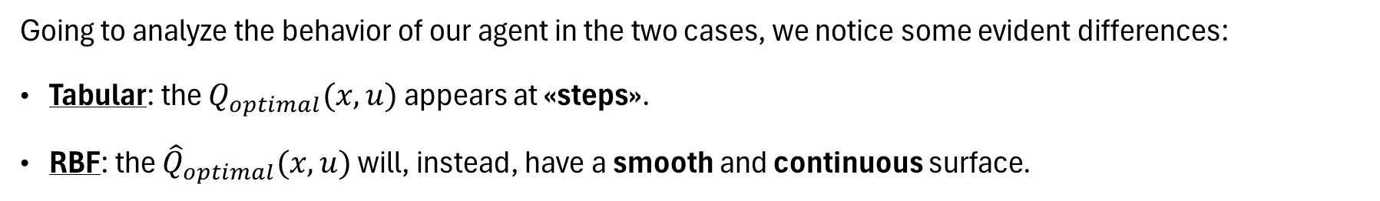
ANALYSIS OF SOLUTIONS
Going to analyze the behavior of our agent in the two cases, we notice some evident differences:
Tabular: the $Q_{optimal}(x,u)$ appears at «steps».
RBF: the ${\hat{Q}}_{optimal}(x,u)$ will, instead, have a smooth and continuous surface.

Slide 13
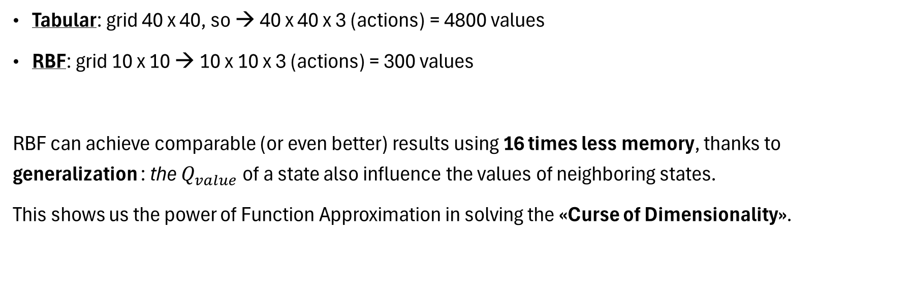
EFFICIENCY OF PARAMETERS
Tabular: grid 40 x 40, so → 40 x 40 x 3 (actions) = 4800 values
RBF: grid 10 x 10 → 10 x 10 x 3 (actions) = 300 values
RBF can achieve comparable (or even better) results using 16 times less memory, thanks to generalization : the $Q_{value}$ of a state also influence the values of neighboring states.
This shows us the power of Function Approximation in solving the «Curse of Dimensionality».

Slide 14

THANKS FOR THE ATTENTION

