Slide 1

Project based on: INVESTMENT PORTFOLIO TRACKING USING MODEL PREDICTIVE CONTROL
University of Trieste: Department of Engineering and Architecture
de Melo MK, Nogueira Cardoso RT, Argolo Jesus T, Vianna Raffo G. Investment
portfolio tracking using model predictive control. Optim Control Appl Meth. 2023
COURSE: CONTROL OF CYBER-PHYSICAL SYSTEMS
Professor: Raimondo Davide Martino
Project carried out: Di Santo Alessandro

Slide 2
INTRODUCTION
The composition of an investment portfolio aimed at increasing financial returns while reducing risk exposure is a topic of growing global interest.
The authors distinguish portfolio management problems into two types:
Passive Management: : starts from the assumption known in finance as the "Efficient Markets Hypothesis", therefore, the goal is tracking a predetermined reference
Active Management: starts from the opposite assumption and aims to "beat the market"

Slide 3
MODEL PREDICTIVE CONTROL
The paper considers Model Predictive Control (MPC) to manage investment portfolio monitoring through a passive strategy with an efficient dynamic approach.
MPC is a method that uses an optimization algorithm that works online to obtain a control sequence that can report the desired output, minimizing the cost function.
To solve an optimal control problem, use the technique of Receding Horizon Control (RHC)

Slide 4
KEY POINTS
MPC is used to track an investment curve taking into account transaction costs.
Comparison of two methods for choosing the most suitable length for the prediction horizon: VPH-MPC and FPH-MPC
Tracking the reference portfolio, through the use of the CVaR (Conditional Value at Risk)

Slide 5

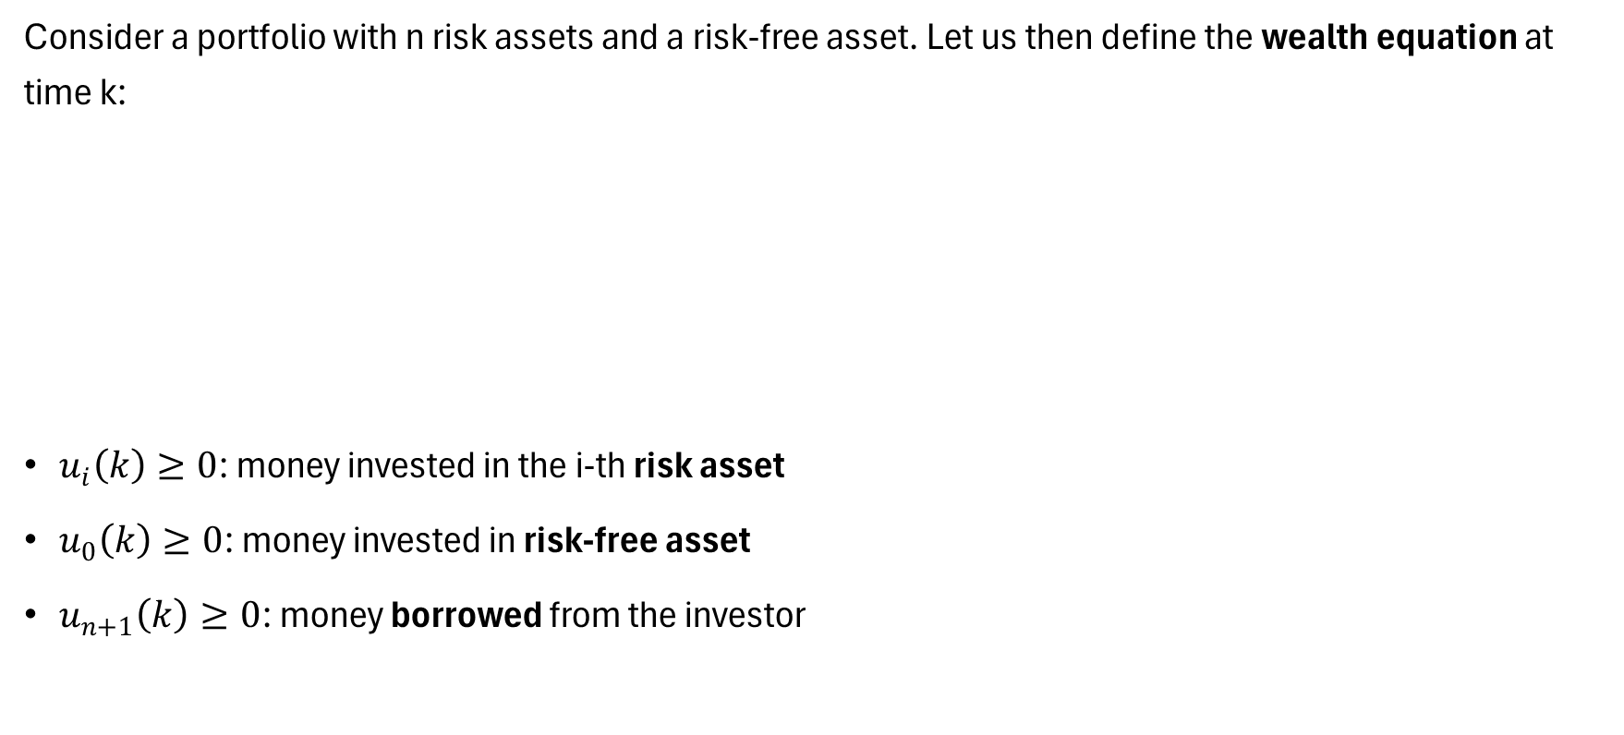
PORTFOLIO WEALTH
Consider a portfolio with n risk assets and a risk-free asset. Let us then define the wealth equation at time k:
$u_{i}\left(k\right)≥0$: money invested in the i-th risk asset
$u_{0}\left(k\right)≥0$: money invested in risk-free asset
$u_{n+1}\left(k\right)≥0$: money borrowed from the investor

Slide 6
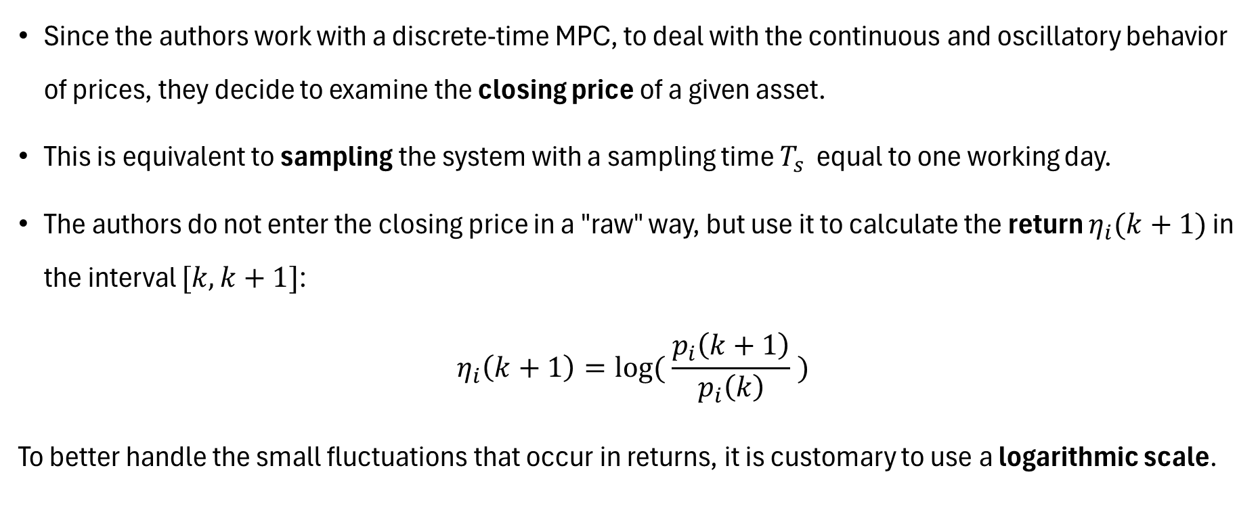
CLOSING PRICE AS RETURN
Since the authors work with a discrete-time MPC, to deal with the continuous and oscillatory behavior of prices, they decide to examine the closing price of a given asset.
This is equivalent to sampling the system with a sampling time $T_{s}$ equal to one working day.
The authors do not enter the closing price in a "raw" way, but use it to calculate the return $η_{i}(k+1)$ in the interval $[k, k+1]$:
$$η_{i}\left(k+1\right)=log⁡( \frac{p_{i}\left(k+1\right)}{p_{i}\left(k\right)} )$$
To better handle the small fluctuations that occur in returns, it is customary to use a logarithmic scale.

Slide 7
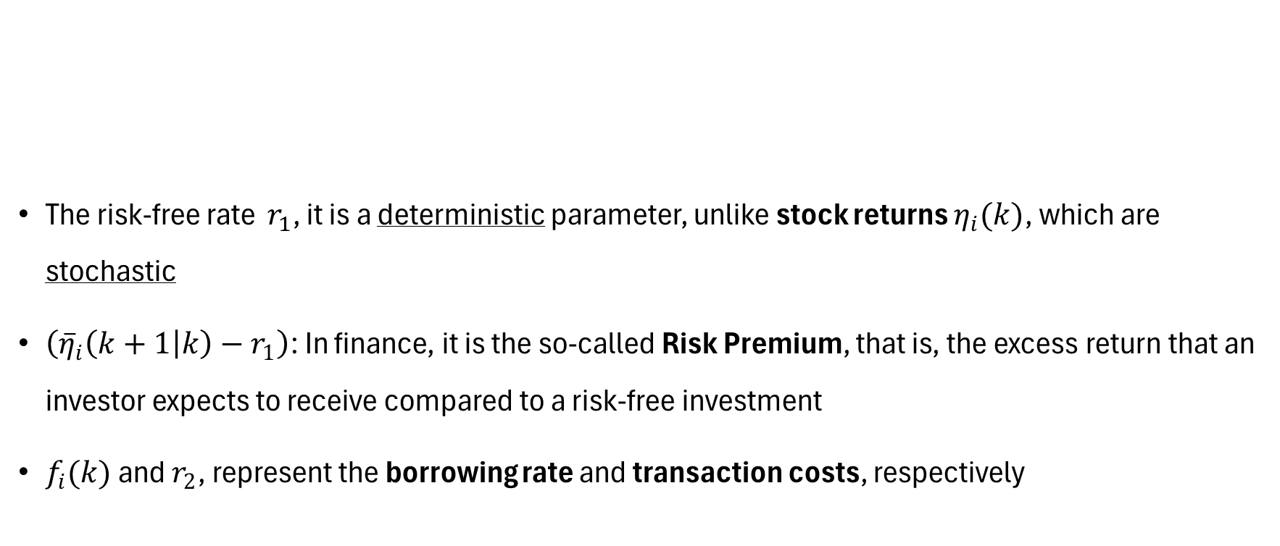
PORTFOLIO WEALTH
The risk-free rate $r_{1}$, it is a deterministic parameter, unlike stock returns $η_{i}(k)$, which are stochastic
$\left({\overline{η}}_{i}\left(k+1 | k\right)−r_{1}\right)$: In finance, it is the so-called Risk Premium, that is, the excess return that an investor expects to receive compared to a risk-free investment
$f_{i}(k)$ and $r_{2}$, represent the borrowing rate and transaction costs, respectively

Slide 8
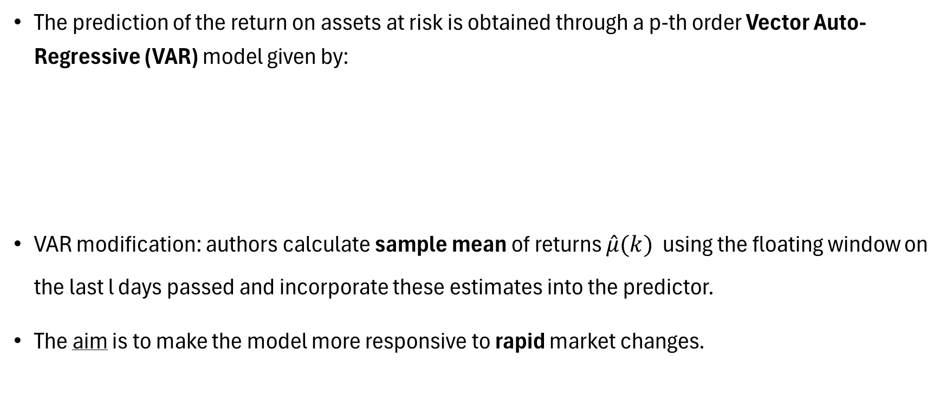
PREDICTION MODEL
The prediction of the return on assets at risk is obtained through a p-th order Vector Auto-Regressive (VAR) model given by:
VAR modification: authors calculate sample mean of returns $\hat{μ}(k)$ using the floating window on the last l days passed and incorporate these estimates into the predictor.
The aim is to make the model more responsive to rapid market changes.

Slide 9

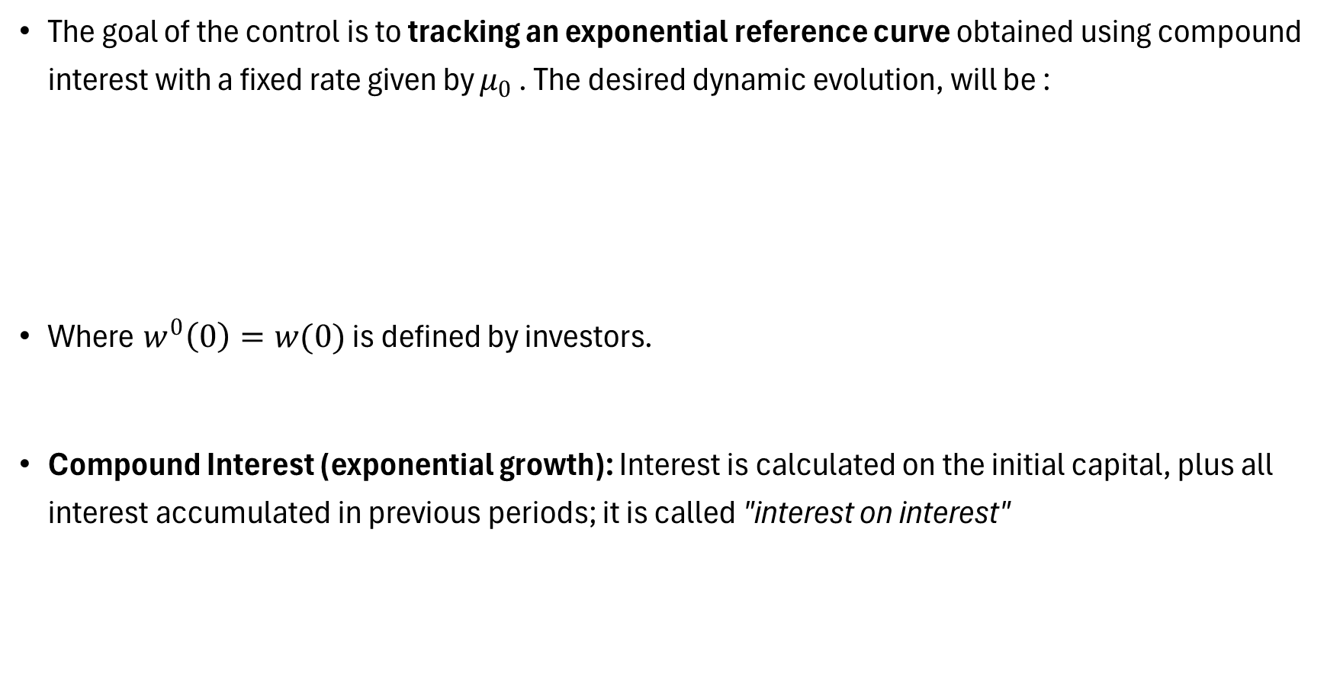
TRACKING MPC: QUADRATIC STANDARD
The goal of the control is to tracking an exponential reference curve obtained using compound interest with a fixed rate given by $μ_{0}$ . The desired dynamic evolution, will be :
Where $w^{0}\left(0\right)=w(0)$ is defined by investors.
Compound Interest (exponential growth): Interest is calculated on the initial capital, plus all interest accumulated in previous periods; it is called "interest on interest"

Slide 10
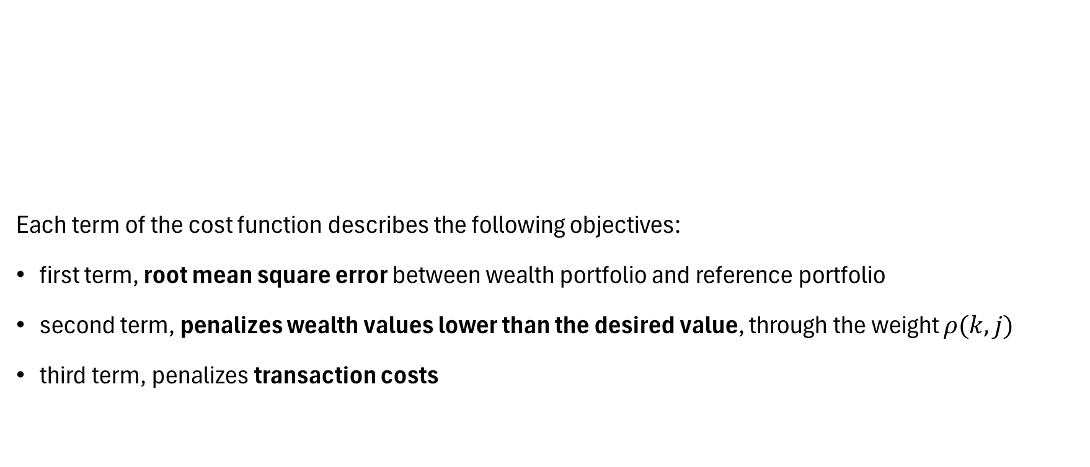
COST FUNCTION
Each term of the cost function describes the following objectives:
first term, root mean square error between wealth portfolio and reference portfolio
second term, penalizes wealth values lower than the desired value, through the weight $ρ(k,j)$
third term, penalizes transaction costs

Slide 11

QUADRATIC COSTS
A common assumption in the literature is to consider a linear impact on market prices for the amount traded, and thus the costs of the impact become quadratic as follows:
NOTE: the last term of the cost function is exactly $v_{j}{\left(k | k\right)}^{T}R\left(k,j\right)v_{j}(k|k)$

Slide 12
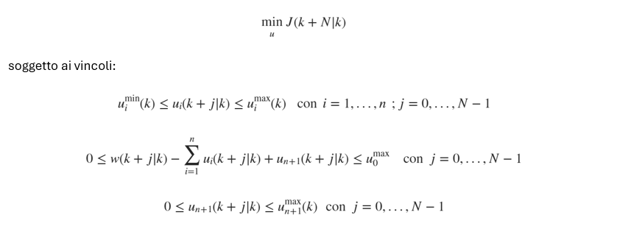
OPTIMAL CONTROL PROBLEM (OCP)
We present the Optimal Control Problem (OCP) where the goal is to minimize the quadratic cost function (tracking error and transaction costs):

Slide 13
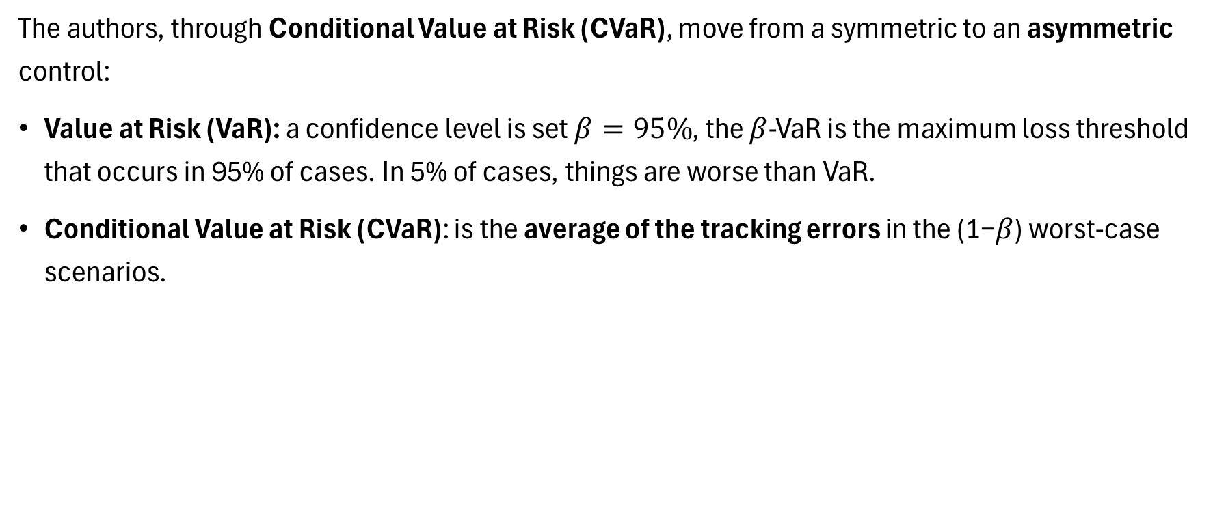
TRACKING MPC: AS LOSS FUNCTION OF CVaR
The authors, through Conditional Value at Risk (CVaR), move from a symmetric to an asymmetric control:
Value at Risk (VaR): a confidence level is set $β=95\%$, the $β$-VaR is the maximum loss threshold that occurs in 95% of cases. In 5% of cases, things are worse than VaR.
Conditional Value at Risk (CVaR): is the average of the tracking errors in the (1−𝛽) worst-case scenarios.

Slide 14
CVaR
CVaR as a stochastic risk measure whose values are obtained through scenarios representing the future trajectories of risk assets.
To develop such scenarios, the first-order VAR model is considered, in which the noise e(k) is randomly sampled for M times.
This sampling process is called Monte Carlo Simulation

Slide 15
MONTE CARLO
Monte Carlo is a method based on the statistical principle called the “Law of Large Numbers”:
Learning-Based Control: We used Monte Carlo when we were unaware of the system dynamics
Paper: Monte Carlo is used to implement CVaR, as it is a complex integral to be calculated over ten assets.

Slide 16
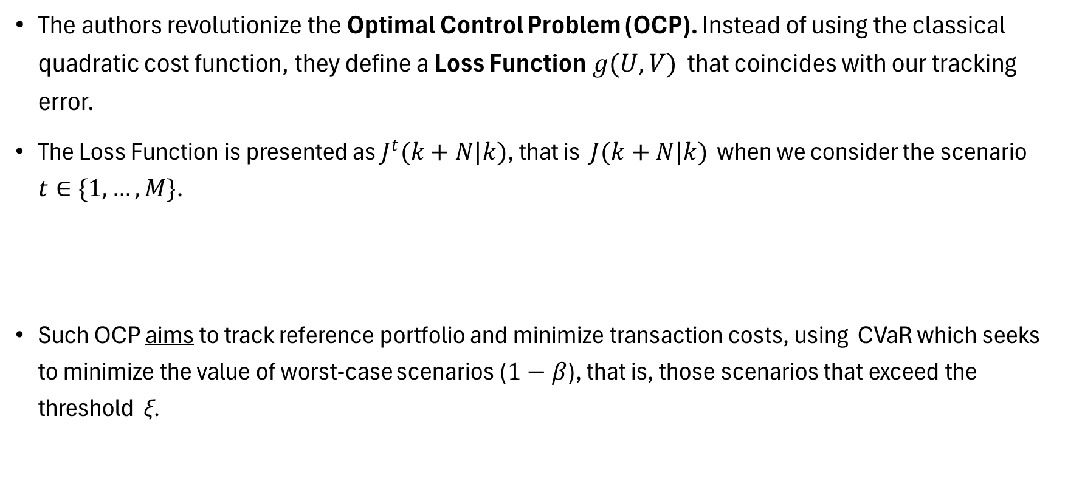
LOSS FUNCTION
The authors revolutionize the Optimal Control Problem (OCP). Instead of using the classical quadratic cost function, they define a Loss Function$g(U,V)$ that coincides with our tracking error.
The Loss Function is presented as $J^{t}(k+N|k)$, that is $J(k+N|k)$ when we consider the scenario $t∈\{1,…,M\}$.
Such OCP aims to track reference portfolio and minimize transaction costs, using CVaR which seeks to minimize the value of worst-case scenarios ($1−β$), that is, those scenarios that exceed the threshold ξ.

Slide 17
MPC STANDARD vs MPC with CVaR
The first OCP (standard MPC tracking) aims to minimize tracking error and transaction costs using a classical optimization method
The second formulation of OCP (CVaR-based MPC tracking) aims to minimize tracking error and transaction costs with the strategy of focusing on worst-case scenarios for the objective function

Slide 18
NUMERICAL EXPERIMENTS - INTRODUCTION
The proposed MPC strategy is implemented in MATLAB. the authors to solve the optimization problem rely on the fmincon function: it is the most widely used solver for constrained nonlinear optimization problems.
The mathematical model on which fmincon is based is Sequential Quadratic Programming (SQP), considered one of the most precise methods for medium-scale nonlinear problems, especially when the constraints are stringent.

Slide 19
DATASET
As specified by the authors, the study proposed in the paper selects a portfolio capable of ensuring high liquidity and broad sectoral diversification, to best describe the economic trend of the Brazilian Stock Exchange.
Since stocks are bought and sold millions of times a day, they allow the algorithm to perform the operations necessary for the continuous rebalancing of the portfolio

Slide 20
TICKER SYMBOL
During the data extraction phase, we changed two assets mentioned in the original paper for the following reasons:
LAME3: suffered an accounting default and corporate reorganization in 2023, events that corrupted historical data on major free databases
JBSS3: Major free databases showed its respective American «clone», thus presenting inconsistencies regarding Brazilian currency and holidays
In order to maintain the integrity of the numerical test, the two assets were replaced with ABEV3 and ITSA4, also highly liquid assets representative of the Brazilian market.

Slide 21
PERIOD EXAMINED
To evaluate the proposed strategies, the authors consider a dataset on daily prices in the period from 2011 to 2021, characterized by:
periods without significant events
periods of bull market, with predominantly growth trends
an atypical year, 2020 with high instability and uncertainty due to the COVID-19 pandemic
a notable recovery in 2021
We obtained this data from the free platform Investing.com

Slide 22
SELIC RATE
Since, in addition to the closing prices of the above-mentioned assets, we also need to know the official interest rate of the Central Bank of Brazil, the SELIC rate, to implement the risk-free asset, as the authors do.
We downloaded his historian on the portal of the Central Bank of Brazil, called SGS.

Slide 23
FPH-MPC vs VPH-MPC
In the paper, the authors implement two different versions of OCP (Tracking MPC Standard) to study the effect of varying the length of the prediction horizon:
FPH-MPC: MPC is implemented in a classical manner, with a fixed prediction horizon throughout the optimization process.
VPH-MPC: At each stage, the model is evolved by considering all the length values of the prediction horizon from which the one that will provide the minimum value of the objective function will be selected

Slide 24
PREMISE
The paper uses a dataset of 2726 working days, and the complexity of the MPC increases exponentially as the predictive horizon increases. These factors prompted us to limit our simulation to 100 working days, in order to test the paper results.
Our approach, however, will allow us to verify the convergence of the optimizer and the correct functioning of the dynamic constraints through comparison with the graphs obtained by the authors

Slide 25
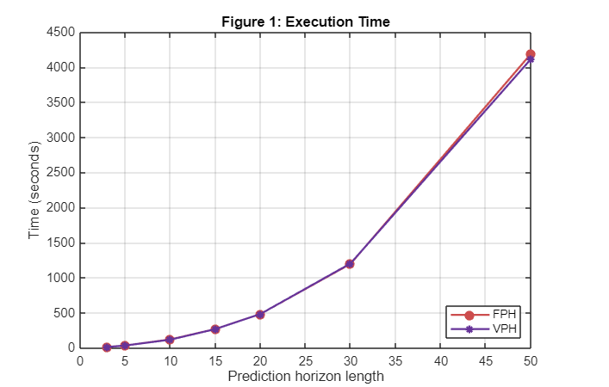
RESULT 1
This graph allows us to show the execution time as a function of the length of the prediction horizon N for the two variants of the algorithm: FPH-MPC and VPH-MPC

Slide 26
RESULT 1 - COMMENT
The graph demonstrates a key concept of MPC: as the prediction horizon N increases, the computational cost (execution time) grows exponentially
In VPH-MPC, the algorithm evaluates all horizons at each iteration and chooses the one with the lowest cost.
The time plotted for the VPH in Figure 1 represents the time spent evaluating the specific horizon along the entire simulation

Slide 27
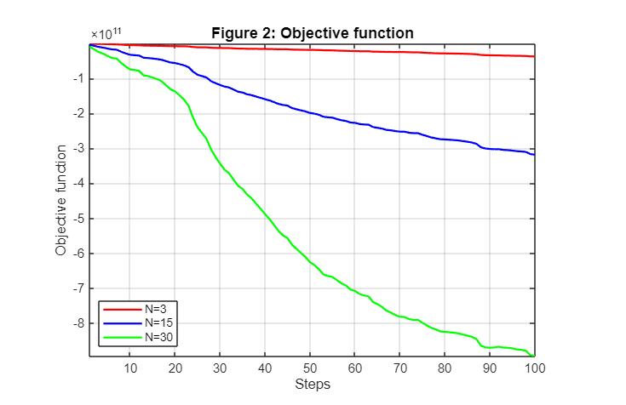
RESULT 2
The following figure allows us to present the values of the objective function based on the length of the prediction horizon, using FPH-MPC.

Slide 28
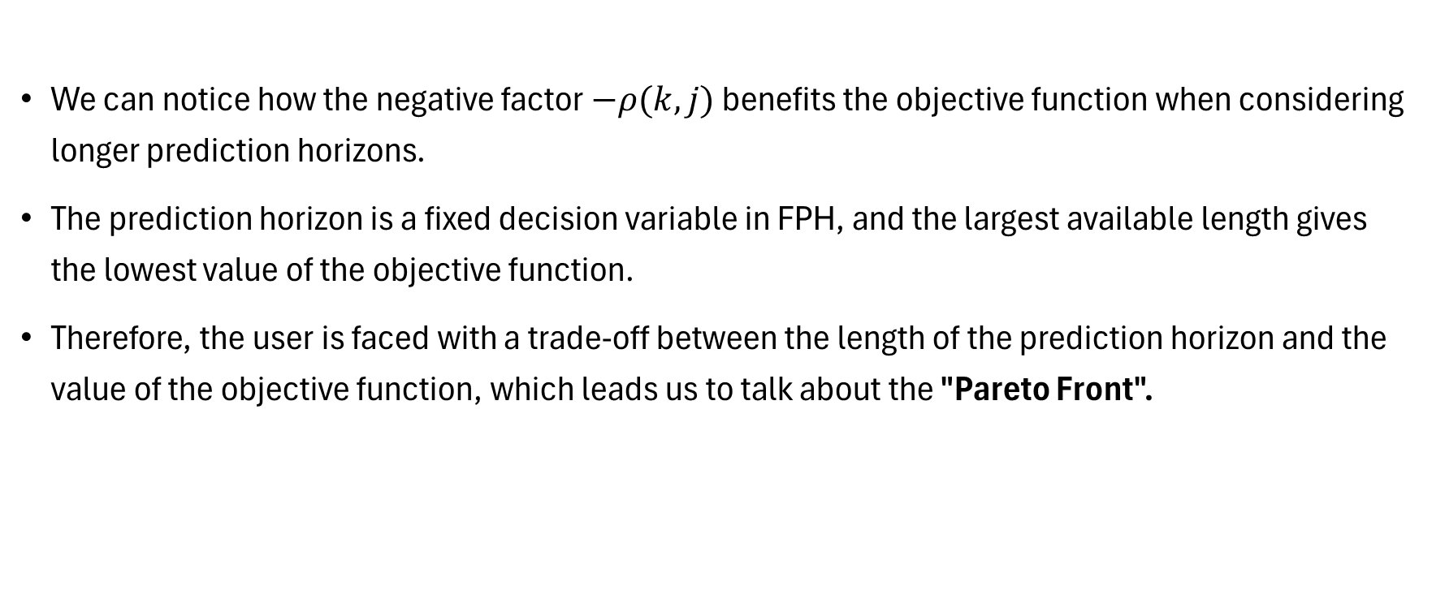
RESULT 2 - COMMENT
We can notice how the negative factor $−ρ(k,j)$ benefits the objective function when considering longer prediction horizons.
The prediction horizon is a fixed decision variable in FPH, and the largest available length gives the lowest value of the objective function.
Therefore, the user is faced with a trade-off between the length of the prediction horizon and the value of the objective function, which leads us to talk about the "Pareto Front".

Slide 29
PARETO FRONT
A multi-objective problem such as the one studied by the authors generates a Pareto Front. Let's consider a graph with:
X-axis: Execution Time (to be minimized)
Y-axis: Value of the Cost Function (to be minimized);
Therefore, the Pareto Front is that curve formed by all «non-dominated» solutions, that is, those solutions for which there is no other alternative that is better in all objectives at once.

Slide 30
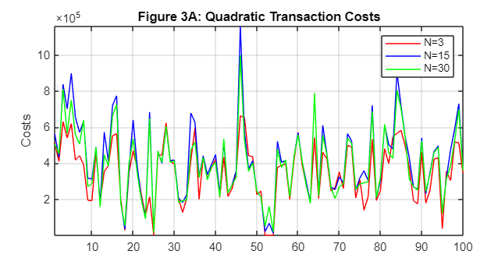
RESULT 3
The figure in question allows us to analyze quadratic transaction costs. We can observe how, in general, the longer the prediction horizon, the higher the transaction cost involved will be.

Slide 31
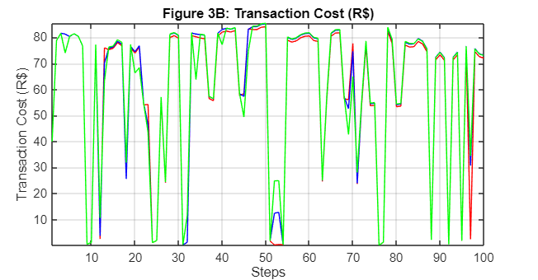
RESULT 4
Now, however, we show the actual costs, discounted in portfolio rebalancing. Let's go, that is, to consider the real cost of the action carried out in the current state, what interests the MPC since it is based on RHC.

Slide 32
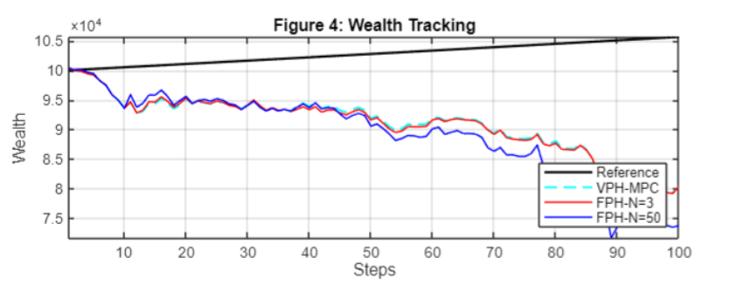
RESULT 5
We now show the reference and accumulated wealth curve for the VPH-MPC and FPH-MPC approaches. We will note that there is a gap, but it is due to the sample used and the market trend

Slide 33
RESULT 5 - COMMENT
If we were to look at Figure 4B of the paper, which shows us a magnifying glass over 500 days, we would notice how the curves of the proposed strategies are not as overlapping as they seem.
Furthermore, as shown by the authors in Figure 8, the trend of Ibovespa, in the period considered, i.e. in the first 100 days, was disastrous, losing 40% of its value. The Ibovespa is a reference index for the Brazilian Stock Exchange, the respective American S&P500

Slide 34
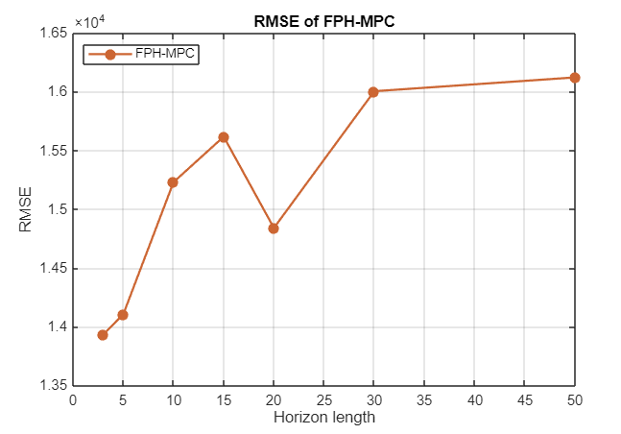
RESULT 6
This result shows us the RMSE (Root Mean Square Error) metric for the various fixed horizons. We note that the higher the predictive horizon, the worse the tracking performance of the FPH-MPC (as also noted by the authors)

Slide 35

FINAL RESULT
The authors also compared their strategy with other investment portfolio optimization strategies, such as the Markowitz curve and a Baseline curve. Going to demonstrate the validity of their work
They then presented the CVaR, comparing it not only with the strategies mentioned above, but with the Ibovespa, highlighting significantly better performances than the comparisons made.

Slide 36
OBSERVATION
Since we limited our problem to 100 days of simulation, we chose not to draw definitive conclusions about the results shown in the previous slide.
In the results described, in fact, monthly returns were compared and a sample of 100 days is equivalent to 4 months of stock market (21 days): a number of samples statistically irrelevant to arrive at satisfactory results

Slide 37
CONCLUSIONS: project
Despite using a small sample, the 100-day simulation provided us with empirical evidence on the controller's behavior:
The higher the value of N, the greater the gap from the reference
Problem difficult to scale: trade-off necessary
Exponential execution time growth
Compatibility between MPC performance and the Brazilian market

Slide 38
CONCLUSIONS: paper
As highlighted by the authors, the main objective of the study conducted was to propose an MPC-based strategy capable of tracking a reference portfolio taking into account transaction costs. From this analysis it emerged:
Tracking effectiveness
Computational trade-off
Effectiveness in using CVaR
Advantage on classic benchmarks

Slide 39
CONCLUDING REMARKS
In the model studied, the authors set the annual target return of 15%. Although it may seem like a financial utopia, when the risk-free rate offers returns that often travel between 8% and 13% per year just to counter inflation (as in the case of the Brazilian market), the stock market must offer a significantly higher risk premium to attract capital
Therefore, if we went to consider this algorithm implemented within a context like the Italian or European one, the dynamics would be radically different

Slide 40
THANKS FOR THE ATTENTION

