Slide 1

inspect network traffic when using the ZOOM app
University of Trieste: Department of Engineering and Architecture
ZOOM
COURSE: Advanced Internet Technologies
Professor: Trevisan Martino
Project carried out by : Di Santo Alessandro

Slide 2

INTRODUCTION
Zoom is a digital communication platform that allows you to make video conferences, audio calls, chats and webinars in real time.
It was developed by the Zoom Video Communications company in 2011 and has experienced exponential growth especially since 2020, becoming one of the most used tools globally for work, teaching and personal remote interactions.

Slide 3
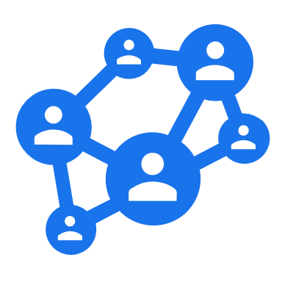
BENEFITS AND USE CASES
Advantages
Ease of use: intuitive interface, quick access via links.
Scalability: suitable for both small meetings and large events.
Versatility: useful for companies, schools, universities, public and private bodies.
Accessibility: doesn't necessarily require an account to join a meeting.
Contexts for use
Distance learning: online lessons, exams, virtual classrooms.
Business and work: team meetings, talks, international conferences.
Events and webinars: product presentations, public conferences, workshops.
Personal use: calls between friends and family, virtual parties, remote meetings

Slide 4
WIRESHARK
We used Wireshark to capture our PC traffic while using Zoom.
Wireshark is a network protocol analyzer: an opensource tool that allows you to capture and inspect in detail data packets passing through a network.

Slide 5
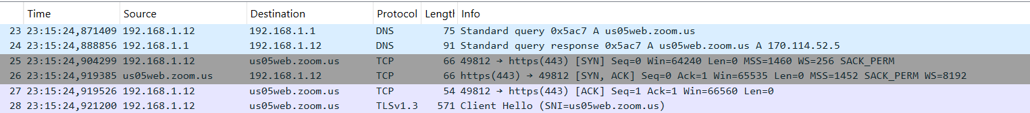
APP OPENING PHASE
During the opening phase of the Zoom app, our PC will perform the following actions:
The PC queries its Default Name Server
That server will provide it with the public IP of the Zoom server to contact
Then the PC establishes a TCP connection with that server

Slide 6
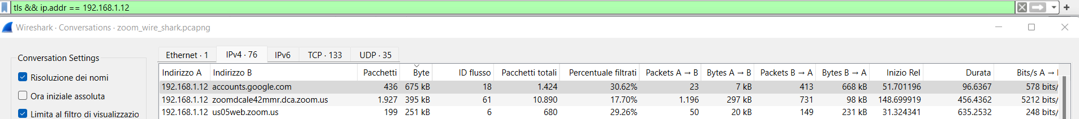
AUTHENTICATION
During the zoom authentication phase it gives us the ability to authenticate with Google credentials: exactly what we did
In fact, we note from the figure below a massive exchange of packets with the google server used for authentication: accounts.google.com

Slide 7
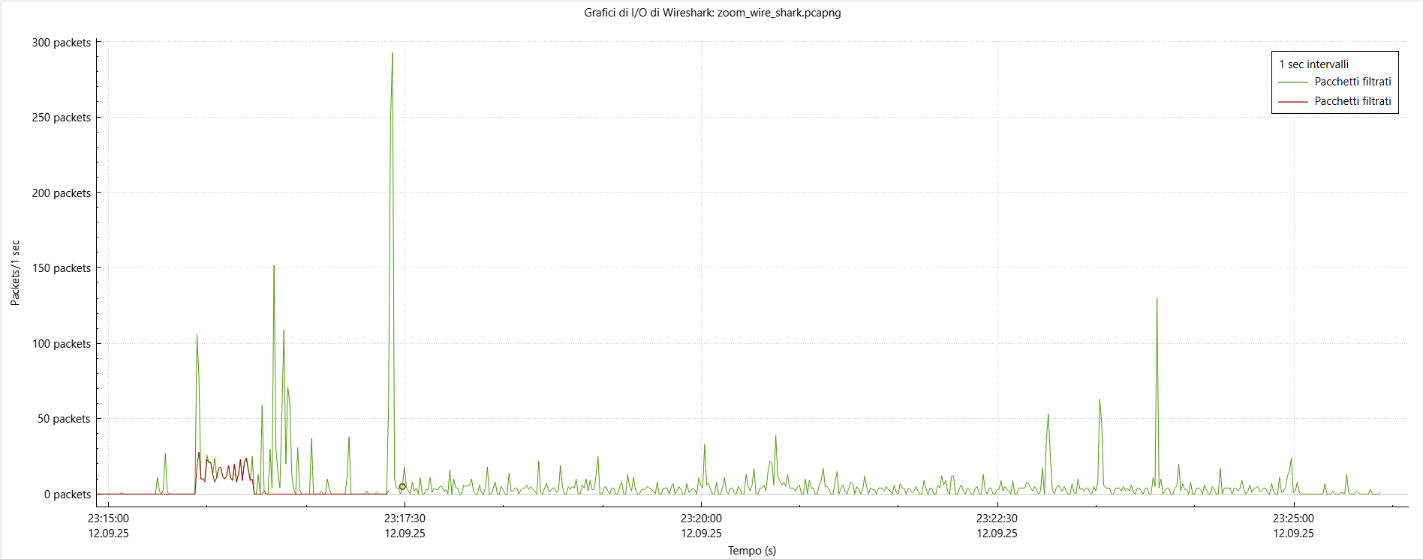
I/O GRAPHIC
TLS traffic between my PC and the Google server used for authentication, in red
TLS traffic between my PC and a Zoom server (206.247.42.42), in green

Slide 8
AUDIO/VIDEO COMMUNICATIONS
Packets with Wireguard Protocol are Zoom packages encrypted with DTLS-SRTP, for the following reasons:
01
WireGuard uses UDP/51820 (not 8801) by default
02
In Wireshark, sometimes DTLS/SRTP encrypted packet headers look like WireGuard, so incorrect labeling
03
IP 206.247.42.42 belongs to a block used by Zoom for media servers, not a VPN provider
04

Slide 9
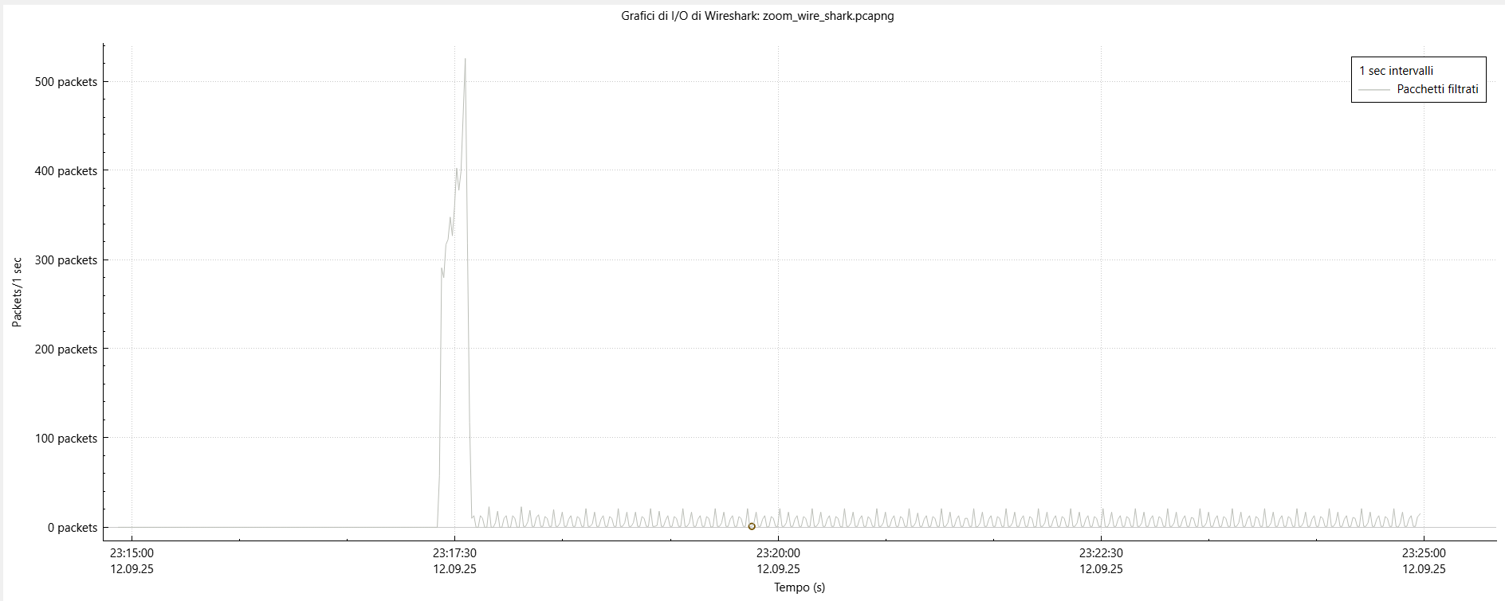
I/O GRAPHICS
UDP streams are already alive even with the microphone and camera turned off

Slide 10
PROTOCOLS USED
In addition to the DNS, TCP, TLS, and UDP protocols, the protocols of SRTP and DTLS will be used:
DTLS is essentially the version of TLS (Transport Layer Security) adapted to run on datagrams, typically UDP, rather than streams as in TCP. Manages an encrypted handshake that establishes security parameters (algorithms, keys) between the parties
SRTP is a secure extension of the RTP (Real-time Transport Protocol), which is used to transport real-time media (audio/video) over the Internet. It does not itself have a complete mechanism for negotiating keys, which is why it combines with DTLS to obtain keys (model “DTLS-SRTP”)

Slide 11

ZOOM SERVERS
Zoom uses:
CDN (Content Delivery Network) and globally distributed servers: to provide static content
Signaling server: to manage authentication, join/leave from meetings
Media server: for audio, video and screen sharing

Slide 12
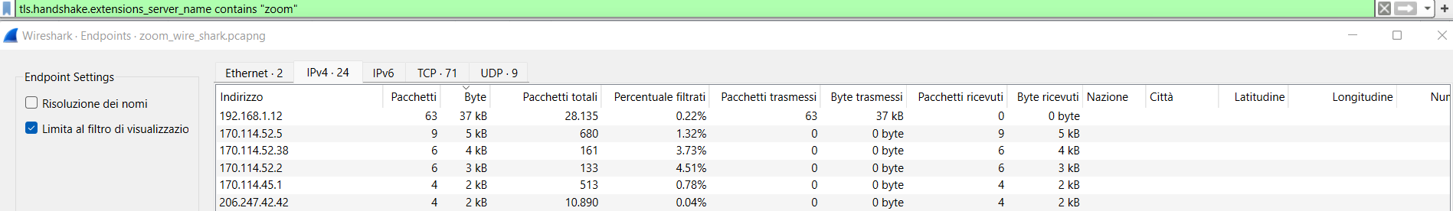
SERVERS CONTACTED FREQUENTLY
The IP addresses: 170.114.45.1, 170.114.52.38, 170.114.52.2 respectively refer to the servers most used by Zoom Video Communications for the distribution of static content via their CDN
The IP address: 206.247.42.42 is the most contacted server during the media phase through the UDP and SRTP protocols; therefore, we could consider it a media server
The IP addresses: 170.114.52.5, 170.114.15.219 are the most contacted servers during the opening and closing phase of the Zoom application; therefore, we can consider them as signaling servers

Slide 13
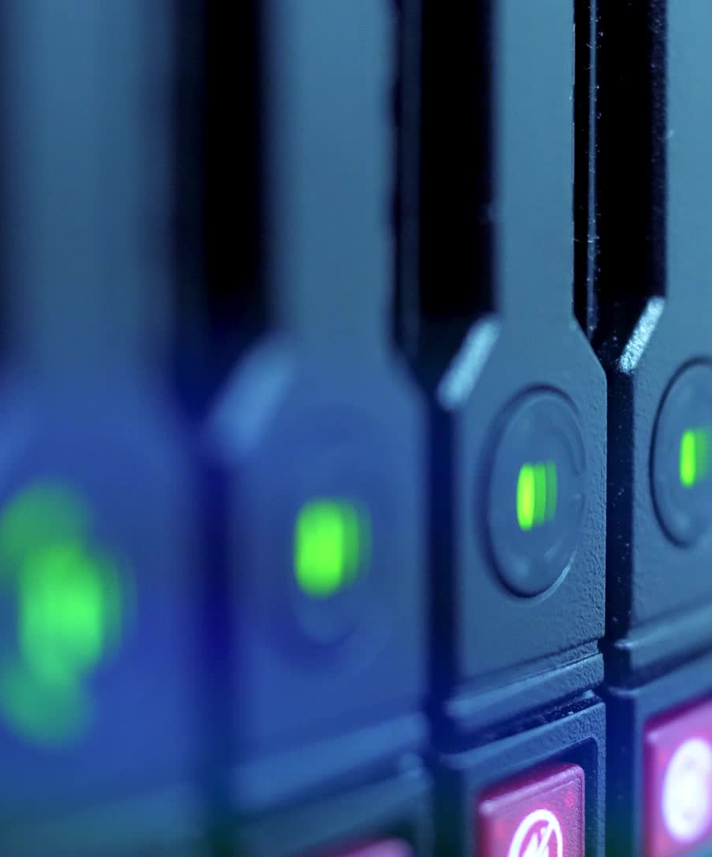
THANKS FOR THE ATTENTION
Below is the information from the two most contacted Zoom servers:
170.114.52.5→ us05web.zoom.us
Country: United States
Region: California
City: San Jose
ISP: Cloudflare London, LLC
Organization: Zoom Video Communications, Inc
170.114.15.219→ us04zpns.zoom.us
Country: United States
Region: California
City: San Jose
ISP: Amazon.com, Inc
Organization: Zoom Video Communications, Inc

