Slide 1
DesignWare Cores SG IP Solutions
For Internal Use Only
BOM Checker Flow … in a NutShell
Patrick Juliano
Last updated : 07/2021

Slide 3
Patrick’s Motivation to Author the flow
IP releases to customers continue to have quality issues
Spending too much time spent cross-checking releases manually by AEs, PEMs, release teams
For internal teams, TAT is burdened by bad releases (e.g. ckt–to–DI)
Goal :
eliminate missing content/files in customer releases
eliminate missing content/files releases between internal teams
improve quality, reduce TAT
reduce releases triggered by quality issues
This flow ensures every release is well structure
BOM defines the standard used to measure all releases
deviations are flagged and reported to user
used for external releases to customers
WIP : used for internal hand-offs/release between teams

Slide 4
Pete’s Deeper Dive into the Motivation
Mandate is coming directly from Warren/Ashfaq to have a more rigorous hand-off between CKT and DI.
Why do we need a more rigorous hand-off?
Currently the quality is very high and there are very few mistakes. However, mistakes create waste for both teams (i.e. developer & consumer), killing the TAT speeds. Automation ensure uniformity across providers. Automation proves hand-off is clean for all stakeholders.
We need to be able to scale up to support more customers, more products, in more tech nodes. Must have rigorous, scalable, well-defined flows and automation achieves this.
The more standardized the flow is, the easier it is to share work and cover for each other.
People tracking a project at a higher level than CKT-DI can have a report proving CKT-DI hand off is clean. Eliminates FUD and misunderstandings.
There is also value in aligning with the rest of the company. The new proposed flow is already used by product release teams, and it is intended to roll out to DI and RTL/front-end teams too. Having a flow that is widely used allows for more CAD support for that flow.
Aren’t the current flows rigorous enough?
Yes and no. The current flow (from seeding scripts right through to release scripts):
does capture intent – it knows the macros and views needed for a given release of a given product
does guarantee that the intended macro views are released – it will flag any views that are missing. It is “correct by construction” and guides the whole engineering process.
So what’s missing?
It is not easy to “see” and audit the intent. The required views can be controlled with configuration files like topCells and legalRelease, but the main content requirement is hard-coded inside the scripts.
It is not possible to run an independent review of the release. The flow will report missing views, and the crr file represents the full release. But there is no way to run an independent check on the release that generates a report that could independently confirm release (regardless of how it was created), and could be distributed to concerned parties.
It is also hard to add new macro/view types or expand/improve the flow. Since it already has a lot of “smarts” built in (to know which views are needed for each macros for example), it is hard to update requirements, and augment the flows (eg add new checks). Adding covercells to the flow was brought up as a recent example.
Non standard views (eg HSpice, IBIS, etc) may be entered manually, but this allows the delivery to diverge among teams.
There are currently no definitions for initial and preliminary type releases.
Not all teams are using the current scripts. Having a way to independently check a release (regardless of how it was created) adds value here.

Slide 5
Proposed Roll Out
Stage | Description | Timeframe
1 – Content List | Capture list of all intended views (in MM and .cfg files) and check for existence in release | ?
2 – Content Checks | Simple/sanity type checks (correct name, formatting, headers exist, etc). As escapes are found, new checks are added | ?
3 – Cross Domain Analysis | I think this is actually checking content, for example that all tests are run and results are either pass or waived. We could consider adding flow-tracing type tools that know which analysis needs to be run and kicks it off whenever a related view is touched. | ?
PMs and CKT managers are heavily loaded and don’t have extra resource allocated to learn/develop new flows
It is proposed we break down stage 1 as follows to reduce impact to current engineering work:
Stage | Description | Impact | Timeframe
1a – Develop MM | Actual release to DI and all engineering work will continue to rely on existing flow. In addition, the new checking tool will be run on each release. Will require creating the MM and .cfg for each release, and running the check after release (but won’t gate release) | PMs will need to generate MM and .cfg for each release – hopefully this is minimal as Bhuvan, Patrick, Pete have already created templates for DDR, LPDDR, and HBM. | ?
1b – Incorporate existing config with new flow | For example, topCells, legalRelease, etc could become sheets in the MM excel file. The flows would have to be updated to accept the new format. Allows entire configuration for a project to be stored together under revision control, and allows CAD to start updating the flows with hopefully no impact to user | Bhuvan would have to update flows to understand new file formats. Hopefully minimal impact to PMs as content would be the same, just slightly different format. | ?
1c – Clean up and automate flow | Once the existing and new configuration files are consolidated in one place (but basically still runs as the existing flow does today) redundancies can be eliminated, and scripts “under the hood” can be simplified and improved, preparing the way for stage 2. | Main impact is to Bhuvan Hopefully very minimal impact to PMs as new versions of the flow are rolled out. -- although cleaning up redundancies in MM may cause slight workflow change to PMs | ?

Slide 6
What is the Main Manifest?
The Main Manifest (MM) is used to record all details of the BOM in a compact format
MM consists of a few major sections and these are required
Release Names
Component Names
File SPECs
View Names
The MM is used to cross-check the release (REL) to ensure all the expected files are present before releasing to customers
The BOM is currently owned by Gordon Buchanan
going forward, the MM for each Product Line will also be owned by Gordon

Slide 7
Bug Reporting in JIRA
A reference ticket has been created to make bug reporting uber-easy
Simply ‘clone’ this JIRA (P10020416-25542) and assign to Patrick Juliano
The following settings will be default
Product L1 : SG MSIP Internal tools
Product L2 : Shelltools
Product L3 : bom-checker
Project Theme : Quality
Priority : 2-Medium
Patrick will acknowledge and engage user to resolve the issues.

Slide 8
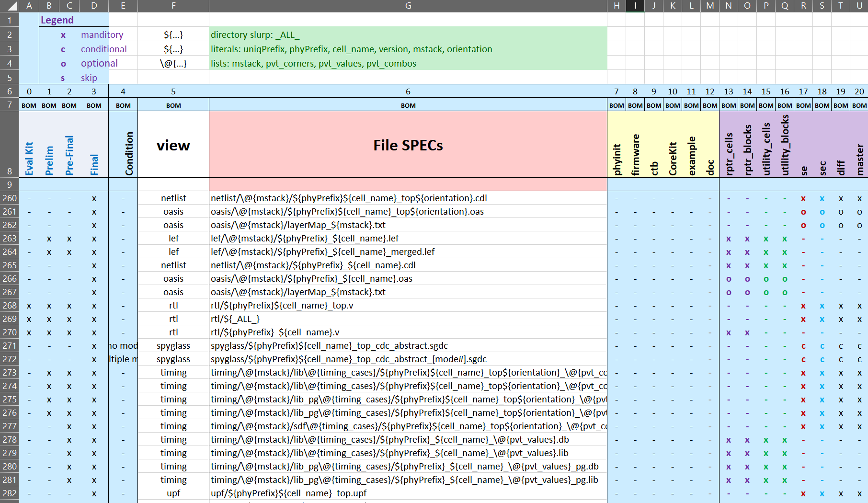
MM Example
Release Name
Soft Component Names
Hard Component Names
File SPEC details

Slide 9
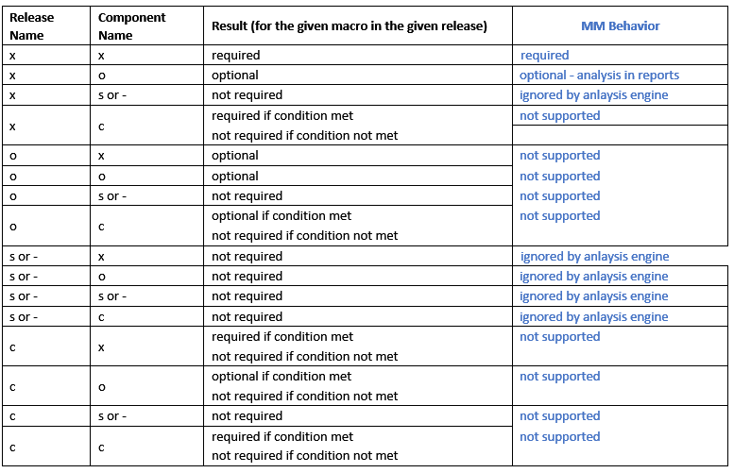
Phase/Release SPEC Designations
Each fileSPEC can be designated to be part of a specific named phase/release. To include the fileSPEC designation in the release, mark it using an ‘x’.
all other designations will result in dropping (removing) the fileSPEC from the release
example: for the release named ‘Pre-Final’, any row with ‘x’ in column ‘C’ (labeled ‘2’ in cell C6) with result in the fileSPEC details being processed. All other rows are ignored completely, regardless of what is designated for the fileSPEC in columns H’ thru ‘U’

Slide 10

File SPEC Options
Each fileSPEC can be designated according to these definitions and is cross-referenced with the cell/component and the release
‘x’ – mandatory / file expected in the REL
if an ‘x’ exists in the column for a given component AND an ‘x’ exists in the column for the selected release, then the fileSPEC will be used in MM to compute files in the BOM
‘o’ – optional : not required in the REL
this fileSPEC will be used to compute files in the optional BOM
if found in the REL, it will be counted as part of the BOM and REL (i.e. common)
if NOT found in the REL, it will be waived from the BOM
‘-’ or ‘s’ – skip : do nothing for this fileSPEC , don’t process it
any fileSPEC with this designation will be ignored entirely
‘c’ – conditional : only include fileSPEC when conditional is met
Warning : not tested … I anticipate this feature being needed … but not used as of today
check the conditional column designated ‘conditional’ for a string and compare to the variable ‘conditional’ in the dictionary; if they match, include it

Slide 11

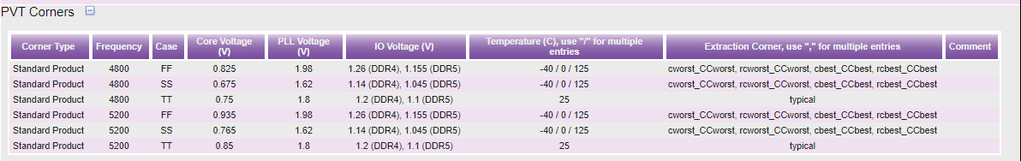
What is the Manifest Dictionary?
The MM Dictionary contains all the known state variables that are allowed
Examples : phyPrefix, process
Values can be defined by construct ‘file_SPEC_variables’ =>
Some are req’d for info extracted from ViCi : version, orientation, mstack, pvt_values , pvt_corners , pvt_combos
Examples :
Only values extracted for orientation : ‘_ns’ , ‘_ew’ , ‘_ew+_ns’
mstack => 8M_1X_h_1Xa_v_1Ya_h_4Y_vhvh
pvt_values => ff0p935vn40c
pvt_corners => cworst_CCworst , cbest_CCbest
pvt_combos => ff0p935vn40c_ cworst_CCworst , ff0p935vn40c_cbest_CCbest

Slide 12
File SPEC : schema for expansion
Typical HBM/DDR BOM is 3,500 files => huge maintenance load
Manifest can fully describe the BOM in just 350 lines => 10x compression
Structure of the release package (rel-pkg) is well-ordered
structure : base_path/componentorientation/version/filespec
Examples : synopsys/dwc_lpddr54_phy_tsmc6ff18/2.00a/diff_ew/2.00a/rtl/dwc_ddrphydiff_ew.v
synopsys/dwc_lpddr54_phy_tsmc6ff18/2.00a/diff_ns/2.00a/rtl/dwc_ddrphydiff_ns.v
Path of a file in the rel-pkg is constructed using team’s pre-existing conventions
base_path => recorded in CFG
component name / orientation / version => recorded in ViCi , ViCi, ViCi
ViCi page URL needs to be recorded in CFG
file SPECs => derived from the MANIFEST

Slide 13
Flow & Command Examples
gen_bom.pl : converts Manifest to fully-specified BOM
Inputs : config file [cfg] , Manifest [xlsx] , REL pkg [txt|tar|tgz]
Outputs : ascii file of BOM
inspect_release_pkg.pl : cross-checks the REL pkg and reports all deviations from BOM
Inputs : config file [cfg] , BOM [txt] , REL pkg [txt|tar|tgz]
Outputs : ascii report + log files
Accessing the flow :
step 1 : module unload bom-checker
step 2 : module load bom-checker
CMD Line Examples
step 1: gen_bom.pl -cfg lp54-v1.18.cfg
step 2: inspect_release_pkg.pl -cfg lp54-v1.18.cfg -rel d862-1.00a.txt
inspect_release_pkg.pl -cfg lp54-v1.18.cfg -rel d862-1.00a.txt –log inspect
alternatively, if the reference list filename is NOT defined in the CFG file, need the opt ‘-ref filename’ …
inspect_release_pkg.pl -cfg lp54-v1.18.cfg -rel d862-1.00a.txt -ref MM.filenames.txt –opt MM.filenames.optional.txt

Slide 14
Configuration File (CFG)
Key parameters are captured in the configuration file (.cfg) and supports tremendous flexibility for the user to adapt to the needs of the given IP title
the CONFIG file is the container for setting parameters that create fluid work-arounds for corner-cases
given the relatively unstructured content defined in ViCi, testing revealed several corner-cases (i.e. “in this case, we had to …”)
corner-cases create complexity and requires appropriate flexibility and minimum sophistication to match the deviations from conventions
CFG consists of content to drive the analysis … and is connected to the MANIFEST
records the MANIFEST XLSX workbook name, and the sheet name where the MM lives
captures the dictionary of variables used to build the file SPECs
if a variable is defined in the dictionary, it should be used in the cell’s config file
specify row & col where critical content is located … each team can decide how to arrange data for their IP title / problem set details
release names are defined
hard/soft components are declared
file SPECs are recorded
USERs running the QA on the releases (i.e. customer REL and/or ckóDI hand-offs)
base path prefix for the release content
Examples : (1) //depot/products/ddr54/project/d809-ddr54-tsmc7ff18/ckt/rel
(2) synopsys/dwc_lpddr54_phy_cuamd_tsmc6ff18/2.00a/
declaration of all valid components and their local settings
and overrides necessary to deal with corner-cases
the list of components/macros user wishes to analyze (can be 1 or more of the declared components)
waivers : user can exclude content from the REFerence and/or the RELease independently

Slide 15
CFG Defaults
Default GLOBAL Variables–
user can override the default parameters using the CFG file
parameter names and default values are shown below
XLSX_sheet_name MM
fname_BOM_TXT MM.filenames.txt
contains the BOM derived from all the fileSPECs designated ‘x’ (mandatory)
fname_BOM_TXT_optional MM.filenames.optional.txt
contains the BOM derived from all the fileSPECs designated ‘o’ (optional)
ViCi_script ../../python/bin/get_vici_info.py
CSV_index_FILES 20 # col index where fileSPECs are located
CSV_index_VIEWS 19 # col index where VIEWs are located
CSV_index_COND 4
manifest__name BOM # use the manifest named here
row__manifest_names 7 # multiple manifest names can co-exist in sheet
row__cell_names 8
row__bom_start 10

Slide 16
CFG File - $misc
Use $misc to setup default values used for all cells/components
this avoids specifying the value in each component
decide which vars should be inherited across all cells using line similar to example below
Example : vars_that_get_inherited_by_cells' => [ 'vici_url', 'mstack_regex', 'PVT_regex', 'pdvs' ]
Defaults are set automatically for the following, but user can override if necessary (see back-up slides for details):
version_regex , orientation_regex , mstack_regex , PVT_regex
User should specify defaults in the CFG for as they are almost always needed:
base_path, vici_url,
base_path use this for any directory names that are used before the level of directory where the component names start
Example: ‘base_path’ => ‘synopsys/dwc_lpddr54_amd_tsmc6ff18/2.00a/’
Note : the default values setup can be overridden for a single cell/component in its local declaration
Ex : details for 1 component is in different ViCi page than all the others in HBM
Note – ‘base_path’ can also be used under overrides for cells/components

Slide 17
CFG : local variables
LOCAL Variables – valid in scope of the given component
user can set the value of each variable in the CFG file
name default is name of component used in the CFG and MM XLSX
cell_name default is name of component used in the CFG and MM XLSX
dirname default is name of component used in the CFG and MM XLSX
if necessary, specify the value required to match the official BOM
Note: the value ${orientation} is automatically appended as a suffix, unless the value is ‘N/A’
viciname default is name of component used in the CFG and MM XLSX
if necessary, specify the value to match what PEM recorded in ViCi
user can set the value of each variable in the CFG file using the ‘overrides’ block in each component’s scope
ViCi Attributes for each cell
version value (e.g. 1.00a) from ViCi using ‘version_regex’ … can specify exact value to use in overrides
orientation list from ViCi using ‘orientation_regex’ … can hard-code value in overrides
mstack list from ViCi using ‘mstack_regex’ … can hard-code value in overrides
pvt_combos list from ViCi using ‘PVT_regex’ … can hard-code value in overrides
pvt_corners list derived from pvt_combos … can hard-code value in overrides
pvt_values list derived from pvt_combos … can hard-code value in overrides
And, any variable specified in the Main Manifest (MM)
Examples: phyPrefix timing_cases mstack orientation version

Slide 18
CFG File – how to add a new variable to MM + CFG
Davit H to add

Slide 19
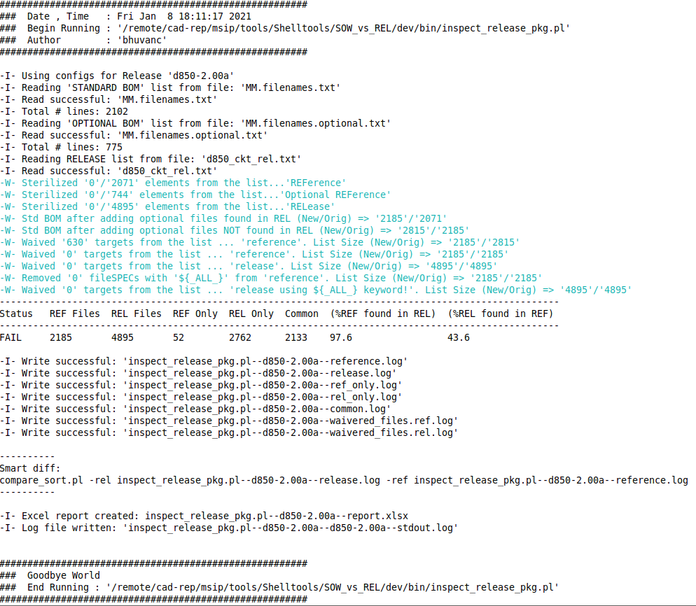
Inspection Report
The CONFIG file (.cfg) captures the settings necessary to deal with the release management system
corner-cases create complexity and requires appropriate flexibility and minimum sophistication to match the deviations from conventions
the CONFIG file allows fluid work-arounds for corner-cases
Output Logs Files
reference.log : captures list of files derived from MM + structs in {waivers + find-n-replace}
release.log : captures list of files derived from MM + structs in {waivers + find-n-replace}
ref_only.log : captures all the files that were defined in the REFeference & not found in the REL pkg
rel_only.log : captures all the files that were defined in the RELease & not found in the REF
common.log : captures list of files that were found in both the REF and the REL
waivered_files.ref.log : pairs of (waiverófile) that were removed from the REF list
waivered_files.rel.log : pairs of (waiverófile) that were removed from the REL list
Excel report with each log file
+ Smart diff command to view
interactive differences using p4diff
9. stdout.log: captures STDOUT for the run
An example of invoking the flow is shown in the graphic to the right

Slide 20
Report Status
Status report contains (%REF found in REL) and (%REL found in REF)
Only when both are 100%, the Status is PASS

Slide 21
How to open inspect report in Unix
Inspect script generates inspect_release_pkg.pl--report.xlsx
To open the excel in unix, set alias to soffice
alias soffice /depot/openoffice-4.1.2/openoffice4/program/soffice
Open report using
soffice inspect_release_pkg.pl--report.xlsx

Slide 22
alphaDepotRelChecker.pl
For CKT to DI releases only
Single script to run both gen_bom.pl and inspect_release_pkg.pl
Inputs:
cfg (config file)
rel (release file)

Slide 24
Process Defined for DDR & HBM Team
General Flow
Main Manifest
Created and maintained by me for all DDR products – included as tab in all BOM releases
Tom/Mike are looking after HBM BOMs now – I’ll talk to them about how they want to handle the MM
Project Specific Manifest
Where necessary, the PEM is responsible for creating project specific manifests (with guidance from me)
stored in P4 => p4:1999//depot/products/<product_name>/project/<project_d#>-<product_name>/manifest/<project_d#>-<product_name>.xlxs
CFG file
There will be 3 cfg files for each release:-
Hard component cfg file -- created by hard component build engr
stored in P4 => p4:1999//msipott/ip/<product_name>/<foundary>/<node>/<process>_<d#>/hard_cfg/<phy_version_number>/hard.cfg
Soft component cfg file – created by soft component build engr
stored in P4 => p4:1999//msipott/ip/<product_name>/common/soft_cfg/<release_train>/soft.cfg
PHY cfg file – created by PHY build engr by merging hard+soft component cfg files
stored in P4 => p4:1999//msipott/ip/<product_name>/<foundary>/<node>/<process>_<d#>/hard_cfg/<phy_version_number>/phy.cfg

Slide 25
CFG File - ViCi Related
In order to gather critical attributes of the release, data is extracted from ViCI
CMD Syntax : get_vici_info.py <URL>
Ex: get_vici_info.py http://vici/releasePageConstruct/index/id/22250/page_id/185
'-I- Opening the \'http://vici/releasePageConstruct/index/id/22250/page_id/185\' url for checking content’,
'+++++++++++++++++++++++++++++++++++++++++++++++++++++++++',
'acx4 : _ew : 0.95a',
'dbyte : _ew : 0.95a',
'decapvddq : : ‘,
'master : : 0.95a’,
'utility cells library : : 1.00a',
'ctb : : ‘,
'firmware : : ‘,
'installed_corekit : : ',
'macro : : ',
'phyinit : : ',
'pub : : 0.95a',
'+++++++++++++++++++++++++++++++++++++++++++++++++++++++++',
'-I- Done grabbing cell_names and version from ViCi',
'-I- Get pvt_corners from vici',
'++++++++++++++++++++++++++++++++++++++++++++++++++++++++',
'Standard Product : PVT options : ff0p935vn40c_cworst_CCworst ff0p935v0c_cworst_CCworst ff0p935v125c_cworst_CCworst ff0p935vn40c_rcworst_CCworst ff0p935v0c_rcworst_CCworst ff0p935v125c_rcworst_CCworst ff0p935vn40c_cbest_CCbest ff0p935v0c_cbest_CCbest ff0p935v125c_cbest_CCbest ff0p935vn40c_rcbest_CCbest ff0p935v0c_rcbest_CCbest ff0p935v125c_rcbest_CCbest ss0p675vn40c_cworst_CCworst ss0p675v0c_cworst_CCworst ss0p675v125c_cworst_CCworst ss0p675vn40c_rcworst_CCworst ss0p675v0c_rcworst_CCworst ss0p675v125c_rcworst_CCworst ss0p675vn40c_cbest_CCbest ss0p675v0c_cbest_CCbest ss0p675v125c_cbest_CCbest ss0p675vn40c_rcbest_CCbest ss0p675v0c_rcbest_CCbest ss0p675v125c_rcbest_CCbest tt0p85v25c_RCtypical tt0p75v25c_RCtypical',
'++++++++++++++++++++++++++++++++++++++++++++++++++++++++’,
'-I- Get metal stacks from vici',
'Foundry Metal Option: 13M_1Xs_h_1Xa_v_1Ya_h_5Y_vhvhv_2Yy2Z 15M_1Xs_h_1Xa_v_1Ya_h_5Y_vhvhv_2Yy2Yx2R',
'PHY Metal Option: 8M_1Xs_h_1Xa_v_1Ya_h_4Y_vhvh 8M_1Xs_h_1Xa_v_1Ya_h_4Y_vhvh',
Regex are used to extract the (1) component’s orientation (2) version (3) metal stack (4) PVTe details. Defaults to extract the above text block can be overridden in the CFG file.

Slide 26
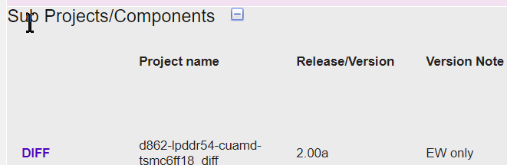
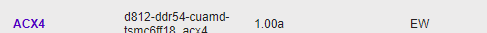
CFG File - ViCi Related
Local Variables – in the context of a given component
version_regex PERL REGEX used to parse version info from ViCi
Components are found using default PERL REGEX:
HARD : "^$viciname.*: “.‘\s+(\d\.\d+\w+)$’ SOFT : "^$viciname\\w+ : “ .‘(\S+-\S+-\S+)$’;
these can be overridden by specifying custom REGEX in the cell’s config
Example: 'version_regex’ => “:\s+(\d\.\d+\w+)$’
The final regex used becomes => “^$viciname” . ‘:\s+(\d\.\d+\w+)$’
orientation default is derived from the field ‘Version Note’ in the ViCi database
if necessary, user can override the value extracted from ViCi in the CFG file
Note: this is always a list, and multiple values causes multiple components to be named
orientation_regex - PERL REGEX used to parse output from the tool used to gather information from ViCi db
The format of the output is always (1) _ns or (2) _ew or (3) _ew+_ns or (4) ‘’
default: “$viciname : (_\w+)\+*(\w* ) :”;
the regex can be specified by the user, but is always pre-pended with “^$viciname”
specify the custom REGEX in the cell’s config like this : ‘orientation_regex’ => ‘.*:\s+(\d\.\d+\w+)$’
The final regex used becomes => “^$viciname” .‘.*:\s+(\d\.\d+\w+)$’

Slide 27

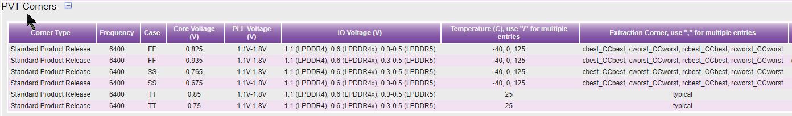
CFG File - ViCi Related
LOCAL Variables – in the context of a given component
mstack - default is derived from ViCi database
if necessary, user can override the value extracted from ViCi in the CFG file
mstack_regex PERL REGEX used to parse metal stack info dumped from ViCi
specify default in the parameters hash ‘$misc’ : mstack_regex => '^PHY Metal Option: (.*)$’,
useful when and/if the fields are not following the standards
pvt_values / pvt_corners / pvt_combos – variables are req’d and used to capture the PVT information recorded in ViCi … cannot be discarded or renamed
PVT_regex PERL REGEX used to parse the ViCi database entry
specify default in the parameters hash ‘$misc’ : PVT options : (.*)$
If a specific corner type is required, use ‘PVT_regex’ => ‘<corner Type> : PVT options : (.*)$’,
Example: ‘PVT_regex’ => ‘Standard Product Release : PVT options : (.*)$’,
If corner type not specified, all corners are taken into consideration
used once when PEM missed value in PVT table column causing automatic parsing to fail.
CSV list expected here

