Slide 1

Data Discovery
Poking Around with Python
Andy Leedom

Slide 2
Basketball: The Question
Is attendance higher at games which are “better”?
How do you rank games with data we are given?
Games with a close score are usually more fun to watch.

Slide 3
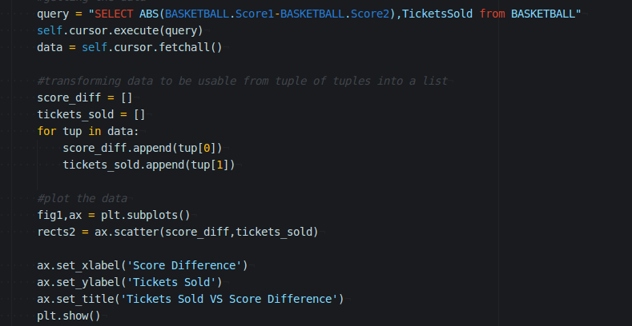
Basketball: Query and Code
SELECT ABS(BASKETBALL.Score1-BASKETBALL.Score2),TicketsSold from BASKETBALL
Query gave me all the data I needed.
Only needed to transform it to make it easier to deal with when graphing

Slide 4
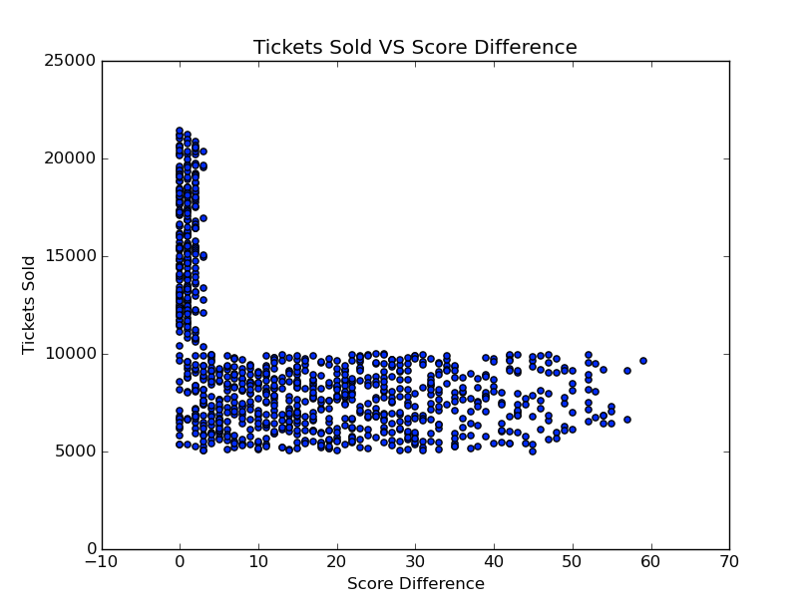
Basketball: The Graph

Slide 5
Basketball: The Analysis
The data seemed too “square”. I thought I made a mistake.
Stadiums sell a minimum number of tickets (5,000)
Most stadiums only have ~10,000 seats.
Question is afirmed, the more competitive games with lower score difference sell more tickets!

Slide 6
Professor Moody:The Question
Does a students attitude have an effect on his/her grade?
I think it should!

Slide 7
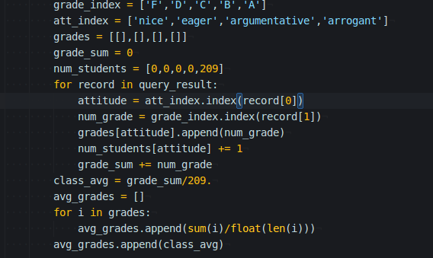
Professor Moody:Query and Code
SELECT Attitude,Grade
FROM PROFESSOR_MOODY

Slide 8
Professor Moody:Query and Code...
Much more processing with python this time
Needed to convert attitude and grade into a numeric values
The averaging and count part could have been done on the database side with the following query but I was already iterating over the set in python(to transform) so I thought it would be more performant to do it with python instead.
SELECT Attitude,AVG(Grade),Count(*)
FROM PROFESSOR_MOODY
GROUP BY Attitude

Slide 9
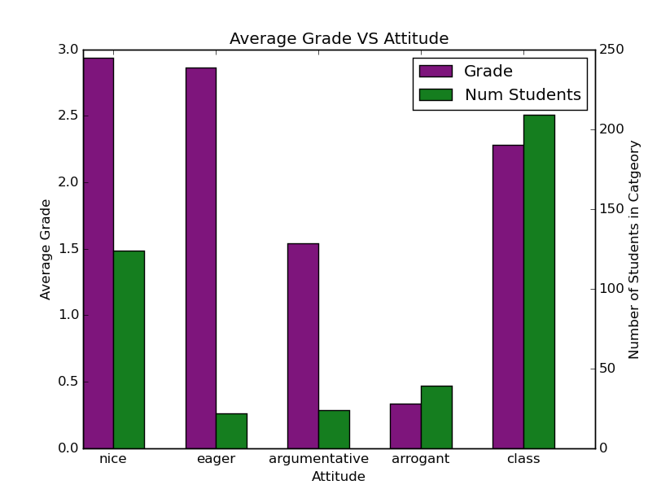
Professor Moody:The Graph

Slide 10
Professor Moody: The Analysis
Yes the data would suggest that attitude has an effect on your grade.
Originally only had the averages, but added the number of students to add meaning/usefulness to the graph.

Slide 11
Thanks
My Code: https://github.com/aleedom/cs336

