Slide 1
FINAL SUBMISSION & Presentation
Mohammad Aleem
06/12/2022

Slide 2
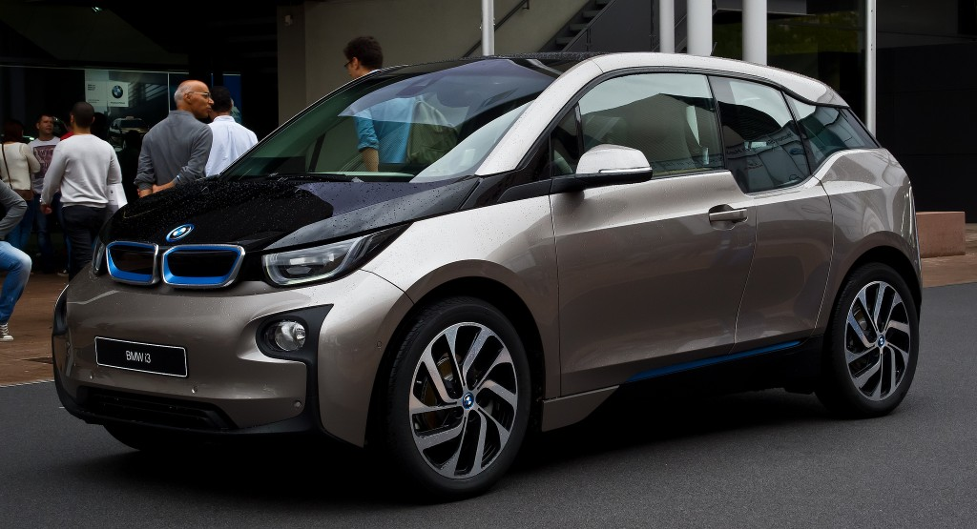
Agenda
Used Car Data Exploration
Data Cleanup and Imputing
Setting up Regression Models
Evaluating Accuracy and Performance
This Photo by Unknown Author is licensed under CC BY

Slide 3

Executive Summary
The demand for used cars in the Indian Market today is quite high. Because sales of new cars have slowed down in the recent past, the pre-owned car market has continued to grow over the past years and is larger than the new car market now. Cars4U is a tech start-up that aims to find this gap of demand in this market. In 2018-19, while new car sales were recorded at 3.6 million units, around 4 million second-hand cars were bought and sold. In fact, some car sellers replaced their old cars with pre-owned cars instead of buying new ones.
Unlike “new cars”, where price is primarily determined and managed by “Original Equipment Manufacture” except for dealership level discounts. The used car market is a very different world with large uncertainties in both pricing and supply. Several factors, including mileage, brand, model, year, etc. can influence the actual worth of a car. From the perspective of a seller, it is not an easy task to set the correct price of a used car. The pricing scheme for a used car could be complex and may involve a huge number of variables which will impact the price position either positively or negatively, and hence, this will need a suitable regression model to predict the price value correctly.

Slide 4
Problem Summary
In this project, we are focused on exploring liner regression models. The target of our work is to find the best regression model that will efficiently and accurately predict the used car price and help the business to set strategies accordingly to make more and more profit.
We used several regression models and related functions from sklearn libraries.
From my personal experience, I found that the decision tree model provided me with a best fit for the given data set.
The given data set in the .csv file, however, was not clean. There were null (NaN) values in the following columns – Mileage, Engine, Power, Seat, New_Price and Price. Also, there some outliers. Because of this, for an error free analysis, needed removing of outliers. Also, we needed imputing NaN values with median values of those data elements. In the slide below, I have the Python code that did the Imputation of data for these columns. Also, we needed to drop the S.No. (Serial Number) and New_Price columns from data set altogether because these were not needed for the regression analysis at all.

Slide 5
Data Dictionary
S.No. : Serial Number
Name : Name of the car which includes Brand name and Model name
Location : The location in which the car is being sold or is available for purchase (Cities)
Year : Manufacturing year of the car
Kilometers_driven : The total kilometers driven in the car by the previous owner(s) in KM.
Fuel_Type : The type of fuel used by the car. (Petrol, Diesel, Electric, CNG, LPG)
Transmission : The type of transmission used by the car. (Automatic / Manual)
Owner : Type of ownership
Mileage : The standard mileage offered by the car company in kmpl or km/kg
Engine : The displacement volume of the engine in CC.
Power : The maximum power of the engine in bhp.
Seats : The number of seats in the car.
New_Price : The price of a new car of the same model in INR 100,000
Price : The price of the used car in INR 100,000 (Target Variable)

Slide 6
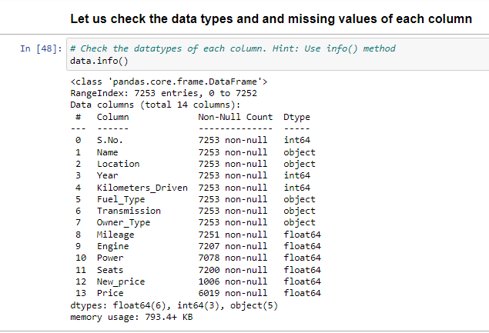
Data – Original State

Slide 7
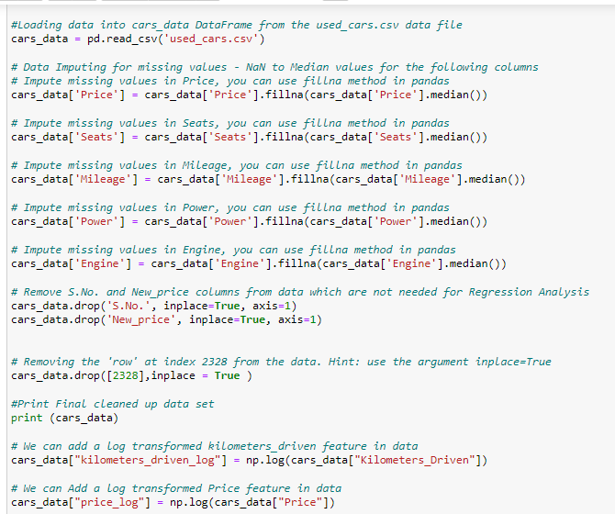
Data – Cleanup and Imputing

Slide 8
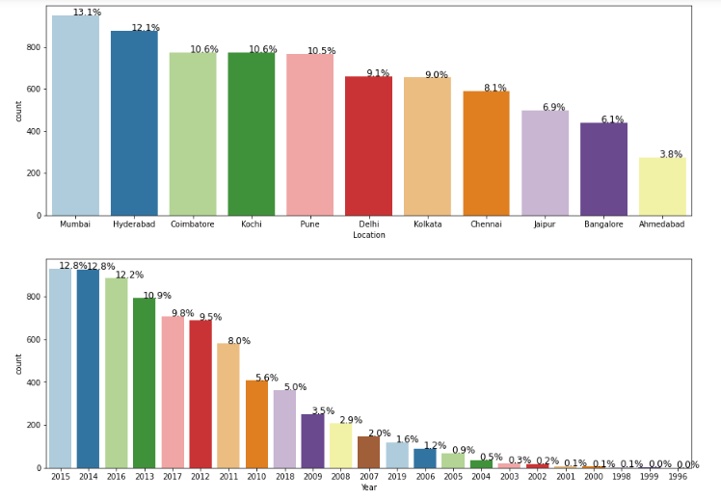
Univariate Data Analysis

Slide 9
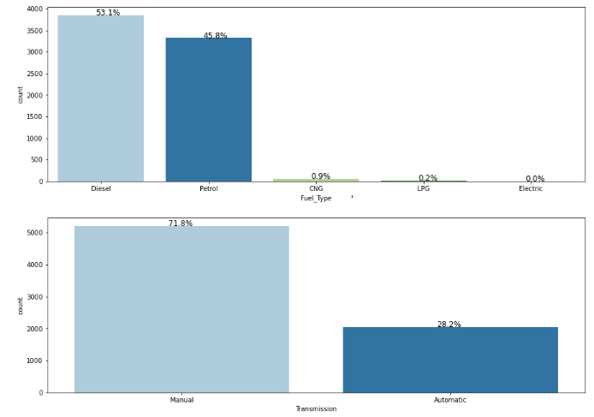

Slide 10
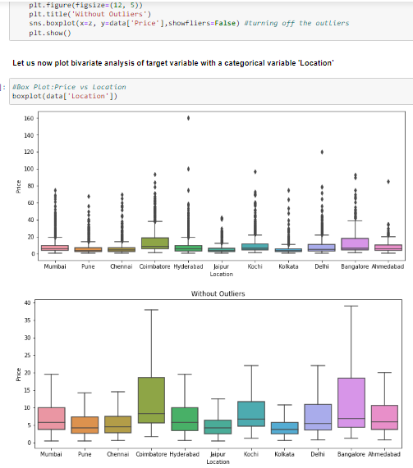
Bivariate Data Analysis

Slide 11
Linear Regression - Model Building
While building the regression model for Pricing, we will keep the following Key Questions in mind –
Does brand of a car have any effect on pricing of car?
Does Location in which the car being sold has any effect on the price?
How does type of Transmission effect pricing?
Do kilometers driven and year of manufacturing have negative correlation with price of the car?
How do the number of seats and fuel type effect the pricing?
How do Mileage, Engine and Power effect on the pricing of the car?
Do various predicating factors effect the price of the used car?
What all independent variables effect the pricing of used cars?

Slide 12
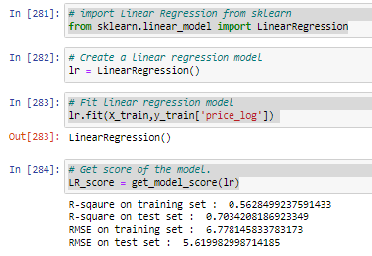
Linear Regression - Model Building
The following 4 types of Regression models were built and tested with training and test data -
Linear Regression
This Model is a good fit for the test data. RMSE for both of training and test data set are relatively small. From this model we found the following –

Slide 13
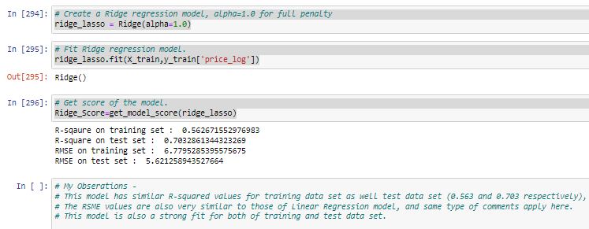
Linear Regression - Model Building
2) Ridge/Lasso

Slide 14
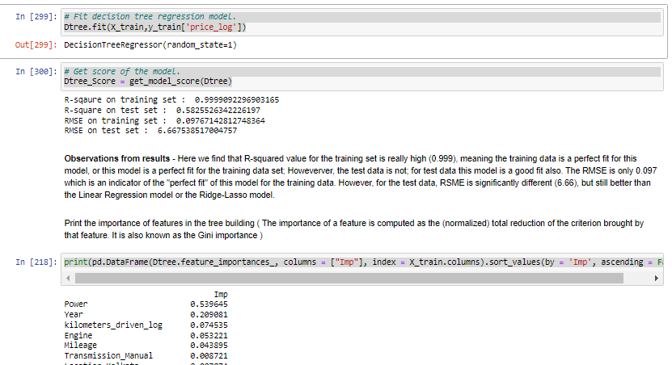
Linear Regression - Model Building
3) Decision Tree

Slide 15
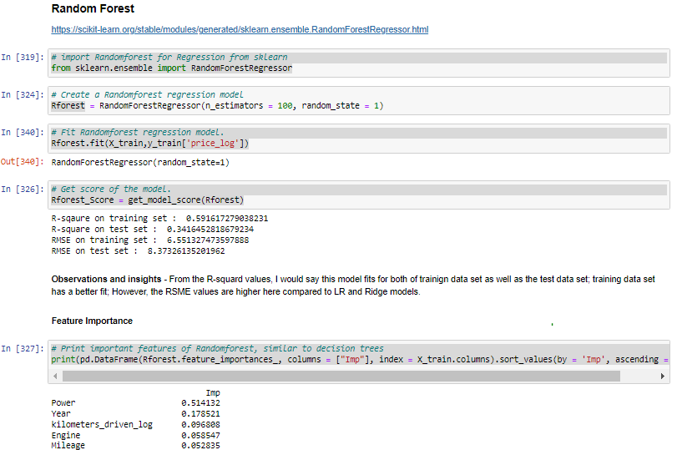
Linear Regression - Model Building
4) Random Forest

Slide 16
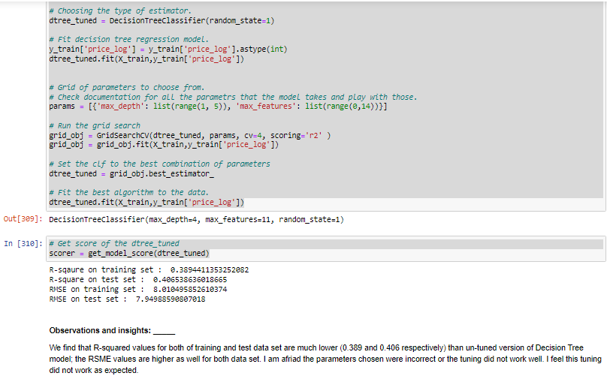
Linear Regression - Model Building
Hyperparameter Tuning: Decision Tree

Slide 17
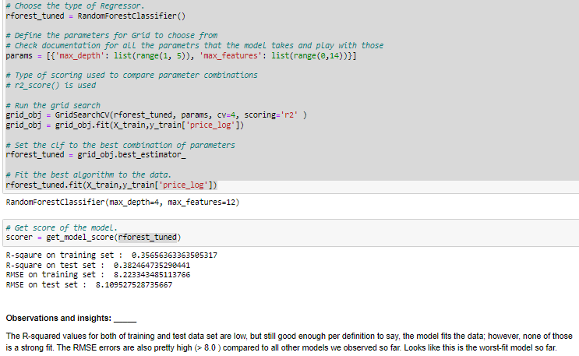
Linear Regression - Model Building
Hyperparameter Tuning: Random Forest

Slide 18



Conclusion
From the Regression Analysis, and scores of R-squared and RMSE, I found the Decision Tree Regressor to be the best one producing close to “Perfect Fit” to the given used car data for the Pricing Model. From the “Imp” feature factors pointed out by this model, I would recommend the following Linear Equation for the Pricing of the used car -
Price (of used car) = MSRP - MSRP* (weighted sum of Imp Factors)… I am still working on this part. Hopefully, I will get this done by EOD Saturday.

Slide 19




Thank you!
Mohammad Aleem
aleem53@yahoo.com

