Slide 1
Sequence Alignment Code Updates (Bioinformatics)
Transition from BCFtools (current lab protocol) to GATK (industry standard)
08 January 2026

Slide 2
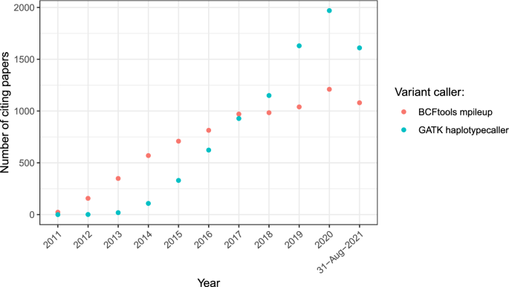
The number of papers citing 'mpileup' or 'HaplotypeCaller' (source: Google Scholar).¹
Increasingly, GATK is published as the bioinformatics tool of choice
1. Lefouili, M., Nam, K. The evaluation of Bcftools mpileup and GATK HaplotypeCaller for variant calling in non-human species. Sci Rep 12, 11331 (2022). https://doi.org/10.1038/s41598-022-15563-2

Slide 3
BCFTools (mpileup)
Current lab protocol
BCFtools¹ is a set of utilities that manipulate variant calls in the Variant Call Format (VCF)
First released in 20091, regularly updated since
Well documented and cited variant calling tool and method
1. Petr Danecek, James K Bonfield, Jennifer Liddle, John Marshall, Valeriu Ohan, Martin O Pollard, Andrew Whitwham, Thomas Keane, Shane A McCarthy, Robert M Davies, Heng Li, Twelve years of SAMtools and BCFtools, GigaScience, Volume 10, Issue 2, February 2021, giab008, https://doi-org.libproxy1.nus.edu.sg/10.1093/gigascience/giab008

Slide 4
GATK
The GATK¹⁻⁴ is the industry standard for identifying SNPs and indels in germline DNA and RNAseq data.
Readily available in NSCC
Well documented and cited variant calling tool and method
McKenna, A., Hanna, M., Banks, E., Sivachenko, A., Cibulskis, K., Kernytsky, A., Garimella, K., Altshuler, D., Gabriel, S., Daly, M., & DePristo, M. A. (2010). The Genome Analysis Toolkit: a MapReduce framework for analyzing next-generation DNA sequencing data. Genome research, 20(9), 1297–1303. https://doi.org/10.1101/gr.107524.110
DePristo, M., Banks, E., Poplin, R. et al. A framework for variation discovery and genotyping using next-generation DNA sequencing data. Nat Genet 43, 491–498 (2011). https://doi.org/10.1038/ng.806
Poplin R, Ruano-Rubio V, DePristo MA, Fennell TJ, Carneiro MO, Van der Auwera GA, Kling DE, Gauthier LD, Levy-Moonshine A, Roazen D, Shakir K, Thibault J, Chandran S, Whelan C, Lek M, Gabriel S, Daly MJ, Neale B, MacArthur DG, Banks E. (2017). Scaling accurate genetic variant discovery to tens of thousands of samples bioRxiv, 201178. DOI: 10.1101/201178
Van der Auwera GA & O'Connor BD. (2020). Genomics in the Cloud: Using Docker, GATK, and WDL in Terra (1st Edition). O'Reilly Media.

Slide 5
Variant Calling Methods
 | GATK | BCFtools mpileup
Pros | Highly sensitive, powerful for complex regions, including indels Industry standard Able to deal with n+1 problem# | Faster, simpler Unable to deal with n+1 problem#
Cons | Slower with high coverage | Latest publications do not use this
# n+1 problem: Refer to next slide

Slide 6
The N+1 problem in joint variant calling
Samples return in batches, cohort-level variant calling is always more accurate than batch level variant calling
However, cohort-level variant calling is computationally intensive
The N+1 problem: if 1 or more samples are added, must recall entire cohort!
BCFtools | GATK
Must recall entire cohort for every sample added! | Simply adds new samples into joint calling algorithm
Computationally heavy, does not scale well | Computationally efficient, scales better with large sample size
No efficient way of solving N+1 problem | Solves N+1 problem through joint calling probability algorithm
https://biohpc.cornell.edu/lab/doc/variant_workshop_part2.pdf
https://gatk.broadinstitute.org/hc/en-us/articles/360035890431-The-logic-of-joint-calling-for-germline-short-variants

Slide 7
Alignment Process (No change)
Raw Sequence Data (fastq)
Alignment / Read Mapping (BWA–MEM)
Alignment Post-processing (Samtools)
Variant Calling (next slide)

Slide 8
BCFtools
(current protocol)
Variant Calling Process
GATK
(new protocol)
Variant Calling (mpileup)
Variant Calling (call)
Extract SNPs (view)
Filter (plink)
Variant Calling (HaplotypeCaller)
Variant Calling (CombineGVCF)
Extract SNPs (GenotypeGVCFs)
Filter (plink)
Extract SNPs (SelectVariants)

Slide 9
Resource Allocation
Step | nCPU (Threads) | RAM (GB) | Time | SU (nCPU x Hours) | Job Type
BWA-MEM | 4 | 100 GB | ~2-5h (tbc) | 4 x 5 = 20 SU | Per sample (run parallel)
samtools sort | 4 | 100 GB
MarkDuplicates | 1 | 100 GB
HaplotypeCaller | 4 | 100 GB
GenomicsDBImport | 2 | 100 GB | ~12-24h (tbc) | 2 x 24 = 48 SU | Per batch
GenotypeGVCFs | 1 | 100 GB
SelectVariants | 1 | 100 GB | ~1-2h (tbc) | 2 SU | Per batch
VariantFiltration | 1 | 100 GB
bcftools view | 1 | 100 GB
Total Resources per batch = 64 x (number of samples) + 48 + 2

Slide 10
Variant Call hard filtering
Based on GATK’s Best Practices recommendation.
QD < 2.0 (Quality by Depth – Variant confidence)
FS > 60.0 (Fisher strand bias)
MQ < 40.0 (Mapping quality – detect misaligment)
SOR > 3.0 (Strand Odds Ratio – Strand bias)
MQRankSum < -12.5 (Mapping quality)
ReadPosRankSum < -8.0 (Read position on strand)
*Further MAF and Missingness filtering to be conducted as per usual

Slide 11
Helpful resources
https://ngs101.com/how-to-analyze-whole-genome-sequencing-data-for-absolute-beginners-part-1-from-raw-reads-to-high-quality-variants-using-gatk/
https://gatk.broadinstitute.org/hc/en-us/articles/360035535912-Data-pre-processing-for-variant-discovery
https://gatk.broadinstitute.org/hc/en-us/articles/360035535932-Germline-short-variant-discovery-SNPs-Indels
https://gatk.broadinstitute.org/hc/en-us/articles/360035890431-The-logic-of-joint-calling-for-germline-short-variants
https://hpc.nih.gov/training/gatk_tutorial/

