Slide 1
Domain-Adapted Retrieval
for Clinical-Note RAG
Does improved retrieval produce more faithful generated answers
when the generator is held constant?
[Name 1] · [Name 2] · [Name 3]
University of California San Diego
Applied Artificial Intelligence — Module 7 Capstone Project
August 2026
Notes:
[SPEAKER 1 — 0:00-0:20] Good afternoon. We're presenting a domain adaptation study on the retrieval component of a clinical retrieval-augmented generation system. The one-sentence version: retrieval models are almost always evaluated on retrieval metrics alone. We asked whether those gains survive downstream — whether a better retriever produces a more trustworthy generated answer — with the generator deliberately frozen so it cannot account for any difference.

Slide 2
OVERVIEW
Presentation Outline
1
Introduction
Problem statement and research hypothesis
Speaker 1
2
Data and Exploratory Analysis
Dataset, corpus characteristics, quality assessment, partitioning
Speaker 1
3
Methodology
Bi-encoder fine-tuning and cross-encoder reranking
Speaker 2
4
Evaluation Design
Configuration matrix, test tiers, metrics
Speaker 3
5
Results
Retrieval performance and faithfulness evaluation
Speaker 3
6
Discussion
Limitations and threats to validity
Speaker 3
7
Conclusion
Findings and future work
Speaker 3
2 / 23
Notes:
[SPEAKER 1 — 0:20-0:35] Briefly, the structure. I'll cover the introduction and the data — that's sections one and two, including the quality problems we had to solve before any training could happen. [Name 2] takes methodology, sections three, and [Name 3] takes evaluation design, results, and our limitations.

Slide 3
1. INTRODUCTION
SPEAKER 1
Problem Statement and Motivation
Our enterprise RAG system (Lyra) retrieves over clinical documentation — discharge summaries, case reports, narrative notes.
Clinical text is dense with abbreviations and named instruments that carry no meaning in general-purpose embedding space.
A model trained on web text has no representation for these terms, so lexical near-misses dominate dense retrieval.
Users are clinical support and knowledge-management staff — a wrong passage becomes a confidently wrong answer.
Vocabulary the base model has never meaningfully seen
TEVAR
thoracic endovascular aortic repair
NIHSS
stroke severity scale
Clavien–Dindo
surgical complication grade
Nurick scale
myelopathy disability grade
Mechanism → this is exactly what a fine-tune can fix, and it is directly observable in error analysis.
3 / 23
Notes:
[SPEAKER 1 — 0:35-1:10] Here's the concrete failure mode. Our production system retrieves over clinical documentation. That text is full of abbreviations and named instruments — TEVAR, NIHSS, Clavien-Dindo grades, the Nurick scale. An embedding model trained on general web text has no real representation for these. It falls back on surface-level lexical similarity, so it retrieves passages that look alike rather than passages that mean the same thing. That matters because our users are clinical support staff. A near-miss passage doesn't produce a blank answer — it produces a confident, wrong one. This is a mechanism we can test, not just assert. We'll come back to it in error analysis.

Slide 4
1. INTRODUCTION
SPEAKER 1
Research Hypothesis
1
Retrieval improves
2
Trust improves with it
Domain adaptation lifts Recall@k, MRR and nDCG@10 over a stock bi-encoder, with a trained reranker adding further gain.
That retrieval gain propagates to answer faithfulness — even though the generator is frozen and the prompt is byte-identical across every configuration.
Table stakes. We expect this to replicate prior work.
This is the contribution. Only the retrieved context differs.
Freezing the generator is the whole design: if faithfulness moves, retrieval is the only thing that could have moved it.
4 / 23
Notes:
[SPEAKER 1 — 1:10-1:40] Two parts. Part one is table stakes: fine-tuning on in-domain data should improve retrieval metrics. Prior work says it does, and we'd be worried if it didn't. Part two is the actual contribution. Does that gain survive the trip downstream into answer quality? The design point that makes this answerable is that we freeze the generator — gemma4, same weights, same prompt template byte-for-byte, same decoding parameters, same query subset across every configuration. The only variable in the entire system is which passages get retrieved. So if faithfulness moves, retrieval is the only thing that could have moved it.

Slide 5
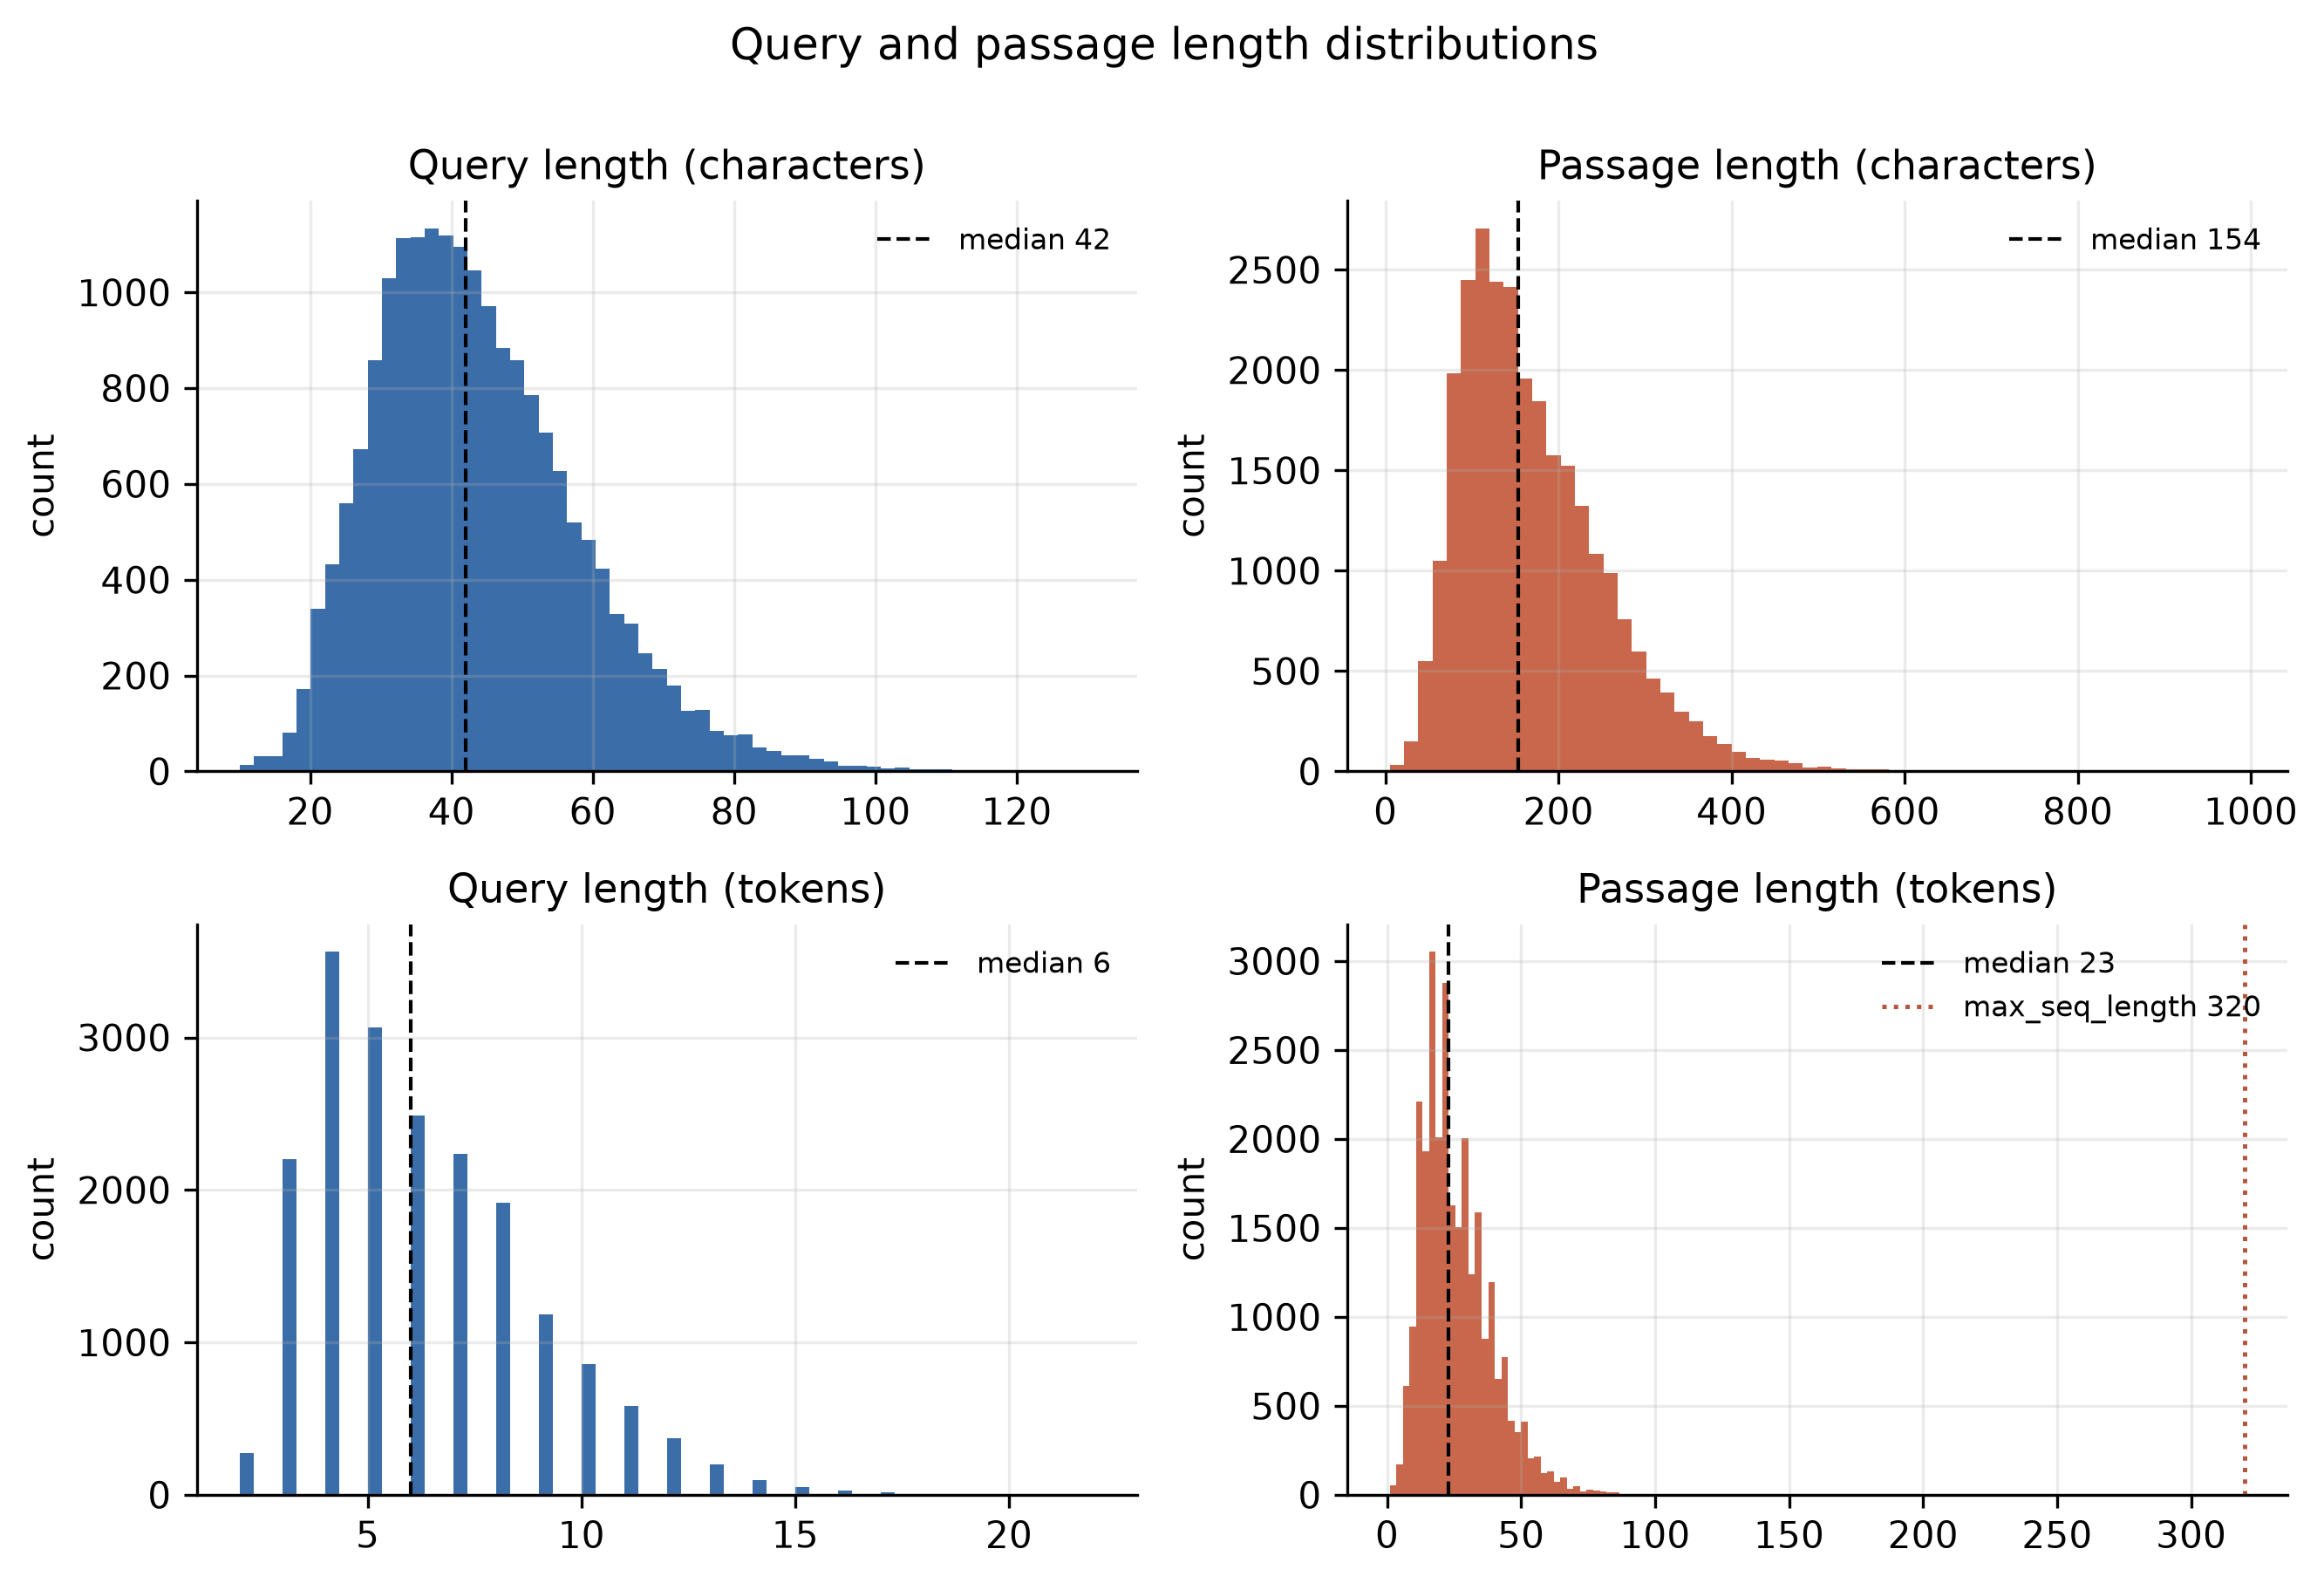
2. DATA AND EXPLORATORY ANALYSIS
SPEAKER 1
Data Source and Scale
21,689
27,590
232,684
unique queries
corpus passages
triplet rows
The effective dataset is ~21.7k queries — not 230k independent examples. Every figure we report uses the unique-query count.
abhinand/MedEmbed-training-triplets-v1 — Apache 2.0
Generated by LLaMA 3.1 70B over PMC clinical notes
Median query 6 tokens; median passage 23 tokens
~10.7 negatives per query before filtering
Passages sit far below the 320-token cap — the tail never reaches it.
Capping max_seq_length at 320 rather than 8192 spends the freed memory on batch size instead, which is what contrastive training actually needs.
5 / 23
Notes:
[SPEAKER 1 — 1:40-2:10] Our data is the MedEmbed triplet set — Apache 2.0, generated by LLaMA 3.1 70B over PubMed Central clinical notes. One correction we had to make to our own early draft: the headline number is 232,000 triplet rows, but those collapse to 21,689 unique queries against 27,590 passages. Every number we report uses the unique-query count, because treating triplets as independent examples would overstate our dataset by an order of magnitude. The length plots drove a real engineering decision. Median passage is 23 tokens, and the tail dies well before our 320-token cap — so the base model's 8192-token window is almost entirely wasted memory. We spent that memory on batch size instead, which is what contrastive training actually needs.

Slide 6
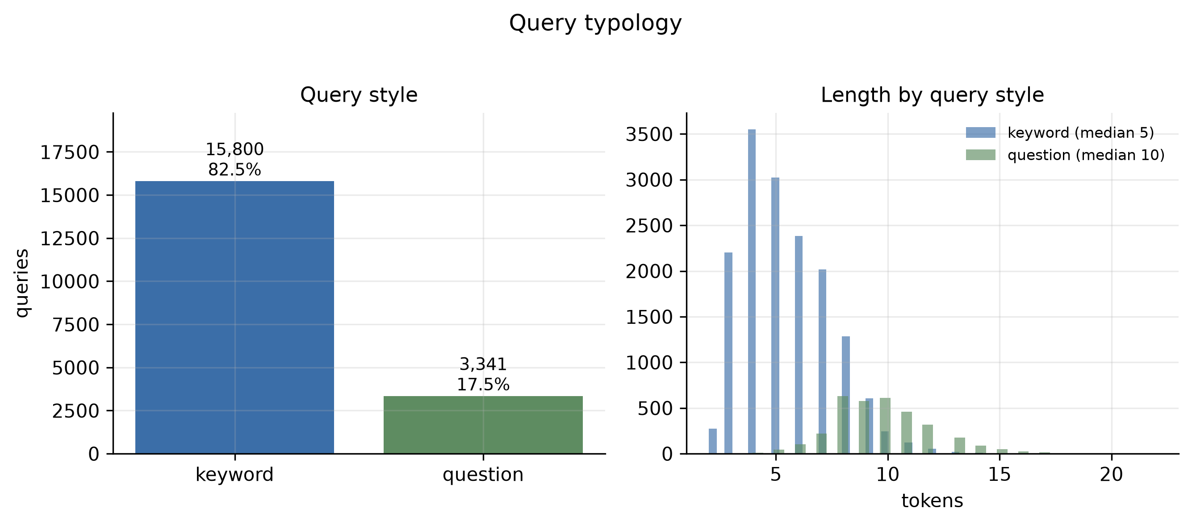
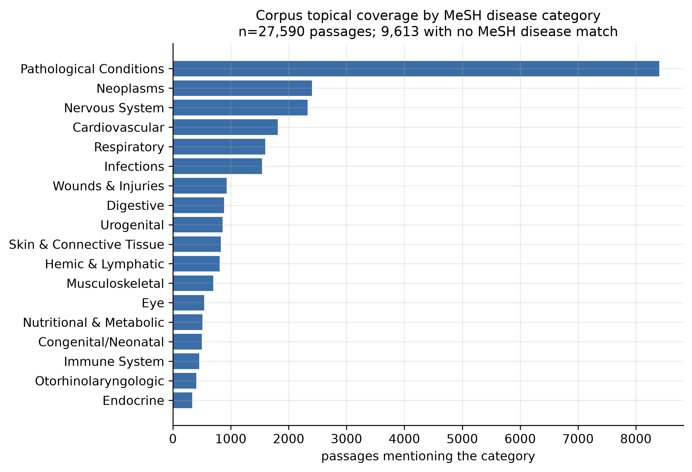
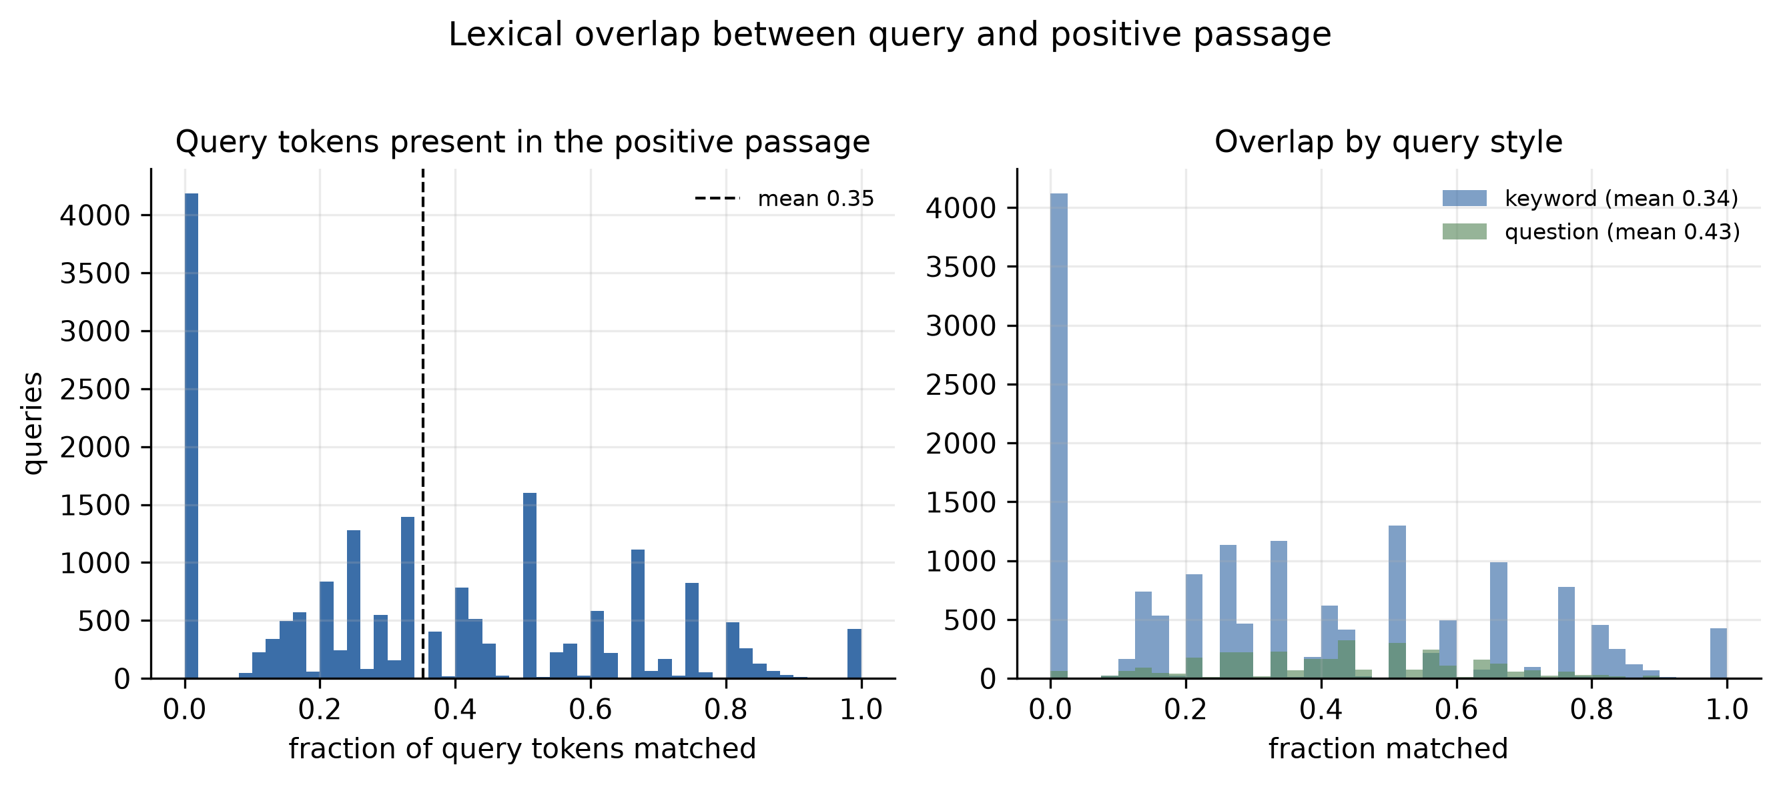
2. DATA AND EXPLORATORY ANALYSIS
SPEAKER 1
Corpus and Query Characteristics
Broad coverage, but 9,613 passages match no MeSH disease category at all — a vocabulary-coverage ceiling, not a gap in the corpus.
6 / 23
Notes:
[SPEAKER 1 — 2:10-2:40] Two things here that shaped how we read every later baseline. Top left: this is not a natural-question dataset. Four out of five queries are keyword-style — "thyroid nodule symptoms" — with a median of five tokens. That's much closer to how our actual users search than a well-formed question benchmark would be. Bottom left is the one I'd flag. This is how much of each query's vocabulary literally appears in its own gold passage. The mean is only a third — and that tall bar at zero is roughly four thousand queries that share no tokens at all with the passage they're supposed to retrieve. BM25 structurally cannot find those. That's the honest case for a dense retriever, and it's why BM25 is in our table as a real competitor rather than a straw man. On the right, corpus coverage is broad across body systems, which matters for claiming this generalizes within clinical text.

Slide 7
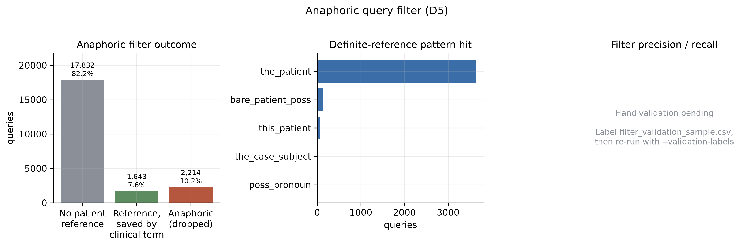
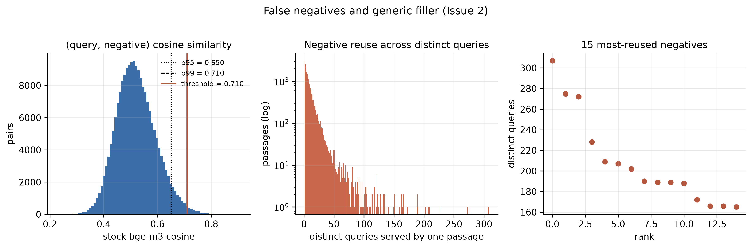
2. DATA AND EXPLORATORY ANALYSIS
SPEAKER 1
Data Quality Assessment
1
2
3
Anaphoric queries
False negatives
Degenerate positives
“What was the outcome of the patient’s treatment?” has no unique correct answer — thousands of near-identical queries point at different passages.
Generic passages recur as negatives across unrelated queries. One passage serves 307 distinct queries. Some are as relevant as their paired positive.
Near-contentless retrieval targets — “Nurick scale 1.” — are unusable as gold passages.
2,214 dropped (10.2%) · 1,643 saved by the clinical-entity clause
1,962 pairs dropped at cosine 0.71 (0.99%)
Filtered on minimum token count
19,141 queries survive filtering — 88.2% of the raw set, and well clear of the 8,000-query floor we set in advance as an abort threshold.
7 / 23
Notes:
[SPEAKER 1 — 2:40-3:20] Three defects, and all three would have degraded training silently. First, anaphoric queries — "what was the outcome of the patient's treatment?" No unique correct answer, so it's noise in training and invalid as an eval item. That's 2,214 queries dropped. The number I'd point at is the green bar: 1,643 queries do mention the patient but also name a clinical entity, so the second clause of our rule keeps them. Without that clause we'd have thrown away "what was the patient's NIHSS score?", which is perfectly retrievable. Second, false negatives. The middle plot is reuse — a single generic passage serves 307 distinct queries. That's filler, not a negative. Third, degenerate positives with essentially no content. One thing to be straight about: the precision and recall panel on the left is still blank. Our hand validation is a hundred labels we have sampled but not yet finished, and until it is done we are reporting the filter's removal rate without its error rate. That is an open item, not a finished result.

Slide 8
2. DATA AND EXPLORATORY ANALYSIS
SPEAKER 1
Threshold Selection Methodology
198,257 (query, negative) pairs scored with the stock encoder. The histogram is smooth and unimodal — no elbow to cut on — so we read samples banded by similarity. p95 sits at 0.650; we cut at p99.
0.71
Similarity band | What is actually in it
0.62 – 0.66 | Mixed — genuine false negatives and fair negatives
0.70 – 0.74 | Near-uniformly generic follow-up boilerplate
0.78 + | Unambiguous false negatives
chosen threshold (p99)
1,962 pairs dropped (0.99%)
766 queries affected
10.36 → 10.26 negatives/query
Recorded in config, not hardcoded
Worst case at 0.910: a query asking why the patient was advised to follow up with her primary care physician, paired against a “negative” saying she was advised to follow up with her primary care provider.
Honest caveat we report: this filter's recall is limited. A plainly relevant heart-failure / polyneuropathy pair scores only 0.633 — mid-distribution. Cosine separates generic from specific better than relevant from irrelevant.
8 / 23
Notes:
[SPEAKER 1 — 3:20-3:55] This is the part I'd want a technical reviewer to push on, so let me pre-empt it. We scored all 198,000 query-negative pairs with the stock encoder. The distribution is smooth and unimodal — there's no natural elbow to cut on. So rather than pick a round number, we read actual samples banded by similarity. Below about 0.66 you get a genuine mix. Between 0.70 and 0.74 it's almost entirely generic follow-up boilerplate. Above 0.78 it's unambiguous — the worst pair we found scores 0.910, where the "negative" is a near-paraphrase of the query itself. We set the threshold at 0.71. It drops one percent of pairs. And we report the limitation: this filter's recall is poor. A clearly relevant pair scores 0.633, sitting mid-distribution. Cosine similarity separates generic from specific much better than it separates relevant from irrelevant — which is why we report the reuse statistic alongside it.

Slide 9
2. DATA AND EXPLORATORY ANALYSIS
SPEAKER 1
Partitioning and Leakage Control
27,590 passages
Each query inherits
Negatives sanitized
partitioned 80 / 10 / 10
the partition of its gold passage
30,217 removed and re-mined
No test-partition passage is ever seen in training — in any role, positive or negative.
Re-mining is capped at the same 0.71 threshold, or top-k mining would silently reinstate the false negatives we just removed.
audit_leakage raises rather than warns; it runs in the build script and again in pytest against the written artifacts.
The near-duplicate problem
Paraphrased queries straddling splits are leakage too. Cut set at 0.95 cosine — lower than intuition suggests, because one query matches its own lowercase form at only 0.934.
503 pairs flagged · resolved by precedence: test > val > train · zero test queries dropped, by construction
At evaluation, the full 27,590-passage corpus is indexed for every configuration — identical distractor pool across the entire results table.
9 / 23
Notes:
[SPEAKER 1 — 3:55-4:25] Briefly on experimental hygiene, because everything downstream depends on it. We partition passages — not queries — 80/10/10, and each query inherits the partition of its gold passage. Then we strip every training negative that points into validation or test and re-mine replacements from train only. That re-mining is capped at the same 0.71 threshold, because top-k mining is exactly where false negatives live and we'd have quietly reintroduced what we just removed. The subtle one is near-duplicates. A paraphrased query straddling splits is leakage. We set that cut at 0.95, which is lower than intuition suggests — one of our queries matches its own lowercase form at only 0.934, because these queries are short and casing moves the embedding. The audit raises an exception rather than warning, and it runs both in the build and in tests. Over to [Name 2].

Slide 10
SECTION 3
Methodology
Two trained components: a domain-adapted bi-encoder and a cross-encoder reranker
10 / 23
Notes:
[SPEAKER 2 — 4:25-4:35] Thanks. I'll walk through the system and the two models we trained.

Slide 11
3. METHODOLOGY
SPEAKER 2
System Architecture
Query
Dense retrieval
Rerank
Top-k context
gemma4
Answer
clinical staff
Milvus · 1024-d COSINE
cross-encoder · top 30–50
identical k everywhere
FROZEN
BM25 lexical baseline (CPU)
NLI judge → faithfulness
trained by us
frozen
unchanged infrastructure
Output dimension and the COSINE metric are unchanged, so the fine-tuned model drops into the existing production collection contract. Reranking sits inside the access filter, so isolation guarantees are untouched. Training is fully offline and never contends with the serving GPU.
11 / 23
Notes:
[SPEAKER 2 — 4:35-5:15] This is the pipeline. Teal is what we trained, dark is frozen, white is existing infrastructure we didn't touch. A query hits dense retrieval against a Milvus collection — 1024 dimensions, cosine. Top candidates go to a cross-encoder reranker. The surviving top-k becomes context for gemma4, which is frozen. BM25 runs alongside as a lexical baseline, and the NLI judge scores the output. Two engineering points a VP of Engineering would ask about. First, we kept the output dimension and the distance metric identical, so the fine-tuned model drops straight into the existing production collection contract — no migration. Second, reranking sits inside the access-control filter, so our tenant isolation guarantees are untouched. Training is entirely offline. It never contends with the serving GPU.

Slide 12
3. METHODOLOGY
SPEAKER 2
Experiment A: Bi-Encoder Fine-Tuning
Base model | BAAI/bge-m3 — XLM-R-large scale, ~568M params, 1024-d
Objective | CachedMultipleNegativesRankingLoss (GradCache)
Batch | Effective 256+, mini-batch sized to fit the card
Sequence length | 320 tokens — passages cap at 993 chars
Precision | bf16, gradient checkpointing on
Selection | Best checkpoint by val nDCG@10 — never final-epoch loss
PASTE FIGURE
training_curve_biencoder.png
Loss + val nDCG@10 vs. steps
Rationale for the cached loss: in-batch negatives are the dominant training signal for contrastive retrieval, and caching is what buys an effective batch of 256+ at this model scale.
Embedding dimension is asserted at load by probing a test embedding — never hardcoded.
12 / 23
Notes:
[SPEAKER 2 — 5:15-5:50] Experiment A is the retriever itself. We fine-tune bge-m3 — about 568 million parameters — using a cached multiple-negatives ranking loss. The caching matters more than it sounds. For contrastive retrieval training, in-batch negatives are the dominant signal, so batch size drives quality. GradCache lets our effective batch reach 256 and beyond while the physical mini-batch stays small enough to fit in memory. We cap sequence length at 320 tokens rather than the model's 8192, because our passages top out under a thousand characters — the rest is wasted memory we can spend on batch size instead. And we select the best checkpoint by validation nDCG@10, never by final-epoch loss. Contrastive loss keeps dropping well past the point where retrieval quality stops improving.

Slide 13
3. METHODOLOGY
SPEAKER 2
Hyperparameter Optimization
At ~21.7k queries an epoch is a few hundred steps — minutes, not hours. That headroom bought a full grid rather than a single lucky configuration.
Learning rate
1e-5, 2e-5
PASTE FIGURE
Epochs
1, 2, 3
sweep_results.png
val nDCG@10 across the grid
Hard negatives / query
4, 8
Selection metric
val nDCG@10
PASTE: best configuration + its margin over the worst
Seeds logged in every run manifest alongside the config snapshot and git SHA; sweeps vary the seed deliberately and record it.
13 / 23
Notes:
[SPEAKER 2 — 5:50-6:20] A note on optimization, since a reviewer will ask whether we just got lucky. Because the dataset is small, an epoch is a few hundred steps — minutes per run. So there was no excuse for a single configuration. We swept learning rate, epoch count, and the number of hard negatives per query, selecting on validation nDCG@10. [PASTE the actual best config and the spread here — state the winner, and state how much it beat the worst configuration by. If the spread is small, say so; that's a legitimate and useful finding.] Every run writes a manifest with its config snapshot, git SHA, and seed, so any number in the paper traces back to the run that produced it.

Slide 14
3. METHODOLOGY
SPEAKER 2
Experiment B: Cross-Encoder Reranker
Fine-tuned retriever
Top 30–50 results
Non-positives = negatives
Cross-encoder
from Experiment A
over the train split
~8 per positive
bge-reranker-v2-m3, BCE
We deliberately do not reuse the dataset's shipped negatives. A reranker only ever sees passages the retriever already ranked highly — so training it on easy negatives teaches it a decision boundary it will never encounter at inference.
Binary cross-entropy on (query, passage) relevance
1–2 epochs with aggressive early stopping on val nDCG@10
Cross-encoders converge fast and overfit faster
PASTE FIGURE
training_curve_reranker.png
Val nDCG@10 — note the turnover point
14 / 23
Notes:
[SPEAKER 2 — 6:20-6:55] Experiment B is the reranker, and the interesting decision here is where its training negatives come from. We deliberately throw away the negatives shipped with the dataset. Instead we run our fine-tuned retriever over the training split, take its top 30 to 50 results, and use the non-positives as negatives. The reason is that a reranker never sees a random passage. It only ever sees passages the retriever already ranked highly. If you train it on easy negatives, you've taught it a decision boundary it will never actually encounter — and you'd measure a gain that evaporates in production. Cross-encoders converge fast and overfit faster, so we early-stop aggressively on validation nDCG@10 — mid-epoch if it turns over. [Name 3] will tell you whether any of this worked.

Slide 15
SECTIONS 4 – 5
Evaluation and Results
Six configurations, two tiers, and one metric that could invalidate all of it
15 / 23
Notes:
[SPEAKER 3 — 6:55-7:05] Thanks. Now the part that decides whether any of this was worth doing.

Slide 16
4. EVALUATION DESIGN
SPEAKER 3
Configuration Matrix and Metrics
# | Retriever | Reranker | What it isolates
1 | BM25 | — | Lexical reference — may beat config 2
2 | Stock bge-m3 | — | Primary baseline
3 | MedEmbed-large-v0.1 | — | Prior art on the same training data
4 | Fine-tuned bge-m3 | — | Experiment A: does adaptation help?
5 | Fine-tuned bge-m3 | Stock reranker | The ablation — does reranking alone explain it?
6 | Fine-tuned bge-m3 | Fine-tuned reranker | Experiment B: the full system
Two tiers
Metrics
Tier 1 — held-out clinical test partition, full 27,590-passage index.
Tier 2 — NFCorpus: out-of-domain transfer check, genuinely external.
Recall@1/5/10, MRR, nDCG@10 — plus a paired bootstrap over per-query
scores between adjacent configurations, so we don't over-read small deltas.
16 / 23
Notes:
[SPEAKER 3 — 7:05-7:40] Six configurations, and each one exists to isolate a single variable. Config 1 is BM25 — a lexical baseline that on clinical text may well beat a stock neural retriever, and if it does we report that. Config 2 is the stock model, our primary baseline. Config 3 is MedEmbed, prior art trained on this same data — that's our sanity check that the pipeline works. Config 4 is Experiment A on its own. Config 6 is the full system. Config 5 is the one I'd point a reviewer at: fine-tuned retriever with an off-the-shelf reranker. Without it, we could never say whether training the reranker bought us anything, or whether any reranker would have done. Everything is measured on the full corpus so the distractor pool is identical, and adjacent configs are compared with a paired bootstrap.

Slide 17
5. RESULTS
SPEAKER 3
Retrieval Performance: In-Domain (Tier 1)
Configuration | R@1 | R@5 | R@10 | MRR | nDCG@10 | p (paired bootstrap)
1 · BM25 | — | — | — | — | — | —
2 · Stock bge-m3 | — | — | — | — | — | —
3 · MedEmbed-large | — | — | — | — | — | —
4 · Fine-tuned bge-m3 | — | — | — | — | — | —
5 · FT + stock reranker | — | — | — | — | — | —
6 · FT + FT reranker | — | — | — | — | — | —
PASTE FIGURE
tier1_retrieval.png
nDCG@10 by configuration
PASTE: the three-sentence read of this table — where the fine-tune lands relative to BM25 and MedEmbed, what config 5 → 6 buys, and which deltas survive the bootstrap.
17 / 23
Notes:
[SPEAKER 3 — 7:40-8:20] Tier 1 — in-domain retrieval, on the held-out test partition against the full corpus. [PASTE the actual reading here. Structure it as three claims: 1. Where the fine-tune lands relative to the two reference points — BM25 and MedEmbed. Landing near MedEmbed validates the pipeline; it isn't a competition and we shouldn't frame it as one. 2. What config 5 to 6 buys — this is the number that justifies having trained a reranker at all. If it's marginal, say so plainly. 3. Which deltas survive the paired bootstrap. Any delta that doesn't clear significance gets described as a wash, not as a small win.] Two guardrails we set before seeing numbers: BM25 beating the stock neural model is expected and reportable, and the fine-tune landing near MedEmbed validates the pipeline rather than losing a race.

Slide 18
5. RESULTS
SPEAKER 3
Out-of-Domain Transfer (Tier 2)
NFCorpus: 3,633 documents, 323 test queries — abstract-level consumer health, a genuine genre shift.
Graded relevance preserved, not binarized — nDCG needs the grades.
Same six configurations, same metrics, so the two tiers read side by side.
PASTE FIGURE
tier2_nfcorpus.png
NFCorpus — same six configurations
Either answer is a legitimate result
A smaller Tier 2 gain is the honest transfer story, not a failure. We state the gap rather than burying it.
PASTE: one line on the size of the Tier 1 → Tier 2 gap, and whether adaptation cost any general retrieval ability.
18 / 23
Notes:
[SPEAKER 3 — 8:20-8:50] Tier 2 asks a question we could have avoided: does clinical-note adaptation transfer to a different medical genre, or did we just make a narrow model? NFCorpus is abstract-level consumer health — 3,600 documents, 323 test queries. Different register, different vocabulary, genuinely external. [PASTE the result and the size of the gap.] We decided in advance that either answer is publishable. A smaller gain out of domain is the honest transfer story. What would be dishonest is reporting only the in-domain number and letting a reader assume it generalizes.

Slide 19
5. RESULTS
SPEAKER 3
Faithfulness Measurement: The Abstention Confound
A model that answers “the context does not contain this” is trivially 100% faithful. Faithfulness without abstention is a null result in disguise.
Abstention DOWN + faithfulness UP
Abstention UP + faithfulness UP
The model answers more often AND grounds more of what it says. Clean causal story — retrieval improved the answer.
The model just refused more often. Faithfulness rose because it said less, not because it retrieved better.
The claim holds.
A null result wearing a disguise — and we report it as one.
We tracked abstention from the very first run. Discovering this in week eight would have been a project-level failure.
19 / 23
Notes:
[SPEAKER 3 — 8:50-9:25] Before I show faithfulness numbers, I want to be upfront about the trap in this metric, because it's the thing that could have invalidated our headline claim. Faithfulness is the fraction of generated claims entailed by the retrieved context. But a model that says "the context doesn't contain this" is trivially 100% faithful. It said nothing, so nothing was ungrounded. So there are two readings. If abstention goes down while faithfulness goes up, the model is answering more often and grounding more of what it says — that's a clean causal story. But if abstention goes up while faithfulness goes up, we haven't improved anything; the model just got more evasive. We tracked abstention from the first run rather than discovering it at the end. That decision is the difference between a result and an artifact.

Slide 20
5. RESULTS
SPEAKER 3
Faithfulness Evaluation Results
Configuration | Faithfulness | Answer relevance | Context precision | Abstention rate
2 · Stock bge-m3 (baseline) | — | — | — | —
4 · Fine-tuned bge-m3 | — | — | — | —
6 · Full system | — | — | — | —
PASTE FIGURE
The judge, validated
faithfulness_by_config.png
DeBERTa-v3-large MNLI class, not an LLM — the generator never judges itself. Entailment threshold validated against hand-labelled claim/context pairs; Cohen's kappa reported.
Four metrics per configuration
PASTE: which direction abstention moved, and therefore which of the two readings from the previous slide applies. State it plainly either way.
300–500 test queries per configuration per tier; identical query IDs across all six, asserted on set equality.
20 / 23
Notes:
[SPEAKER 3 — 9:25-10:00] Here's the faithfulness suite. Four metrics, and abstention is deliberately in the rightmost column highlighted, because it's the one that decides how to read the other three. On the judge: we use a DeBERTa MNLI model, not an LLM. That's a deliberate choice — using an LLM to score LLM output means the generator effectively grades its own homework. We validated the entailment threshold against hand-labelled pairs and report Cohen's kappa, because an unvalidated judge cannot carry a headline claim and a reviewer will go straight there. [PASTE the result. Critically: say which direction abstention moved, and name which of the two readings applies. If it's the null-in-disguise case, say so directly — that's still a finding, and hiding it would be the actual failure.]

Slide 21
5. RESULTS
SPEAKER 3
Central Hypothesis: Retrieval Gain vs. Faithfulness Gain
Representative case
QUERY
PASTE: an abbreviation-bearing query from error analysis (TEVAR / NIHSS / Clavien–Dindo / Nurick)
PASTE FIGURE
STOCK RETRIEVER RETURNED
gain_scatter.png
PASTE: the lexical near-miss passage — and the ungrounded answer it produced
Retrieval gain (x) vs. faithfulness gain (y), per configuration
FINE-TUNED RETRIEVER RETURNED
PASTE: the correct passage — and the grounded answer from the same frozen generator, same prompt
Every configuration is a point. If the relationship is flat, retrieval improvements are not reaching the user.
Same model. Same prompt. Same decoding parameters. Only the retrieved context changed.
21 / 23
Notes:
[SPEAKER 3 — 10:00-10:40] This scatter is the plot the whole project points at. Each configuration is a point: retrieval gain on one axis, faithfulness gain on the other. If that relationship is flat, then retrieval improvements are real but they aren't reaching the user — which would itself be worth knowing. [PASTE the reading of the scatter.] On the right is a concrete case, which is what makes the mechanism legible. [PASTE a real example from error analysis.] The stock retriever returns a lexical near-miss on an abbreviation it has no representation for, and the generator confidently answers from the wrong passage. The fine-tuned retriever returns the right one, and the same frozen model — identical prompt, identical decoding — produces a grounded answer. That's the whole thesis in one example.

Slide 22
6. DISCUSSION
SPEAKER 3
Limitations and Threats to Validity
1
Filter recall is bounded
The false-negative filter catches generic filler well and genuinely relevant pairs poorly. Cosine similarity separates generic from specific better than relevant from irrelevant.
2
Some test queries have a second valid answer
Near-duplicate queries straddling splits point at different passages by construction, so scoring counts a legitimate hit as a miss. This depresses absolute recall equally for every configuration — the comparison holds, the absolute numbers read low.
3
Synthetic queries, real passages
Queries were generated by LLaMA 3.1 70B, not written by clinicians. The passages are real clinical text; the information needs are modelled.
4
One judge, one threshold
Faithfulness rests on a single NLI model at a validated threshold. We report kappa against human labels so the reader can discount accordingly.
22 / 23
Notes:
[SPEAKER 3 — 10:40-11:10] Four limitations we'd rather state than have found. Our false-negative filter has good precision and poor recall. Second, and this one is subtle: because near-duplicate queries straddling splits point at different gold passages, some test queries almost certainly have a second valid answer that our scoring counts as a miss. That understates absolute recall — equally for every configuration, so the comparison is safe, but the absolute numbers should be read as a floor. Third, our queries are synthetic. The passages are real clinical text, but the information needs were modelled by a language model, not written by clinicians. Fourth, faithfulness rests on one judge at one threshold. We report the agreement statistic so you can discount it appropriately.

Slide 23
7. CONCLUSION
Conclusions and Future Work
1
Retrieval gain is the easy half
Domain adaptation improves in-domain retrieval, and we can point at the abbreviations where it happens.
2
The downstream question is the interesting one
Whether that gain reaches the user is a separate empirical question, and abstention is what decides how to read the answer.
3
Thresholds belong to the data
Every cut we made — 0.71, 0.95, minimum token count — was read off distributions, and every one is recorded in config and reproducible from a manifest.
4
It drops into production unchanged
Same dimension, same metric, same collection contract, reranking inside the access filter.
Thank you — questions welcome
23 / 23
Notes:
[SPEAKER 3 — 11:10-11:40] To close. Improving retrieval on domain text is the easy half, and we can point to the specific vocabulary where the gain comes from. Whether that gain reaches the person reading the answer is a genuinely separate question, and we built the experiment so that abstention tells us whether we're looking at a real effect or an evasive model. Everything we cut, we cut on evidence from the distribution rather than a round number, and every figure traces back to a run manifest with its config and git SHA. And the whole thing drops into the existing production system without a migration — same dimension, same metric, same collection contract. Thank you. Happy to take questions.

