Slide 1

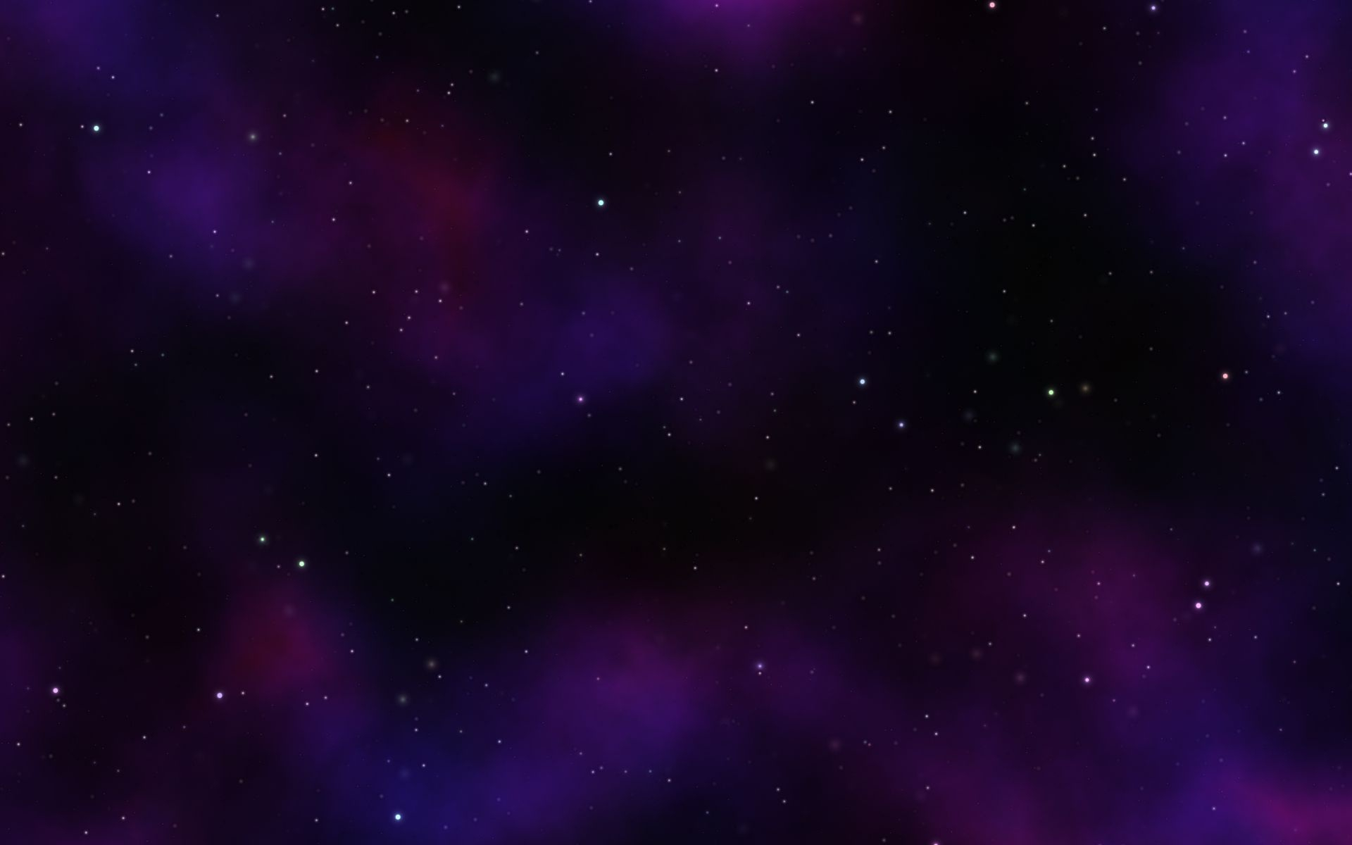



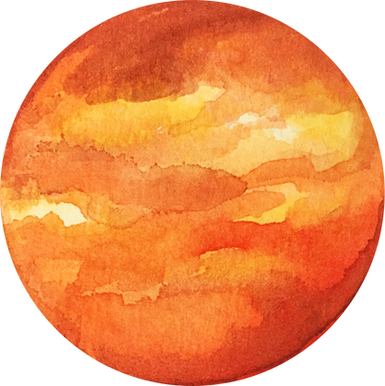
Borcelle
SPACE BIOLOGY KNOWLEDGE SEARCH ENGINE
www.reallygreatsite.com

Slide 2


Borcelle
PROJECT AIM
The Space Biology Knowledge Search Engine is designed to provide accessible, comprehensive exploration of NASA’s space biology research. It integrates data from multiple NASA Open Science Data Repositories into a centralized platform for Spaceflight Life Investigations (SLIs). Using AI-powered summarization with Google’s Gemini, the system delivers clear, grounded explanations of complex studies, helping users understand how microgravity, radiation, and other spaceflight factors affect living organisms—from microbes to humans.
Key features include categorized search filters, detailed metadata tagging, and intuitive navigation, allowing users to find studies by species, research field, or experimental procedure. The repository encompasses data from over 500 biological experiments, covering microbial behavior, plant growth, and human health in space.
Additionally, the platform supports bioinformatics analyses, including molecular pathway exploration and omics data interpretation, to advance understanding of space-induced biological changes. Ultimately, this project aims to democratize space biology research, making it more accessible and interpretable for scientists, students, and space enthusiasts alike—fostering innovation in both space exploration and Earth-based biomedical research
TEAM MEMBERS
ALEENA JOSEPH
ANEENA JOSAN
DEVIKA M
AMRITHA PRIYA R S

Slide 3
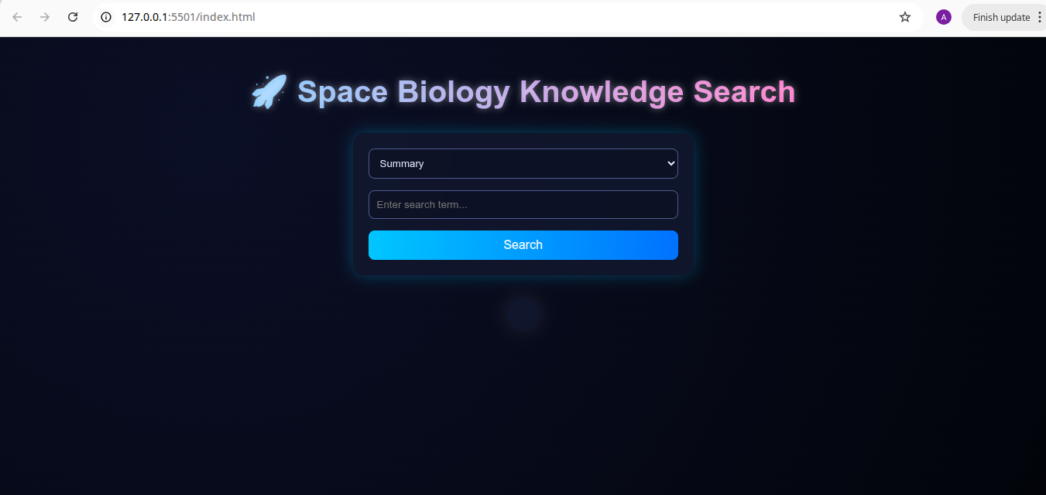

This project benefits the scientific community by streamlining access to voluminous and diverse space biology datasets, promoting better data interpretation and discovery.
It supports astronauts' health research and accelerates new insights into how living organisms respond to space conditions, which is crucial for future long-duration missions.

Slide 4
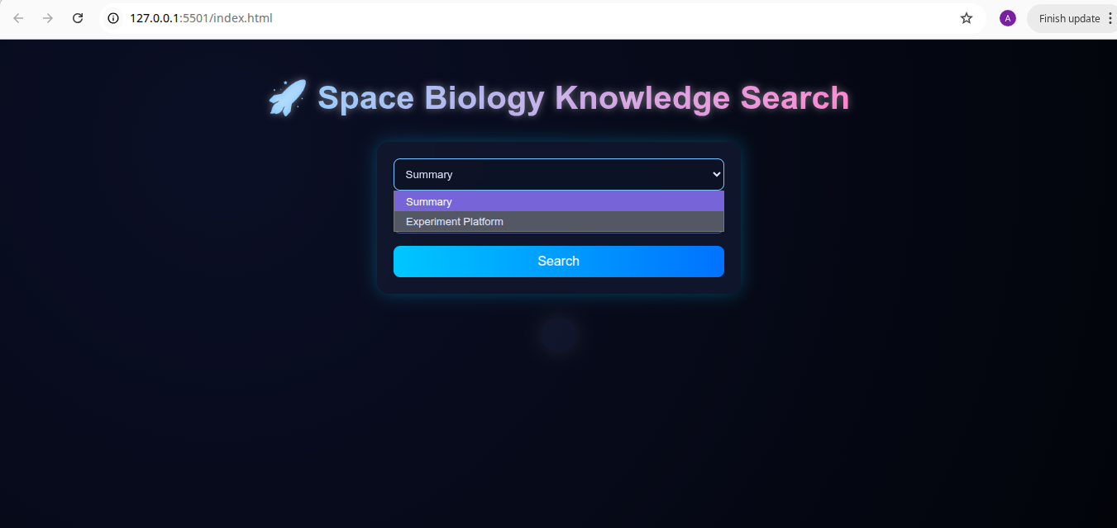
Our project uses AI, specifically Google’s Gemini, to generate enhanced, grounded textual summaries of search results from the OSDR API.
This helps users receive clear, accessible explanations of space biology studies and findings, starting from experimental protocols to summarized biomedical insights relevant for both researchers and the general public.

Slide 5
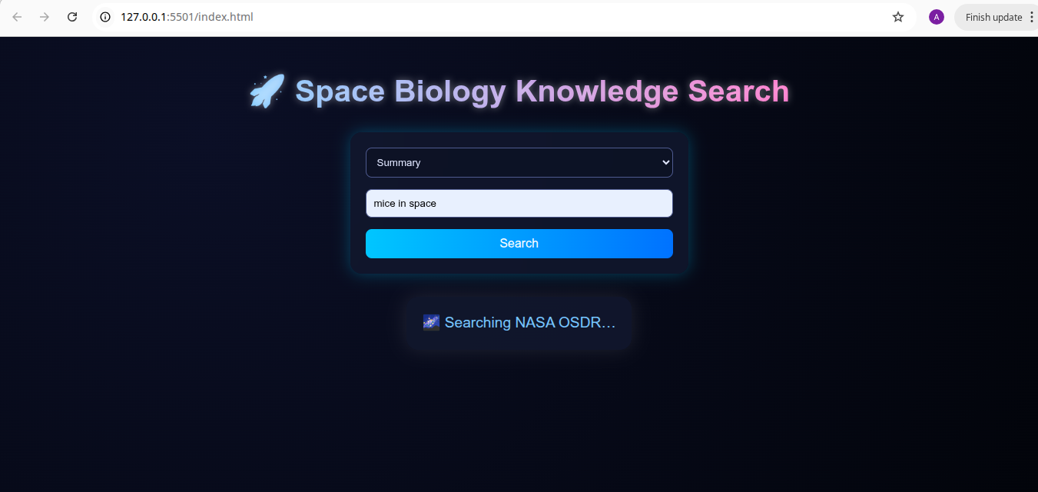
The overall goal is to boost research in space biology by making data more accessible, interpretable, and usable through a sleek web interface that connects metadata search with AI-powered summarization.
This aligns with NASA’s broader vision of leveraging space biological data to understand the impact of spaceflight on living systems—ultimately supporting research relevant to human space exploration and health

Slide 6
Key features include categorized search filters, detailed metadata tagging, and intuitive navigation, enabling users to find studies by species, research field, or experimental procedure.
The development used Python and Flask for the backend API, integrating with NASA’s APIs and the Google Gemini AI. On the front end, modern web technologies like HTML, CSS, and JavaScript create a futuristic, user-friendly interface.

Slide 7
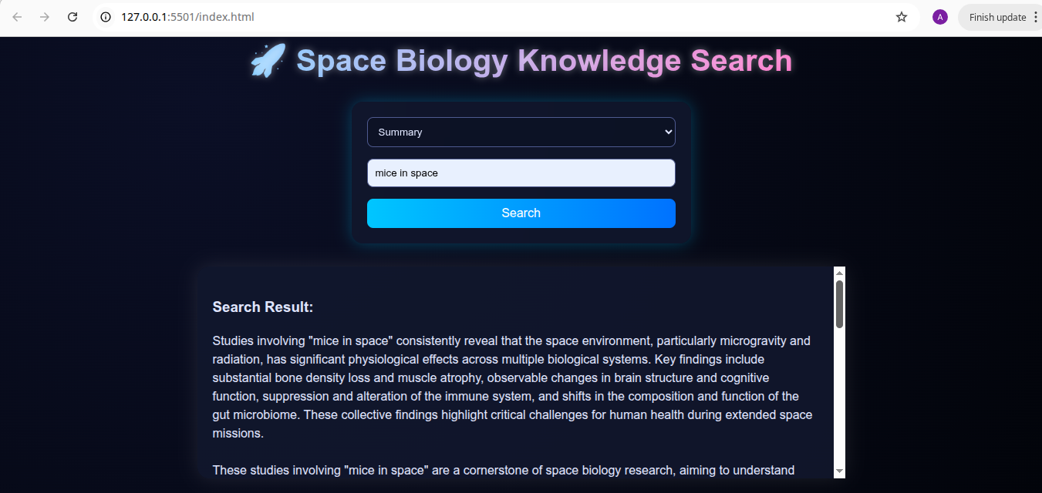
The output is produced by sending the user’s search query along with relevant search result data to Google’s Gemini AI model. Gemini processes this combined information using advanced natural language understanding to generate a concise, clear, and context-aware summary. This AI-driven summarization distills complex scientific metadata into a user-friendly explanation that highlights the most important insights tailored to the query.
THANK YOU

