Slide 1



universal design
Notes:
Universal design is about designing systems so that they can be used by anyone in any circumstance.
Universal design means designing for diversity, including:
– people with sensory, physical or cognitive impairment
– people of different ages
– people from different cultures and backgrounds.

Slide 2
Definition
Universal design is the process of designing products so that they can be used by as many people as possible in as many situations as possible.
For example(Not universal):
  Font size- Difficult to read

Slide 3
universal design principles
Equitable use
    The design is useful and marketable to the people with diverse abilities.
  the design is useful to people with a range of abilities and appealing to all. No user is excluded or stigmatized.
Flexibility in use
  the design allows for a range of ability and preference, through choice of methods of use and adaptivity to the user’s pace, precision and custom.
  Use – Power Point
Simple and intuitive to use
  The design needs to support the user’s expectations and accommodate different language and literacy skills
Perceptible information
  the design should provide effective communication of information regardless of the environmental conditions or the user’s abilities.
Notes:
Equitable - fair and impartial. مساوی

Slide 4
Tolerance for error
  minimizing the impact and damage caused by mistakes or unintended behaviour
Low physical effort
  systems should be designed to be comfortable to use, minimizing physical effort and fatigue.
Size and space for approach and use
  the placement of the system should be such that it can be reached and used by any user regardless of body size, posture or mobility

Slide 5
Multi-Sensory Systems
More than one sensory channel in interaction
  e.g. sounds, text, hypertext, animation, video, gestures, vision
Used in a range of applications:
  particularly good for users with special needs, and virtual reality
Will cover
  general terminology
  speech
  non-speech sounds(Like traffic signal guide sound)
  handwriting
considering applications as well as principles
Notes:
providing access to information through more than one mode of interaction is an important principle of universal design. Such design relies on multi-modal interaction

Slide 6
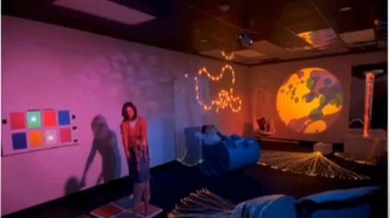
MSS for Special Kids

Slide 7
Usable Senses
The 5 senses (sight, sound, touch, taste and smell) are used by us every day
  each is important on its own
  together, they provide a fuller interaction with the natural world
Computers rarely offer such a rich interaction
Can we use all the available senses?
  ideally, yes
  practically – no
We can use • sight • sound • touch (sometimes)
We cannot (yet) use • taste • smell

Slide 8
Multi-modal vs. Multi-media
Multi-modal systems
  use more than one sense (or mode ) of interaction
    e.g. visual and aural senses: a text processor may speak the words as well as echoing them to the screen
Multi-media systems
  use a number of different media to communicate information
    e.g. a computer-based teaching system:may use video, animation, text and still images: different media all using the visual mode of interaction; may also use sounds, both speech and non-speech: two more media, now using a different mode

Slide 9
Speech
Human beings have a great and natural mastery of speech
  makes it difficult to appreciate the complexities
  but
  it’s an easy medium for communication

Slide 10
Structure of Speech
phonemes
  40 of them (24 consonants and 16 vowel sounds)
  basic atomic units
  sound slightly different depending on the context they are in, these larger units are …
allophones
  all the sounds in the language
  between 120 and 130 of them
  these are formed into …
morphemes
  smallest unit of language that has meaning.
Notes:
phonemes -

Slide 11
Speech (cont’d)
Other terminology:
• prosody
  alteration in tone and quality
  variations in emphasis, stress, pauses and pitch
  impart more meaning to sentences.
• co-articulation
  the effect of context on the sound
  transforms the phonemes into allophones
• syntax – structure of sentences
• semantics – meaning of sentences

Slide 12
Speech Recognition Problems
Different people speak differently:
  accent, intonation, stress, idiom, volume, etc.
The syntax of semantically similar sentences may vary.
Background noises can interfere.
People often “ummm.....” and “errr.....”
Words not enough - semantics needed as well
  requires intelligence to understand a sentence
  context of the utterance often has to be known
  also information about the subject and speaker
e.g. even if “Errr.... I, um, don’t like this” is recognised, it is a fairly useless piece of information on it’s own

Slide 13
Speech Recognition: useful?
Single user or limited vocabulary systems
e.g. computer dictation
Open use, limited vocabulary systems can work satisfactorily
e.g. some voice activated telephone systems
general user, wide vocabulary systems …
… still a problem
Great potential, however
  when users hands are already occupied
  e.g. driving, manufacturing
  for users with physical disabilities
  lightweight, mobile devices

Slide 14
Speech Synthesis
The generation of speech
Useful
  natural and familiar way of receiving information
Problems
  similar to recognition: prosody particularly
Additional problems
  intrusive - needs headphones, or creates noise in the workplace
  transient - harder to review and browse

Slide 15
Speech Synthesis: useful?
Successful in certain constrained applications
when the user:
  is particularly motivated to overcome problems
  has few alternatives
Examples:
screen readers
  read the textual display to the user
  utilised by visually impaired people
warning signals
  spoken information sometimes presented to pilots whose visual and haptic skills are already fully occupied

Slide 16
Non-Speech Sounds
boings, bangs, squeaks, clicks etc.
commonly used for warnings and alarms
Evidence to show they are useful
  fewer typing mistakes with key clicks
  video games harder without sound
Language/culture independent, unlike speech

Slide 17
Non-Speech Sounds: useful?
Dual mode displays:
  information presented along two different sensory channels
  redundant presentation of information
  resolution of ambiguity in one mode through information in another
Sound good for
  transient information
  background status information
e.g. Sound can be used as a redundant mode in the Apple Macintosh; almost any user action (file selection, window active, disk insert, search error, copy complete, etc.) can have a different sound associated with it.

Slide 18
Auditory Icons
Use natural sounds to represent different types of object or action
Natural sounds have associated semantics which can be mapped onto similar meanings in the interaction
e.g. throwing something away
~ the sound of smashing glass
Problem: not all things have associated meanings
Additional information can also be presented:
  muffled sounds if object is obscured or action is in the background
  use of stereo allows positional information to be added
Notes:
a telephone ring can be used to represent the telephone, a car horn to represent a car; a train toot for a train, etc.

Slide 19
SonicFinder for the Macintosh
items and actions on the desktop have associated sounds
folders have a papery noise
moving files – dragging sound
copying – a problem …
sound of a liquid being poured into a receptacle
rising pitch indicates the progress of the copy
big files have louder sound than smaller ones

Slide 20
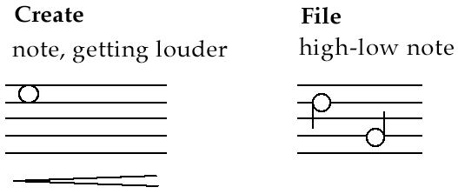
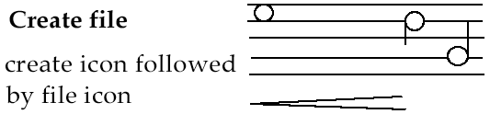
Earcons
Synthetic sounds used to convey information
Structured combinations of notes (motives ) represent actions and objects
Motives combined to provide rich information
  compound earcons
  multiple motives combined to make one more complicated earcon

Slide 21
Earcons (ctd)
family earcons
  similar types of earcons represent similar classes of action or similar objects: the family of “errors” would contain syntax and operating system errors
Earcons easily grouped and refined due to compositional and hierarchical nature
Harder to associate with the interface task since there is no natural mapping

Slide 22
touch
haptic interaction
  cutaneous perception
    tactile sensation; vibrations on the skin
  kinesthetics
    movement and position; force feedback
information on shape, texture, resistance, temperature, comparative spatial factors
example technologies
  electronic braille displays
  force feedback devices e.g. Phantom
    resistance, texture
Notes:
Kinesthetics - consider a hand that reaches for, picks up and explores a Cricket ball. As the hand reaches for the ball and adjusts its shape to grasp, a unique set of data points describing joint angle, muscle length and tension is generated. This information is collected by a specialized group of receptors embedded in muscles, tendons and joints.
spatial analysis is the technique applied to structures at the human scale, most notably in the analysis of geographic data.

Slide 23
Handwriting recognition
Handwriting is another communication mechanism which we are used to in day-to-day life
Technology
  Handwriting consists of complex strokes and spaces
  Captured by digitising tablet
    strokes transformed to sequence of dots
  large tablets available
    suitable for digitising maps and technical drawings
  smaller devices, some incorporating thin screens to display the information
    PDAs such as Palm Pilot
    tablet PCs

Slide 24
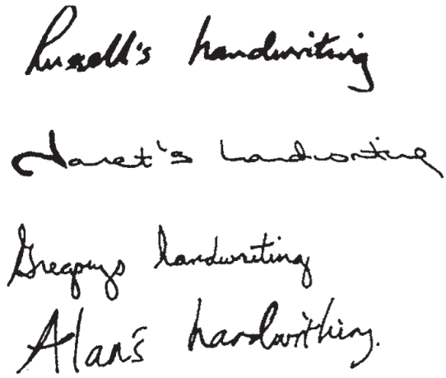
Handwriting recognition (ctd)
Problems
  personal differences in letter formation
  co-articulation effects
Breakthroughs:
  stroke not just bitmap
  special ‘alphabet’ – Graffeti on PalmOS
Current state:
  usable – even without training
  but many prefer keyboards!

Slide 25
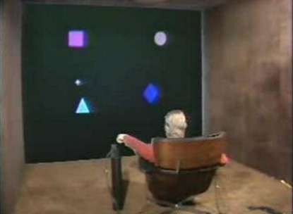
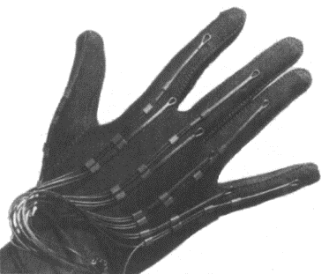
gesture
applications
  gestural input - e.g. “put that there”
  sign language
technology
  data glove
  position sensing devices e.g MIT Media Room
benefits
  natural form of interaction - pointing
  enhance communication between signing and non-signing users
problems
  user dependent, variable and issues of coarticulation

Slide 26
Users with disabilities
visual impairment
  screen readers, SonicFinder
hearing impairment
  text communication, gesture, captions
physical impairment
  speech I/O, eyegaze, gesture, predictive systems (e.g. Reactive keyboard)
speech impairment
  speech synthesis, text communication
dyslexia
  speech input, output
autism
  communication, education
Notes:
It is estimated that at least 10% of the population of every country has a disability
Dyslexia - Dyslexia is a learning disorder(cognitive disability) that involves difficulty reading due to problems identifying speech sounds and learning how they relate to letters and words (decoding). Also called reading disability, dyslexia affects areas of the brain that process language.
Consistent navigation structure and clear signposting cues are also important to people with dyslexia. Color coding information can help in some cases and provision of graphical information to support textual can make the meaning of text easier to grasp.
Autism - Computer-mediated communication and virtual environments

Slide 27
… plus …
age groups
  older people e.g. disability aids, memory aids, communication tools to prevent social isolation
  children e.g. appropriate input/output devices, involvement in design process
cultural differences
  influence of nationality, generation, gender, race, sexuality, class, religion, political persuasion etc. on interpretation of interface features
  e.g. interpretation and acceptability of language, cultural symbols, gesture and colour
Notes:
ticks 3 and crosses 7 represent positive and negative respectively in some cultures
Rainbow color
Red - danger, red represents life (India), happiness (China) and royalty (France). Green is a symbol of fertility (Egypt) and youth (China) as well as safety (Anglo-American).

