Slide 1

REGEX MATCHER AND EMAIL VALIDATION

Slide 2
About me
Name : Aleena Joseph
I am currently pursuing BTech in Computer Science from College of Engineering Kallooppara.
Linkedin url: https://www.linkedin.com/in/aleenajoseph2003
Github link: https://github.com/aleenaj23

Slide 3
SCENARIO
Task is to replicate the core functionality of the website regex101.com. This entails creating a web application that allows users to input a test string and a regular expression (regex) and displays all the matches found.This functionality empoweres users to efficiently test and validate their regex patterns,aiding in various text processing and pattern matching tasks.

Slide 4
STEPS
1. Create a new directory for project and navigate into it.
2. Set up virtual development environment.
3. Initialize a new Flask application:
- Create a new Python file named `app.py`.
- Import Flask and create a new Flask app instance.
- Define a route for the home page ("/") where users can input the test string and regex.
- Render an HTML template containing a form with fields for the test string and regex, and a submit button.

Slide 5
STEPS
4. Create the HTML template:
- Create a new directory named `templates` within project directory.
- Inside the `templates` directory, create a new HTML file named `index.html`.
- Design the HTML form with input fields for the test string and regex, and a submit button.
5. Define a route to handle form submission.
6. Render the results:
- Pass the list of matched strings to the HTML template.
- Modify the HTML template to display the matched strings below the input form.

Slide 6
STEPS
7. Test application:
- Run Flask application (`python app.py`).
- Open a web browser and navigate to http://localhost:5000 to access application.
- Input various test strings and regex patterns to ensure the application displays the correct matches.
8. Implement a new route where a user can validate if a given email id is valid or not.
9. Deploy the application on AWS Cloud.

Slide 7
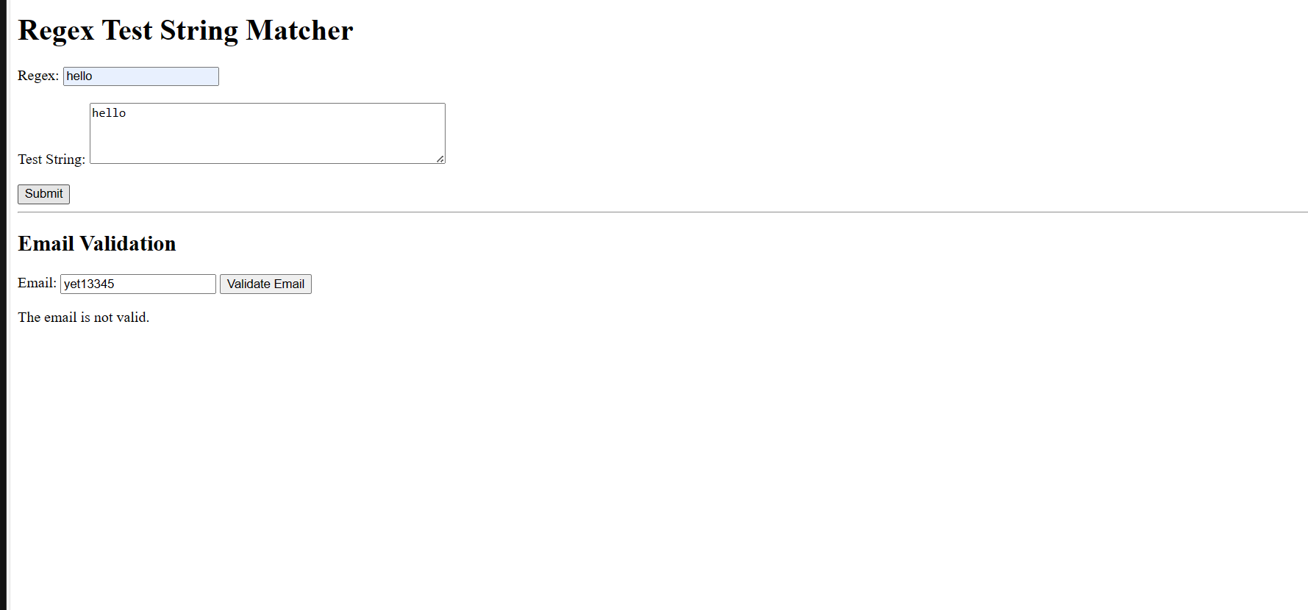

Slide 8


Slide 9
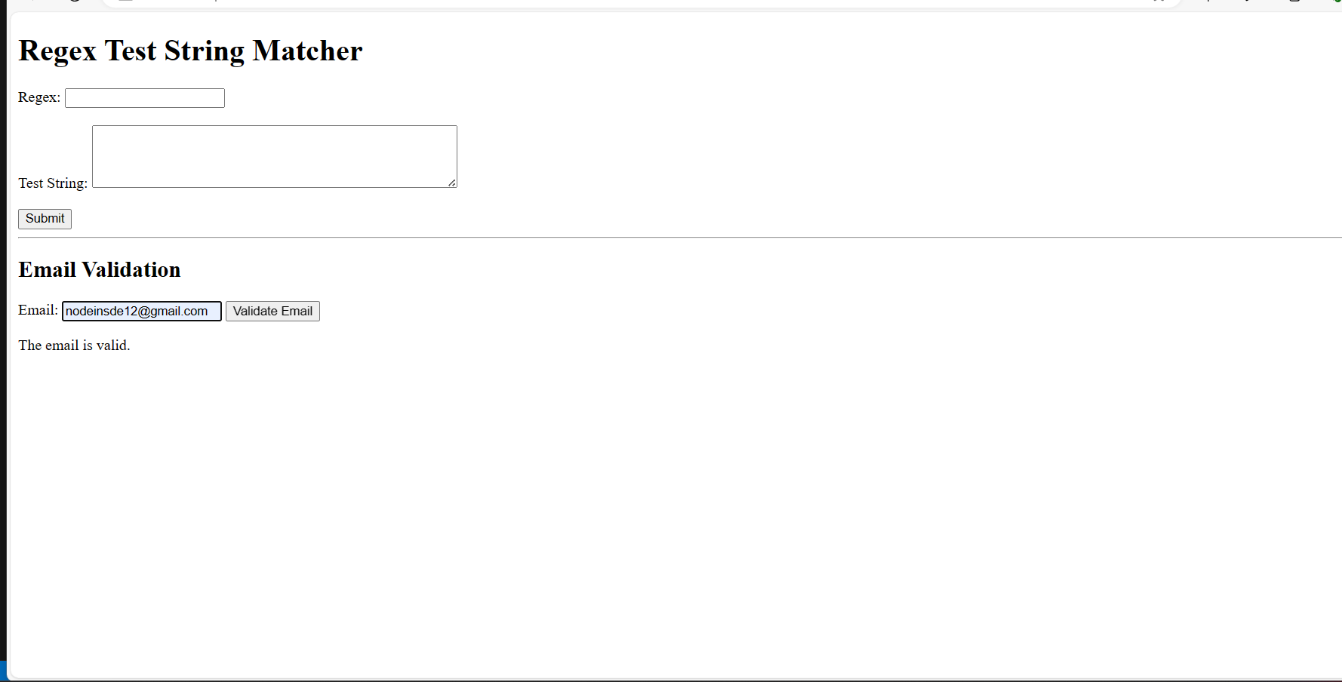

Slide 10
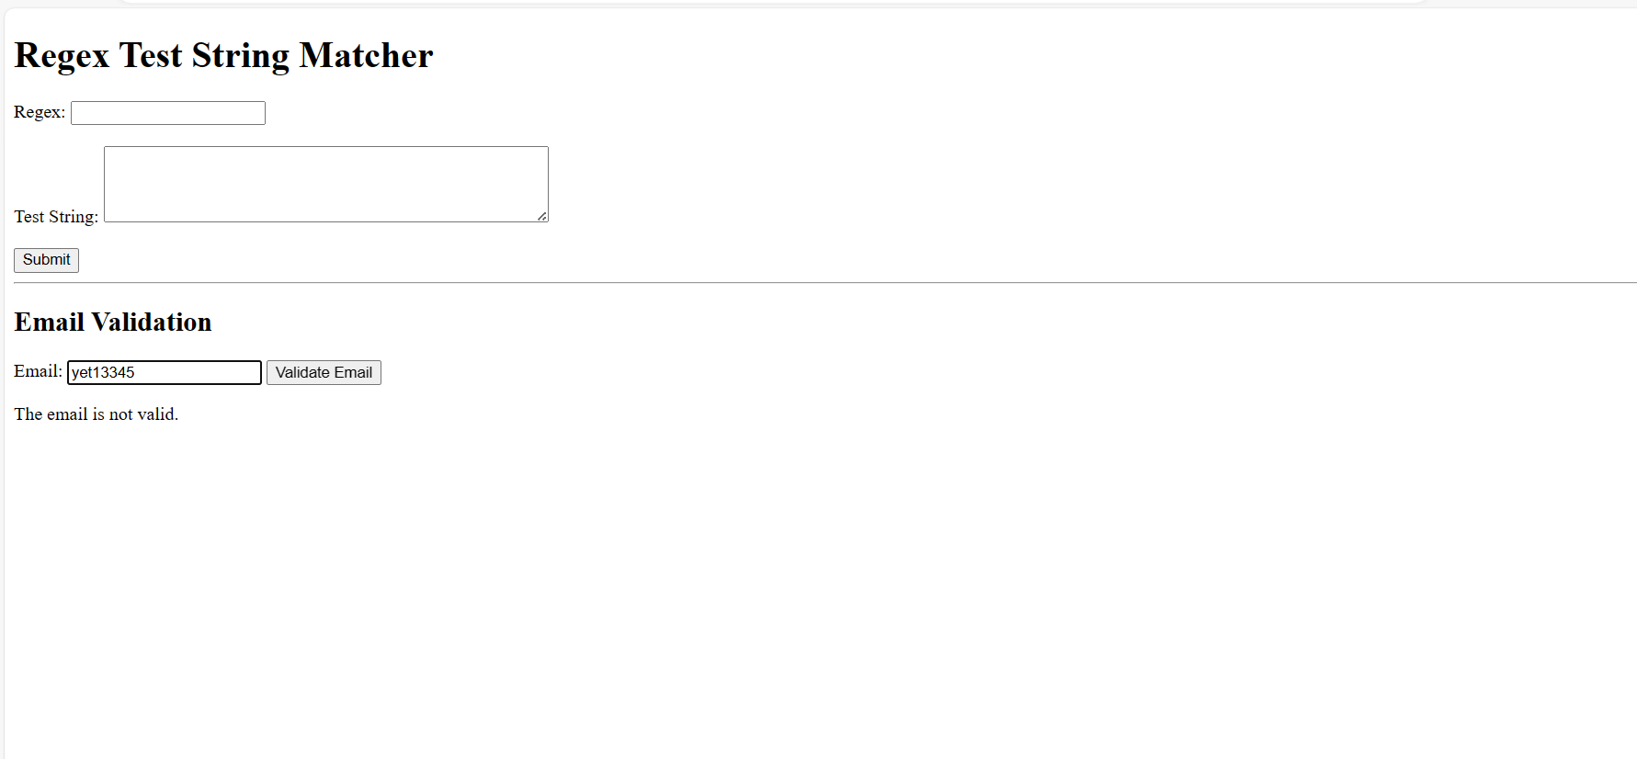

Slide 11
CONCLUSION
In summary I’ve replicated reex101.com’s functionality, enabling users to input test strings and regexes to find matches.I also added an email validation feature.
Testing validated its accuracy ,offering users a dependable regex testing tool ,enhancing our Flask development skills and regex proficiency.

Slide 12

THANK YOU

