Slide 1
AI Code Reviewer and Quality Assistant.
Automated Python Documentation & Code Quality Platform
Presented by Aleena Mary V A

Slide 2
Abstract
AI Code Reviewer and Quality Assistant
AI Code Reviewer is a unified Streamlit web application that automates the analysis, validation, and documentation of Python codebases. It leverages Python's Abstract Syntax Tree (AST) to statically analyze source files without executing them.
The platform combines four powerful modules:
Scanning for undocumented functions across a codebase
Validating PEP-compliance and docstring coverage
Auto-generating & injecting docstrings in multiple styles
Visualizing coverage metrics on an interactive dashboard
⚙️
100%
Static Analysis
🎨
3
Docstring Styles
📂
∞
Files Supported
💾
Live
Disk Write-Back

Slide 3


Section 02 — Problem Statement
Problem Statement
📉 Missing Documentation
🔍 Manual Auditing is Tedious
⚠️ Inconsistent Style
Most Python projects lack consistent docstrings. Developers skip documentation under time pressure, making code hard to understand and maintain.
Scanning hundreds of functions across multiple files for missing docstrings manually is impractical and error-prone at scale.
Teams use mixed docstring formats — Google, NumPy, reST — with no enforcement, creating confusion when onboarding new members.
💸 High Technical Debt
🔧 No Unified Tooling
🚫 No Live Feedback Loop
Undocumented code accumulates as technical debt. Fixing it retroactively is costly, slow, and often deprioritised in agile workflows.
Existing tools handle only one aspect — linting OR generation OR visualization. No single platform addresses the full documentation lifecycle.
Developers receive no real-time feedback on coverage during development, making it difficult to maintain quality standards continuously.

Slide 4
Our Solution
AST-Based Engine
Smart Generation
Uses Python's built-in AST to parse code without execution. Extracts function names, args, types, return hints, and existing docstrings with 100% accuracy.
Auto-generates contextual docstrings in Google, NumPy, and reST styles using a verb-map heuristic engine and type annotation inference.
Safe Injection
Live Dashboards
Real-time coverage charts, complexity heatmaps, and test-suite simulation across all loaded files with Plotly and Matplotlib visualisations.
Injects docstrings directly into live source files using precise line-number tracking. Sequential multi-function edits work without line-shift corruption.

Slide 5
Section 04 — System Flowchart
System Flowchart
📂
Input
Files
⚙️
AST
Parse
🔍
Scan
Functions
✅
Validate
Docs
✍️
Generate
Docstring
▶
▶
▶
▶
💾 Apply
In Memory
📊 Dashboard
View
✅ Coverage Report + Export

Slide 6
Milestone 1 — 🏠 Home Scanner
Milestone 1
📂
Dual File Input
⚙️
AST Function Scan
Upload multiple .py files via browser or paste a folder/file path. Recursively loads all .py files from nested directories.
Parses every uploaded file with Python's AST engine. Detects all functions, classes, async defs and checks docstring presence.
🔢
Complexity Metrics
📊
Coverage Dashboard
Cyclomatic complexity score per function. Colour-coded chart: red (>5), amber (>3), blue (≤3). Identifies the most complex function instantly.
Displays function/class coverage %, complexity bar charts, drill-down filters (All / Documented / Missing), and a complexity heatmap.
📋
Data Table + JSON
Export-ready DataFrame with Name, Kind, Lines, Complexity, Has Docstring. Also exports full coverage report as downloadable JSON.

Slide 7
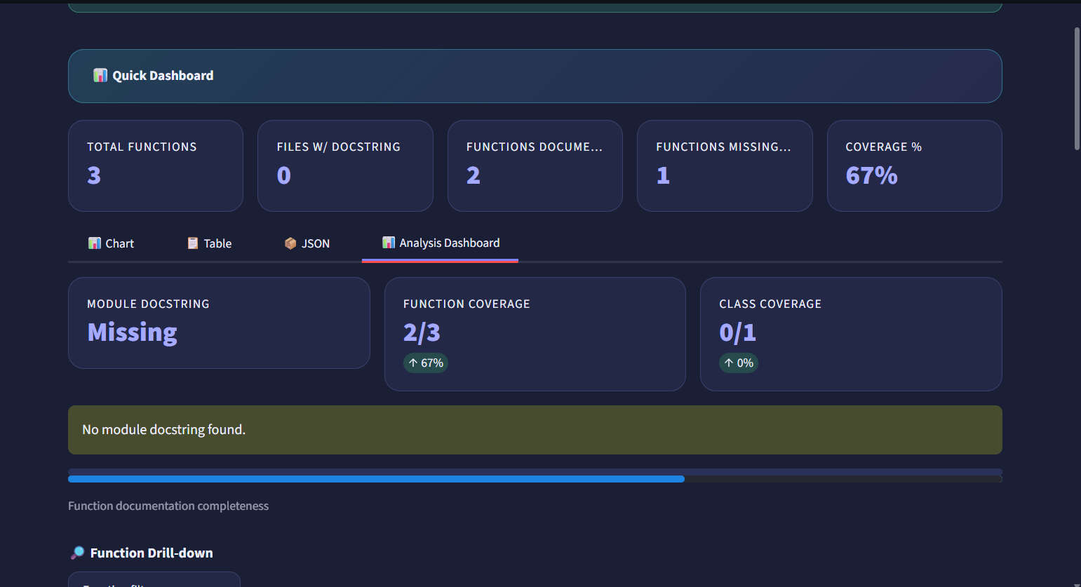
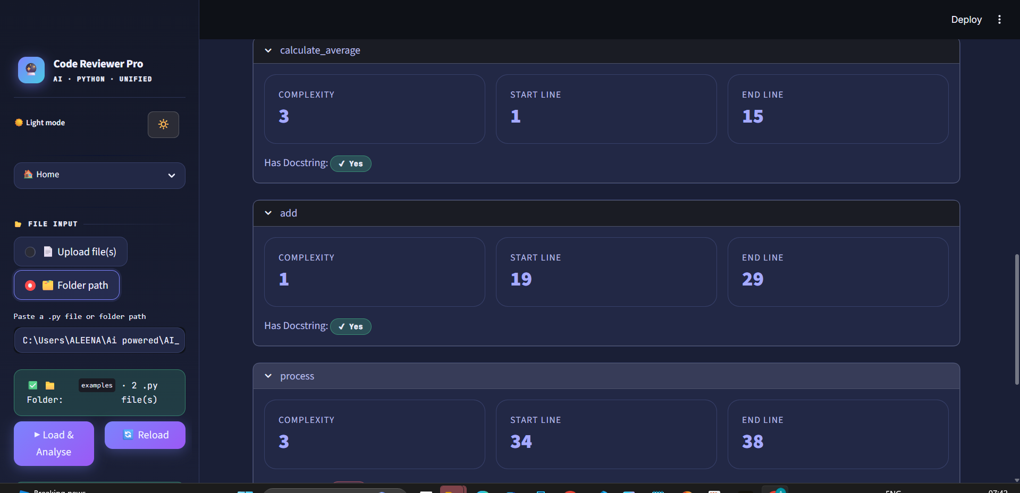

Slide 8
Validation
Milestone 2
🧪 PEP Validation Mode
Key Outcomes
PEP 257 is used to ensure every function, class, and module has a properly formatted docstring so that code is consistently documented and easily understood by other developers.
Zero-config PEP audit
✏️ Live Code Editor
Left-pane editable textarea pre-loaded with source. Any change is synced immediately back to the in-memory file store and re-analysed in real time.
Real-time editor feedback
🚦 Live Fix Status Panel
Right pane lists each function with red ❌ or green ✅ badges. One-click 'Fix' button injects a basic docstring via regex for any undocumented function.
Visual pie chart of violations
📈 Coverage Metrics Strip
One-click docstring injection
Three metric cards: Documented Functions, Missing Docstrings, Coverage %. Recalculates on every editor keystroke without requiring a full reload.
Download corrected file instantly
⚠️ Violation Pie Chart
Plots error distribution by rule type using Matplotlib on a dark background. Skips the chart entirely when all functions are compliant.
Supports multi-file tab switching
💾 Download Fixed File
One-click download of the edited, fixed .py file directly from the UI. Useful when no file path is provided and disk write-back isn't available.

Slide 9
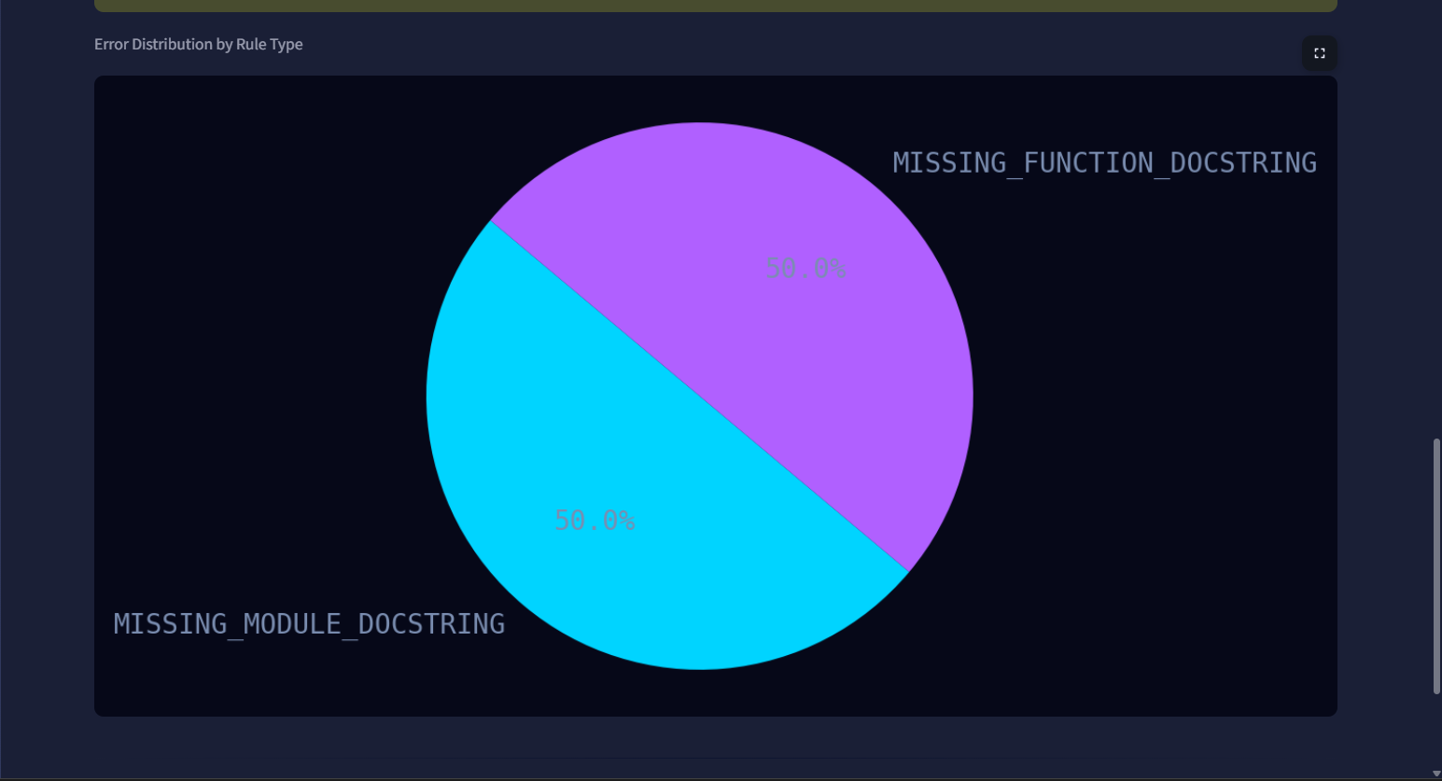
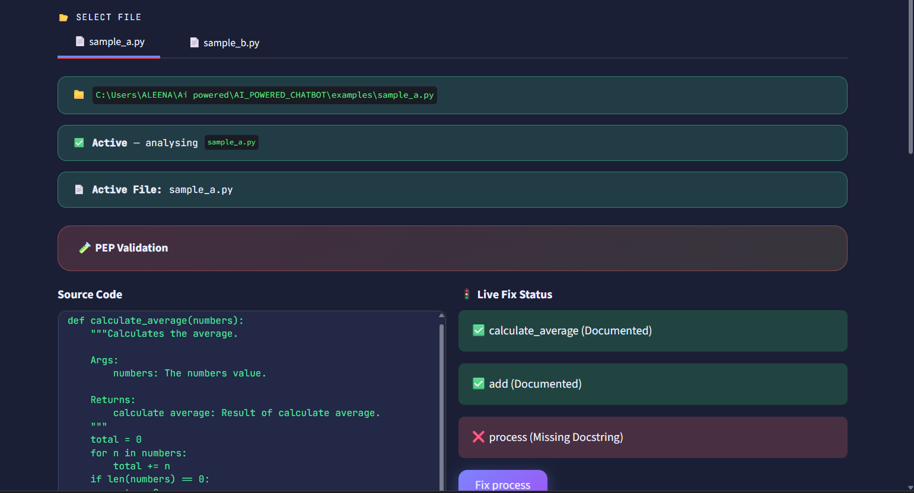

Slide 10
Milestone 3
Milestone 3
File & Function Browser
Generation Engine
Safe Injection & Save
Left panel lists all loaded files with ⚠ N missing badge or ✓ OK
Reads function name, args, type hints, return annotation
Re-parses live in-memory source before every injection
Click any file to expand its function list
Verb-map heuristic maps prefix → action (get→Retrieves, calc→Calculates)
Single-line docs use """text""" — no line-shift drift
Each function shown with 🟢 / 🔴 docstring status icons
Generates Google, NumPy or reST style docstrings automatically
Multi-line docstrings replace old ones with slice assignment
Functions identified by name + line number to handle duplicates
Inferred description shown when no docstring exists
Apply & Save writes to memory + disk in one click
Selectbox fallback for large files with many functions
Editable text-area lets you refine before applying
Source Viewer at bottom reflects all applied changes live

Slide 11
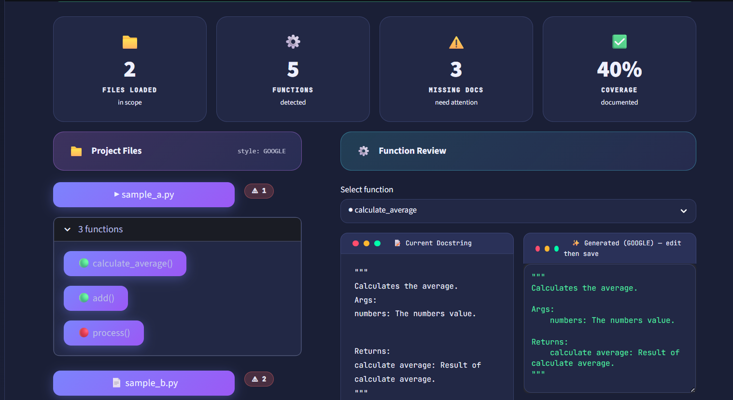
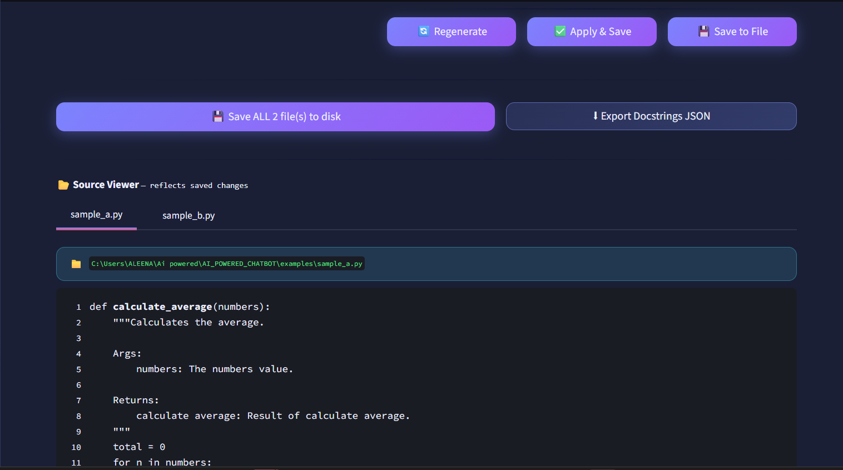

Slide 12
Milestone 4 — 📊 Dashboard
Milestone 4
📊
Coverage Bar Chart
🧪
Test Suite Simulation
📈
Plotly Interactive Bar
Functions vs Classes vs Overall coverage rendered as a colour-coded bar chart. Labels show exact % values above each bar.
Groups functions by file into named test suites. Shows passed/total as green ✅ or red ❌ rows. Mirrors CI pipeline output.
Optional Plotly bar chart of functions per file with hover tooltips. Falls back to Matplotlib when Plotly is not installed.
🔍
Advanced Filters
🔎
Function Search
📤
Export JSON / CSV
Filter all scan results by documentation status (All / OK / Fix) and by individual file. Updates a live count and HTML table.
Instant full-text search across function names and file names. Returns results with file, line number, arg count, and docstring badge.
Download full scan results as JSON (with metadata) or CSV (spreadsheet-ready) from the Dashboard or Export page.

Slide 13
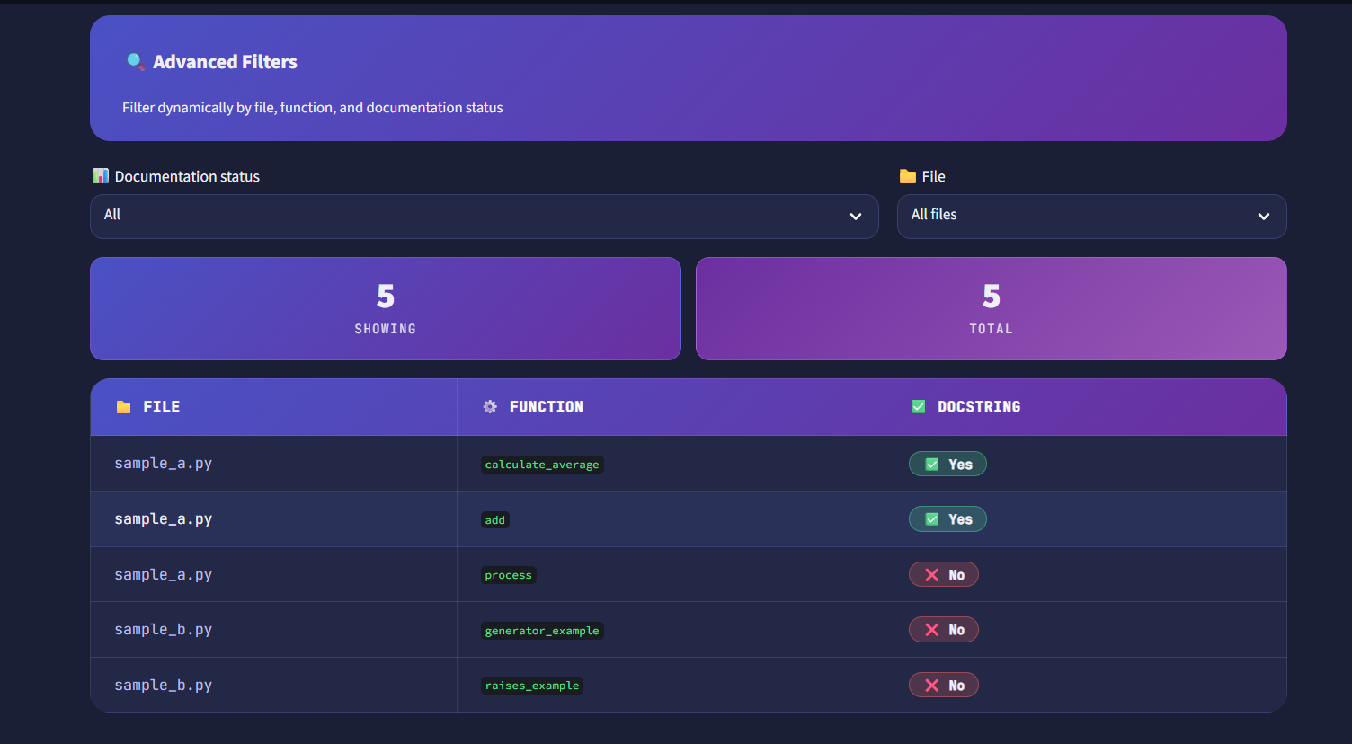
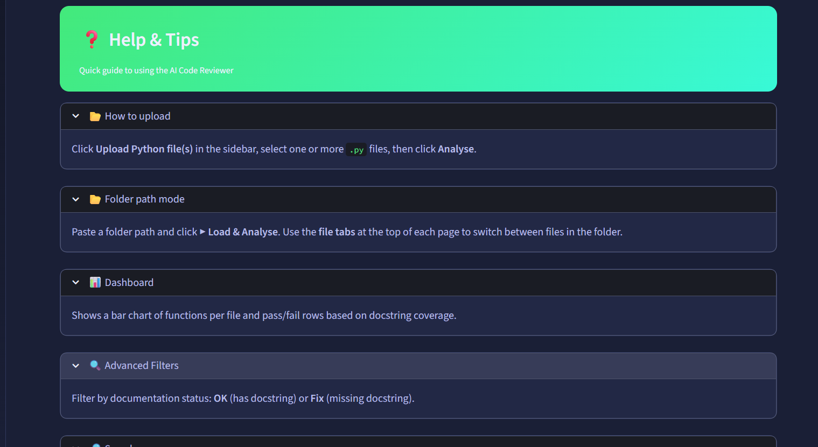

Slide 14
Thank You

