Slide 1
jQuery
Presented By Miss Aleena

Slide 2

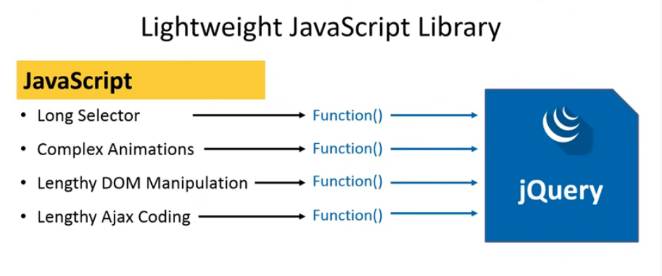
What is jQuery?

Slide 3
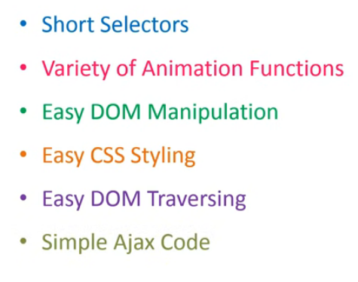
What is jQuery?

Slide 4
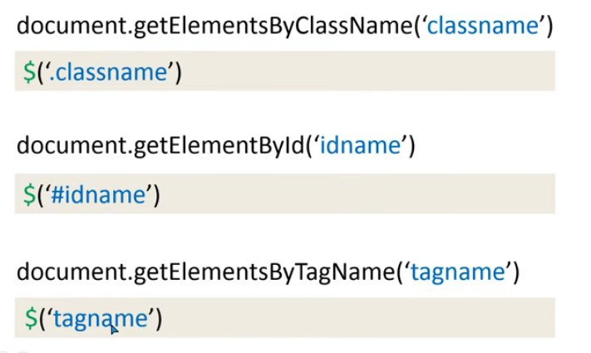
Short Selectors Examples

Slide 5
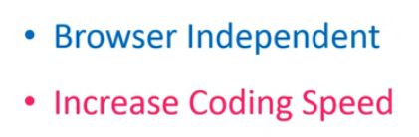
Benefits of jQuery

Slide 6
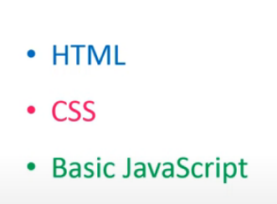
Knowledge before learning jQuery:

Slide 7
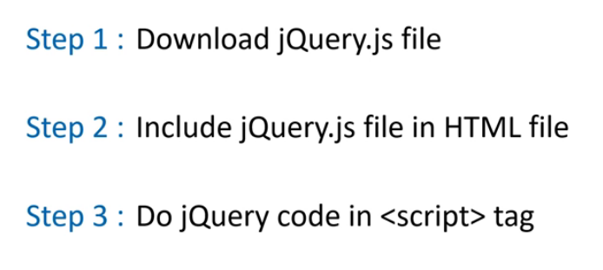
3 Steps to implement jQuery in HTML

Slide 8
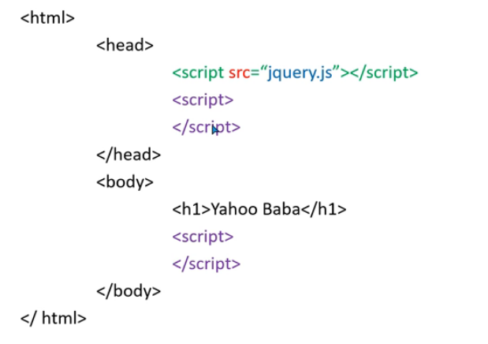
How to use jQuery?

Slide 9
Download jQuery
https://jquery.com/

Slide 10
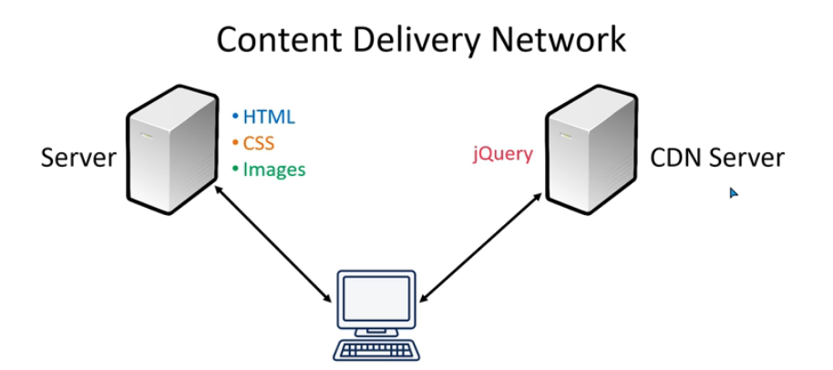
jQuery with CDN path:

Slide 11
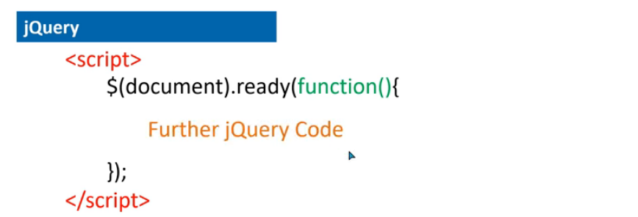
jQuery Basic Syntax

Slide 12
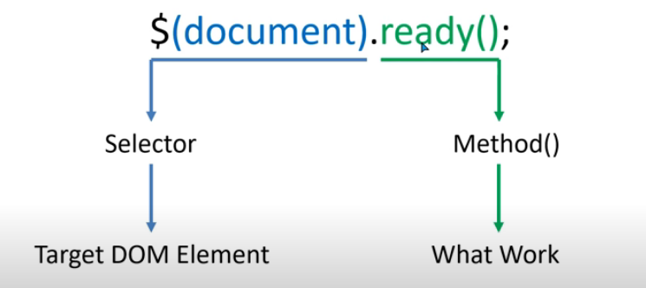
jQuery Basic Syntax

Slide 13
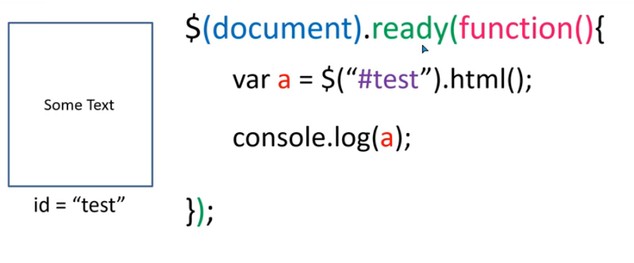
jQuery Basic Syntax

Slide 14
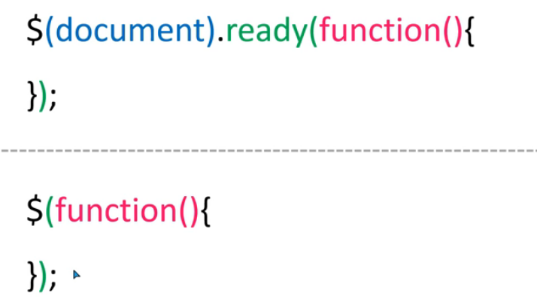
Another Method to start jQuery

Slide 15
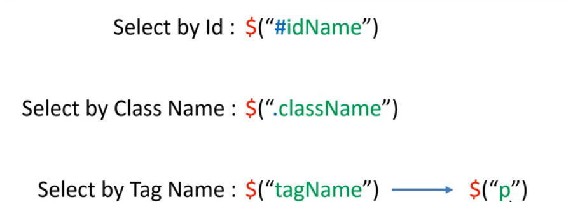
Targeting DOM Element with ID , Class & Tag

Slide 16
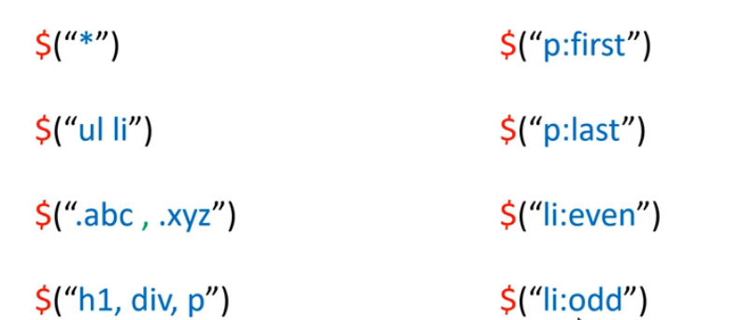
Advance Selector

Slide 17
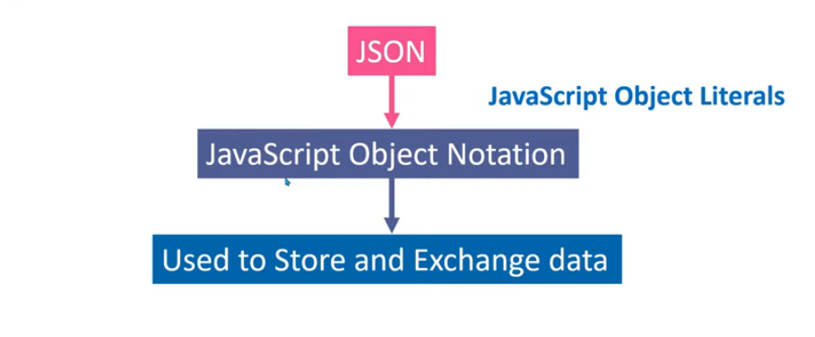
What is JSON

Slide 18
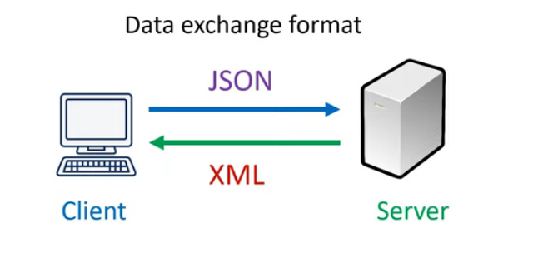
When to use JSON

Slide 19
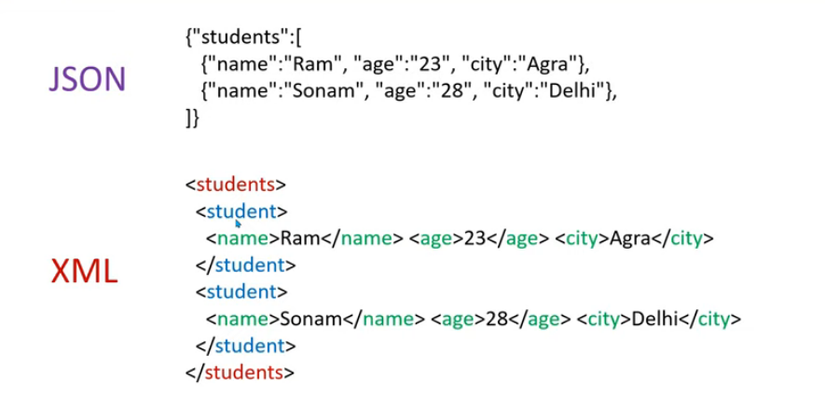
Data Format of JSON & XML

Slide 20
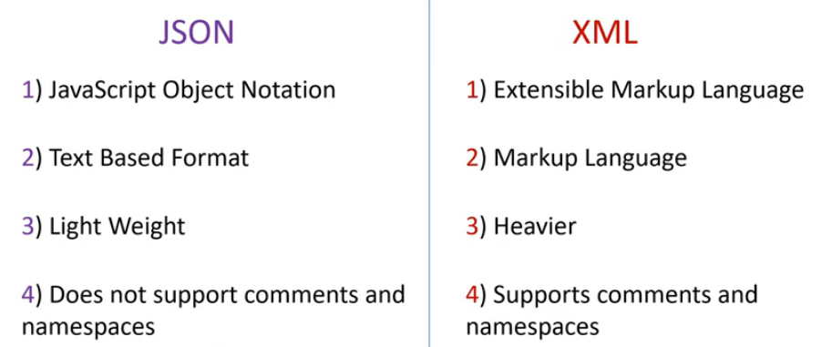
Difference Between JSON and XML

Slide 21
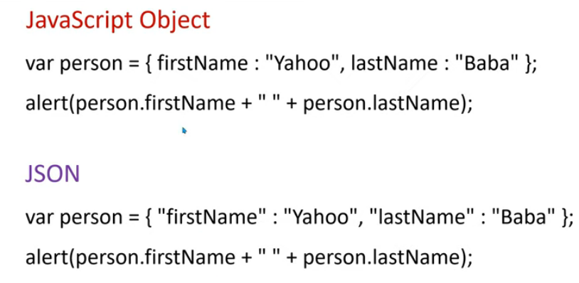
JavaScript Object Literals VS JSON

Slide 22
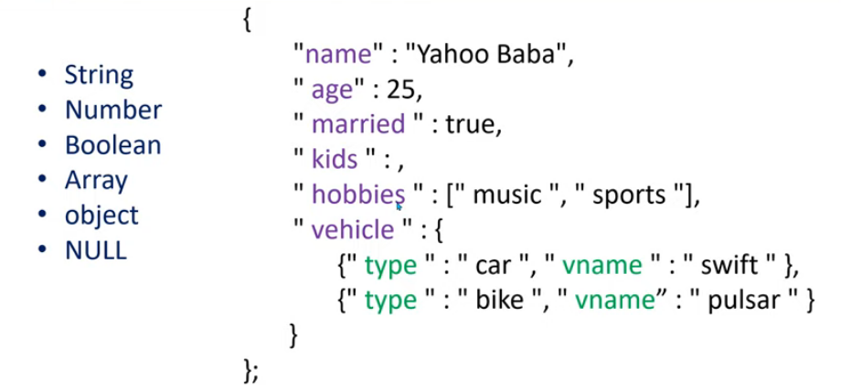
Data Types allowed in JSON

Slide 23
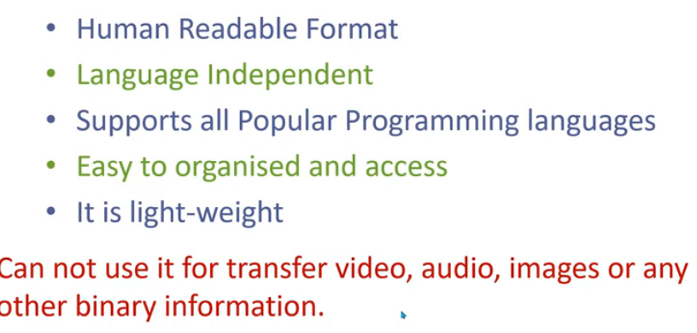
Advantages

Slide 24
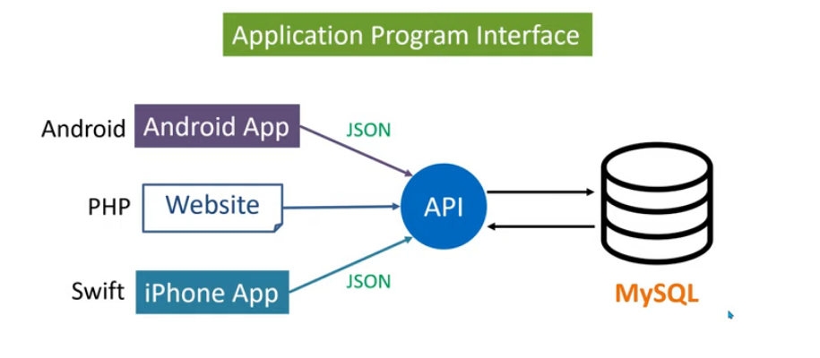
What is API

