Slide 1
Entrepreneurship
Faculty : Miss Aleena Lateef

Slide 2
Entrepreneurship
I CREATE
I TAKE RISK
I LIVE MY PASSION
I AM AN ENTREPRENEUR
Who are entrepreneur ?

Slide 3

Entrepreneurship

Slide 4

Entrepreneurship

Slide 5
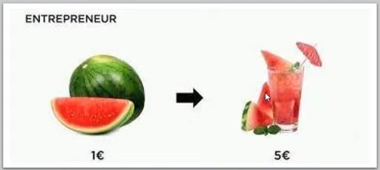
Entrepreneurship

Slide 6
99% OF THOSE WHO QUIT, WORK FOR THE 1% THAT NEVER GIVE UP.
Who are entrepreneur ?

