Slide 2
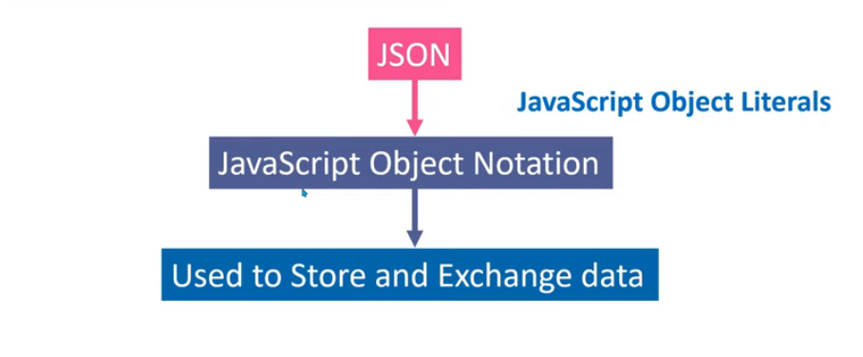
What is JSON

Slide 3
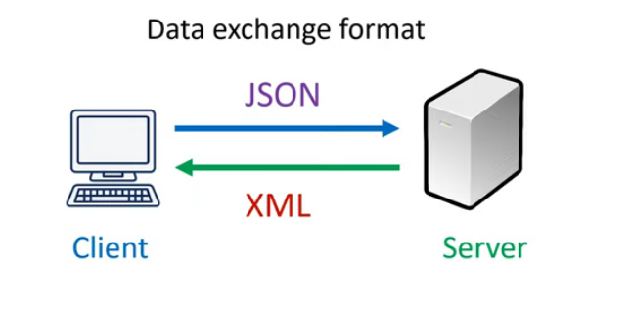
When to use JSON

Slide 4
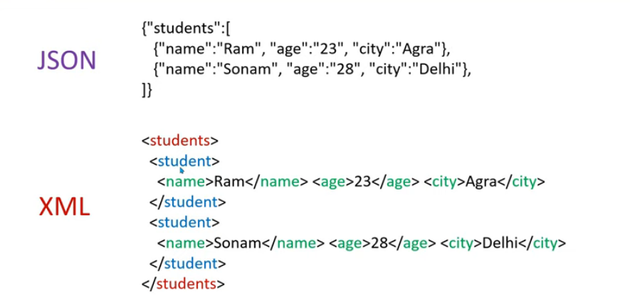
Data Format of JSON & XML

Slide 5
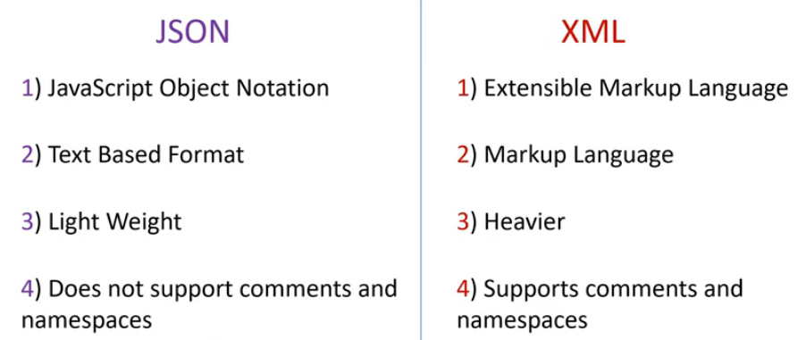
Difference Between JSON and XML

Slide 6
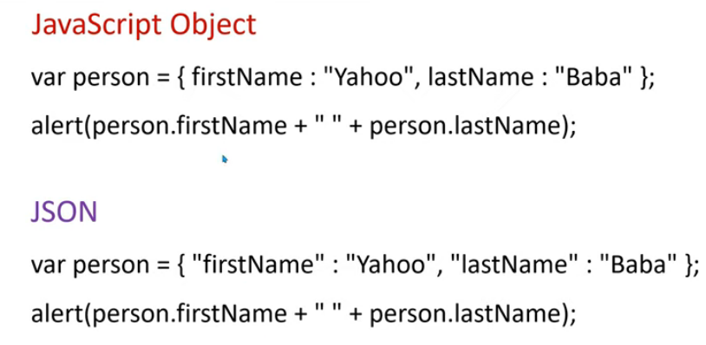
JavaScript Object Literals VS JSON

Slide 7
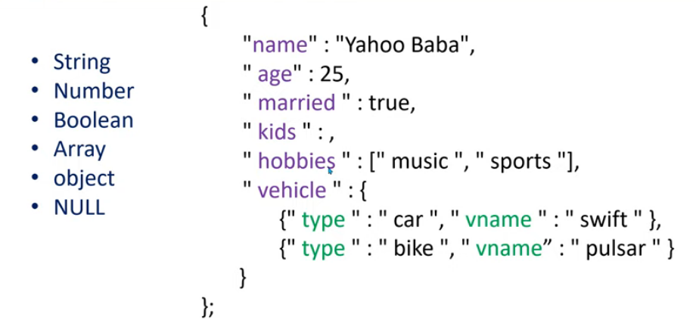
Data Types allowed in JSON

Slide 8
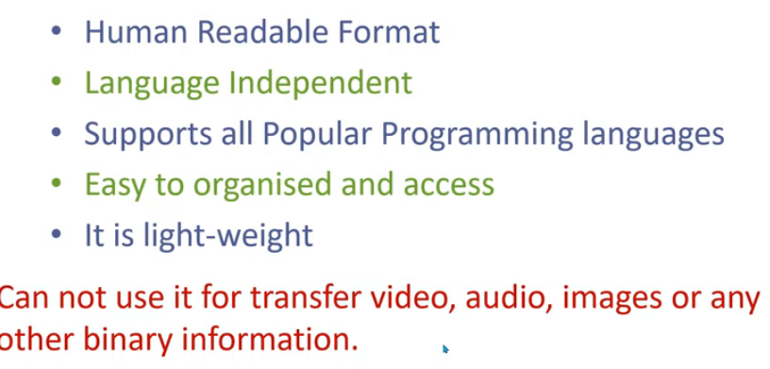
Advantages

Slide 9
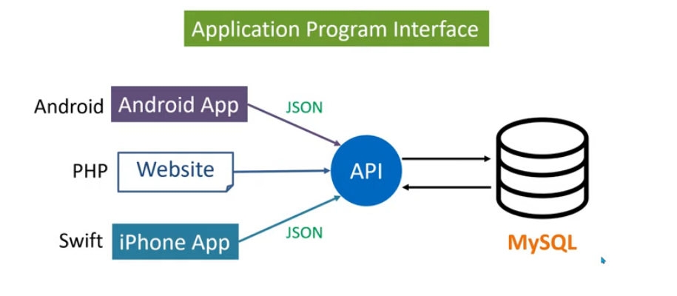
What is API

