Slide 1
MY SQL
Database

Slide 2
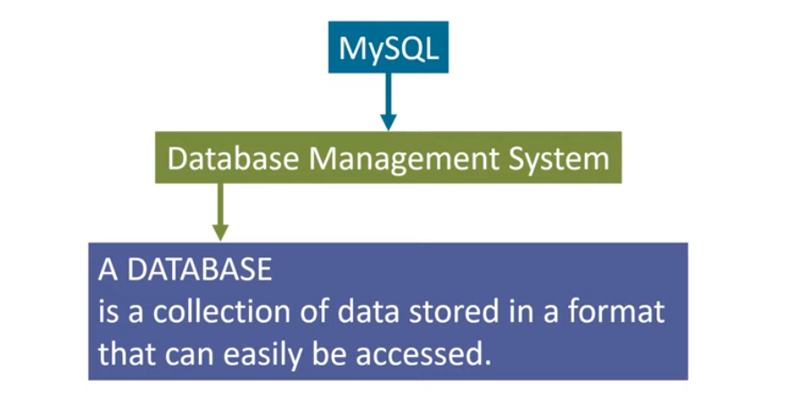
What is MySQL

Slide 3
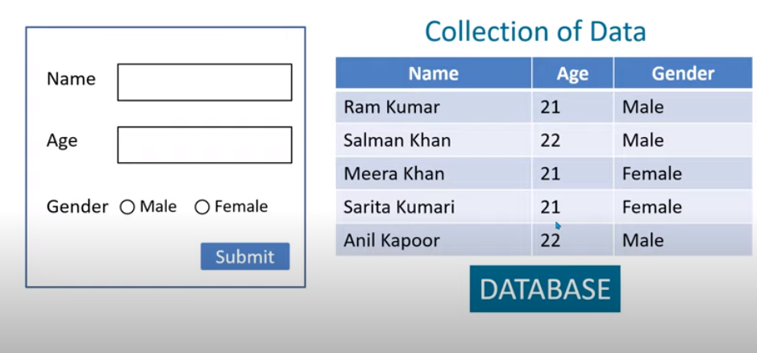
What is Database?

Slide 4
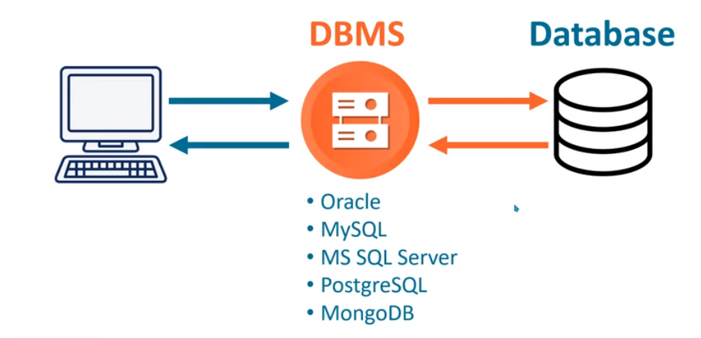
What is DBMS?

Slide 5
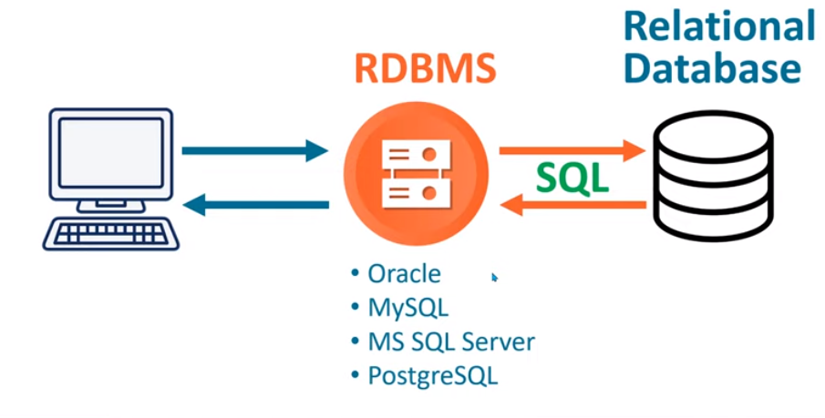
Relational Database Management System

Slide 6
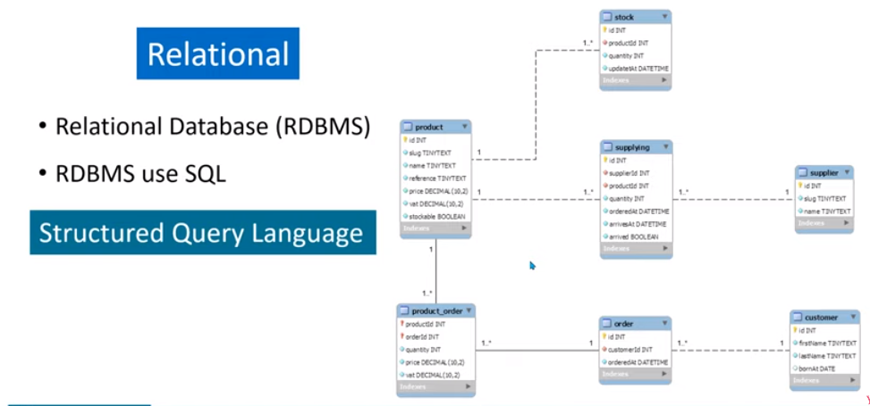
Two types of Database
Relational Database Management System

Slide 7
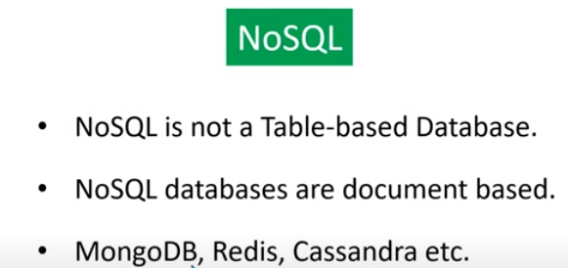
NoSQL
2. Relational Database Management System

Slide 8
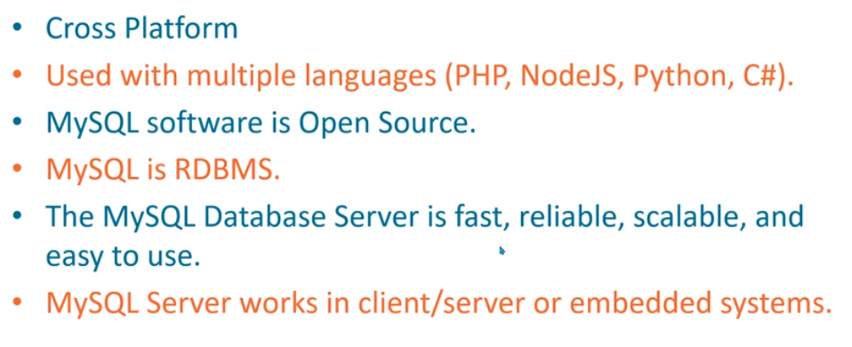
Advantages Of MySQL

Slide 9
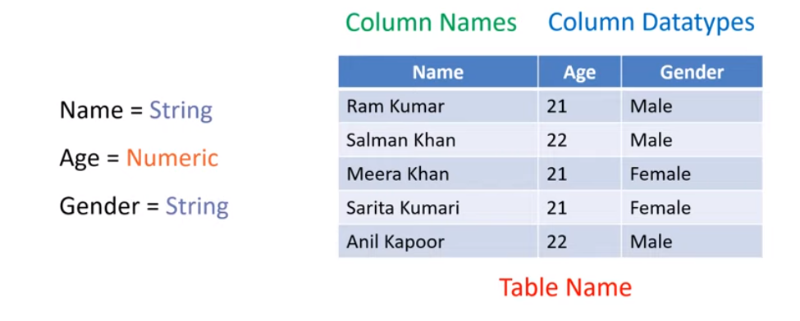
How to create Table?

Slide 10
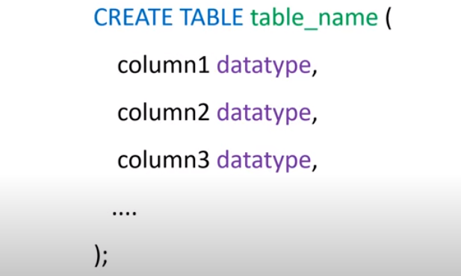
Create Table syntax

Slide 11
Datatypes in Mysql
3 Types of category in Datatypes
String
Numeric
Date and Time

Slide 12
String Datatypes in MySQL
Data type | Description
CHAR(size) | A FIXED length string (can contain letters, numbers, and special characters). The size parameter specifies the column length in characters - can be from 0 to 255. Default is 1
VARCHAR(size) | A VARIABLE length string (can contain letters, numbers, and special characters). The size parameter specifies the maximum string length in characters - can be from 0 to 65535
BINARY(size) | Equal to CHAR(), but stores binary byte strings. The size parameter specifies the column length in bytes. Default is 1
VARBINARY(size) | Equal to VARCHAR(), but stores binary byte strings. The size parameter specifies the maximum column length in bytes.
TINYBLOB | For BLOBs (Binary Large Objects). Max length: 255 bytes
TINYTEXT | Holds a string with a maximum length of 255 characters
TEXT(size) | Holds a string with a maximum length of 65,535 bytes
BLOB(size) | For BLOBs (Binary Large Objects). Holds up to 65,535 bytes of data
MEDIUMTEXT | Holds a string with a maximum length of 16,777,215 characters
MEDIUMBLOB | For BLOBs (Binary Large Objects). Holds up to 16,777,215 bytes of data
LONGTEXT | Holds a string with a maximum length of 4,294,967,295 characters
LONGBLOB | For BLOBs (Binary Large Objects). Holds up to 4,294,967,295 bytes of data
ENUM(val1, val2, val3, ...) | A string object that can have only one value, chosen from a list of possible values. You can list up to 65535 values in an ENUM list. If a value is inserted that is not in the list, a blank value will be inserted. The values are sorted in the order you enter them
SET(val1, val2, val3, ...) | A string object that can have 0 or more values, chosen from a list of possible values. You can list up to 64 values in a SET list

Slide 13
Numeric DataTypes
Data type | Description
BIT(size) | A bit-value type. The number of bits per value is specified in size. The size parameter can hold a value from 1 to 64. The default value for size is 1.
TINYINT(size) | A very small integer. Signed range is from -128 to 127. Unsigned range is from 0 to 255. The size parameter specifies the maximum display width (which is 255)
BOOL | Zero is considered as false, nonzero values are considered as true.
BOOLEAN | Equal to BOOL
SMALLINT(size) | A small integer. Signed range is from -32768 to 32767. Unsigned range is from 0 to 65535. The size parameter specifies the maximum display width (which is 255)
MEDIUMINT(size) | A medium integer. Signed range is from -8388608 to 8388607. Unsigned range is from 0 to 16777215. The size parameter specifies the maximum display width (which is 255)
INT(size) | A medium integer. Signed range is from -2147483648 to 2147483647. Unsigned range is from 0 to 4294967295. The size parameter specifies the maximum display width (which is 255)
INTEGER(size) | Equal to INT(size)
BIGINT(size) | A large integer. Signed range is from -9223372036854775808 to 9223372036854775807. Unsigned range is from 0 to 18446744073709551615. The size parameter specifies the maximum display width (which is 255)
FLOAT(size, d) | A floating point number. The total number of digits is specified in size. The number of digits after the decimal point is specified in the d parameter. This syntax is deprecated in MySQL 8.0.17, and it will be removed in future MySQL versions
FLOAT(p) | A floating point number. MySQL uses the p value to determine whether to use FLOAT or DOUBLE for the resulting data type. If p is from 0 to 24, the data type becomes FLOAT(). If p is from 25 to 53, the data type becomes DOUBLE()
DOUBLE(size, d) | A normal-size floating point number. The total number of digits is specified in size. The number of digits after the decimal point is specified in the d parameter
DOUBLE PRECISION(size, d)
DECIMAL(size, d) | An exact fixed-point number. The total number of digits is specified in size. The number of digits after the decimal point is specified in the d parameter. The maximum number for size is 65. The maximum number for d is 30. The default value for size is 10. The default value for d is 0.
DEC(size, d) | Equal to DECIMAL(size,d)

