Slide 1
DevOps
Submitted by
Aleesha Joji(166574)
Mentor:
Nabeen Najeeb

Slide 2
Version Control Systems
What is version control?
system that records changes of files over time
There are basically 2 types of version control systems:
-Centralized version control
a single server contains all the versioned files
-Distributed version control
everyone has a local copy of the entire work history

Slide 3
GIT & GITHUB
Git → tool that is installed in your pc
GitHub →server
Unlike other VCS it considers data as a series of snapshots
Every time you commit you take a snapshot of the files that are listed in the staging area.
Advantages:
Tracking history
Collaborations
Backup’s
Tracking status

Slide 4
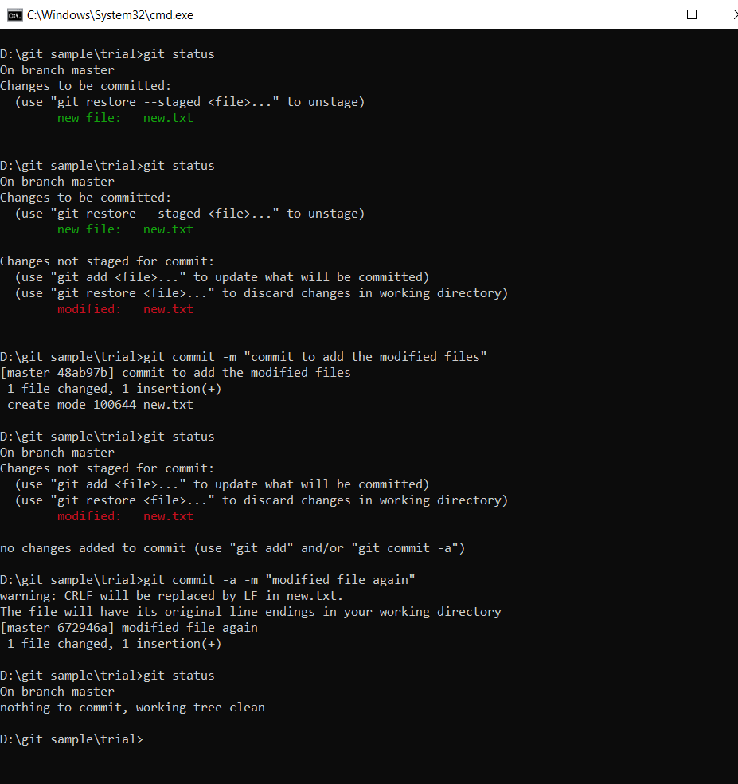
Life-cycle of GitHub
When you say a file is present in your git repo, there are 3 possible stages for it
1)Modified
2)Staged
3)Committed

Slide 5
Git initialization and basic commands
There are 2 main ways to initialize a git repo:
Clone an existing repo using git clone command
Next is using git init command
This creates a .git file in the local repository
Basic commands
Git add
Git commit
Git status
Git log
Git rm
Git mv

Slide 6
Git Branching and Merging
Branching means you diverge from the main line of development and continue to do work without messing with that main line.
HEAD Pointer
Types of merges:
Fast-forward merge
3-way merge

Slide 7
Branching Strategies
Long running branches
-simple 3-way merge, always have a parallel branch to check stability
-useful when dealing with large and complex projects
Topic branches
-short lived branch
- it can be deleted after use

Slide 8
Cloud –Data centre
What is a cloud?
-A cloud data service is a remote version of a data center
-lets you access your data through the internet.
Scaling up and down
adding more CPU, memory, or I/O resources to an existing server, or replacing one server with a more powerful server.
Eg: AWS and Azure.

Slide 9
AWS –EC2
Why do we need AWS?
Advantages:
reliable
scalable
inexpensive cloud computing services
Amazon EC2 provides scalable computing capacity in the AWS cloud. It enables organizations to develop and deploy applications faster, without any hardware. Users can launch virtual servers, configure security and networking from an intuitive dashboard.

Slide 10
VM creation and keys
A virtual machine (VM) is a virtual environment that functions as a virtual computer system with its own CPU, memory, network interface, and storage, created on a physical hardware system.
What is a key pair and how is it connected to AWS?
SSH and remote connections
-SSH key pairs are often used to individually authorize users. As a result, organizations have to store, share, manage access for, and maintain these SSH keys.

Slide 11
THANK YOU

