Slide 1
EMOTION RECOGNITION SYSTEM
Facial Expression Classification with a Convolutional Neural Network
Final Year Project | CNN trained from scratch on FER-2013 | 57.09% accuracy on 7,178 unseen test images
P R E S E N T E D B Y
S U P E R V I S E D B Y
Aleeza Zubair · 70147042
Sehar Mehmood · 70147004
Aneeb Bari · 70150957
Amish Hassan

Slide 2
Introduction
Why the automatic reading of facial expression is worth solving
Facial expressions are one of the primary channels of non-verbal human communication. Automating their interpretation enables applications in human–computer interaction, driver-attention monitoring, market research, mental-health screening and adaptive learning systems.
The task is non-trivial. Expressions vary across individuals, cultures and contexts; they are often subtle or blended; and image conditions such as lighting, pose and occlusion vary widely.
The ceiling is not 100%
Human annotators agree on FER-2013 labels only about 65% of the time. The ground truth is itself subjective, which places a practical ceiling on the accuracy any model can reach on this dataset.
Human–Computer Interaction
Driver-Attention Monitoring
Mental-Health Screening
Adaptive Learning Systems
Traditional approaches relied on hand-engineered features. A CNN learns the discriminative features directly from pixels — which is why it is the architecture used throughout this project.
Emotion Recognition System — Convolutional Neural Network
1

Slide 3
Objectives
Build and train a CNN classifier for seven-class facial emotion recognition
1
Evaluate the model rigorously using accuracy, precision, recall, F1-score and a confusion matrix
2
Deploy the model in a real-time application driven by a live camera feed
3
Analyse the failure modes of the system and identify concrete improvements
4
Emotion Recognition System — Convolutional Neural Network
2

Slide 4
Scope of the Project
What the system classifies — and what was deliberately left out
In Scope
Out of Scope
Single largest detected face per frame
Multi-face tracking within a frame
Seven fixed emotion categories
Emotion-intensity regression
48×48 grayscale, frontal faces
Profile views and heavy occlusion
Real-time deployment in a browser
Remote / client-side camera capture
Emotion Recognition System — Convolutional Neural Network
3

Slide 5
Background
The benchmark, and why a convolutional network suits it
FER-2013
Why a CNN
Introduced for the ICML 2013 Challenges in Representation Learning. 48×48 grayscale face images collected by automated web search and labelled into seven emotion categories.
Its known difficulties — low resolution, label noise and heavy class imbalance — appear directly in the results of this project.
Early convolutional layers respond to edges and simple textures; deeper layers compose these into parts — eyes, mouth corners, brow furrows — that are discriminative for expression.
Weight sharing makes the representation translation-tolerant and cuts the parameter count far below a dense network of comparable capacity.
W H E R E T H I S W O R K S I T S
≈71%
≈65 ± 5%
57.09%
2013 competition winner
Human performance
This project
Emotion Recognition System — Convolutional Neural Network
4

Slide 6
Dataset — FER-2013
35,887 labelled images across seven emotion categories
35,887
48×48
Grayscale
7
Total images
Pixels per image
Colour format
Emotion classes
Emotion | Train images | Test images | Train share
Angry | 3,995 | 958 | 13.9%
Disgust | 436 | 111 | 1.5%
Fear | 4,097 | 1,024 | 14.3%
Happy | 7,215 | 1,774 | 25.1%
Neutral | 4,965 | 1,233 | 17.3%
Sad | 4,830 | 1,247 | 16.8%
Surprise | 3,171 | 831 | 11.0%
Total | 28,709 | 7,178 | 100%
How the data is split
Training 22,967 (64%)
Validation 5,742 (16%)
Test 7,178 (20%)
The 28,709 training images are split 80 / 20 into fit and validation partitions. The split is stratified with random_state = 42, so class proportions are preserved and validation metrics are not distorted by sampling.
Emotion Recognition System — Convolutional Neural Network
5

Slide 7
Class Imbalance
The defining property of FER-2013 — and the source of the largest failure mode
Happy
7,215
16.5 : 1
Happy (7,215) against Disgust (436)
The network is trained with an unweighted cross-entropy loss. It can therefore reduce that loss more effectively by learning the frequent classes well and effectively ignoring the rare ones.
The results section shows that this is precisely what happened: Disgust recall falls to 0.171.
Neutral
4,965
Sad
4,830
Fear
4,097
Angry
3,995
Surprise
3,171
Disgust
436
Emotion Recognition System — Convolutional Neural Network
6

Slide 8
Data Preprocessing
training/preprocessing.py — applied identically at training and inference time
1
2
3
4
5
Grayscale
Resize
Normalise
Reshape
Cache
›
›
›
›
Each image is read in grayscale. Expression is carried by shape and shading, and this cuts input dimensionality threefold.
Every image is resized to a uniform 48×48 pixels.
Pixel values are scaled from [0, 255] to [0, 1], keeping gradients well-scaled during optimisation.
A channel dimension is added, giving each sample the shape (48, 48, 1).
Processed arrays are written to X_data.npy and y_labels.npy so training runs never repeat the decode step.
The label order is load-bearing
Labels are assigned by index into [ angry, disgust, fear, happy, neutral, sad, surprise ]. Every component that maps a model output index back to a human-readable name must use exactly this order — a mismatch produces confident but wrong labels, silently.
Emotion Recognition System — Convolutional Neural Network
7

Slide 9
CNN Model Architecture
training/model.py — 355,847 trainable parameters
Input
48 × 48 × 1 grayscale image
355,847
trainable parameters
Conv2D 32 @ 3×3 + ReLU
→ MaxPooling 2×2
Conv2D 64 @ 3×3 + ReLU
→ MaxPooling 2×2
32 → 64 → 128
Filter counts double at each stage while pooling halves the spatial resolution — a standard design that trades spatial detail for representational depth.
Conv2D 128 @ 3×3 + ReLU
→ MaxPooling 2×2
Flatten
feature maps → 1-D vector
A single regulariser
Dropout(0.5) before the classifier is the only explicit regularisation in the network — a point returned to under Limitations.
Dense 128 + ReLU
→ Dropout 0.5
Dense 7 + Softmax
probability over seven emotions
Emotion Recognition System — Convolutional Neural Network
8

Slide 10
Training Configuration
training/train.py
Optimiser
Adam, default learning rate 0.001
Why stratify?
The stratified split preserves the class proportions of the full dataset in both the training and validation partitions, so validation metrics are not distorted by sampling.
Loss function
Categorical cross-entropy
Batch size
64 images per step
Maximum epochs
50
Validation split
20% of the training set, stratified, random_state = 42
Why early stopping?
Training was permitted to run for 50 epochs but was halted automatically at epoch 19, with the best weights restored — the network had already begun to overfit.
Early stopping
Monitor val_loss, patience 10, restore best weights
Learning-rate reduction
Factor 0.5, patience 5, minimum 1e-5
Checkpointing
Save the best model by val_accuracy
Emotion Recognition System — Convolutional Neural Network
9

Slide 11
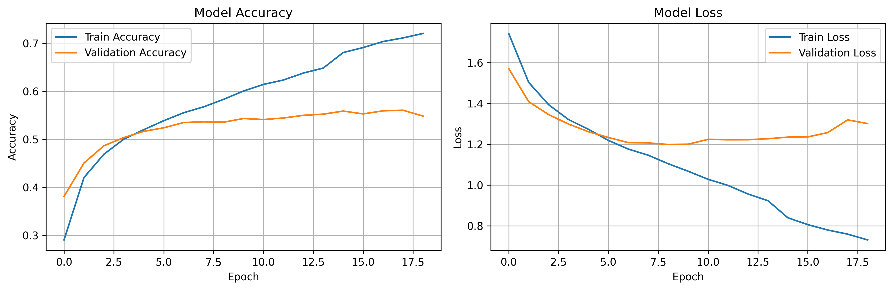
Training Behaviour
What the learning curves reveal
Epoch 19 / 50
≈ 72%
≈ 56%
Epoch 8
Early stopping fired; best weights restored
Final training accuracy
Validation accuracy — plateaued and flat
Validation loss bottoms at ≈1.20, then rises to ≈1.29
A rising validation loss alongside a falling training loss is the textbook signature of overfitting: beyond roughly epoch 8 the network is memorising training examples rather than learning generalisable features.
Emotion Recognition System — Convolutional Neural Network
10

Slide 12
Results — Overall Performance
Evaluated on the complete 7,178-image test set, disjoint from training and validation
57.09%
Against baselines
Random guess (1 / 7) 14.29%
Always predict “happy” 24.71%
This model 57.09%
0.514
0.566
Macro-averaged F1
Weighted-averaged F1
Test accuracy across seven classes on 7,178 unseen images
Random baseline (1 / 7)
14.29%
Majority class — always “happy”
24.71%
Trained CNN
57.09%
The model performs well above both baselines, confirming that it has learned genuine discriminative structure rather than exploiting the class prior.
Emotion Recognition System — Convolutional Neural Network
11

Slide 13
Per-Class Performance
Accuracy alone conceals how uneven the model is
Emotion | Precision | Recall | F1 | Support
Angry | 0.494 | 0.478 | 0.486 | 958
Disgust | 0.792 | 0.171 | 0.281 | 111
Fear | 0.422 | 0.294 | 0.346 | 1,024
Happy | 0.767 | 0.796 | 0.781 | 1,774
Neutral | 0.496 | 0.606 | 0.545 | 1,233
Sad | 0.423 | 0.477 | 0.448 | 1,247
Surprise | 0.747 | 0.681 | 0.712 | 831
Recognised reliably
Happy (F1 0.781) and Surprise (F1 0.712). Both involve large, unambiguous geometric deformation — a raised mouth curve, lifted brows — that survives downsampling to 48×48.
Recognised poorly
Fear (F1 0.346) and Sad (F1 0.448) are subtle, low-contrast expressions whose distinguishing cues are fine-grained and largely destroyed at this resolution.
Disgust — the revealing case
Precision 0.792 but recall 0.171. When the model predicts disgust it is usually right, but it makes that prediction only 24 times in 7,178 images, catching 19 of 111 real cases. A direct consequence of the 1.5% training share — and invisible to accuracy alone.
Emotion Recognition System — Convolutional Neural Network
12

Slide 14
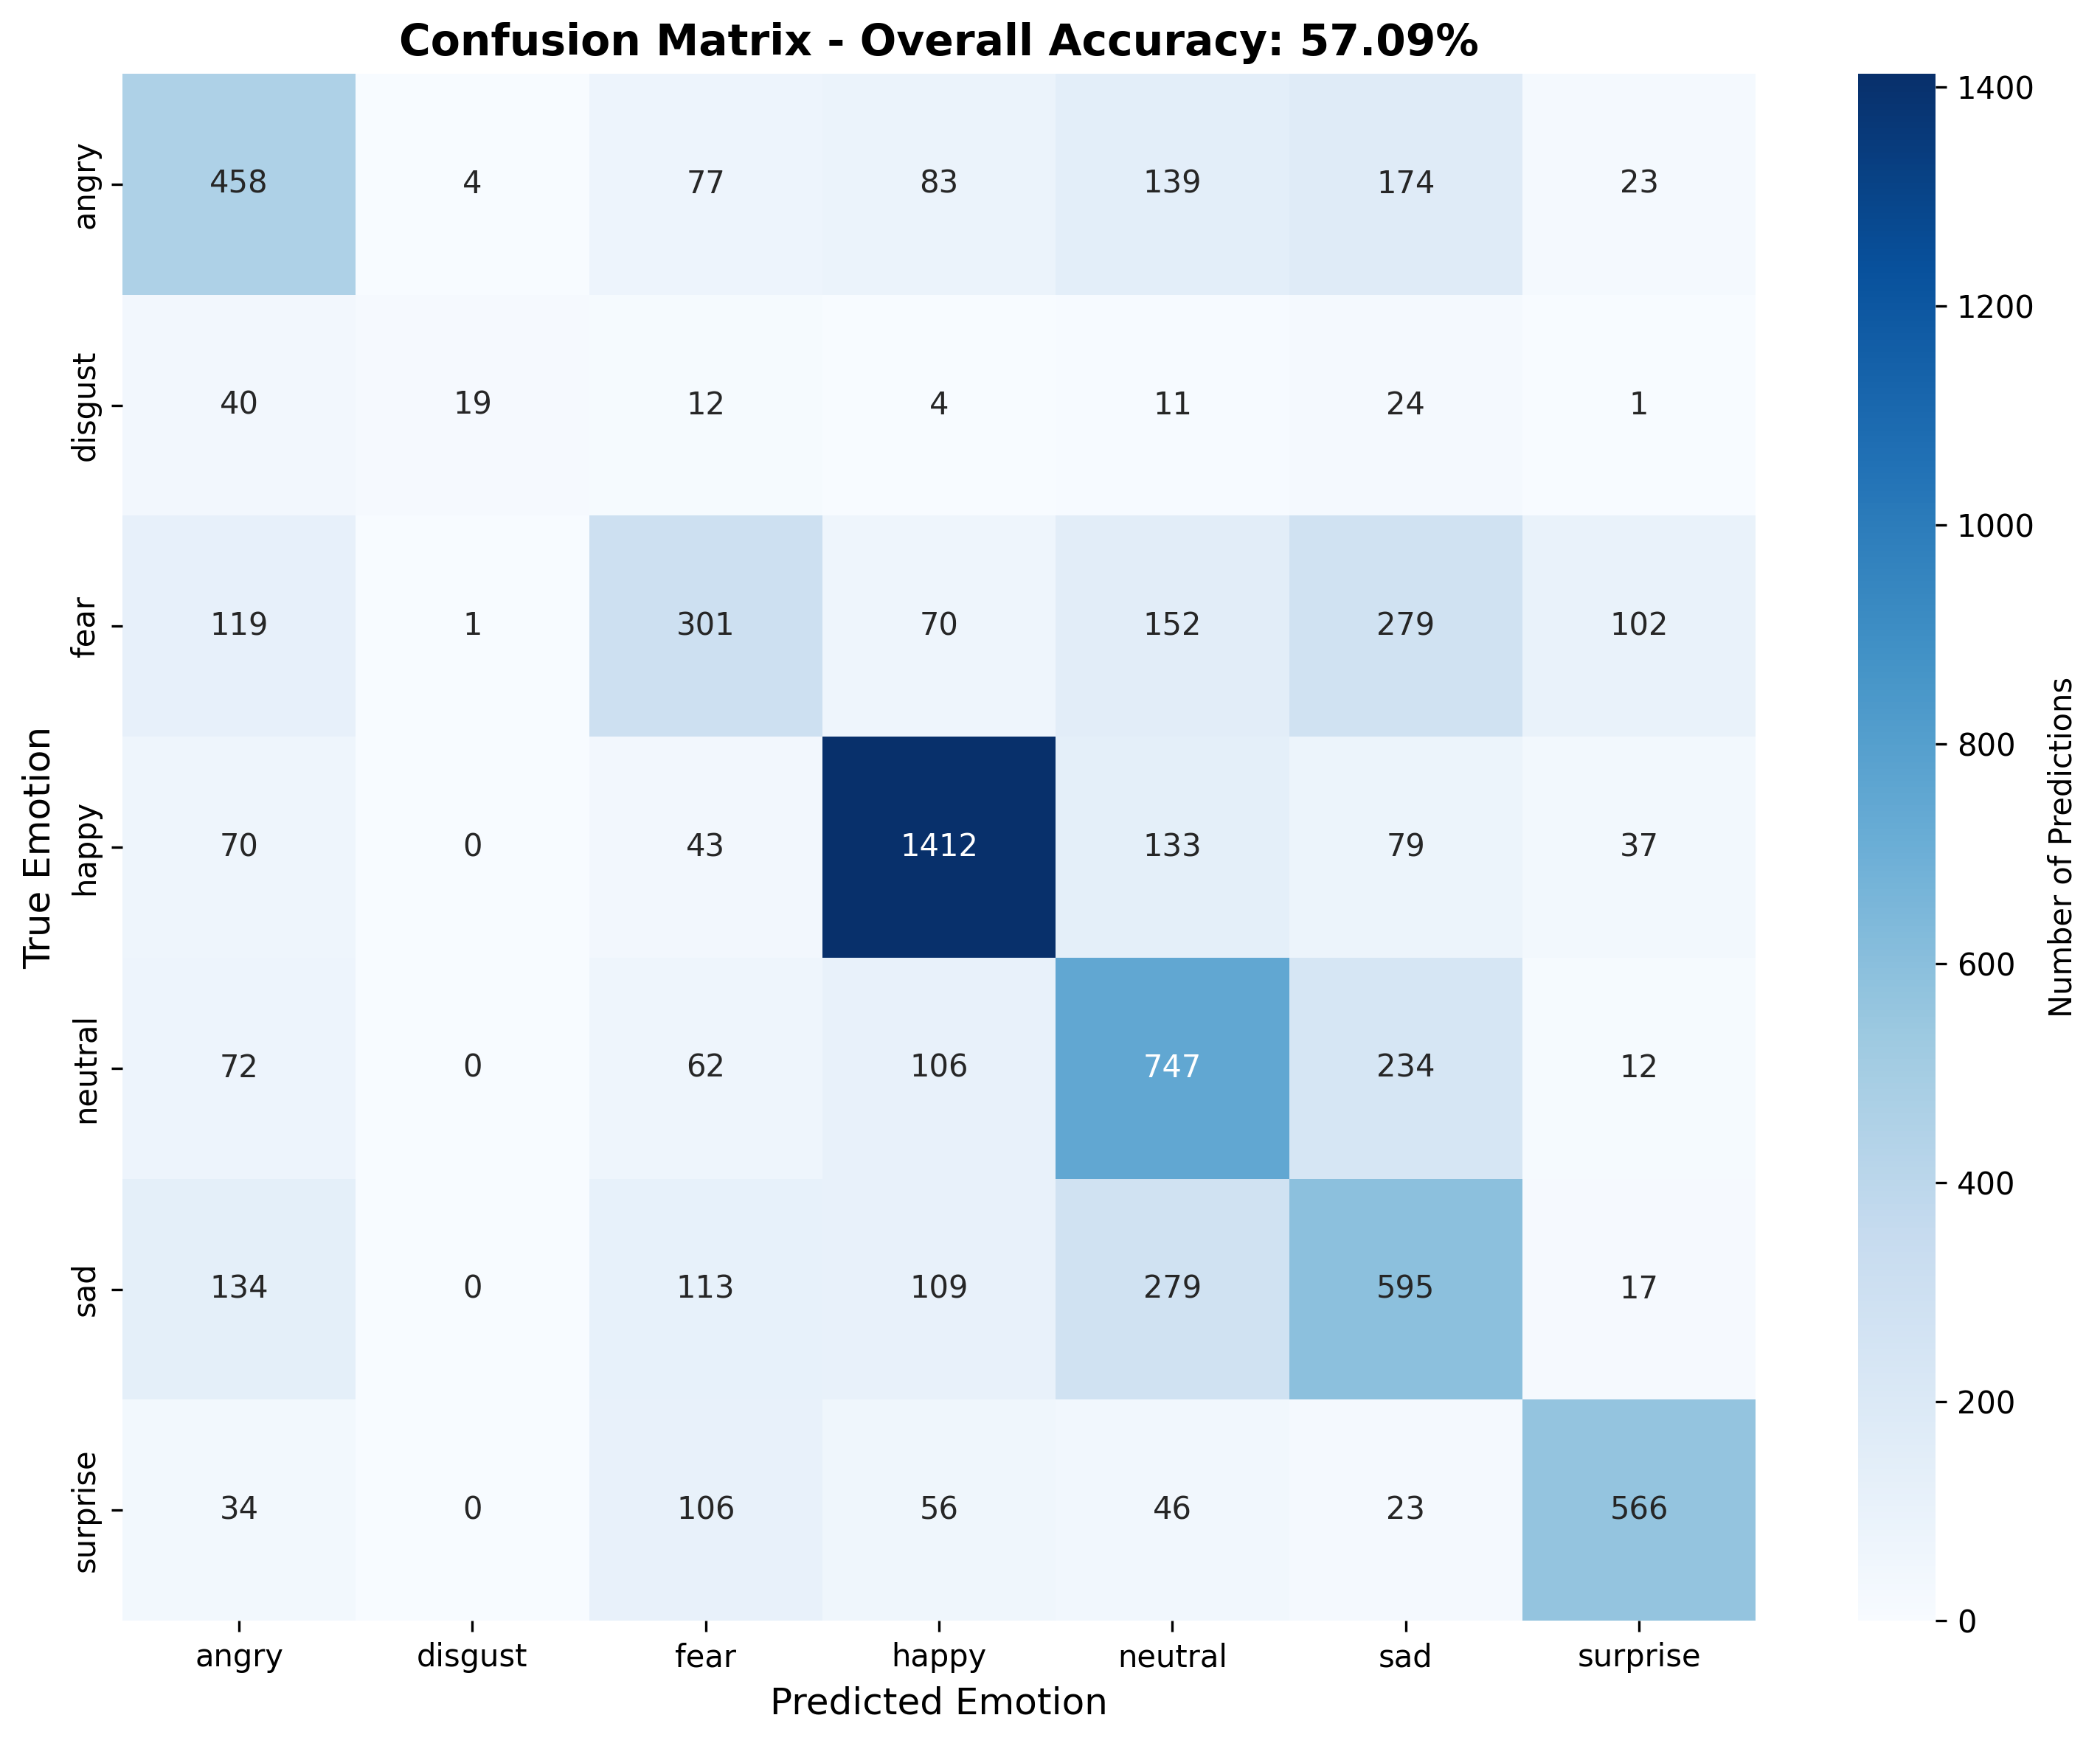
Confusion Analysis
The errors are systematic, not arbitrary
True → Predicted | Count | % of class
Disgust → Angry | 40 | 36.0%
Fear → Sad | 279 | 27.2%
Sad → Neutral | 279 | 22.4%
Neutral → Sad | 234 | 19.0%
Angry → Sad | 174 | 18.2%
Surprise → Fear | 106 | 12.8%
Every dominant confusion pairs emotions that are genuinely similar in facial geometry and affective valence.
Disgust and anger share a lowered brow and raised upper lip. Fear and surprise share widened eyes and raised brows, differing mainly in mouth tension — a cue largely lost at 48×48.
Sad, neutral and angry form a mutually confusable cluster of low-arousal expressions. The model’s errors mirror the ambiguities human annotators also face.
Emotion Recognition System — Convolutional Neural Network
13

Slide 15
System Implementation
Flask backend, Haar Cascade face localisation, CNN inference
1
2
3
4
Face localisation
›
Crop
›
Normalise
›
Predict
A Haar Cascade locates faces in the grayscale frame. Where several are found, the largest bounding box is taken as the subject.
The face region is cropped. Essential — the network was trained on tight crops, so a full scene shifts the input off-distribution.
The crop is resized to 48×48 and scaled to [0, 1], matching training preprocessing exactly.
Softmax yields a probability per class; the argmax is reported with its confidence score.
Endpoint | Method | Purpose
/ | GET | Web user interface
/video_feed | GET | MJPEG stream of annotated frames
/status | GET | Latest prediction and all seven confidence scores
/camera/start, /camera/stop | POST | Acquire and release the webcam
/api/health | GET | Service and model status
≈ 10 fps
Running the CNN on every captured frame stalls the stream. Inference therefore runs on every fifth frame and reuses the most recent prediction in between; face detection and box drawing still run every frame, so the overlay tracks smoothly. Measured at 84 frames over an 8-second capture.
Emotion Recognition System — Convolutional Neural Network
14

Slide 16
Real-Time Camera Detection
The trained model running live in the browser
Server-side capture
Flask serves a single-page application; OpenCV captures webcam frames on the machine running the server.
MJPEG streaming
Annotated frames are JPEG-encoded and pushed as a multipart/x-mixed-replace stream, rendered by a plain <img> element — no client-side video or ML code is required.
[ Screenshot placeholder ]
Paste your live-detection screenshot here — the annotated webcam frame with the bounding box and emotion label.
Live confidence readout
The browser polls /status four times per second to update the emotion label and the confidence bars for all seven classes.
Emotion Recognition System — Convolutional Neural Network
15

Slide 17
Discussion and Limitations
The two principal weaknesses, both identifiable in the design
1. Overfitting
No data augmentation. The network sees each of the 28,709 images in an identical form every epoch. Random flips, rotations, zooms and brightness shifts would multiply the effective dataset size at zero labelling cost.
Minimal regularisation. A single dropout layer before the classifier is the only explicit regulariser. Batch normalisation and weight decay would further constrain the network.
2. Class Imbalance
Training with an unweighted loss allows the network to abandon the rare classes, as the disgust recall of 0.171 demonstrates.
Passing class_weight to model.fit() — inversely proportional to class frequency — would penalise errors on rare classes proportionally more, at some cost to majority-class accuracy. Oversampling and focal loss are alternative remedies.
O T H E R C O N S T R A I N T S
Frontal faces only
Server-side camera
Lighting sensitivity
Single-face assumption
The Haar Cascade fails on profile views and heavy occlusion — no face means no prediction.
Capture happens on the machine running the server, which suits a single-machine demonstration.
Training data offers limited illumination diversity; accuracy degrades in low light.
Only the largest detected face is classified in each frame.
Emotion Recognition System — Convolutional Neural Network
16

Slide 18
A Defect Found and Corrected
Label-order consistency — and why end-to-end verification mattered
The mismatch
50.0% vs 27.6%
Accuracy on the same held-out images under the correct ordering versus the incorrect one. The fix nearly doubled measured accuracy.
API returned: [ Angry, Disgust, Fear, Happy, Sad, Surprise, Neutral ]
Model trained on: [ Angry, Disgust, Fear, Happy, Neutral, Sad, Surprise ]
Indices 4, 5 and 6 were permuted, so every prediction falling into those three classes was reported under the wrong name.
The defect was silent. The API returned well-formed responses with high confidence values, and nothing in the output indicated an error.
Lesson 1
Lesson 2
The class ordering is a contract between training and inference. It should be defined once and imported everywhere, never restated per file.
A defect of this kind is invisible to unit-level checks. It surfaces only when predictions are compared against known labels end to end.
Emotion Recognition System — Convolutional Neural Network
17

Slide 19
Future Work
Ordered by expected benefit relative to effort
1
2
3
Data augmentation
Class weighting
Batch normalisation
Random flips, rotations, zooms and brightness jitter. Directly addresses the primary limitation; expected to add several points of accuracy.
Recover usable recall on disgust and fear by penalising rare-class errors proportionally more.
Deeper regularisation for faster, more stable convergence and reduced overfitting.
4
5
6
Transfer learning
Better face detection
Temporal smoothing
Fine-tune a VGG-16 or ResNet-50 backbone pretrained on ImageNet. Published results reach ≈70% on FER-2013.
Replace the Haar Cascade with an MTCNN or DNN-based detector for robustness to pose and lighting.
Average predictions over a short window of frames to suppress the flicker of per-frame classification.
Emotion Recognition System — Convolutional Neural Network
18

Slide 20
Application Extension — MoodFlick
A demonstration of the trained classifier used as a component in a larger product
Same model, new surface
The identical emotion_model.h5 classifier drives MoodFlick; nothing about the network or its training changes.
Emotion → recommendation
A scanned expression is mapped to a curated movie shelf, with the prediction confidence carried through into the ranking.
[ Screenshot placeholder ]
Paste a MoodFlick screenshot here — the detected-emotion panel and the recommended shelf.
Manual refinement
Eight mood tags, fourteen genres and an actor/title search let users refine results beyond the camera scan.
MoodFlick is presented as an application of the model, not as the contribution of this project. The classifier itself remains the work.
Emotion Recognition System — Convolutional Neural Network
19

Slide 21
Conclusion
A complete facial emotion recognition system was designed, trained, evaluated and deployed. The CNN attains 57.09% accuracy across seven classes on 7,178 unseen test images — substantially exceeding the 14.29% random and 24.71% majority-class baselines, and comparable to typical results for a network of this size trained from scratch on FER-2013 without augmentation.
Beyond the headline figure, the evaluation established where the model succeeds and fails: high-signal expressions are recognised reliably, subtle and under-represented ones are not, and the training curves locate the onset of overfitting at approximately epoch 8 — identifying data augmentation and class weighting as the concrete next steps.
57.09%
355,847
≈ 10 fps
0.514
test accuracy
parameters
live inference
macro F1
Thank You
Emotion Recognition System — Convolutional Neural Network
20

