Slide 1
The importance of Big Data Analytics in studying consumer behavior
Dr. Paul Blondel • 27.09.2019

Slide 2
What is Big Data?
A combination of characteristics
High volume
High variety/complexity
High velocity

Slide 3
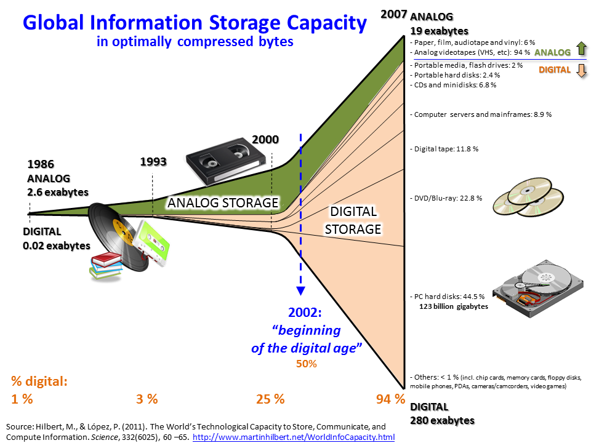

Slide 4
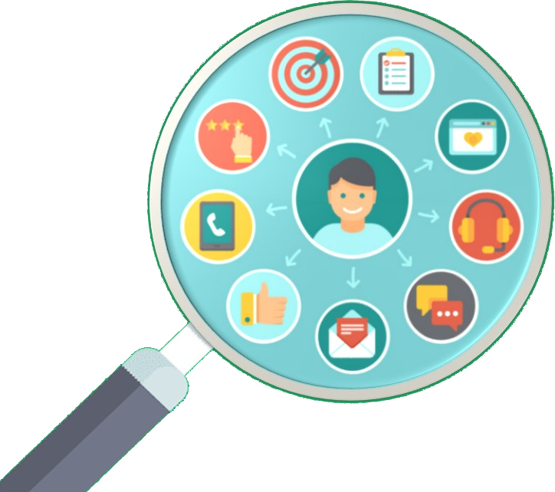
Where comes consumers’ Big Data?
The digital era created new sources of information
CRM* softwares
Social networks
Sensors/IOTs**
* CRM: Customer Relationship Management **IOT: Internet Of Things
Blog articles
Digitized news and articles
Etc.

Slide 5
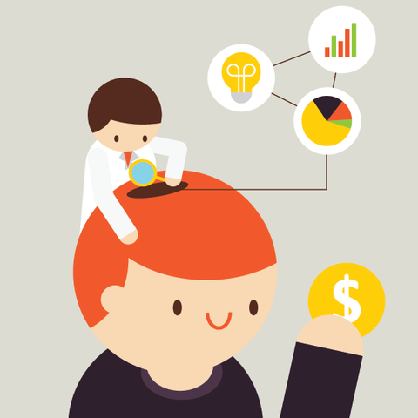
Consumer behavior?
Definition
How consumers make decisions about what they need, want and desire
How do they buy, use, and dispose of goods.

Slide 6
Why study consumer behavior?
Business needs
Attracting new customers
Keeping acquired customers
*ROI: Return On Investment
While having a high ROI*

Slide 7
Studying customer behavior with Big Data Analytics
New possibilities
Forecast trends
Compute dynamic prices
Improve customer satisfaction
Forecast the demand
Detect the churn
Etc.

Slide 8

Forecast trends
Goal: Forecasting the trends to be the first supplier
What we can forecast:
Excitement trends (for new products)
Worry trends (ex: concerns about a material )
Future needs (ex: organic materials)
Analyzing social networks and blog articles can be particularly interesting here.
Example: Deloitte’s Blab tool

Slide 9
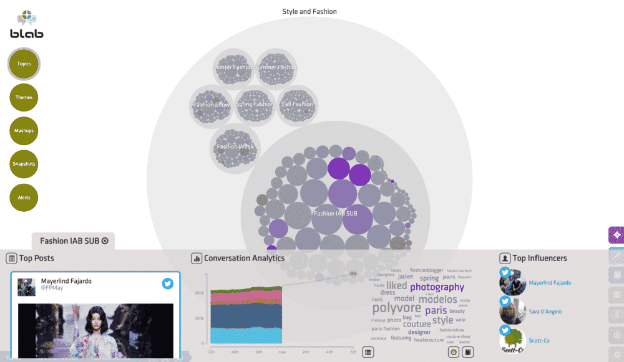

Slide 10
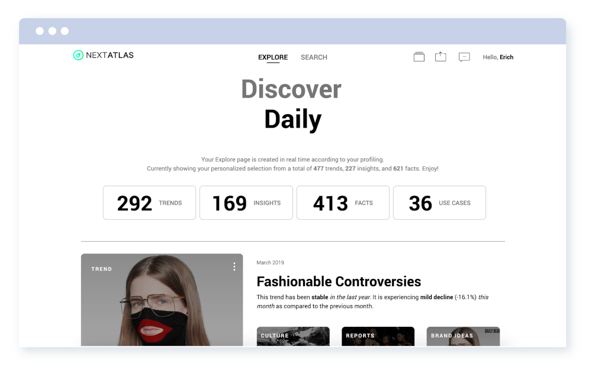

Slide 11
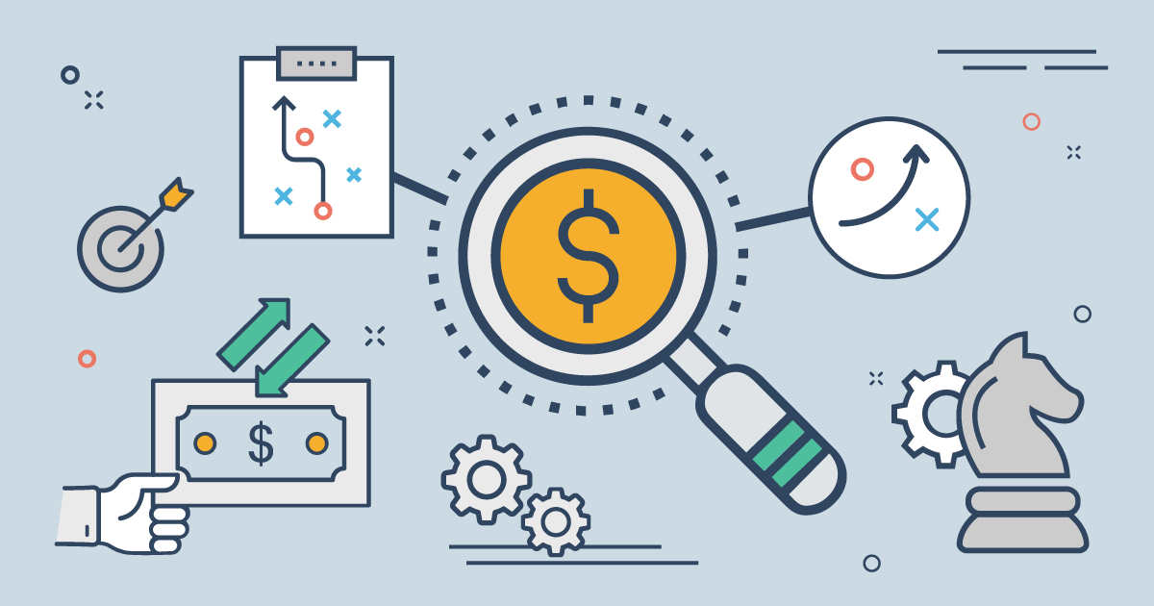
Compute dynamic prices
Goal: keep the highest ROI possible while beating the competition
With dynamic prices we can adapt to:
Taxe changes
Competitor prices
Seasonal effects
Material cost changes
Perceived value
This is highly strategic to keep acquired consumers, continue to get new ones and to have a high ROI.
Example: H&M uses dynamic pricing

Slide 12
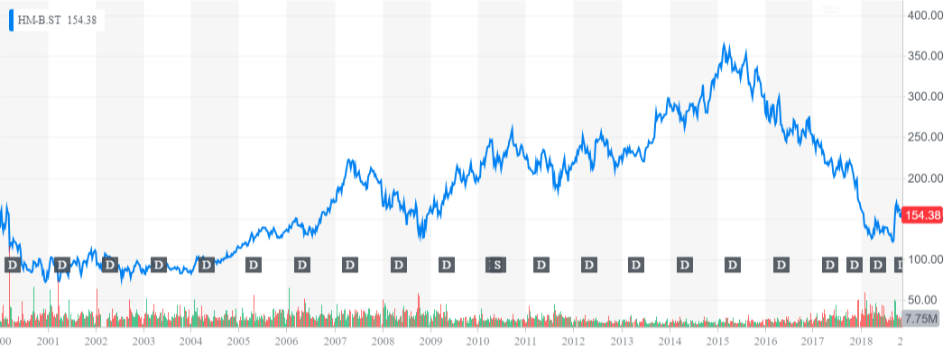

Slide 13
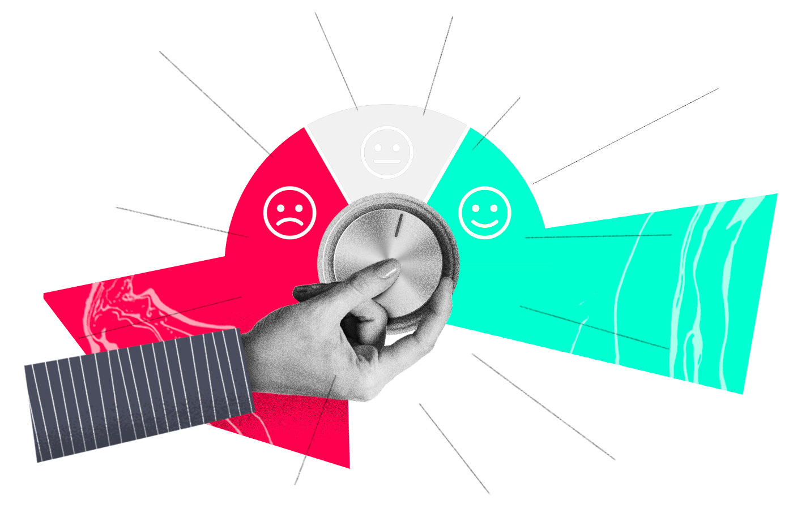
Improve consumer
satisfaction
Goal: improve satisfaction means improve retention and loyalty
Consumer satisfaction can be gauged from:
Consumer service calls
Mentions in social networks
Mentions in social media
Finding poor customer experience from data and solving this can easily help improving the satisfaction.
About 5 times less expensive to keep an existing consumer rather than get a new one.

Slide 14

Forecast the demand
Goal: knowing the demand to produce the right amount of products
Forecasting the demand helps:
Limiting number of unsold products
Reducing overall production costs
Reducing environment damages
BUT: forecasting the demand is particularly challenging for the fashion industry, although recently the research focused on this issue*.
*Fashion Retail: Forecasting Demand for New Items, KDD 2019

Slide 15
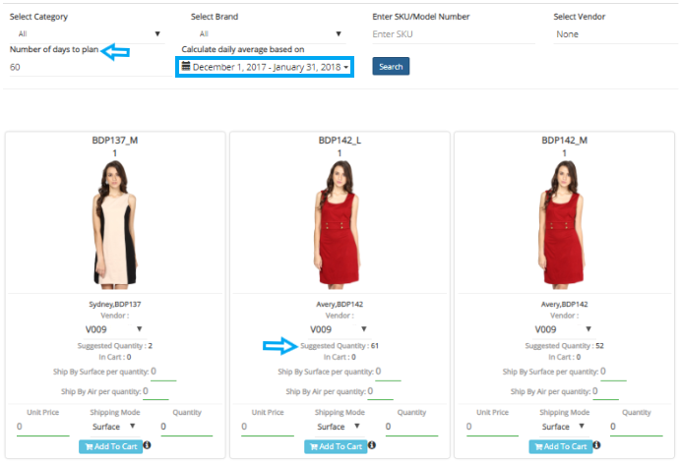

Slide 16
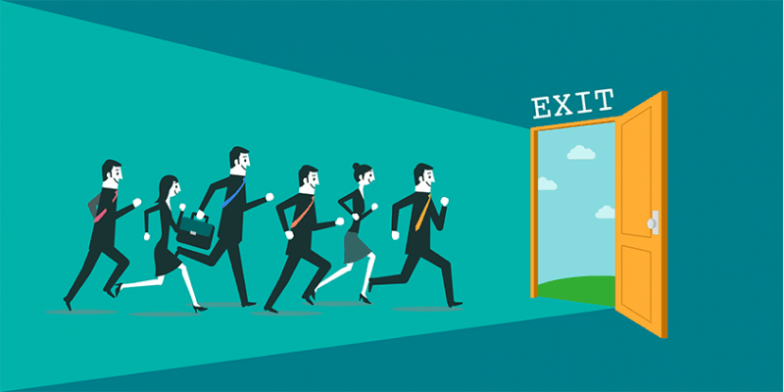
Detect the churn
Goal: detect in advance if and when a consumer is likely to disengage
How to detect this?
Not opening your company’s mails
Unfollow your social networks
Followed KOLs less interested
Not buying for a while
Contact the customers likely to churn and give them free coupons, promotions, invite them to social events .. . Remember it’s 5 times harder to get new customers!

Slide 17
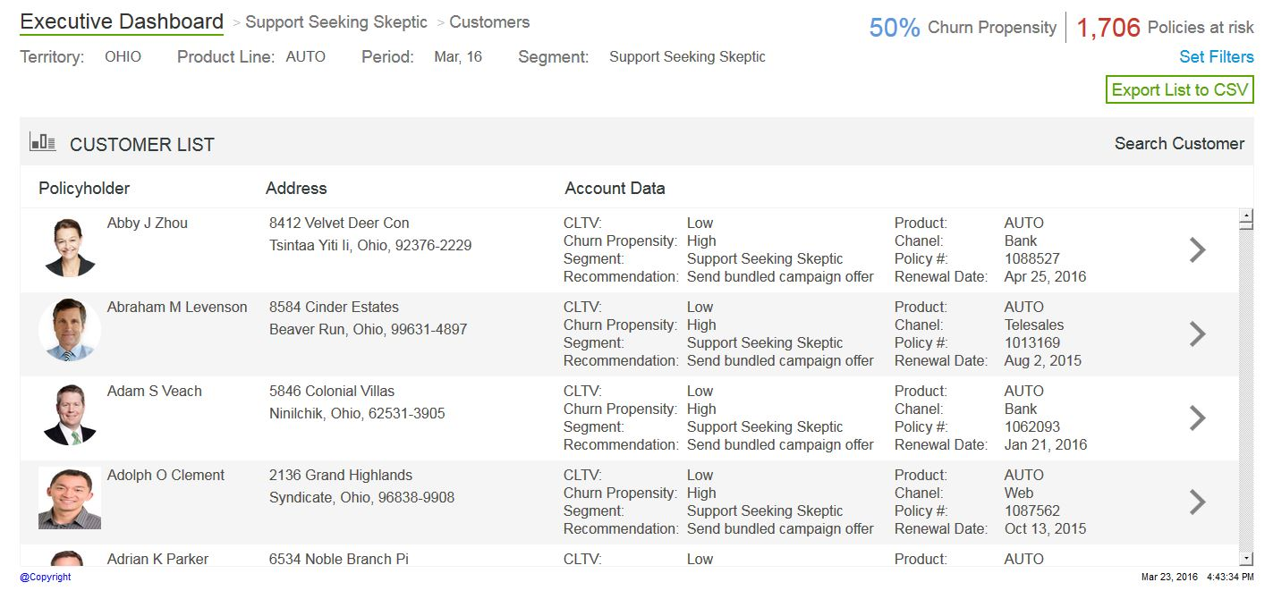

Slide 18
The importance of Big Data Analytics
McKinsey
“Big data will become a key basis of competition”, Big data: The next frontier for innovation, competition, and productivity
“Big Data: Many companies don’t have one… [those having one] can deliver productivity and profit gains that are 5 to 6 percent higher than those of the competition”, Big data: What’s your plan?
“Our colleagues at the McKinsey Global Institute (MGI) … estimated that retailers exploiting data analytics … could increase their operating margins by more than 60 percent”, Getting big impact from big data

Slide 19
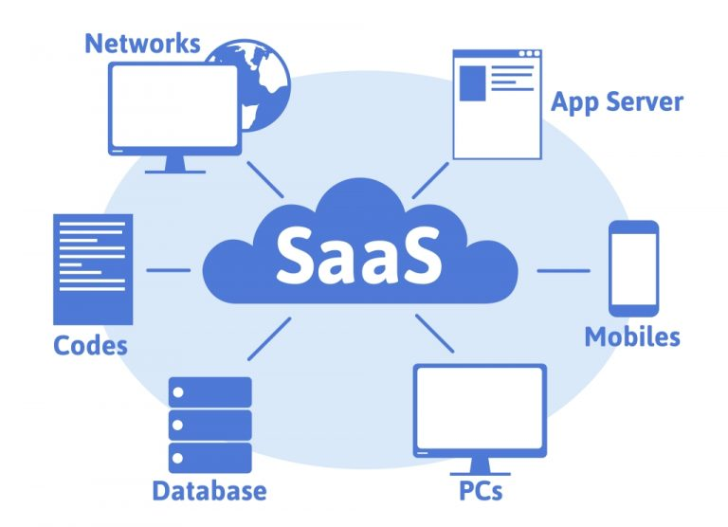
Big Data Analytics solutions for you
Nowadays you don’t need a massive budget for a super expensive team of Data engineers.
You can use SaaS* solutions:
Inventory forecast: https://www.easyecom.io/
Consumer analytics: https://www.sas.com/ https://www.trifacta.com
Trends forecast: https://www.spate.nyc/ https://www.nextatlas.com/
Dynamic pricing: https://www.5analytics.com https://www.antuit.com/
* SaaS: Software as a Service (web platform)

Slide 20
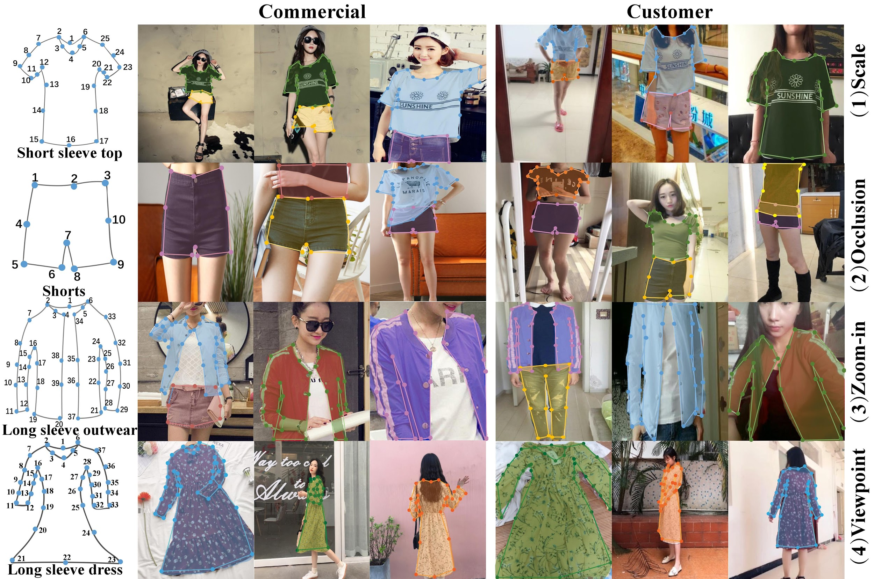
For fun!
Clothing Detection for fashion recommendation

Slide 21
Thank you for listening!
What you can do better thanks to Big Data Analytics:
Be more competitive,
Forecast what want your consumers,
Keep your consumers
Reduce cost by forecasting demand
Have a lower environment impact!
Etc (the potential is huge).
Big Data Analytics is more and more accessible to companies of all size thanks to SaaS solutions.

