Slide 1
Credit One.
Credit Scoring Service.
Predictive Analysis.

Slide 2
Index
- Framework
- Some Ideas after fast overview
- Possible pitfalls

Slide 3
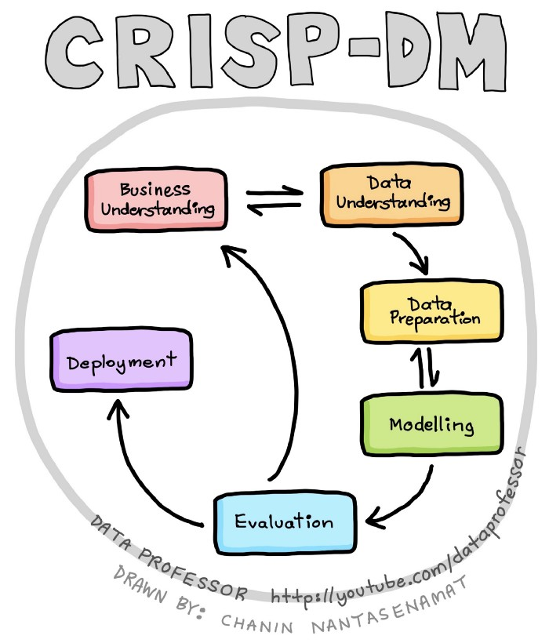
Project Framework
CRoss Industry Standard Process for Data Mining

Slide 4
Goals
Keep defaults as low as possible.
Understand how much credit to allow someone to use or, at a very least, if someone should be approved or not.

Slide 5
Data Understanding & preparation
Get Data
Exploratory Data Analysis
  Cleaning, Relabeling, grouping, etc
  Feature engineering
As required, all the project will be stored in a GitHub Account:
https://github.com/alefbenages/CreditOne
Notes:
Get Data
First Exploration
Cleaning: time to make choices about undocumented labels and
Feature Engenieering: time to be creative

Slide 6
Modeling
Predictive Analysis (What will happen?)
It’s a Classification problem.

Slide 7
Evaluation
Evaluate
Rinse and repeat
Future
Repeat

Slide 8
Some Ideas after a fast Overview
data divided in:
  ±30.000 rows and,
  23 categories= ID, Sex, Marital Status, Education, Age, History of past payments, Amount of bill statement, Amount of previous payments, Client’s behavior.
Default Probability = 22%

Slide 9
Some Ideas after a fast Overview
SEX → 60% Female // 40% Male
EDUCATION →
AGE →
MARITAL STATUS→
SOME GRAPHS???

Slide 10

Potential Pitfalls
> Some undocumented categories
Education 0,4,5,6=Other
> Why there is no Pay_1 ?
> Some cases of mixed data types
>

Slide 11
Questions?

Slide 12
THANKS!
Alejandro Fernandez Benages
Data Science Team

Slide 13
Evaluation
Evaluate the accrued results and review the process performed, to determine if the goals are met or not.
Rinse and repeat, some steps may need to be performed more than once, each time improving metrics and the understanding of the data.
Future, in this evaluation phase, some findings may ignite new project ideas for which to explore.
Is there any recommended metric that we can use to guide our project?
- minimum accuracy desired
- minimum % of rejected customers
- ..

