Slide 1
ICTSAS519
Perform systems tests

Slide 2
Timetable
Week | Task
23/04 (Thur) | Task 1 (Q&A)
24/04 (Fri) | Task 2 (PPT)
30/04 (Thur) | Task 3 (Develop Test Plan)
01/05 (Fri) | Assignment Day (present, if any)
03/05 (Sun) | Deadline

Slide 3
TASK 1 (Q & A)
Question 1: Choose one automated test tool for website and describe the key features and processes.
Related to course materials 1.3
e.g. You can pick any one and describe the key features and processes.
https://www.capterra.com/sem-compare/automated-testing-software?gclid=EAIaIQobChMIkLXu6enr6AIVjQ4rCh29lQxQEAAYBCAAEgJY9_D_BwE

Slide 4
TASK 1 (Q & A)
Question 2: Describe the typical procedure for one of the testing and acceptance.
Related to course materials 1.1
e.g. Usability Testing/ Load Testing / Security Testing … and describe the procedure.

Slide 5
TASK 1 (Q & A)
Question 3: What are the Implications for organisational operations of system testing activities?
Related to course materials 1.6
You can state some examples for the following areas.
e.g. network issues, budget issues, manpower issues

Slide 6
TASK 1 (Q & A)
Question 4: Briefly describe the software life cycle in your own words.
Related to course materials 1.2
e.g. Waterfall Model…

Slide 7
TASK 1 (Q & A)
Question 5: How to identify different users and modules?
Related to course materials 1.4
e.g. different users – divide the testing up into small tasks…
Different modules – divide the testing up into functions…

Slide 8
TASK 1 (Q & A)
Question 6: Write three test cases for website.
Related to course materials 2.2
You can try to design 3 test cases with the help of the link below.
http://softwaretestingfundamentals.com/test-case/

Slide 9
TASK 1 (Q & A)
Question 7: What is proofing content?
Related to course materials 1.1
e.g. checking broken links, typo …

Slide 10
TASK 1 (Q & A)
Question 8: Why is it not a good idea to manually check for broken links?
Related to course materials 1.1
e.g. waste time …

Slide 11
TASK 1 (Q & A)
Question 9: What sort of environment should be set up to conduct the various tests on a website?
Related to course materials 1.1
e.g. isolated test system …

Slide 12
TASK 2 (role play / presentation)
Sample website
http://demo.guru99.com/V4/
Or any website with web application and you must have admin right.
Remember you need to prepare a powerpoint (or other presentation software) which is for presenting to your client and tell them what you will prepare for test; how to conduct test; how to analyse and classify results,
Therefore you DO NOT need to prepare for a full test plan and run the test. All will be done in Task 3

Slide 13
TASK 2 (role play / presentation)
1.1 Determine acceptance criteria from system specifications
Give some samples
e.g. when I click on the ‘New Customer’, ‘Add New Customer’ page will be displayed on the right-hand side
…

Slide 14
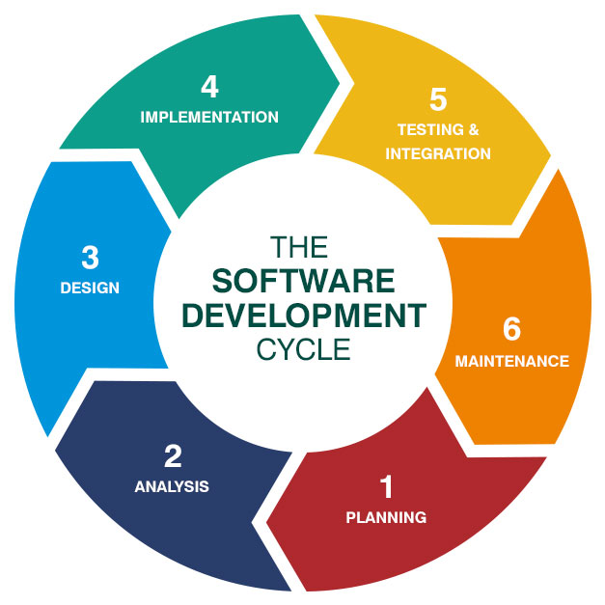
TASK 2 (role play / presentation)
1.2 Determine and document software life cycle according to system specifications and contact in operations
You can mention how to do that, e.g. which software life cycle you are using…

Slide 15
TASK 2 (role play / presentation)
1.3 Define test plan from acceptance criteria, software life cycle, system specifications and in compliance with organisational testing and acceptance processes
You can mention what topics you will put inside the test plan
http://uniinstitute.com.au/ica50615/pst_respak/images/Template%20TESTPLAN.pdf

Slide 16
TASK 2 (role play / presentation)
1.4 Notify contact in operations of scheduled tests to understand implications for operations and modify schedule to minimise implications for operations
You can say how to notify contact in operations of scheduled tests e.g. inform network administrator because internet will be used up during test…

Slide 17
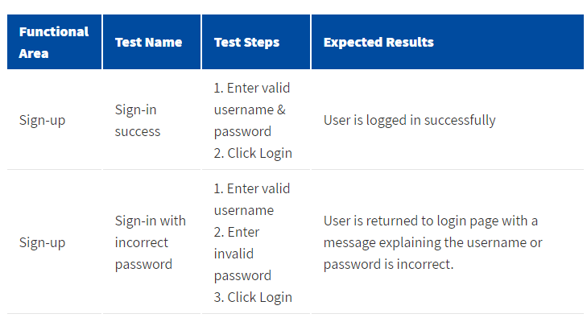
TASK 2 (role play / presentation)
1.5 Develop test scripts for online test and test run for batch test according to test plan
Here are some test scripts samples, e.g.

Slide 18
TASK 2 (role play / presentation)
1.6 Prepare test environment and select test tools according to test plan
You can say what test environment and test tools you will use e.g. which browsers, OS…
You can pick some test tools from the link below
https://www.adstriangle.com/blog/website-testing-tools/

Slide 19
TASK 2 (role play / presentation)
1.7 Prepare test logs and result sheets according to test plan
Some sample test logs and result sheets will be prepared…
See next page

Slide 20
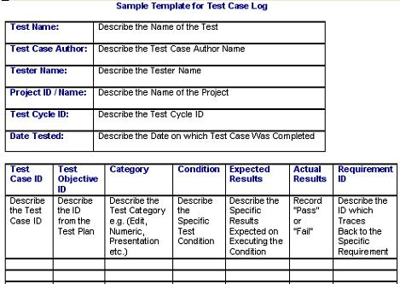

Slide 21
TASK 2 (role play / presentation)
1.8 Conduct walk-through with superior to review expected results against acceptance criteria and incorporate feedback
List some points how to conduct walk-through…
https://infodesign.com.au/wp-content/uploads/Walkthrough.pdf

Slide 22
TASK 2 (role play / presentation)
2.1 Create clean test environment and initialise test environment according to test plan
What clean test environment will be, e.g. clearly cookies and history of the browsers…

Slide 23
TASK 2 (role play / presentation)
2.2 Run test scripts and document results according to organisational testing and acceptance processes and test plan
How to run test scripts and document results… e.g. use clean environment to follow the test scripts to run…

Slide 24
TASK 2 (role play / presentation)
2.3 Finalise test environment and document completed tests according to test plan and test logs and result sheets.
How to document completed tests… e.g. paper-based? Data input?

Slide 25
TASK 2 (role play / presentation)
2.4 Compare and document actual results to expected results for each system unit and complete result sheets
The importance of comparing and documenting actual results to expected results…

Slide 26
TASK 2 (role play / presentation)
3.1 Analyse test results against acceptance criteria to identify variances
How to analyse test results against acceptance criterial…e.g. any tools like diagram in course materials 3.1

Slide 27
TASK 2 (role play / presentation)
3.2 Summarise and classify test results to prepare report highlighting critical and urgent variances
Test results sample, e.g. the next page

Slide 28
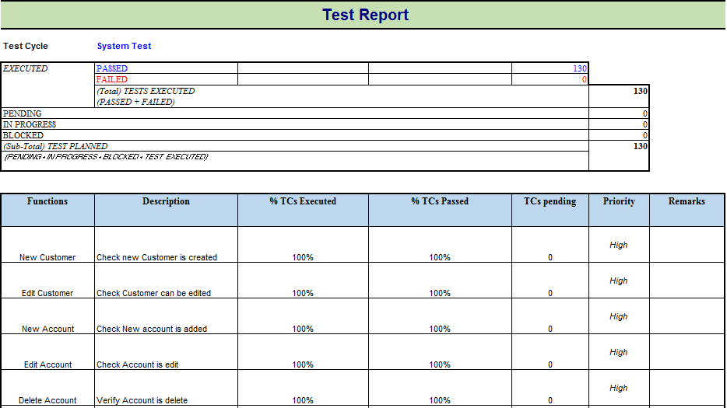

Slide 29
TASK 2 (role play / presentation)
3.3 Notify contact in operations of test completion to communicate implications
The importance of notifying contact in operations of test completion… You can refer to course materials 3.3

Slide 30
TASK 2 (role play / presentation)
3.4 Obtain and incorporate feedback from superior on test results report to finalise report
The procedure to obtain and incorporate feedback from superior… e.g. hold a meeting, sign non-disclosure agreement…

Slide 31
TASK 3 – REQUIREMENTs
Part 1 – Develop a test plan for the website you used in Task 2
Here is sample test plan template
http://uniinstitute.com.au/ica50615/pst_respak/images/Template%20TESTPLAN.pdf

Slide 32
TASK 3 – REQUIREMENTs
Part 1 – Develop a test plan for the website you used in Task 2
Test plan should include the following items
Test items
Features to be tested
Features not to be tested
Approach
Pass/ Fail criteria
Testing Process
Environmental requirements
Change management procedures
Plan approvals

Slide 33
TASK 3 – REQUIREMENTs
Part 2 – conduct the test and generate test report
Test report should include the following items
Functions | Descriptions | % Test Cycle Executed | % Test Cycle Passed | Test Cycle Pending | Priority | Remarks
Add Customer | Check new Customer is created | 100% | 100% | 0 | High

Slide 34
TASK 3 – REQUIREMENTs
Part 3 – Analyse and classify results. Compare the test result with acceptance criteria, classify any critical and urgent variances
List all acceptance criteria and compare with result
Acceptance Criteria | Result | Critical and urgent variances
when I click on the ‘New Customer’, ‘Add New Customer’ page will be displayed on the right-hand side | The page is shown on the left-hand side | Urgent variance - Should be corrected immediately

Slide 35
Task 3 – DOCUMENTATION
Test plan
Test Result
Analysed and classified result

Slide 36
Submission GUIDELINES
Task 1
Answer in the “ICTSAS519 - Assessment Task 1[Your Name]” and submit
Task 2 (Compress the files and submit)
PowerPoint (or any presentation software)
Fill in the student details in “ICTSAS519 - Assessment Task 2[Your Name]”
Task 3 (Compress the files and submit)
Prepare 3 documents
Fill in the student details in “ICTSAS519 - Assessment Task 3[Your Name]”

