Slide 1



TIME SERIES FORECASTING
Alessandro Fossati, University Bicocca of Milan, Faculty of Data Science
Streaming Data Management and Time Series Analysis’ Final Project

Slide 2
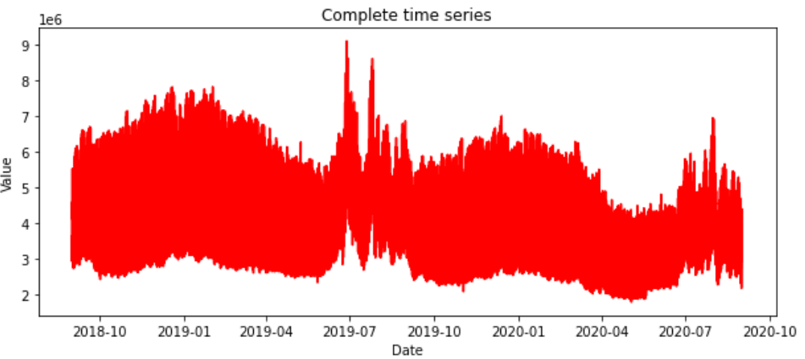
DATA PRESENTATION AND PIPELINE
Starting Data: hourly time series from 2018-09-01 to 2020-08-31
Target: to forecast time series’ data from 2020-09-01 to 2020-10-31
Daily, Weekly and Annual Seasonalities found
No Covid-19 variable included
Forecast with ARIMA, UCM and ML models
Training models with Holdout Train-Test split
Selection of the best model

Slide 3

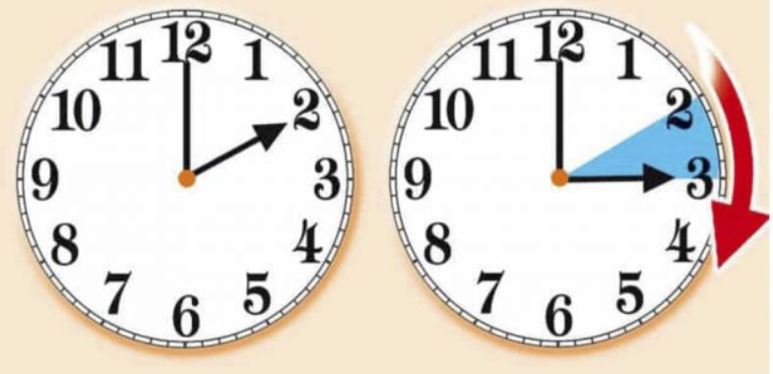

DATA PREPROCESSING
Starting Data restructuring: DateTime index creation, keeping time series values
Missing values filling for 2020-05-31
Outliers handling
Missing values filling for the change to summer time (end of March 2019 and 2020)
Leap year handling

Slide 4
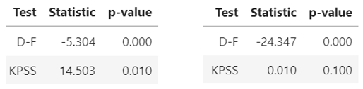
TRAINING ARIMA MODELS
Obtaining time series stationarity with seasonal difference application (order 24)
KPSS and DF test are good now (right side)
Correlograms analysis and Grid search method to select best ARIMA
SARIMA(3,0,1)(1,1,1)24 gets the best MAE on TestSet

Slide 5
TRAINING SARIMAX MODELS
Improvement including harmonics to model seasonalities (6 for Week and 8 for Year)
Graphical Performances:
Difficulty with 2020 Aug-Jul peak
Descendent trend caught

Slide 6

TRAINING UCM
Trend component selected searching for best MAE value on Train and on Test between:
Random Walk
Random Walk with Drift
Local Linear Trend
Local Linear Deterministic Trend
Seasonal component with 6 harmonics for weekly seasonality and 8 harmonics for annual seasonality

Slide 7
TRAINING UCM
Graphical performance:
Generalized overestimation
Descendent Trend caught
Good on the 2° half of Test Set

Slide 8

TRAINING ML MODELS
Searching for best RNN between LSTM and GRU
Strategy:
Fixing some common parameters and characteristics after some trials
Data normalization and dataset reshaping
Searching for best number of Epochs and Batch Size exploiting iterated Grid Search
Common parameters and characteristics:
Stateless networks
Single layer of 300 neurons in input, Dense output layer with activation = tanh
Dropout rate = 0.2
Loss function = MAE
Optimizer = adam
5 training iterations for MAE

Slide 9
TRAINING ML MODELS
The winner is GRU
Graphical performance:
Generalized underestimation
Trend is caught
Possible improvement changing parameters

Slide 10
FINAL COMPARISON
Selection of the best model analyzing MAE and plots
SARIMAX could be considered the best
Similarity in September predictions

Slide 11
THANKS FOR YOUR ATTENTION
Alessandro Fossati, University Bicocca of Milan

