Slide 1
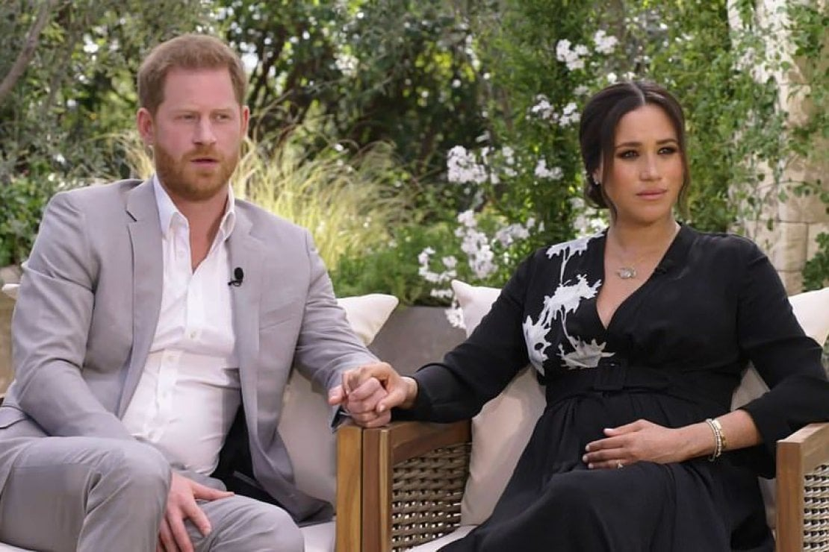
MEGHAN AND HARRY INTERVIEW
ANALYSIS OF USERS’ BEHAVIOUR ON TWITTER
Alessandro Fossati, Giorgio Nardi
Big data in behavioural psicology

Slide 2





Analisi progetto diapositiva 2
Characteristics of Twitter Collection
8TH MARCH 2021
95K TWEETS COLLECTED
TWEETS COLLECTION
SEARCH BY HASHTAG
LIBRARY TWEEPY
TWITTER DEVELOPER API
SELECTION OF FIELDS

Slide 3


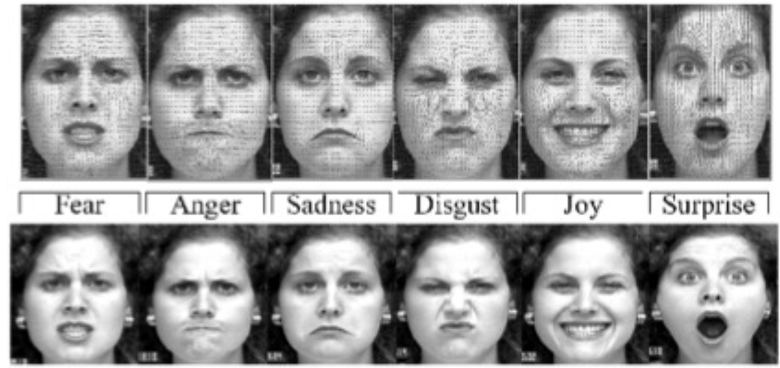


Technical Instruments for Analysis
Text preprocessing using NLTK python library
Sentiment Analysis:
Filtering for specific fields (hours, words, retweet)
VADER tool to compute sentiment scores
Matplotlib python library and Tableau Software to create Data Visualizations
Emotion Analysis:
NRCLex python library to detect emotions
Matplotlib python library to create pie charts
Emoji Analysis:
emoji python library to detect emojis
Matplotlib python library to create barplots
Retweet Analysis:
Creating retweet networks using networkx python library
Matplotlib python library to create retweet barplots

Slide 4



Analisi progetto diapositiva 4
Interactive Dashboard
Obiettivi Gestione
LINK TABLEAU DASHBOARD
Obiettivi Cliente

Slide 5
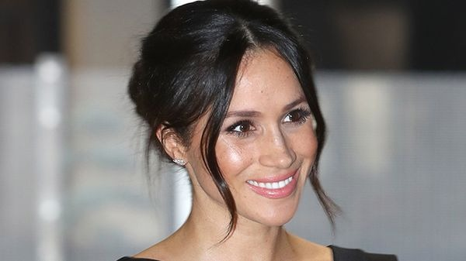
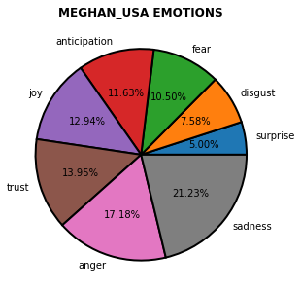
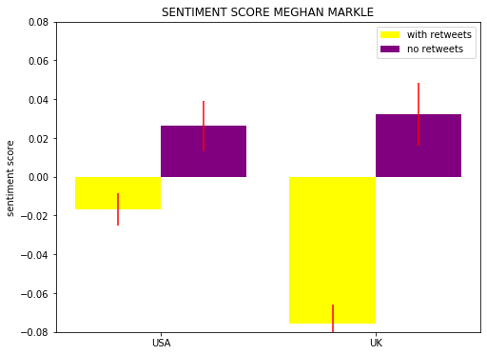
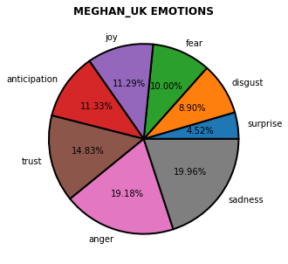
Analisi progetto diapositiva 4
Focus on Meghan
Obiettivi Gestione
Obiettivi Cliente

Slide 6

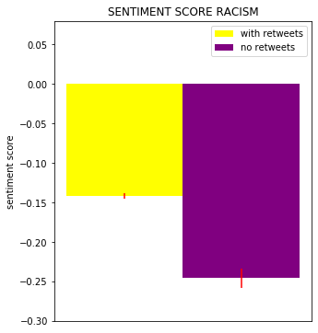
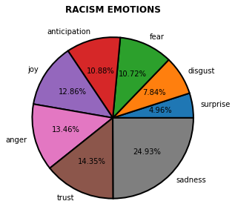
Analisi progetto diapositiva 4
Focus on racism
Obiettivi Gestione
Obiettivi Cliente

Slide 7
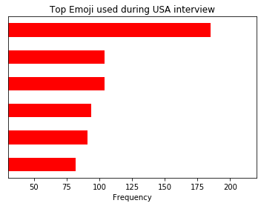
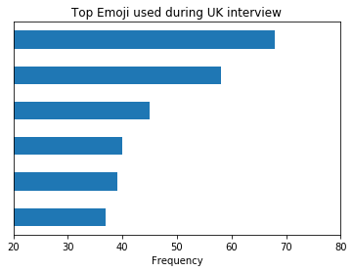












Analisi progetto diapositiva 4
Emoji analysis
Obiettivi Gestione
Obiettivi Cliente

Slide 8
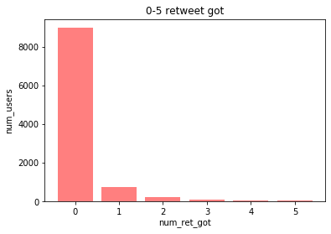
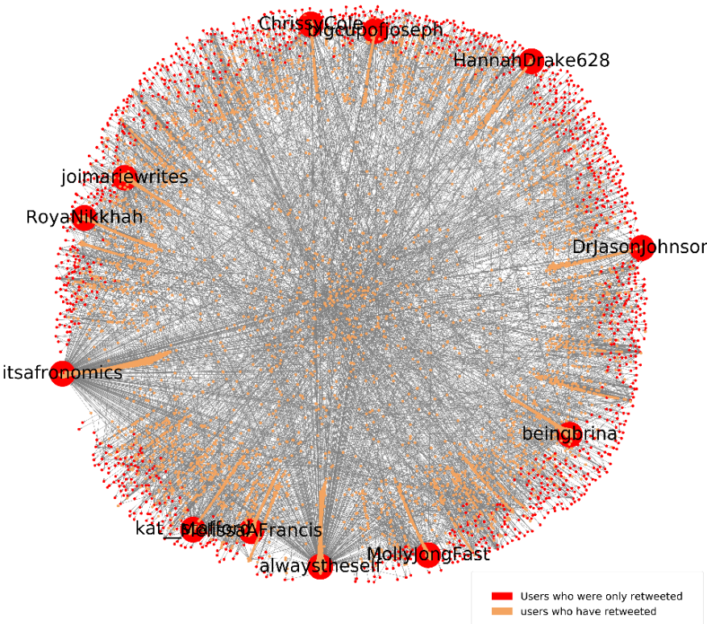
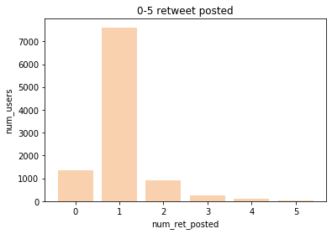
Analisi progetto diapositiva 4
Focus on Retweet: USA interview
Obiettivi Gestione
Obiettivi Cliente

Slide 9
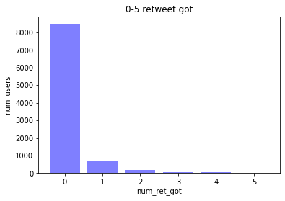
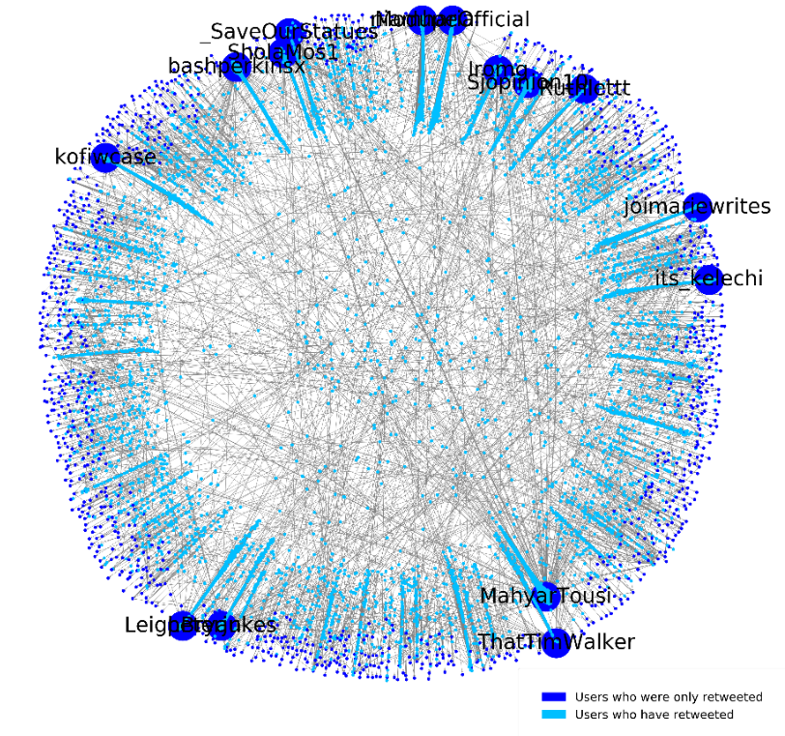
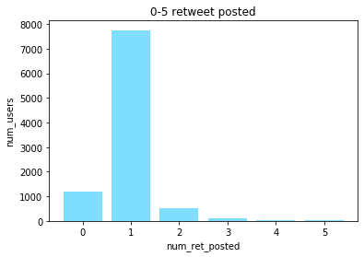
Analisi progetto diapositiva 4
Focus on Retweet: UK interview
Obiettivi Gestione
Obiettivi Cliente

Slide 10
Thank you for listening!
Alessandro Fossati, Giorgio Nardi
Big data in behavioural psicology

