Slide 1
UNJ
Build Automation
Alessandro Fragnani
SOFTPLAN, JANUARY 13, 2017

Slide 2
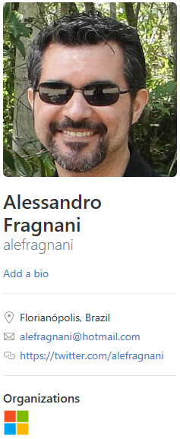
SOFTPLAN // BUILD AUTOMATION
Who am I?
Delphi
20 years experience
Softplan – UNJ Support
NewAge Team
OpenSource
4 years
Delphi / Sublime Text / Atom / Visual Studio Code
Delphi, Python, CoffeeScript and TypeScript
github.com/alefragnani
SOFTPLAN, JANUARY 13, 2017

Slide 3
SOFTPLAN // BUILD AUTOMATION
Agenda
Where are we?
Build Automation
Continuous Integration
Demo
SOFTPLAN, JANUARY 13, 2017

Slide 4
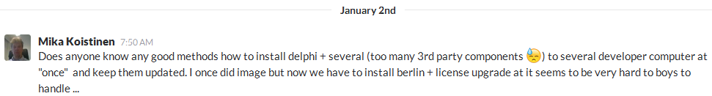
SOFTPLAN // BUILD AUTOMATION
Where are we?
How big are your projects?
Systems
Frameworks
Third Party Components
Packages/Units/LOC
How do you install and compile your projects in developer machines?
SOFTPLAN, JANUARY 13, 2017

Slide 5
SOFTPLAN // BUILD AUTOMATION
Where are we?
NewAge Project
+50 Third Party Components (DevExpress, TMS, JVCL, Eldos, ReportBuilder)
25 Frameworks
7 Systems
±300 DPK/DPR
8k PAS (12k total) / ±10 milions of line
SOFTPLAN, JANUARY 13, 2017

Slide 6
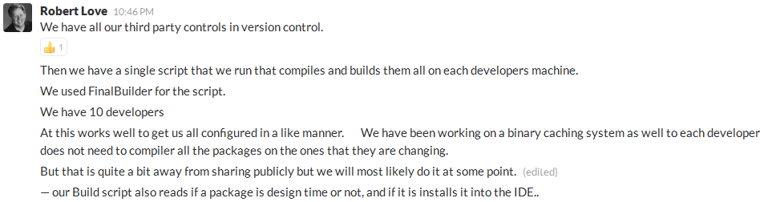
SOFTPLAN // BUILD AUTOMATION
Where are we?
SOFTPLAN, JANUARY 13, 2017

Slide 7
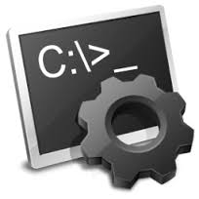
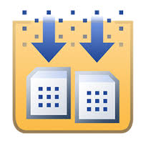



SOFTPLAN // BUILD AUTOMATION
Build Automation
The process of automating the creation of a software build and the associated processes including: compiling computer source code into binary code, packaging binary code, and running automated tests.
SOFTPLAN, JANUARY 13, 2017

Slide 8
SOFTPLAN // BUILD AUTOMATION
Build Automation
Some tasks that we automate
Read settings from XML files
Interact with CVS
Generate Code Metrics
Run BATs
COMPILE
Run Unit Tests
Read/Write Windows Registry
Copy Resources
Interact with VMWare
SOFTPLAN, JANUARY 13, 2017

Slide 9
SOFTPLAN // BUILD AUTOMATION
Build Automation
Why is it important?
Minimize repetitive tasks
Speed up context switch
Avoid the excuse “works on my machine”
Be a Pragmatic Programmer
21 - Use the Power of Command Shells
Use the shell when graphical user interfaces don't cut it
61 - Don't Use Manual Procedures
A shell script or batch file will execute the same instructions, in the same order, time after time.
SOFTPLAN, JANUARY 13, 2017

Slide 10





SOFTPLAN // BUILD AUTOMATION
Continuous Integration
The practice of merging all developer working copies to a shared mainline several times a day.
…a continuous integration server is a type of build automation server.
SOFTPLAN, JANUARY 13, 2017

Slide 11
SOFTPLAN // BUILD AUTOMATION
Continuous Integration
Some tasks we automate
Get sources from VCS
Update VCS Labels
Publish Unit Tests
Send Email
Compile
Archive Artifacts
Publish Code Metrics
SOFTPLAN, JANUARY 13, 2017

Slide 12
SOFTPLAN // BUILD AUTOMATION
Demo
SOFTPLAN, JANUARY 13, 2017

Slide 13


Thank you!
Alessandro Fragnani
alessandrofm@softplan.com.br
48 3027 8078
github.com/alefragnani

