Slide 1
Building an Azure Data Warehouse for Bike Share Data Analytics
By Amanda L

Slide 2
Star Schema Design
https://dbdiagram.io/d/644f69c9dca9fb07c44c67a0

Slide 3
Copy Data from Azure PostgreSQL Proof of Extract

Slide 4
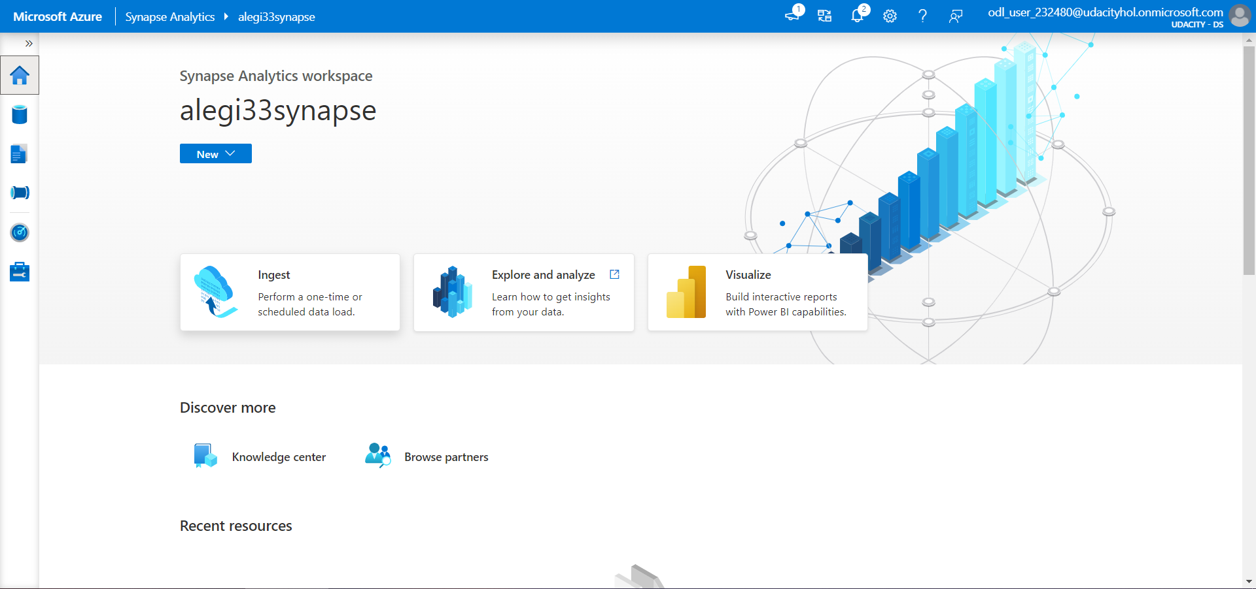
1. Click on Ingest shortcut

Slide 5
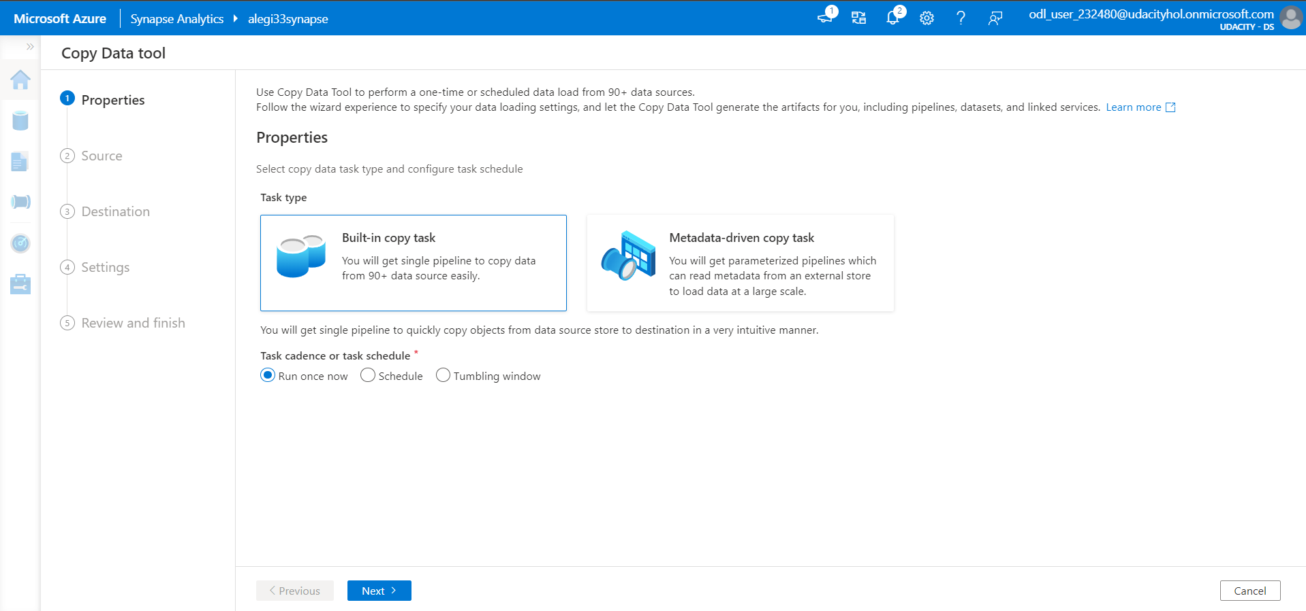
2. Click on Built-in copy task 3. Choose Run once now

Slide 6
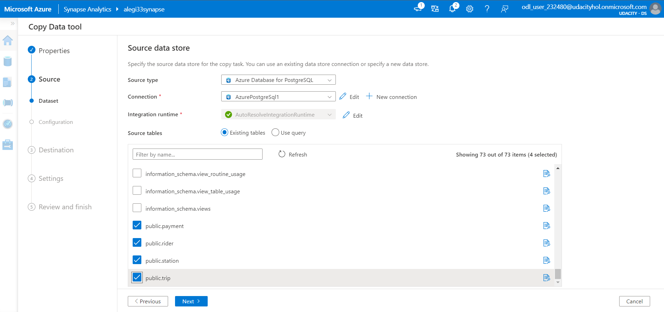
4. Complete source table details 5. Select 4 tables

Slide 7
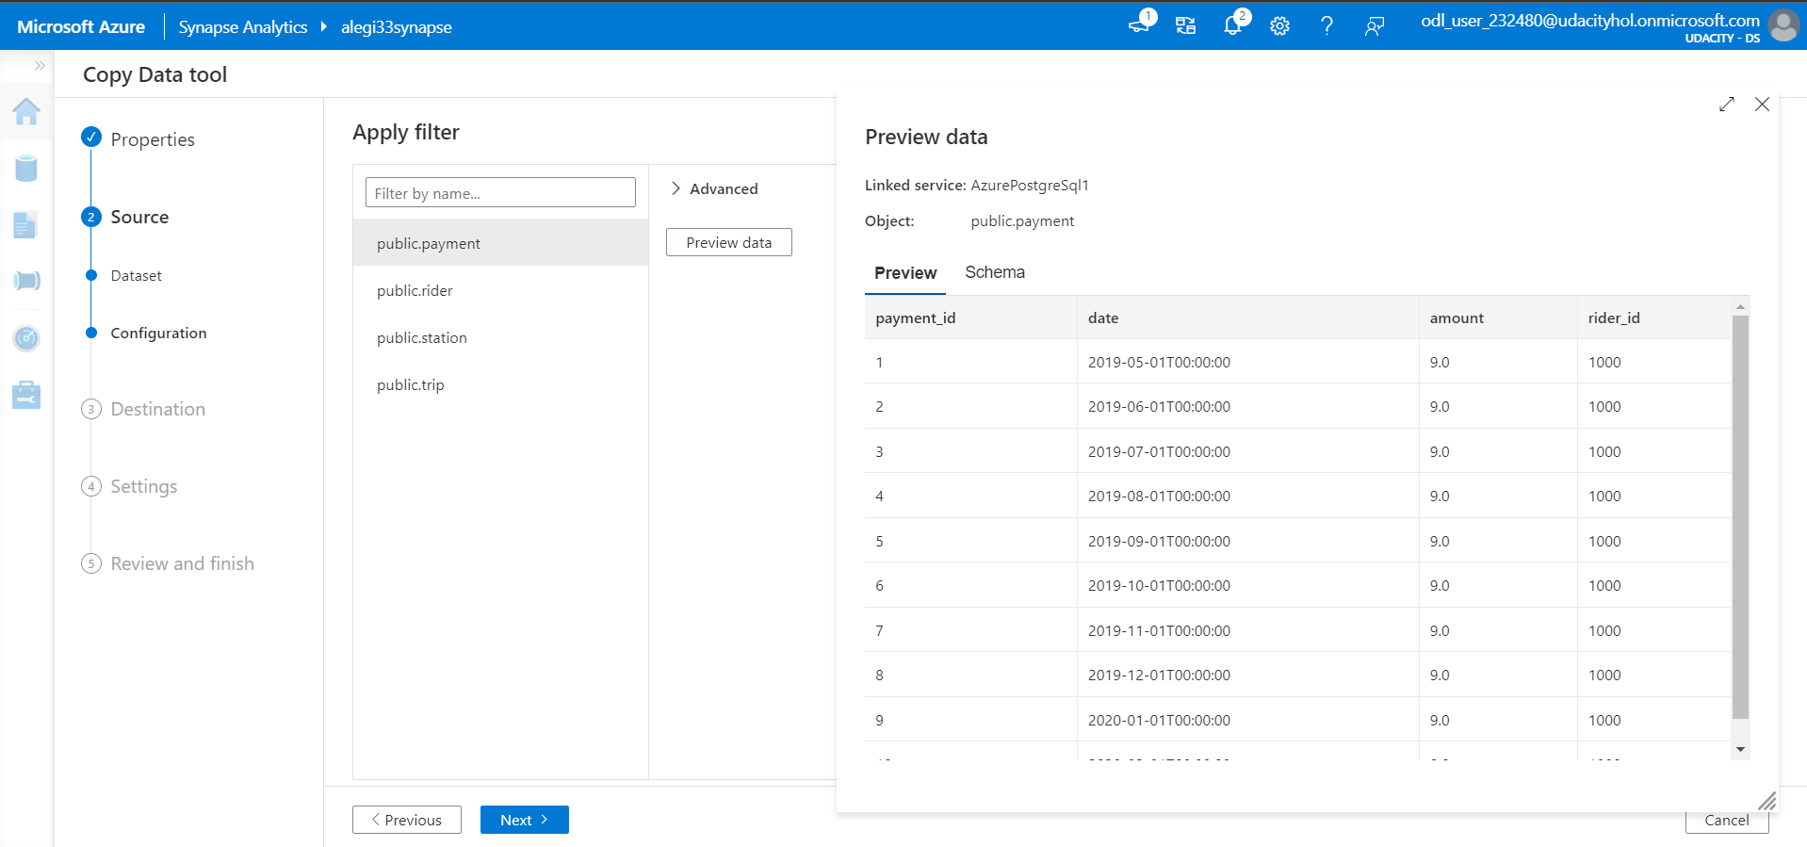
6. Preview data to make sure it is correct

Slide 8
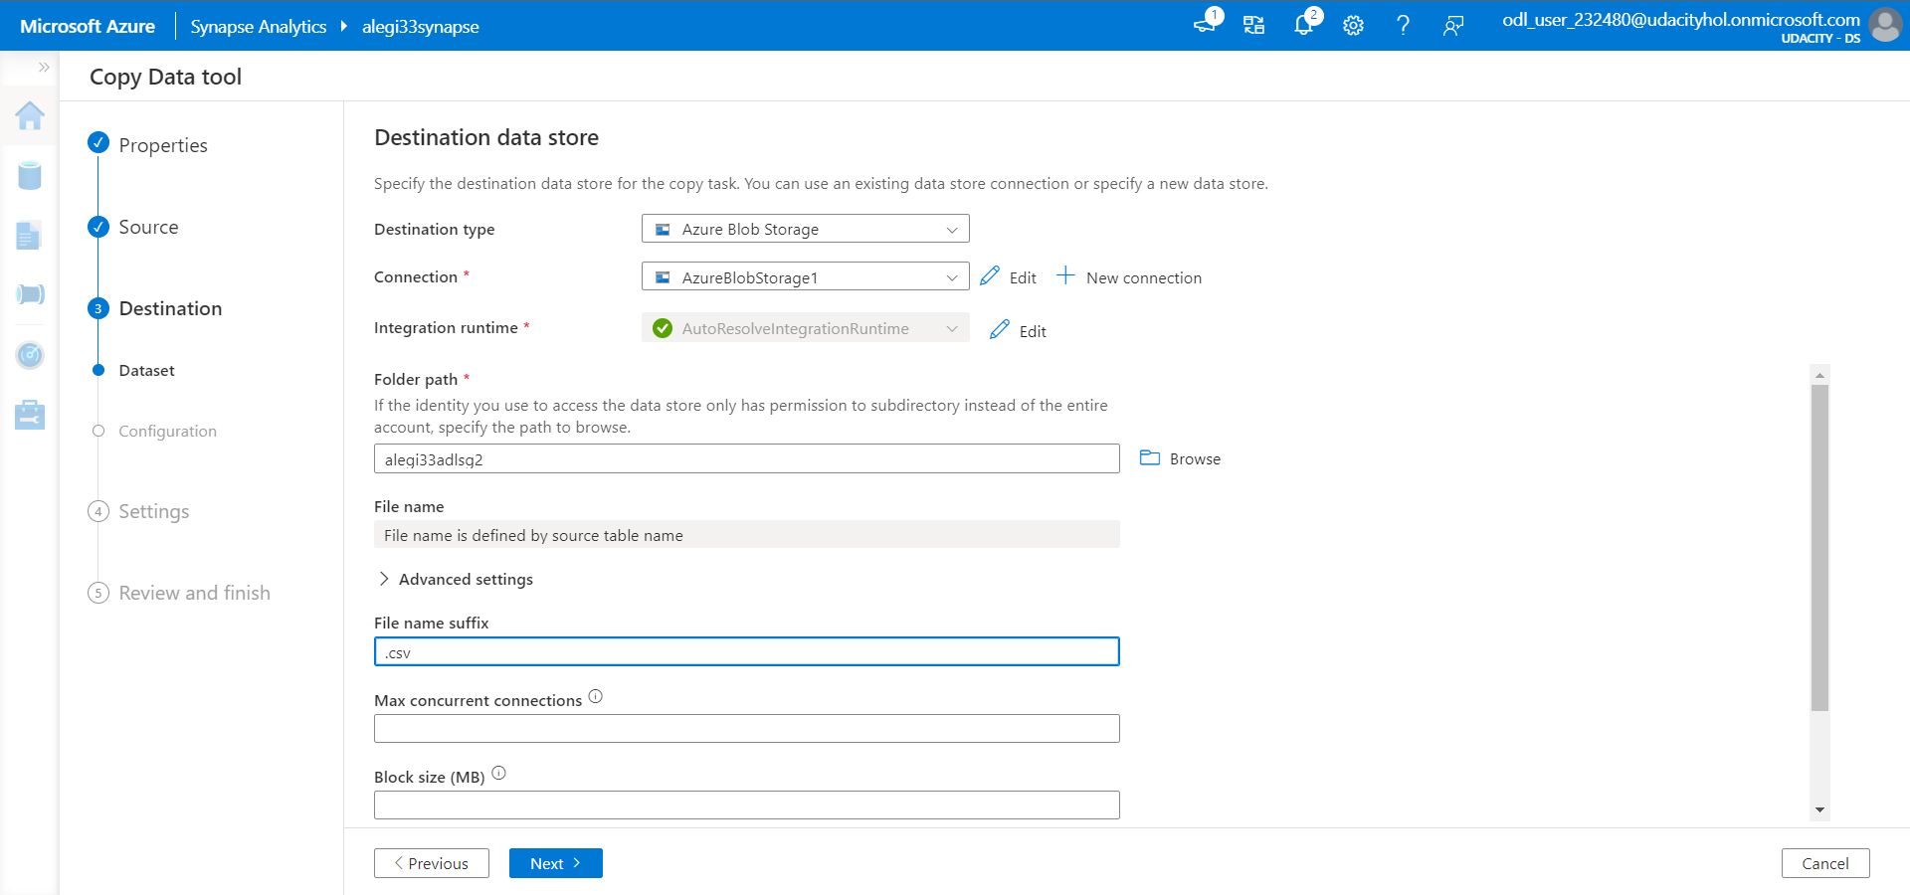
7. Complete Destination details by creating Blob storage 8. Specify file name suffix as .csv

Slide 9
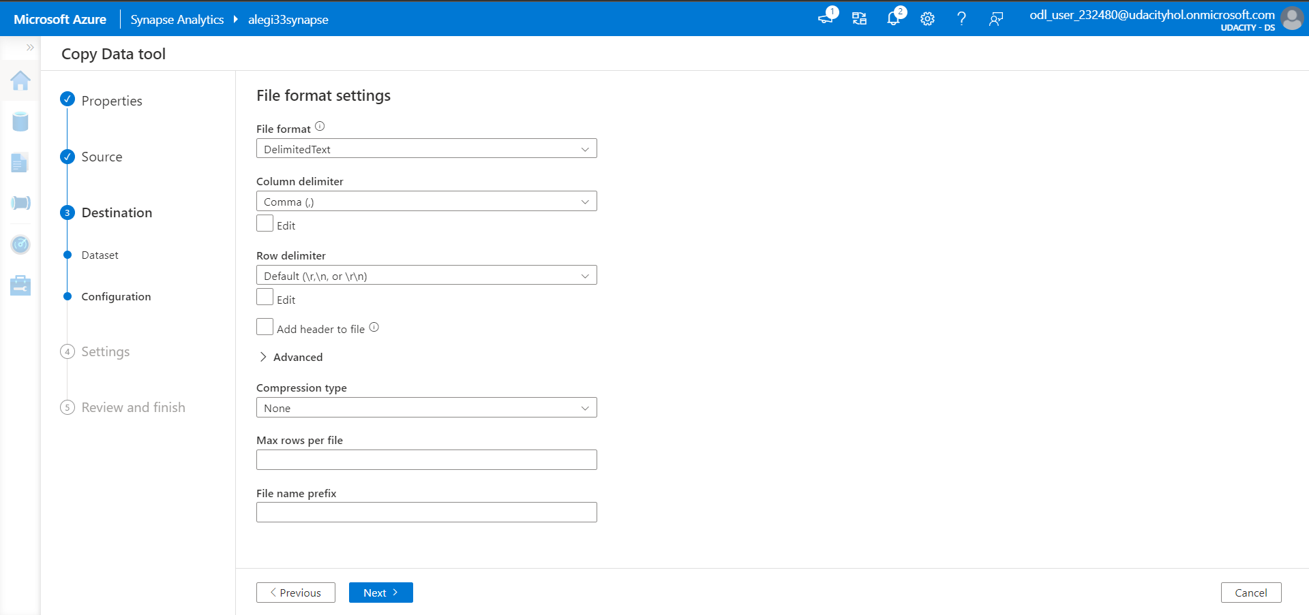
9. Check that the default setting is correct

Slide 10
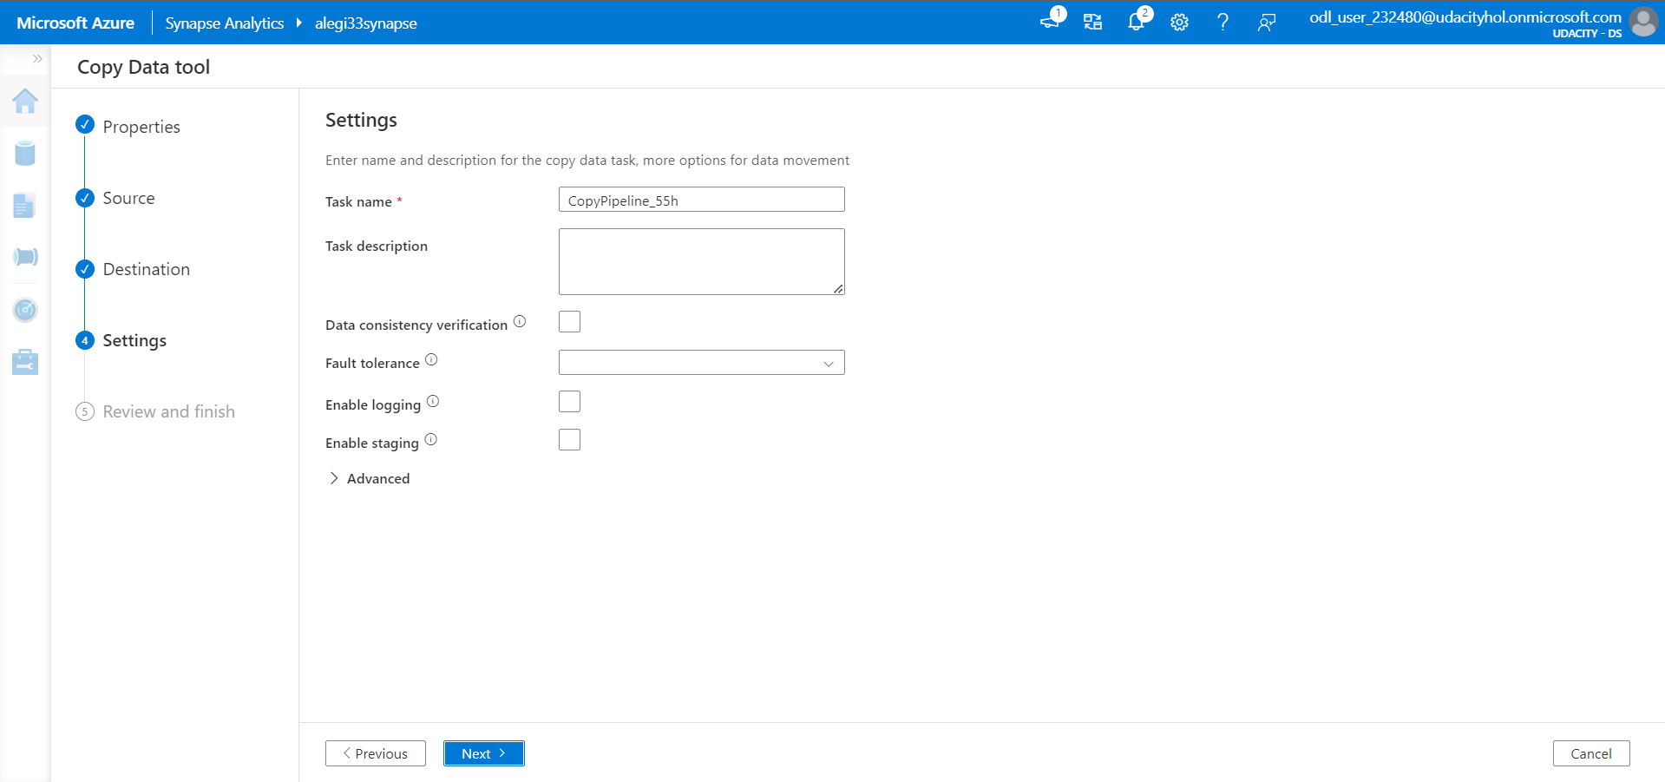
10. Click Next button

Slide 11
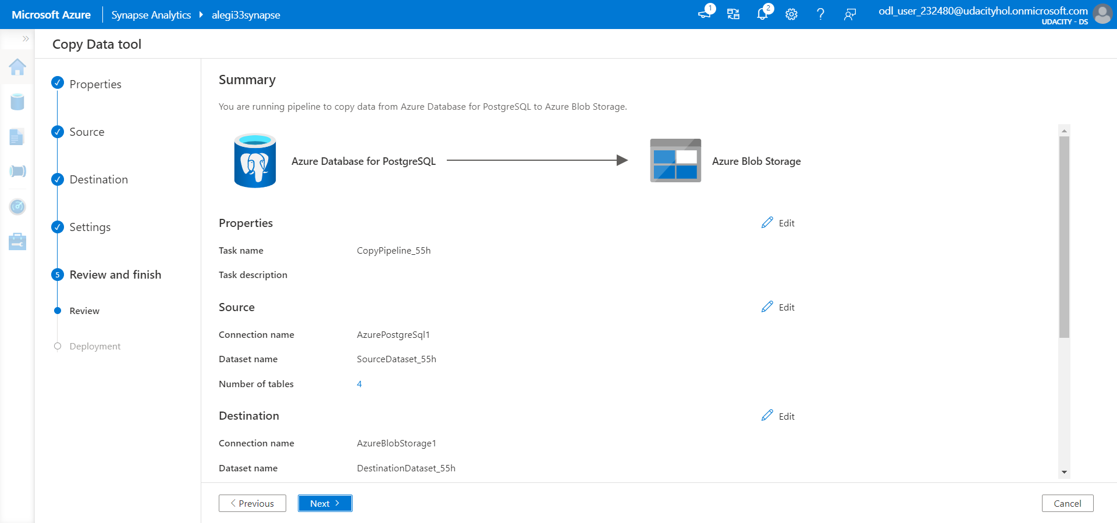
11. Review and make sure everything is in order

Slide 12
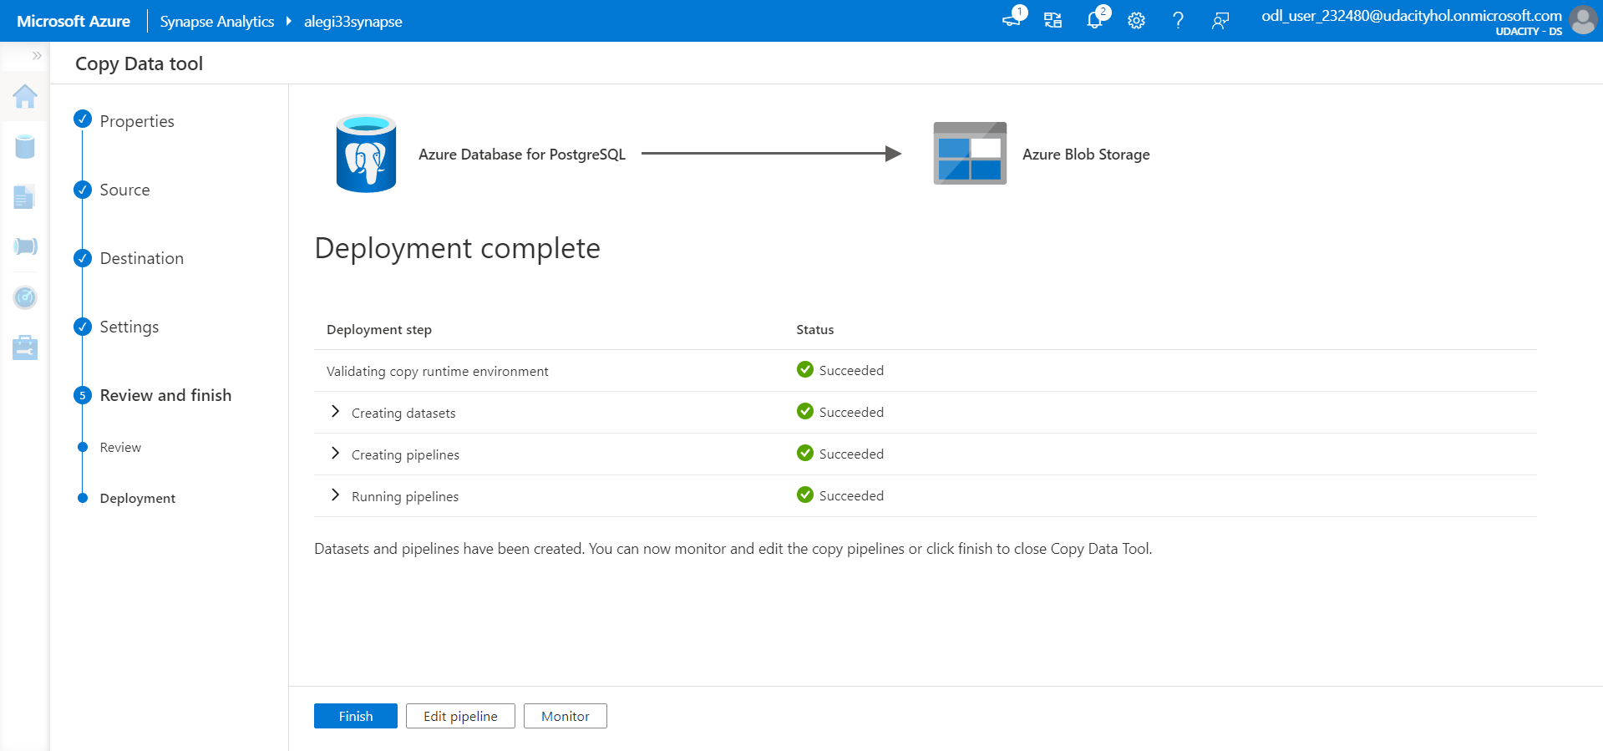
12. Deployment completed

Slide 13
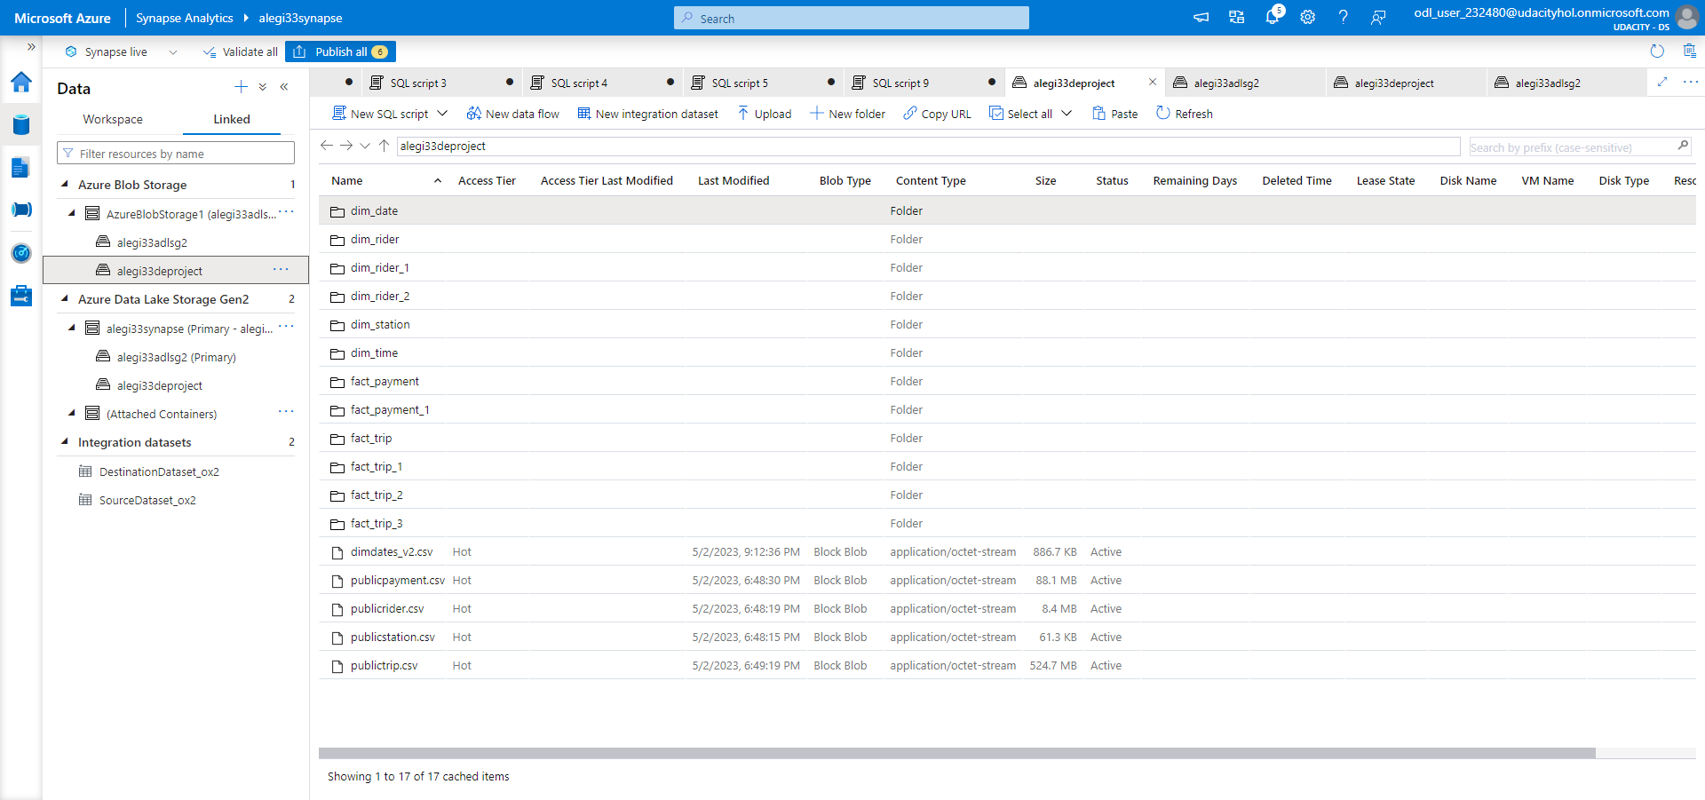
13. CSV files are now available in the Blob storage

Slide 14
Uploading Date Dimension File into Azure Proof of Extract

Slide 15
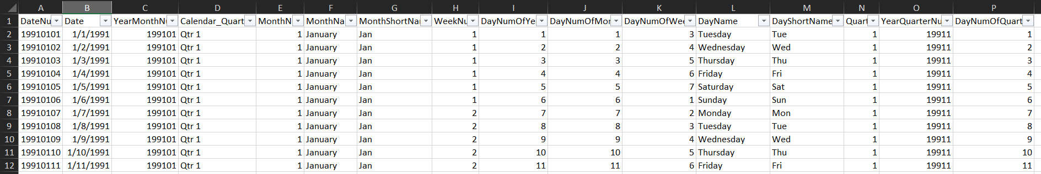
1. Download and extract necessary columns 2. Convert into CSV
Source: https://community.sisense.com/t5/knowledge/date-dimension-file/ta-p/9562
Downloaded file:

Slide 16
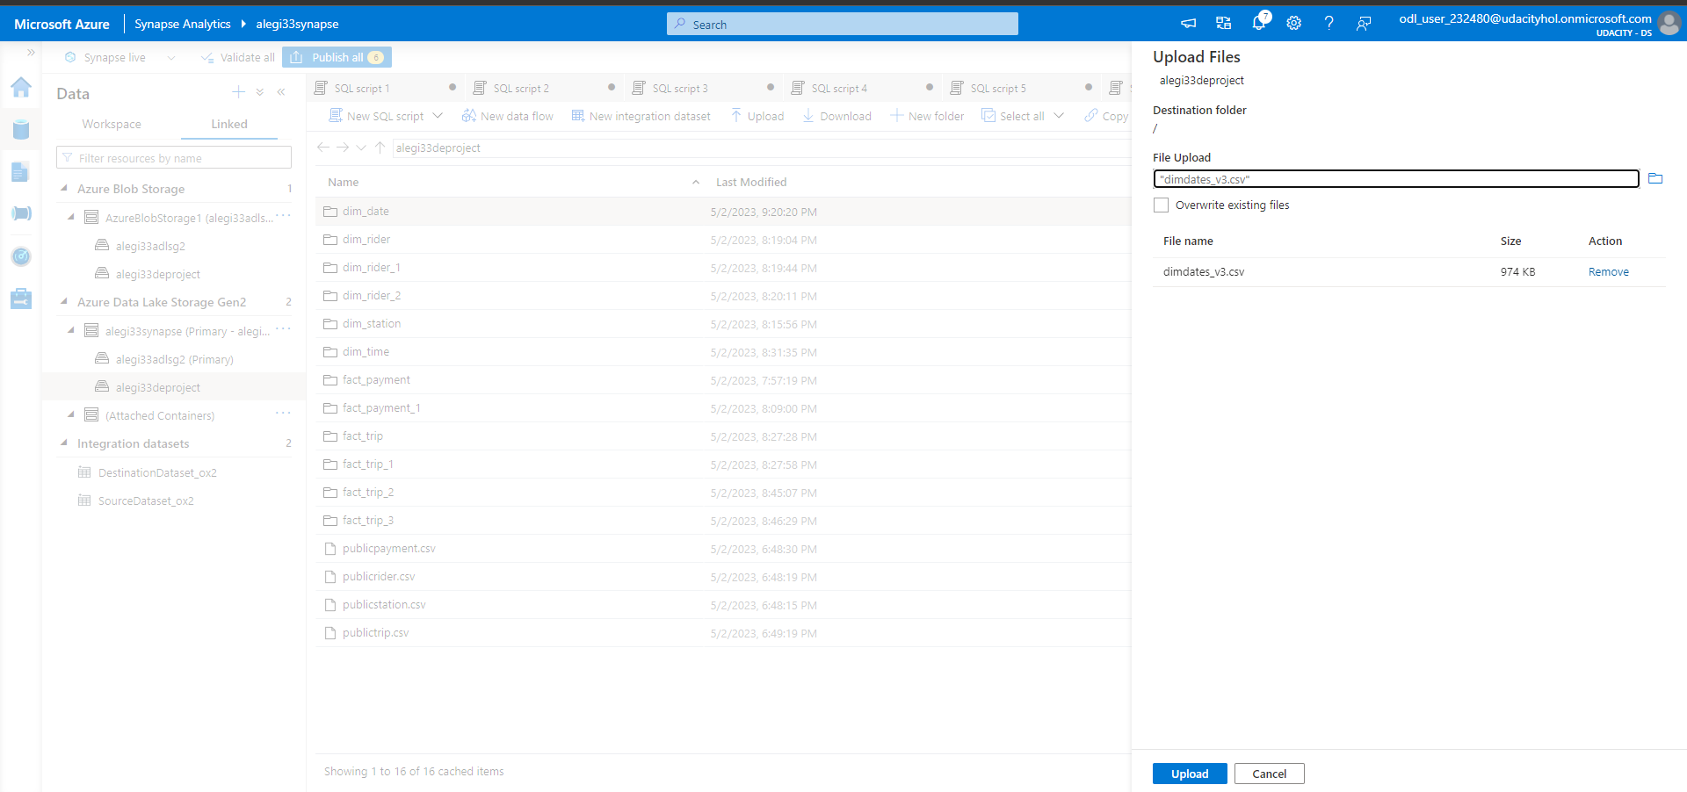
3. Upload into Azure Date Lake Storage Gen2

Slide 17
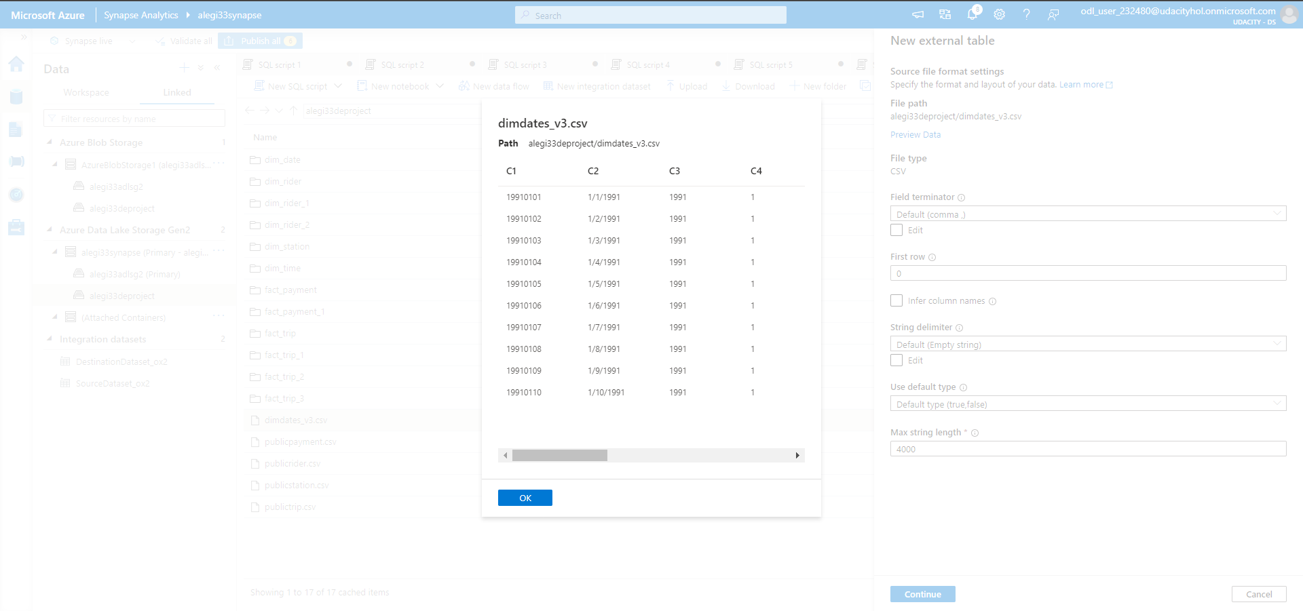
3. Preview the uploaded file

Slide 18
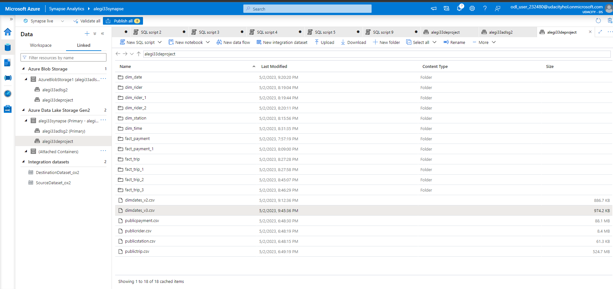
4. Verify that file has been uploaded successfully

Slide 19
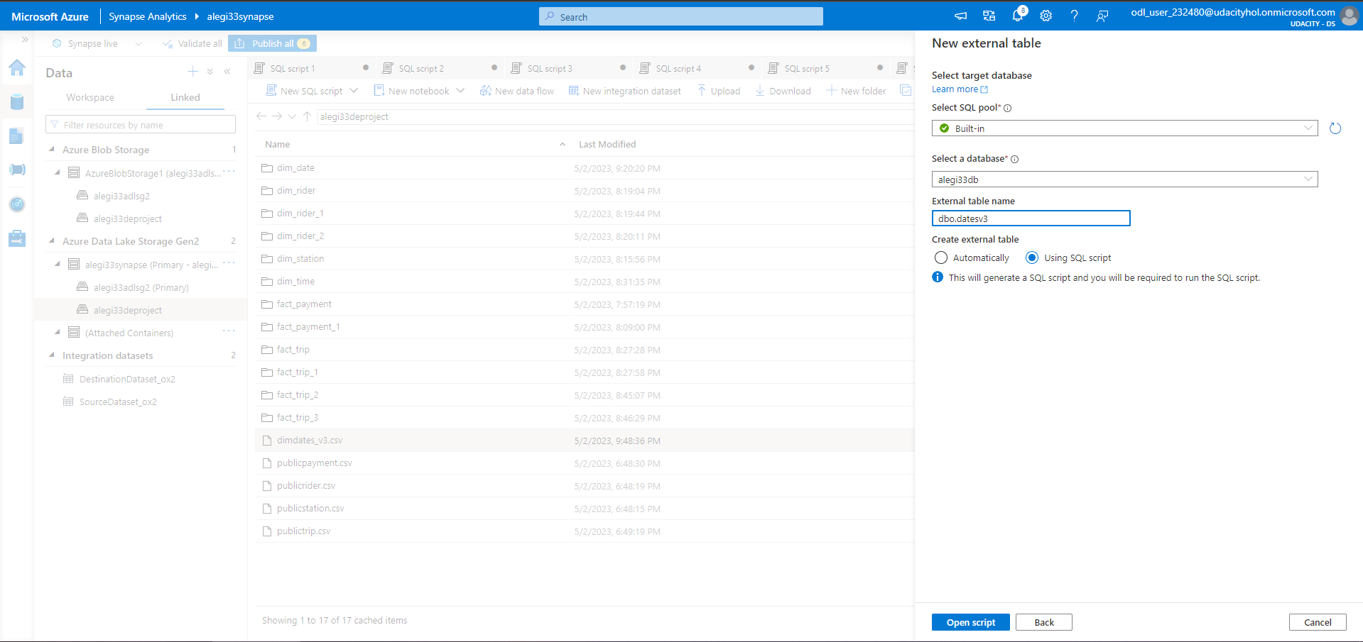
5. Generate the code to create external table

Slide 20
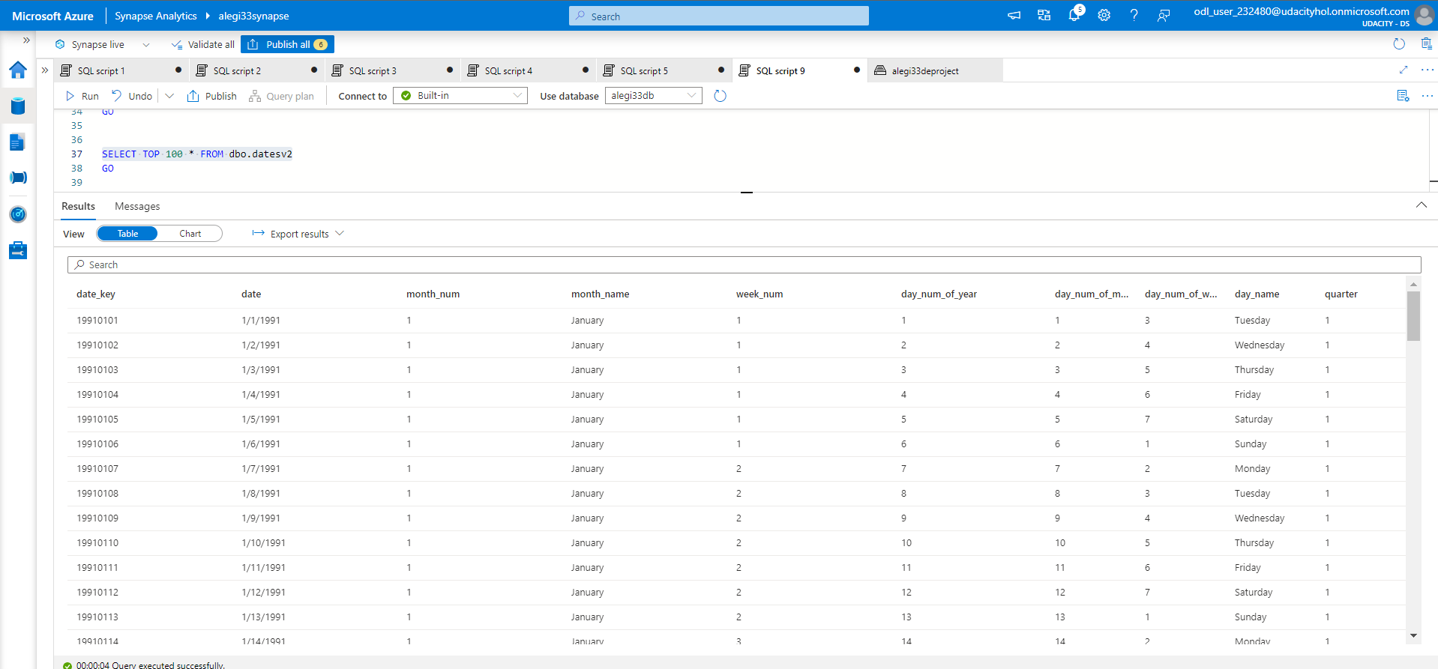
6. Table is ready to be converted as dimension table for the star schema

Slide 21
Thank you

