Slide 1
Proof of Concept Proposal Lamborghini

Slide 2
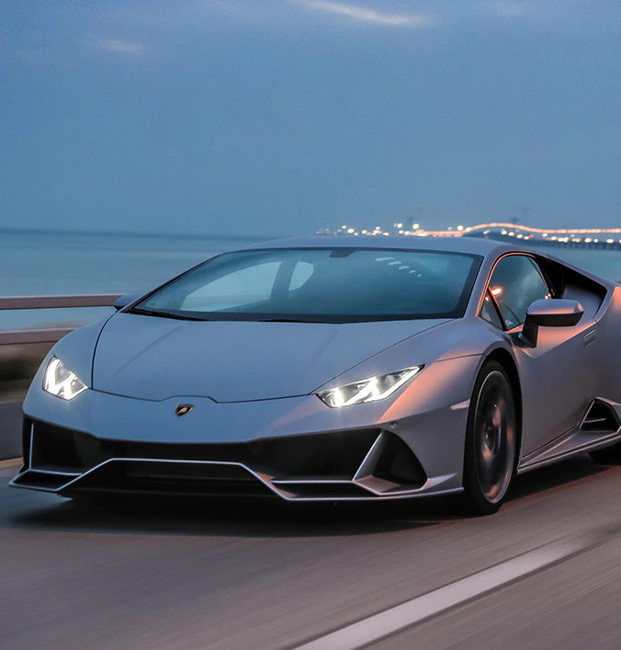
agenda
PROPOSALS
POC #1: Connected Car
Focus on POC #1
POC #2: Work-bench use
Focus on POC #2

Slide 3

POC #1: Connected car
In order to improve Lamborghini service portfolio to fully understand users’ preferences and car usage style, we plan make full use of the Connected Car data lake and analyze the available information to identify patterns in the data and thus possibly classifying drivers, on the basis of their actual driving behaviors.

Slide 4
POC #1 focus
Input Data:
Telemetric driving data from connected cars
Our Process:
Find patterns based on telemetric driving data;
Develop a model to classify driving styles;
Develop a model to detect driving conditions;
Detect anomalies;
Use driving styles and usage patterns to identify types of users
Expected Results:
Develop evidence-based user typologies
Enable Lamborgini to develop a more client oriented service portfolio

Slide 5

POC #2: Work-bench use
Improving digital asset management in R&D would mean making a clearly estimated planning of utilization, effort needed to measure, monitor and optimize the utilization of an asset (=resource) and enable full fleet management logic, allowing thus less discrepancies between planning and actual.
Through data on the possible outlook of occupancy of work-benches, we plan to develop a realistic simulation of work-bench saturation, allowing the creation of evidence-based asset management rules.

Slide 6
POC #2 focus
Input Data:
List of potential usage of the work-benches.
Our Process:
Use a MonteCarlo Simulation to model the probability of different scenarios based on input data parameters;
Develop a probabilistic model of work-bench occupancy.
Expected Results:
Realistic simulation of work-bench saturation;
Development a basis of a Digital Twin prototype;
Allowing to build asset management rules.

Slide 7
EXPERIENCES
## Blockchain Talk & Model Re-design ##
2-3h webinar on Blockchain and its impact on automotive market with Top Professional.
Development of Business cases with MBA student from Wyoming University USA.

