Slide 1

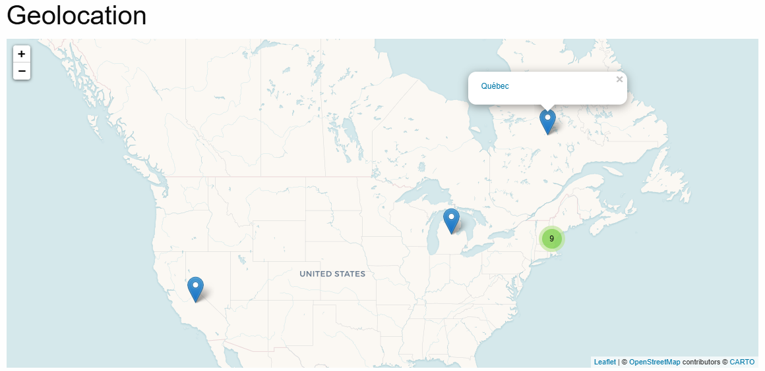
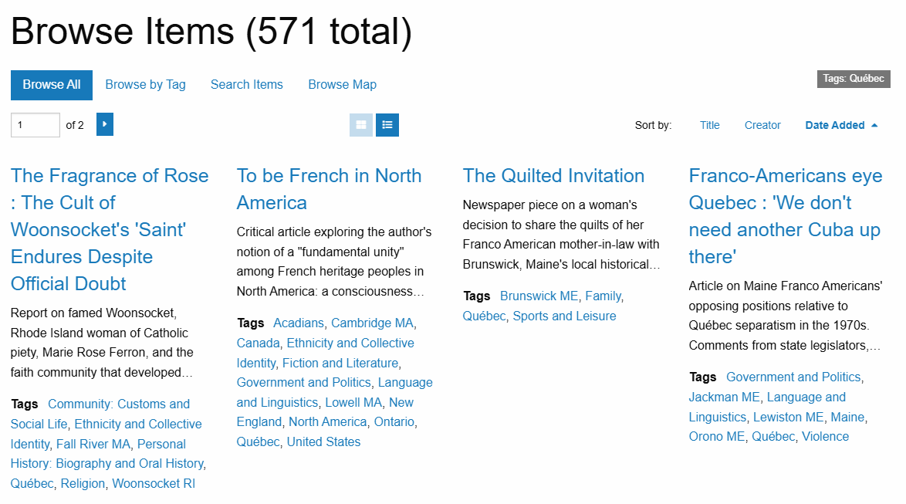

Map it!: The Geolocation Of Published Franco-American Works
Johnny Sylvain
Department of Computer Science, University of Maine
Department of Franco-American Programs, University of Maine
Introduction
Solution
The Franco-American Center at the University of Maine hosts a digital library of Published Franco-American works. Recently this database has been updated and transferred to a new public website: francolibrary.org. This database houses a collection of different works organized via media format, ranging from Journals, Newspapers, cookbooks and audio recordings. Due to the bilingual nature of the published works, an interactive map is an inclusive solution to ensure that finding a desired text is not hindered by a language barrier.
None of the existing front facing plugins had all the pieces to solve this problem. Fortunately, with some additional digging a modified version of the Geolocation plugin existed that allowed items to store multiple locations. To implement the plugin, each item needs to have its location data added to the database, as well as link that location to other items sharing the same location. With the recent data migration, the regional text markers, “tags”, have been updated to be standardized and follow a convention of “location - State Initials” or “name of State/Country/Province”. I created a list for each location that relates to the longitude and latitude for each tag, and a HTML link that will bring the user to a search for all the locations that share the tag. Each objective has been met with this system; the text markers are translated to a visual map for each work, and each marker redirects to a search for works that share the same location data.
Objectives
Results
Translate regional text markers for published Franco-American works into a visual map.
Each marker on the map redirects to a search for works that share the same marker.
Process
The website is built on Omeka, a free open source digital collection management system widely used for libraries, museums, archives and other scholarly exhibits. Omeka has a thriving community of users that create plugins and other solutions. Some of the existing mapping solutions for Omeka are:
Geolocation - Adds location info and maps to Omeka
MapsAlive - Integration with MapsAlive, a third party mapping solution
NeatlineFeatures - Allows drawing on maps associated with a work.
Walking Tour - Creates interactive walking tours
Each of these plugins has upsides and downsides:
Geolocation data for Histoire de Montferrand : L'Athlete Canadien and Joe Mufraw (Left), Search results for all works that have the tag “Québec” (Right).
For each work in the Franco-American published works digital library, there is an entry at the bottom of the page that geolocates each tagged location. Often there are clusters of locations that are close together, which are represented by different color circles, (Red, Yellow, Green) with red being the most dense. These clusters are clickable to expand to that specific area and break into markers or smaller clusters. Each location marker is clickable, as a linking HTML element to a search for that location among every work in the database. This dynamic mapping feature enhances user experience, making the exploration of Franco-American cultural works both accessible and engaging.
 | Pros | Cons
Geolocation | Searchable map for all items | Only one location per item
MapsAlive | Multiple location per item | Paid subscription
NeatlineFeatures | Draw geospatial shape metadata | Old and depreciated
Walking Tour | Exhibits for each location | Builds lines between items
Acknowledgements
I would like to thank and acknowledge Susan Pinette and Jacob Albert for their support and help. I would also like to thank everyone in the Omeka Classic Forums for their deep knowledgebase.
The University of Maine System is an equal opportunity institution committed to nondiscrimination.
Notes:
To use this template:
Make a copy go to FILE->Make a copy->Entire Presentation
Download Powerpoint file, go to FILE->Download->.pptx

