Slide 1
Broker office system
College of Engineering
Department of Electrical and Computer Engineering

Slide 2
Background of the Project
The Current Scenario: Real estate and vehicle brokerage in Ethiopia relies heavily on manual systems (paper logbooks, phone calls, and Excel sheets).
The Challenge: As business grows, tracking hundreds of houses and customers manually becomes impossible.
The Solution: The "Group 4 Broker System" is a centralized Desktop Application designed to digitize these operations.
Core Function: It connects Admins (Owners), Brokers (Staff), and Customers through a shared digital platform using Java and MySQL.

Slide 3
Statement of the Problem
We identified five critical issues in the traditional brokerage workflow:
Data Redundancy: Customer info is often duplicated or lost in paper piles.
Time Inefficiency: Searching for a specific "Rental Villa" takes minutes of flipping through pages.
Lack of Visuals: Customers cannot see the item without traveling to the physical location.
Financial Errors: Manual commission calculations lead to revenue leakage.
No Transparency: It is difficult for the owner to track which broker sold which item.

Slide 4
Objectives
General Objective:
To develop a secure, robust, and user-friendly Rental and Sales Management System that automates the daily workflow of a Broker Office.
Specific Objectives:
Security: Implement Role-Based Login (Admin, Broker, Customer).
Inventory: Enable digital registration of items with Images and Prices.
Search: Develop a smart filtering system (by Name, Category, or Status).
Transactions: Automate the "Deal Closing" process and generate digital Receipts.
Reporting: Provide real-time revenue analytics for the Admin.

Slide 5
System Scope and User Roles
System Scope:
Platform: Desktop Application (Java Swing).
Network: Local Area Network (LAN) / Single Station.
Data: Relational Database storage.
User Roles:
Admin (The Manager): Has full control. Can add items, hire brokers, delete data, and view financial reports.
Broker (The Staff): Can register customers, post new items, search inventory, and process transactions.
Customer (The Client): Can browse the gallery, search for items, filter by status, and view item details (Zoom view).

Slide 6
Methodology
Approach: Object-Oriented Analysis and Design (OOAD).
Development Model: Iterative Model (Design -> Code -> Test -> Refine).
Architecture Pattern: Layered Architecture.
  Presentation Layer: The User Interface (Windows/Forms).
  Business Logic Layer: Java Classes handling the rules.
  Data Access Layer: JDBC handling database connections.

Slide 7
System Architecture
System Architecture
User Interface(Java Swing)
Database (MySQL Server
Application Logic (Java class and JDBC Driver)

Slide 8
Database Design
Our system relies on three core relational tables:
users Table:
  Stores: user_id, username, password, role, phone.
  Purpose: Handles authentication and staff details.
items Table:
  Stores: item_id, price, image_path, status (Available/Taken), contact_phone.
  Purpose: The central inventory.
transactions Table:
  Stores: transaction_id, date, final_price.
  Foreign Keys: Links to customer_id, broker_id, and item_id.
  Purpose: Financial history and receipt generation.

Slide 9
Implementation Tools
Programming Language: Java (JDK 8+).
Integrated Development Environment (IDE): NetBeans 8.2 / 12+.
Database Engine: MySQL (via XAMPP Server).
GUI Framework: Java Swing (with Nimbus Look & Feel for modern UI).
Connectivity: MySQL JDBC Driver (Connector/J).

Slide 10
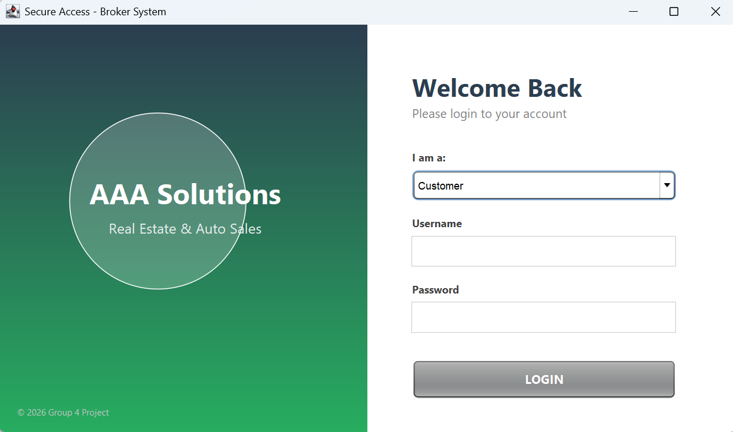
Demo - Login & Security
Feature: Split-screen professional UI.
Security: Validates credentials against the MySQL database.
Routing: Automatically opens the correct dashboard (Admin vs. Customer) based on the user's role.

Slide 11
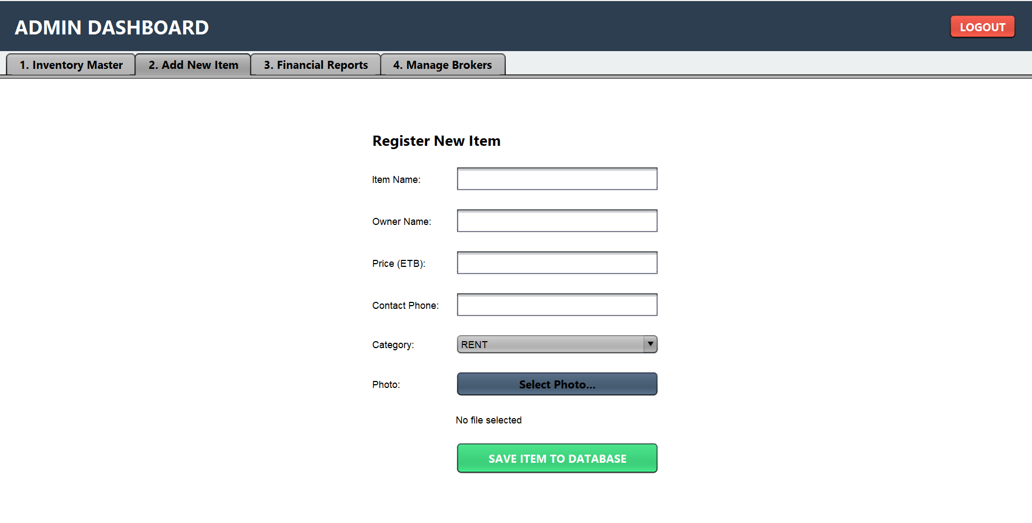
Demo - Inventory & Photos
Feature: Admin and Brokers can upload items.
Capability: Supports image selection from the PC.
Data Handling: Images are copied to the system folder; text data is saved to SQL.

Slide 12
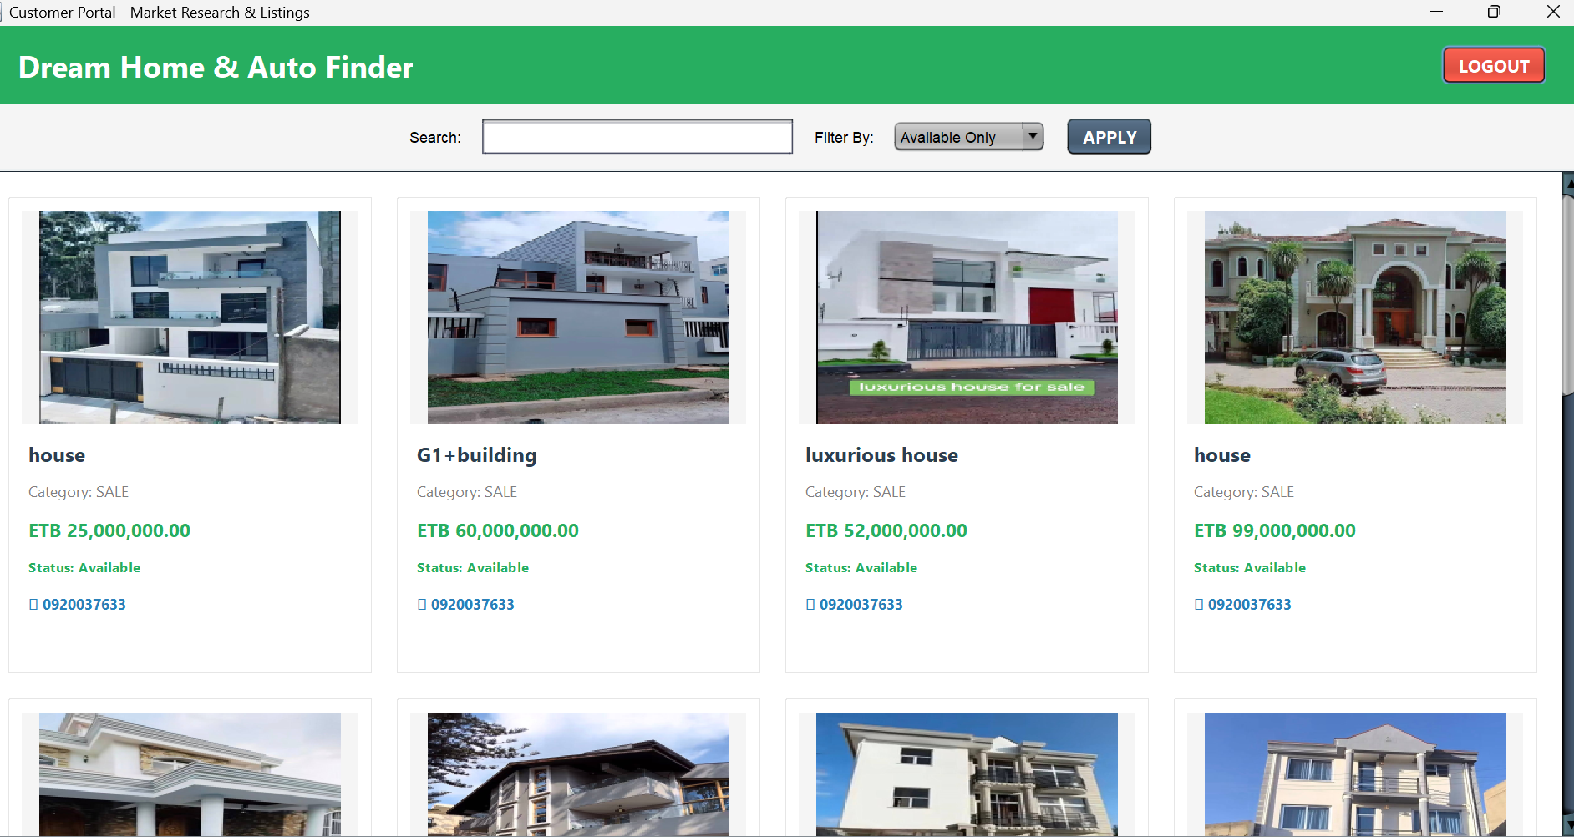
Demo - Search & Filtering
Feature: Customers can filter the gallery.
Logic:
  Search: Filters by Name or Category.
  Status: Filters by "Available" vs "Sold".
UX: Items appear as clickable Cards with visual previews.

Slide 13
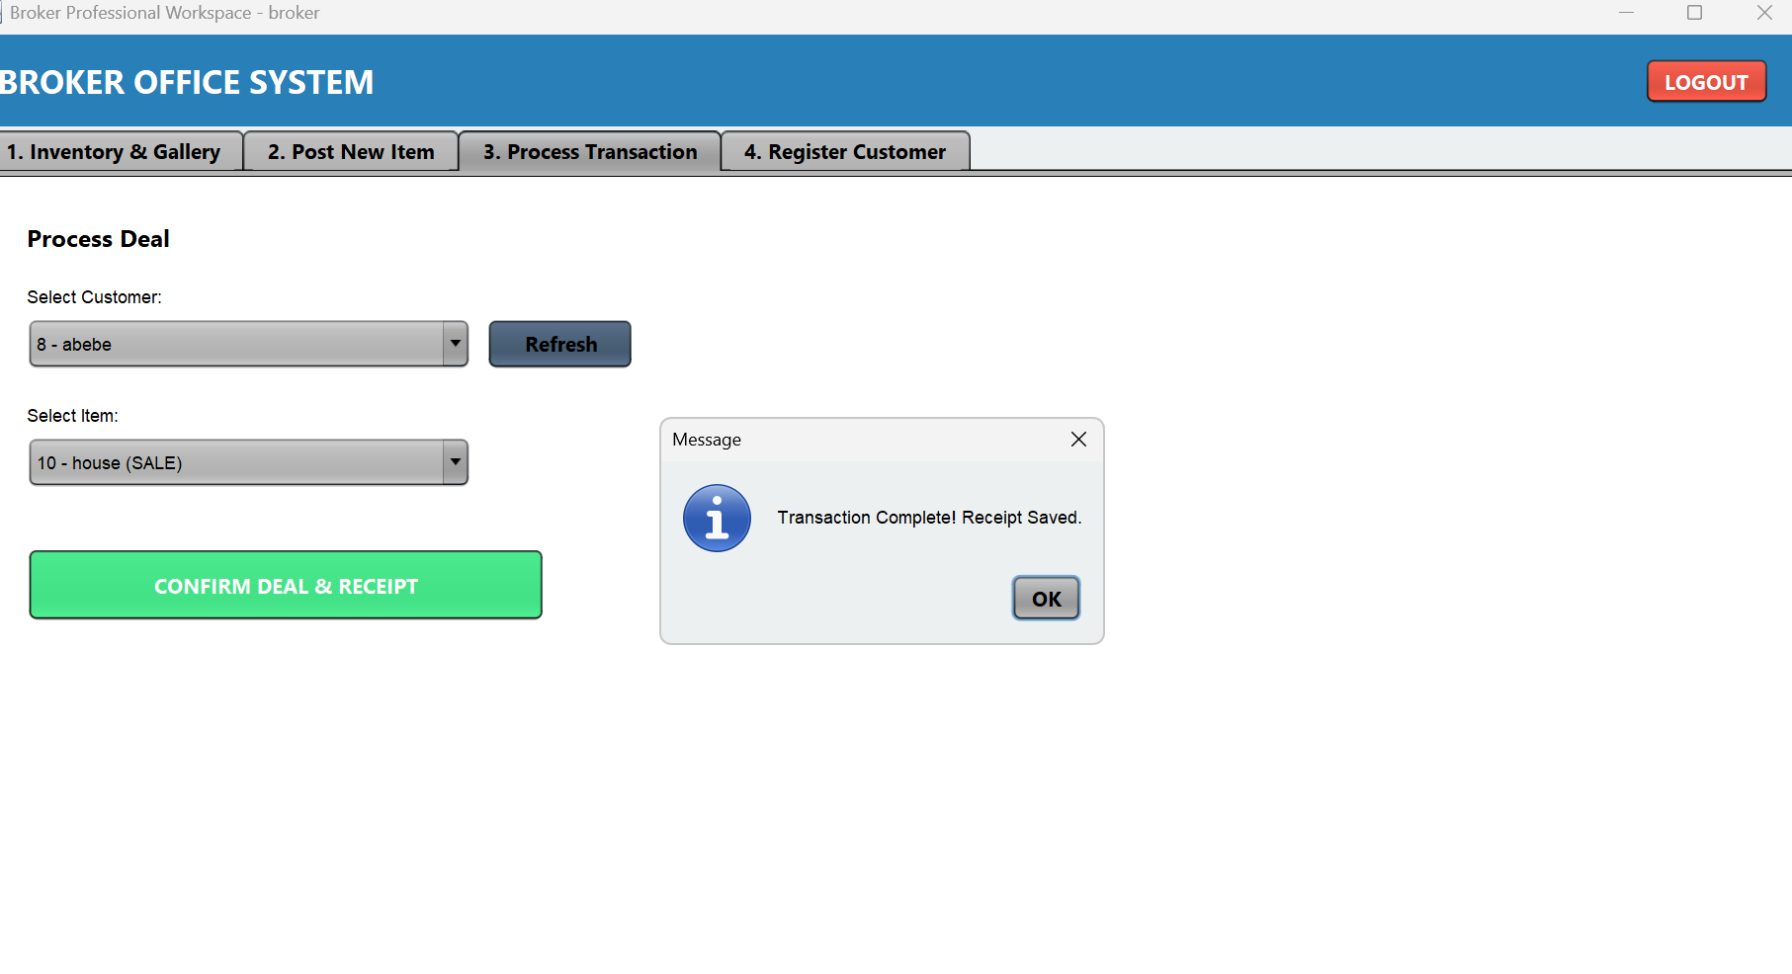
Transactions & Receipts
Process: Broker selects a Customer and an Item -> Clicks "Confirm".
Automation:
  Item status changes to "Taken" (Red) in the database.
  Transaction is recorded in the history table.

Slide 14
Conclusion
The Group 4 Broker System has successfully met all design requirements:
✔ Centralized Data: No more data loss or redundancy.
✔ Efficiency: Search time reduced from minutes to seconds.
✔ Modern UI: Visual gallery experience for customers.
✔ Financial Integrity: Automated revenue tracking and receipts.
This project demonstrates the power of OOP principles in solving real-world business problems.

Slide 15
Recommendations
To further enhance this system in the future, we recommend:
Cloud Migration: Moving the database to a cloud server for multi-branch access.
Mobile App: Developing an Android version for customers.
GPS Integration: Adding Google Maps to show property locations.

Slide 16
Thank You!

