Slide 1
Ontology Acquisition
簡瑋德

Slide 2
Framework
Input
Documents with CKIP-Tag
EHowNet
Root Concept
Output
Ontology of the Concept

Slide 3
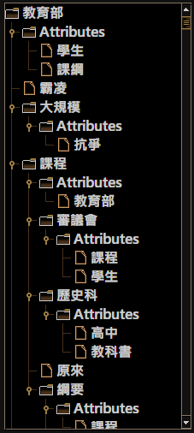
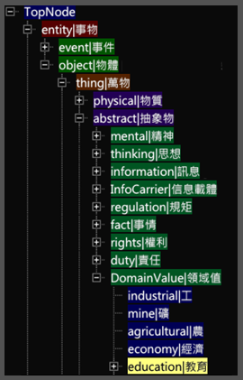

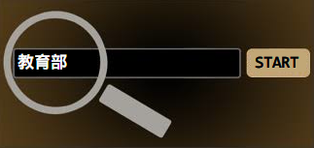
Framework

Slide 4
Categories and Attributes
Categories
Sub-Concepts
Unique
Attributes
Related Concepts
$≠$ Hyponym
≠ Hyponym
Not Unique

Slide 5
Steps
EHowNet: Combine Similar Concepts
EHowNet: Find the Relationships
Extraction Rules and Document Frequency: Find the Relationships
Completion

Slide 6
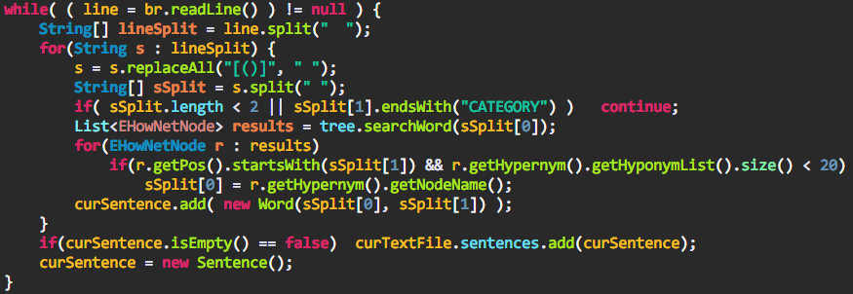
Similar Concepts
tool.TextController Line 108

Slide 7
Steps
EHowNet: Combine Similar Concepts
EHowNet: Find the Relationships
Extraction Rules and Document Frequency: Find the Relationships
Completion

Slide 8
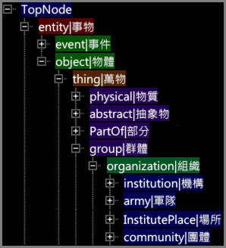

Relationship in EHowNet
團體 $∈組織$ and 組織 $∈$ 群體 are right on the beam

Slide 9
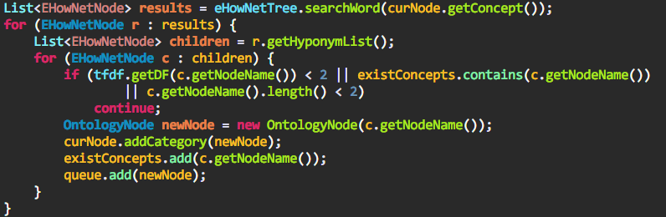
Relationship in EHowNet
tool.OntologyController Line 51

Slide 10
Steps
EHowNet: Combine Similar Concepts
EHowNet: Find the Relationships
Extraction Rules and Document Frequency: Find the Relationships
Completion

Slide 11
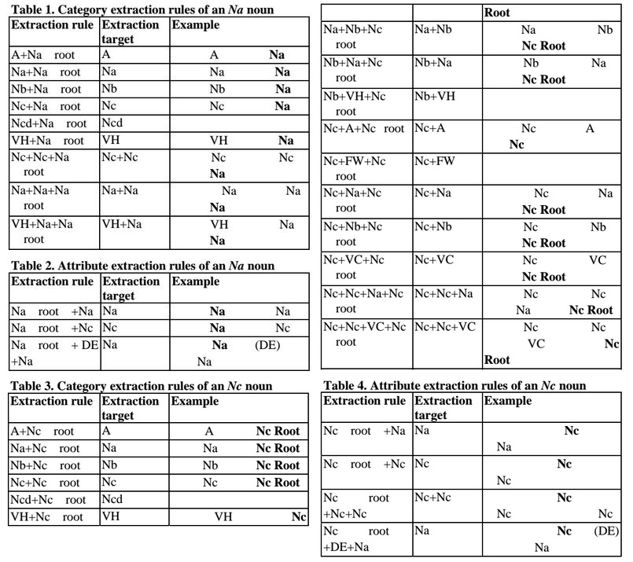
Extraction Rules

Slide 12
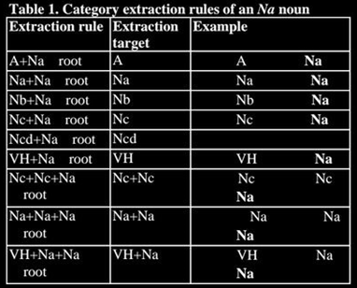

Extraction Rules
Example
課綱(Na) 爭議(Na) 涉及(VK) 行政(Na) 作業(Na) 和(Caa) 政治(Na) 問題(Na)
課綱 $∈$ 爭議
行政 $∈$ 作業
政治 $∈$ 問題
How about this
爭議 $∈$ 課綱
作業 $∈$ 行政
問題 $∈$ 政治

Slide 13

Modification of Extraction Rules
Example
課綱(Na) 爭議(Na) 涉及(VK) 行政(Na) 作業(Na) 和(Caa) 政治(Na) 問題(Na)
Modification
Let $D_{f}\left(w_{i}\right)$denotes the document frequency of word $w_{i}$
R$elationship= \left\{\begin{aligned} \text{課綱 }∈\text{ 爭議} \text{if} D_{f}\left(課綱\right)<D_{f}(爭議) \\ \text{爭議 }∈\text{ 課綱} \text{if} D_{f}\left(課綱\right)≥D_{f}(爭議)\end{aligned}\right.$

Slide 14
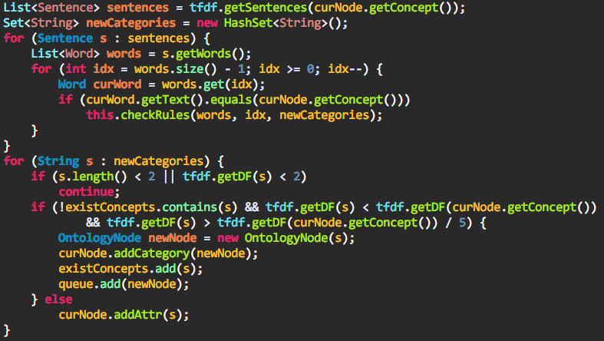
Modification of Extraction Rules
tool.OntologyController Line 62

Slide 15
Steps
EHowNet: Combine Similar Concepts
EHowNet: Find the Relationships
Extraction Rules and Document Frequency: Find the Relationships
Completion

Slide 16
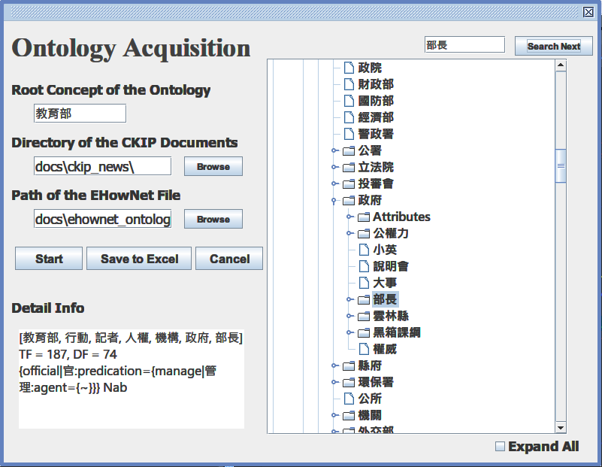
Demo

Slide 17
Future Goals
Use Association Rules to optimize the Ontology
Improve the accuracy of document frequency with the help of Zero Anaphor

Slide 18
References
Domain Event Extraction and Representation with Domain Ontology
Text Categorization Using Automatically Acquired Domain Ontology
A Semi-Automatic Domain Ontology Acquisition Tool from Chinese Corpus
Semantic Frame-Based Natural Language Understanding for Intelligent Topic Detection Agent
PAT-Tree-Based Keyword Extraction for Chinese Information Retrieval

Slide 19
Thank You

