Slide 1
Ontology Acquisition
簡瑋德

Slide 2
Framework
Input
Documents with CKIP-Tag
EHowNet
Root Concept
Output
Ontology of the Concept

Slide 3
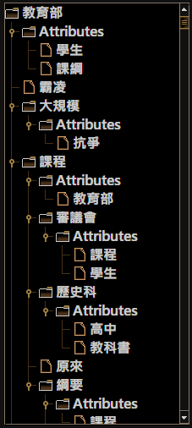
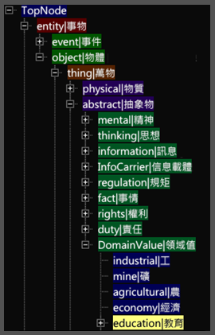

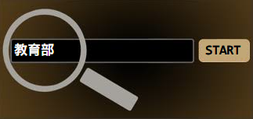
Framework

Slide 4
Categories and Attributes
Categories
Sub Concepts
Unique
Attributes
Related Concepts
$≠$ Hyponym
≠ Hyponym
Not Unique

Slide 5
Steps
EHowNet: Combine Similar Concepts
EHowNet: Find the Relationship
Extraction Rules and Document Frequency: Find the Relationship
Complete

Slide 6

Similar Concepts
Examples
攔住 $∈$ 阻止, 抵制 $∈$ 阻止 $→$ 攔住 $=$ 抵制
事務 $∈$ 物體, 內$部∈$ 物體 $→$ 事務 $=$ 內部
Consider the number of Hyponyms
Let $h$ denotes the hypernym of word $w_{i}$ and $w_{j}$
$w_{i}=w_{j}$ if and only if $size\left(h.hyponym\right)<20$

Slide 7
Steps
EHowNet: Combine Similar Concepts
EHowNet: Find the Relationship
Extraction Rules and Document Frequency: Find the Relationship
Complete

Slide 8
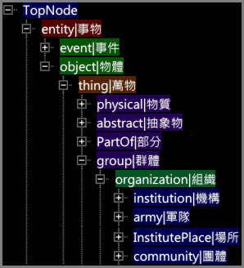

Relationship in EHowNet
團體 $∈組織$ and 組織 $∈$ 群體 are right on the beam

Slide 9
Steps
EHowNet: Combine Similar Concepts
EHowNet: Find the Relationship
Extraction Rules and Document Frequency: Find the Relationship
Complete

Slide 10
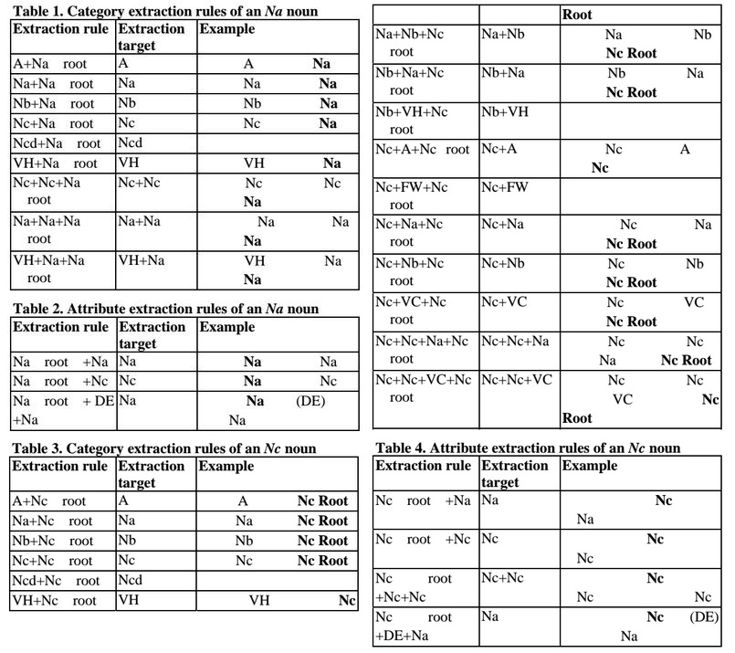
Extraction Rules

Slide 11
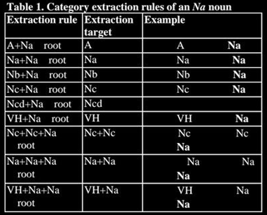

Extraction Rules
Example
課綱(Na) 爭議(Na) 涉及(VK) 行政(Na) 作業(Na) 和(Caa) 政治(Na) 問題(Na)
課綱 $∈$ 爭議
行政 $∈$ 作業
政治 $∈$ 問題
How about this
爭議 $∈$ 課綱
作業 $∈$ 行政
問題 $∈$ 政治

Slide 12

Modification of Extraction Rules
Example
課綱(Na) 爭議(Na) 涉及(VK) 行政(Na) 作業(Na) 和(Caa) 政治(Na) 問題(Na)
Modification
Let $D_{f}\left(w_{i}\right)$denotes the document frequency of word $w_{i}$
R$elationship= \left\{\begin{aligned} \text{課綱 }∈ \text{爭議} \text{if} D_{f}\left(課綱\right)<D_{f}(爭議) \\ \text{爭議 }∈ \text{課}\text{綱} \text{if} D_{f}\left(課綱\right)≥D_{f}(爭議)\end{aligned}\right.$

Slide 13
Steps
EHowNet: Combine Similar Concepts
EHowNet: Find the Relationship
Extraction Rules and Document Frequency: Find the Relationship
Complete

Slide 14
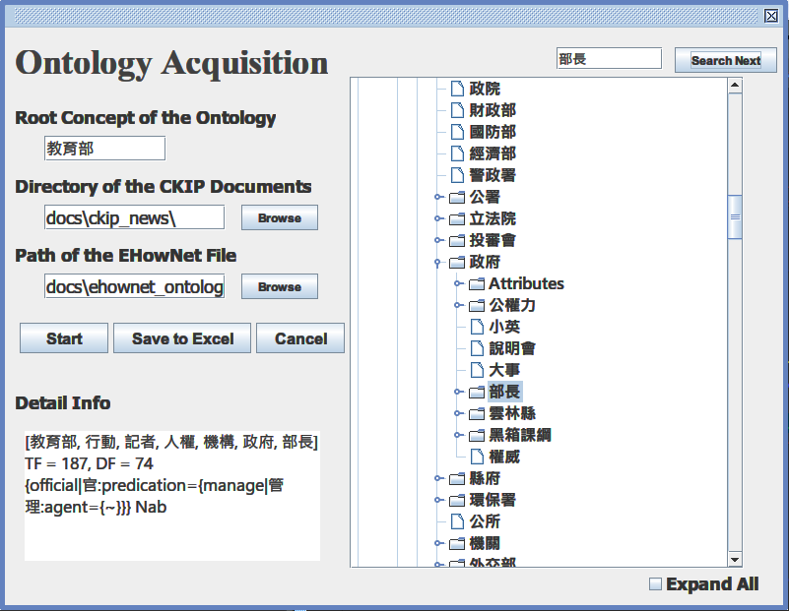
Demo

Slide 15
Future Works
Use Association Rules to optimize the Ontology
Improve the accuracy of document frequency with the help of Zero Anaphor

Slide 16
References
Domain Event Extraction and Representation with Domain Ontology
Text Categorization Using Automatically Acquired Domain Ontology
A Semi-Automatic Domain Ontology Acquisition Tool from Chinese Corpus
Semantic Frame-Based Natural Language Understanding for Intelligent Topic Detection Agent
PAT-Tree-Based Keyword Extraction for Chinese Information Retrieval

Slide 17
Thank You

