Slide 1
Waste Not Want Not
Alecia Thomas
celestialrae on GitHub

Slide 2
Reduce Waste
My project is intended to reduce waste by keeping track of a user's ingredients. Whenever a user goes grocery shopping they would input their new items into their digital pantry along with the expiration dates. When an ingredient is about to expire it will trigger an automatic message to the user with a warning to use the ingredient up within the selected timeframe.

Slide 3
Features
User Login
Add, Delete, and Update
Messaging

Slide 4
Planning - User Stories
Add, Delete, or Update an Ingredient
Sort by Date, Food Group, or Amount
Alter settings to message when there's more of an item to use so it is spread out over an interval of time instead of eating 10 pounds of rice in the last week.
A pie chart will show the ratio of each food group in your diet.

Slide 5
Planning - Database
The "Food Group" table has the 5 groups recommended by the USDA, this will go towards making a pie chart as a visual representation of a user's diet.
There is another table for "Units", this will be used along with "Weight" to allow the user to spread out a food item.
There is a "Ingredients" table with all of the names and "Expiration Dates".

Slide 6
Technology Stack
C#, JavaScript
.NETCore, EntityFrameworkCore
ASP.NET, Razor
SQL Server, Azure Data Studio)
Bootstrap

Slide 7
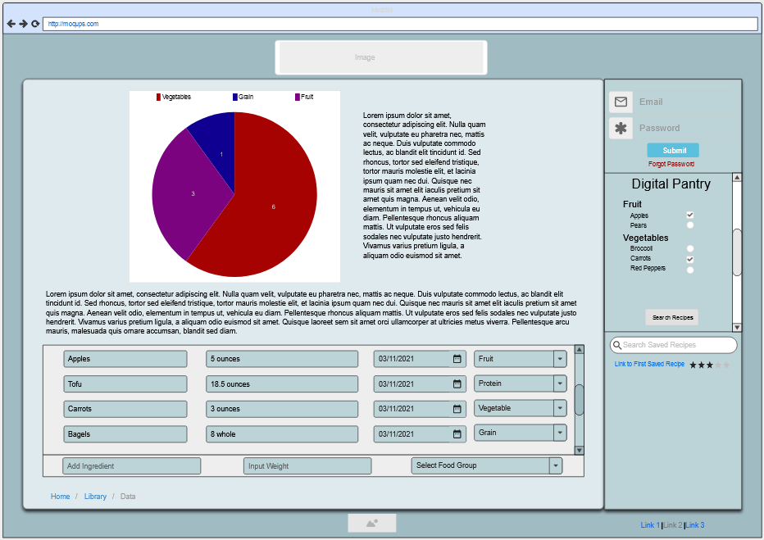
Wireframe

Slide 8
What I Learned
Identity
How to create a login feature
What databases were available and possible hosting options
How to add User Secrets

Slide 9
What’s Next
Text message feature
Adding more partial views for a better UI
Adding more sort functionality
Recommending recipes based upon a user's ingredients
Filtering through recipes to find one with the most ingredients owned
Notes:
Be specific! If you mention another feature describe why that features is necessary, or what problem it solves. If you mention changing the UI mention specific technologies, or libraries you will use to do that. If you mention a technology, or feature you don’t know yet tell them how you plan on learning it.

