Slide 1
The game will start after you read through these instructions. You will make 250 flights to the mountains and get paid for every gold coin the genies give you.
Press the enter key to continue

Slide 2


You will explore other mountains now: Blue Mountain and Pink Mountain. You have bought a new pair of magic carpets to take you there. Your new carpets are shown below.
One has been enchanted by a magician to fly to Blue Mountain and the other to Pink Mountain. The symbols written on the carpets mean “Blue Mountain” and “Pink Mountain.”
Press the enter key to continue

Slide 3

Sometimes your carpets will be on different sides of the room, because each time you want to use them, you take them out of a cupboard and might put them down in different positions.
Press the enter key to continue

Slide 4
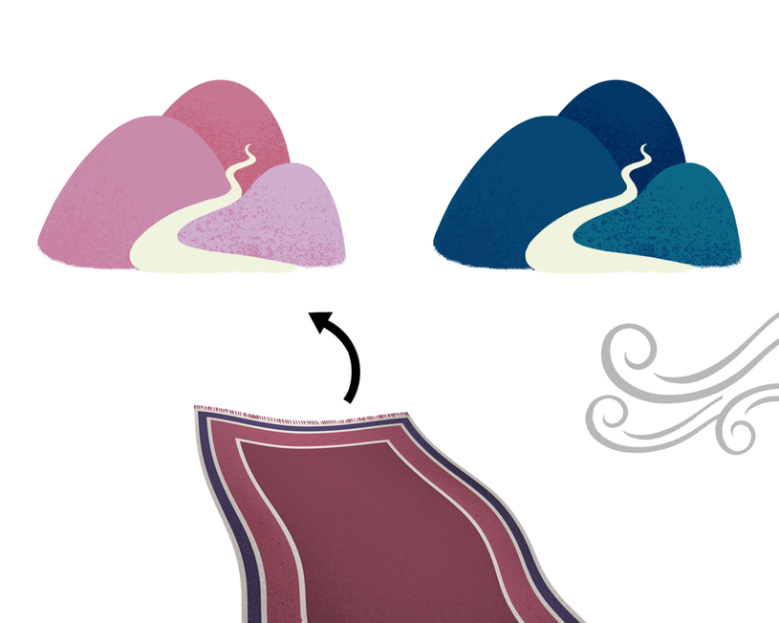
The carpets have also been upgraded to be completely self-driving. They will automatically try to fly to the mountain whose name is written on them, but if the wind is too dangerous, a safety procedure will be activated, and the carpets will land on the other mountain.
Press the enter key to continue

Slide 5

You have already tested your new self-driving carpets and they work perfectly. Because these flights are long and boring, you will now sleep through them and just wake up at your destination.
Press the enter key to continue

Slide 6
After you select a carpet, you will not see the trip to the mountain because you’ll be taking a nap and only wake up when you are already on one of the mountains.
Press the enter key to continue

Slide 7
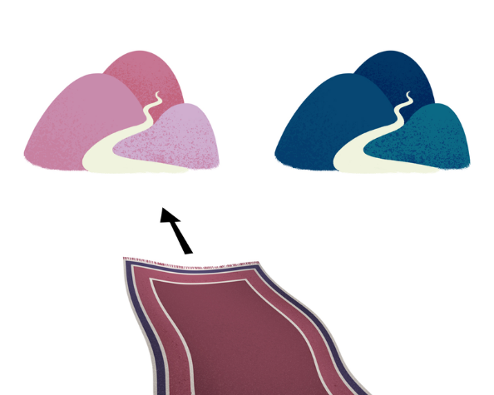
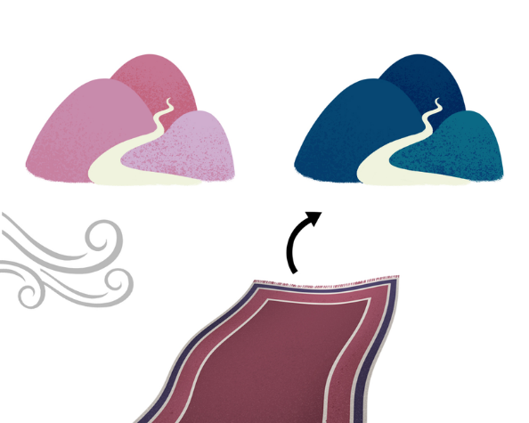
During the game, you’ll have to figure out by yourself which symbol means “Blue Mountain” and which means “Pink Mountain.” This should be easy, because each carpet will land more often on the mountain whose name is written on it.
For example, the carpet with the symbol that means “Pink Mountain” will always try to land on Pink Mountain, unless the wind forces it to land on Blue Mountain, which happens more rarely.
Press the enter key to continue

Slide 8

The wind blows unpredictably and is equally likely to blow near both mountains. You can never predict when it will start or stop.
During a flight, you won’t see the wind blowing because you’ll be sleeping comfortably on your self-driving carpet.
Press the enter key to continue

Slide 9
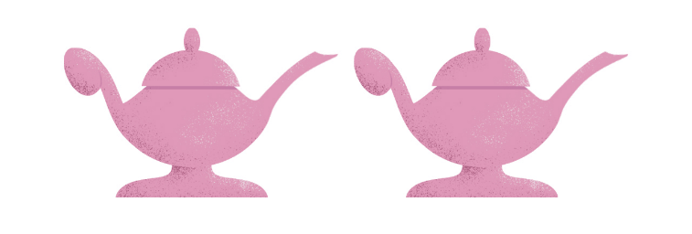
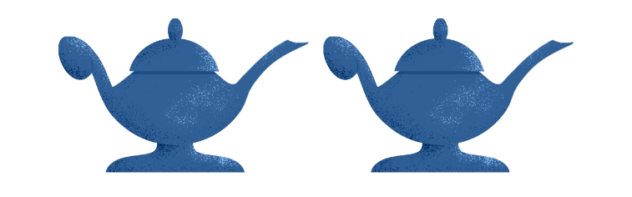
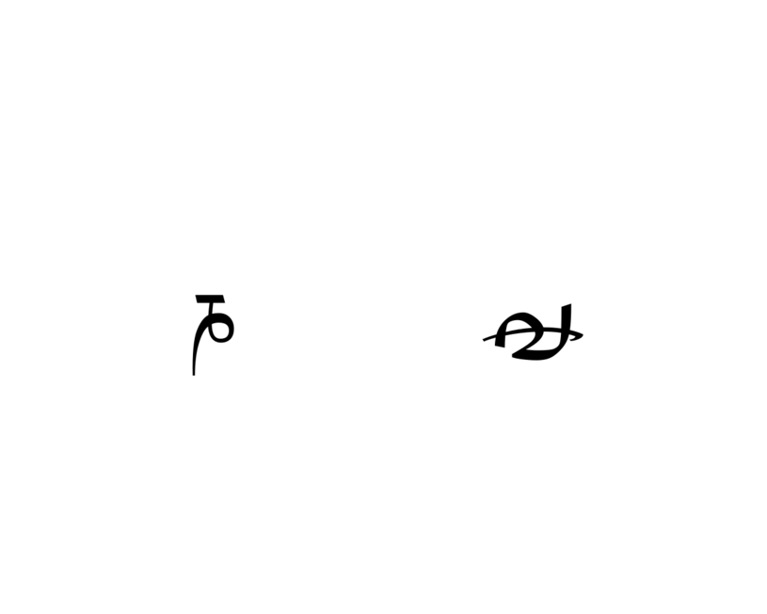
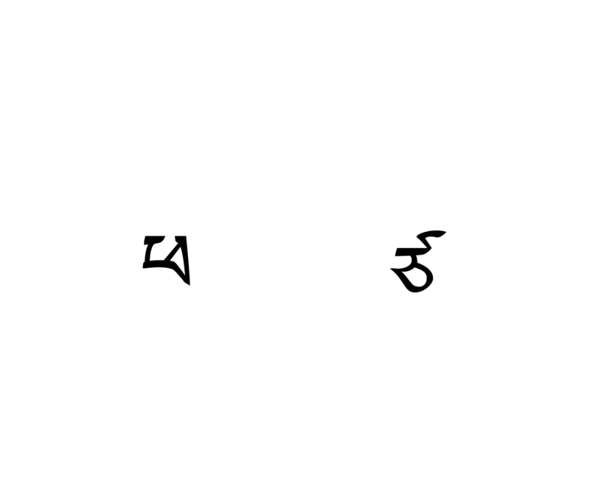
On a mountain, you should press the left or right arrow key to choose a lamp. Each lamp has the name of the genie that lives inside it written on it.
The same lamp will be sometimes on the left and sometimes on the right, because each time you pick up a lamp to rub it you might put it down later in a different place.
Press the enter key to continue

Slide 10
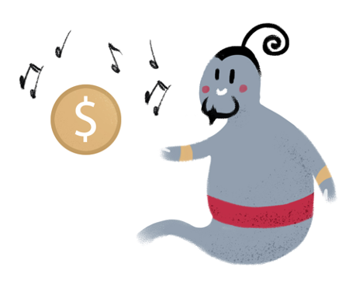
You must decide quickly which lamp you’re going to rub. If you take more than 3 seconds to make your choice, the genies will assume there won’t be any music and go to sleep.
Remember that when a genie is currently interested in music, they’ll probably come out of their lamp and give you a coin.
Press the enter key to continue

Slide 11

But when a genie isn’t very interested in music, they’ll tend to stay inside their lamp.
It is hard to tell how interested in music each genie currently is, but if a genie will often come out of their lamp to listen to your songs, they are probably interested.
Each genie may be more or less interested in music, and their interest may change with time.
Press the enter key to continue

Slide 12
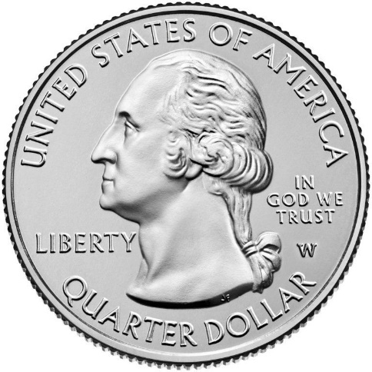
Each gold coin the genies give you is worth real money in our world. Good luck getting them!
=
Press the enter key to continue

Slide 13
If the word BREAK appears on the screen, you can take a short break before continuing the game.
Press the enter key to continue

Slide 14
Please let the research assistant know if you have any questions at this point!
You can start the game now by pressing the enter key.

