Slide 1
Thank you for agreeing to participate in this study about how people make decisions.
After you exercise, you will play a game in which you are a musician working for gold coins in a fantasy land. But first you will complete a tutorial to learn about the game story and controls, and then read the instructions for the actual game.
The tutorial allows you to learn a key part of the game. It will help you maximize your earnings during the game, so do your best to learn how to play the game during the tutorial.
Throughout this tutorial, press the right arrow key to proceed to the next page and the left arrow key to visit the previous page.
Let’s begin!
Press the enter key to continue

Slide 2
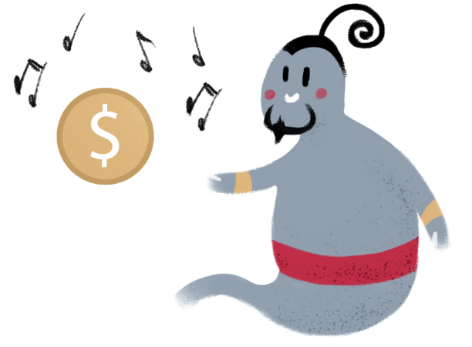
You are a musician in a fantasy land. You play the flute for an audience of genies in return for gold coins.
Press the enter key to continue

Slide 3

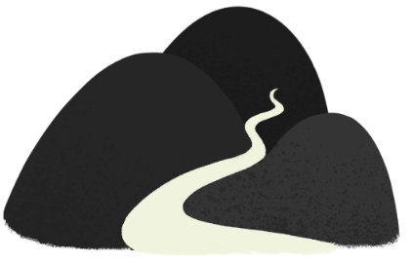


To find the genies, you travel on a magic carpet to Orange Mountain and Black Mountain, where the genies live inside their magic lamps.
Press the enter key to continue

Slide 4


Each magic lamp is marked with a symbol that is the genie’s name in the local language.
Press the enter key to continue

Slide 5
You can pick up a lamp and rub it by using the left or right arrow keys. If the genie that lives inside is in the mood for music, they’ll come out, listen to a song, and give you a gold coin in return.
Press the enter key to continue

Slide 6

But sometimes the genie won’t be interested and will just stay inside their lamp. In this case, you won’t get a gold coin.
Press the enter key to continue

Slide 7
It is hard to tell how interested in music each genie is, because genies are very shy, but if a genie will often come out of his lamp to listen to your songs, they are probably interested in music.
A genie’s interest in music may also change with time. A genie that is initially interested in music may later lose interest, or vice versa.
Press the enter key to continue

Slide 8
If you recently visited a certain genie and they gave you a gold coin for a song, this genie may be currently interested in music and it may be a good idea to visit them again.
Press the enter key to continue

Slide 9
But if the genie stayed inside their lamp, they may not be very interested in music, and it may be a better idea to visit a different genie.
Press the enter key to continue

Slide 10
Also, because genies are very shy, they rarely talk to each other. Each genie has their own interests, and one genie’s interest in music doesn’t influence the other genies.
To go to the mountains where the genies live, you fly on magic carpets that you bought from a magician.
Press the enter key to continue

Slide 11
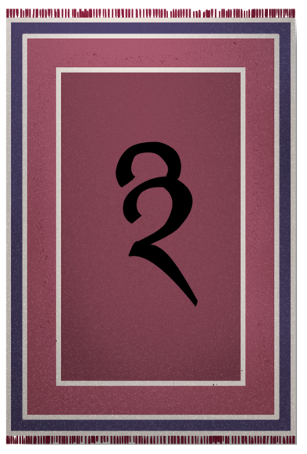
The magician enchanted one of your carpets, shown below, to fly to Black Mountain. The symbol written on the carpet means “Black Mountain” in the local language.
Press the enter key to continue

Slide 12
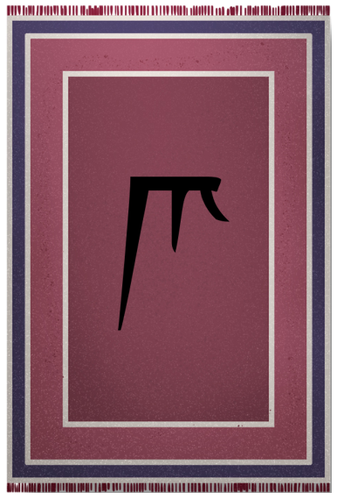
The magician also enchanted your other carpet, shown below, to fly to Orange Mountain. The symbol written on the carpet means “Orange Mountain” in the local language.
Press the enter key to continue

Slide 13
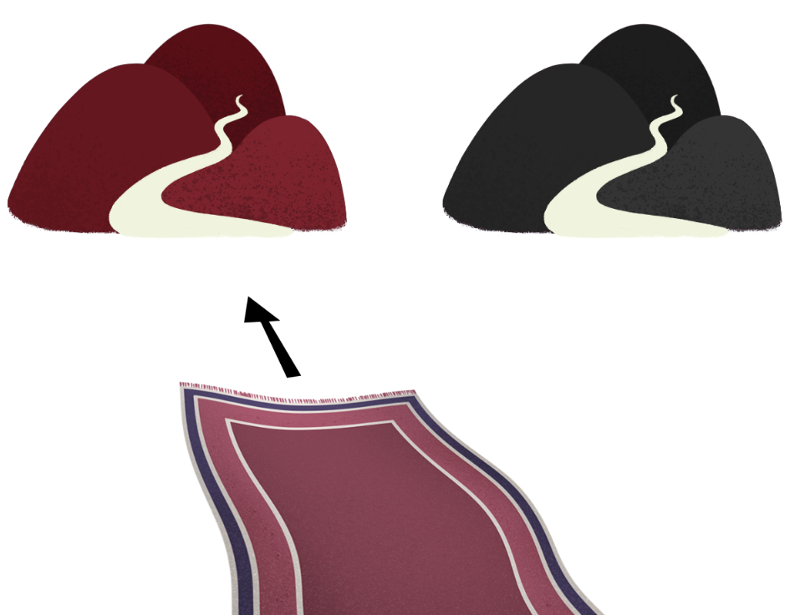
After you decide which genie you want to visit, you should fly to the mountain where they live.
If you want to visit a genie that lives on Orange Mountain, you should fly on the carpet shown below.
Press the enter key to continue

Slide 14
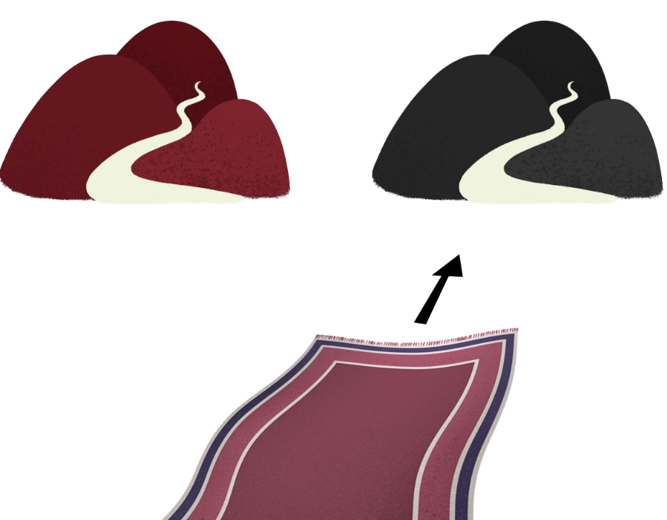
If you want to visit a genie that lives on Black Mountain, you should fly on your other carpet shown below.
Press the enter key to continue

Slide 15
Sometimes your carpets will be on different sides of the room, because each time you want to use them, you take them out of a cupboard and might put them down in different positions.
You can always identify each carpet by the symbols written on them.
Press the enter key to continue

Slide 16
You will use the left and right arrow keys to choose a carpet. The left arrow key chooses the carpet on the left …
Press the enter key to continue

Slide 17
… and the right arrow key chooses the carpet on the right.
Press the enter key to continue

Slide 18
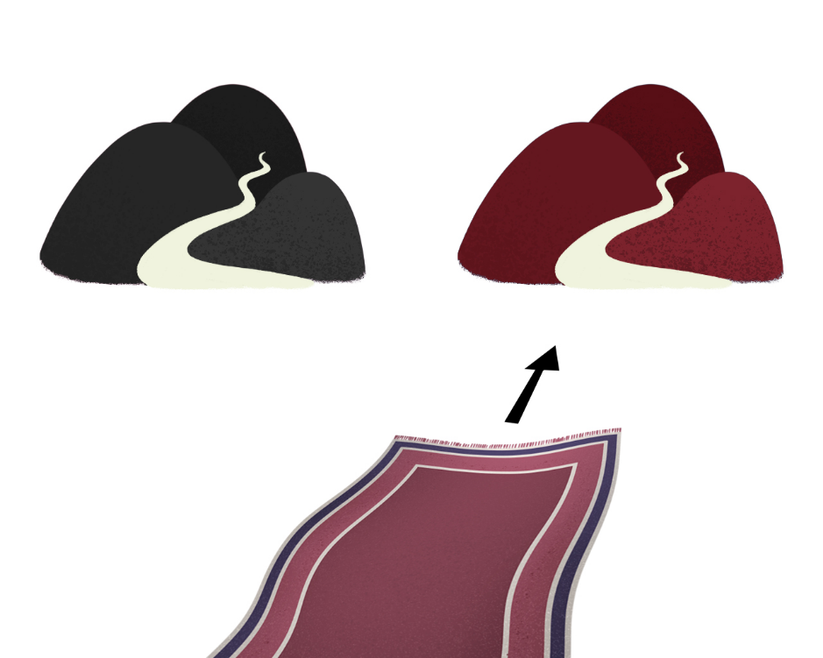
After you choose a carpet, you will jump on it and fly away. Most of the flights to Orange Mountain and Black Mountain end successfully with the carpet landing at the planned destination.
Press the enter key to continue

Slide 19
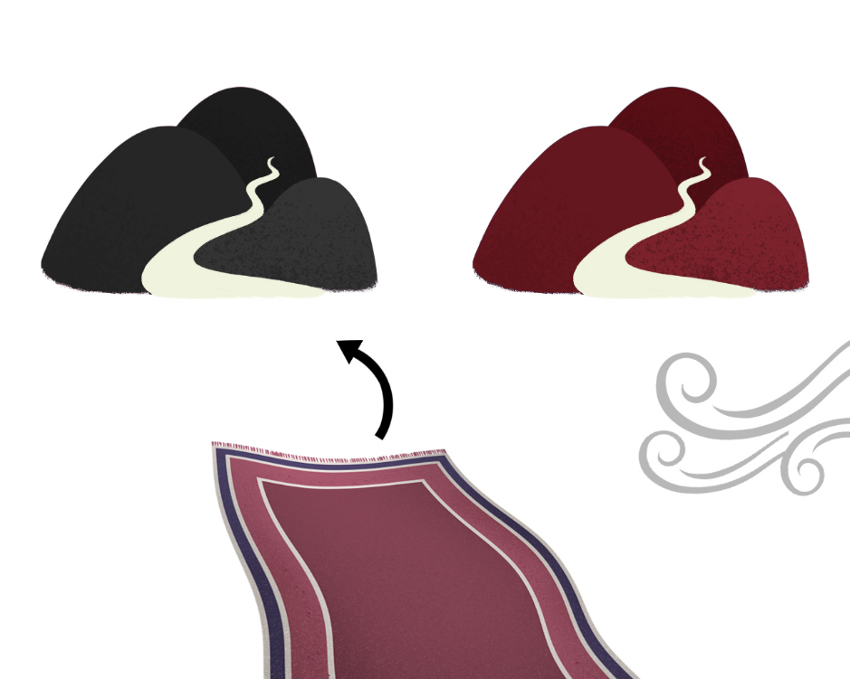
But more rarely a strong wind will blow near the mountain where you want to go, and it’s dangerous to fly there, because the wind might blow you off the carpet.
When this happens, you will drive your carpet to the other mountain and do an emergency landing there.
Press the enter key to continue

Slide 20
On most days the weather will be good for flying, but strong winds may appear randomly. It is impossible to tell when the wind will start and stop, and the wind is equally likely to blow near Orange Mountain and Black Mountain.
Press the enter key to continue

Slide 21
Let’s say you decided to go to Orange Mountain, because during your last two trips there a genie came out of their lamp to listen to a song, and you think this genie is currently interested in music.
Press the enter key to continue

Slide 22
So you choose to fly on the carpet that was enchanted to fly to Orange Mountain.
Press the enter key to continue

Slide 23

Unfortunately, a strong wind is blowing near Orange Mountain and for your safety you decide to land your carpet on Black Mountain instead.
Not all is lost. You can still see if a genie from Black Mountain wants to hear you play the flute.
Press the enter key to continue

Slide 24

There are two lamps on each mountain, each marked with a different symbol, which is the name of the genie inside. You can only rub one lamp during each trip, because after a while the genies go to sleep.
Press the enter key to continue

Slide 25


After you land on a mountain you should press the left arrow key to rub the lamp on the left or the right arrow key to rub the lamp on the right.
Press the enter key to continue

Slide 26
The same lamp will be sometimes on the left and sometimes on the right, because each time you pick up a lamp to rub it you might put it down later in a different place.
Just pay attention to the genie’s name written on the lamp so that later you’ll remember which lamp you chose.
Press the enter key to continue

Slide 27
Maybe the genie that lives inside the lamp you chose isn’t interested in music and will stay inside their lamp. You’ll then have to go back home without a gold coin.
Press the enter key to continue

Slide 28
But maybe the genie will come out, enjoy your music, and give you some money.
Press the enter key to continue

Slide 29
You will now take a short quiz on these instructions. Please let the research assistant know if you have any questions at all.
Press the enter key to continue

Slide 30
Which mountain is more likely to be windy?
Both mountains are equally likely to be windy
Orange Mountain
Black Mountain
Press the enter key to continue

Slide 31
2. Which carpet is more likely to experience strong winds?
The carpet enchanted to go to Orange Mountain
The carpet enchanted to go to Black Mountain
Either carpet is equally likely to experience strong wind
Press the enter key to continue

Slide 32
3. Which carpet is more likely to go to Orange Mountain?
The carpet on the left
The carpet with the symbol that means “Orange Mountain” on it
The carpet on the right
Press the enter key to continue

Slide 33
4. Where are you more likely to get a gold coin?
On Orange Mountain
It depends on each genie’s interest in music
On Black Mountain
Press the enter key to continue

Slide 34
5. How can you tell when a genie is interested in music?
When a genie is interested in music, they look different
When a genie is interested in music, their lamp glows
Genies that are interested in music will often come out of their lamps and listen to a song
Press the enter key to continue

Slide 35
6. How does a genie’s interest in music affect the other genies?
When one genie on a mountain is interested in music, the other isn’t
Each genie has their own interests and one genie’s interest doesn’t affect the other genies
When one genie on a mountain is interested in music, the other one is too

Slide 36
7. How does the wind affect the genie’s interest in music?
Genies are more interested in music on windy days
Genies live inside lamps so they don’t care about the wind outside
Genies are more interested in music on days without wind
Press the enter key to continue

Slide 37
Good job! You will now complete a few practice trials to get familiar with the game.
Press the enter key to continue

