Slide 1
Stock Pitch
Phoenix

Slide 2
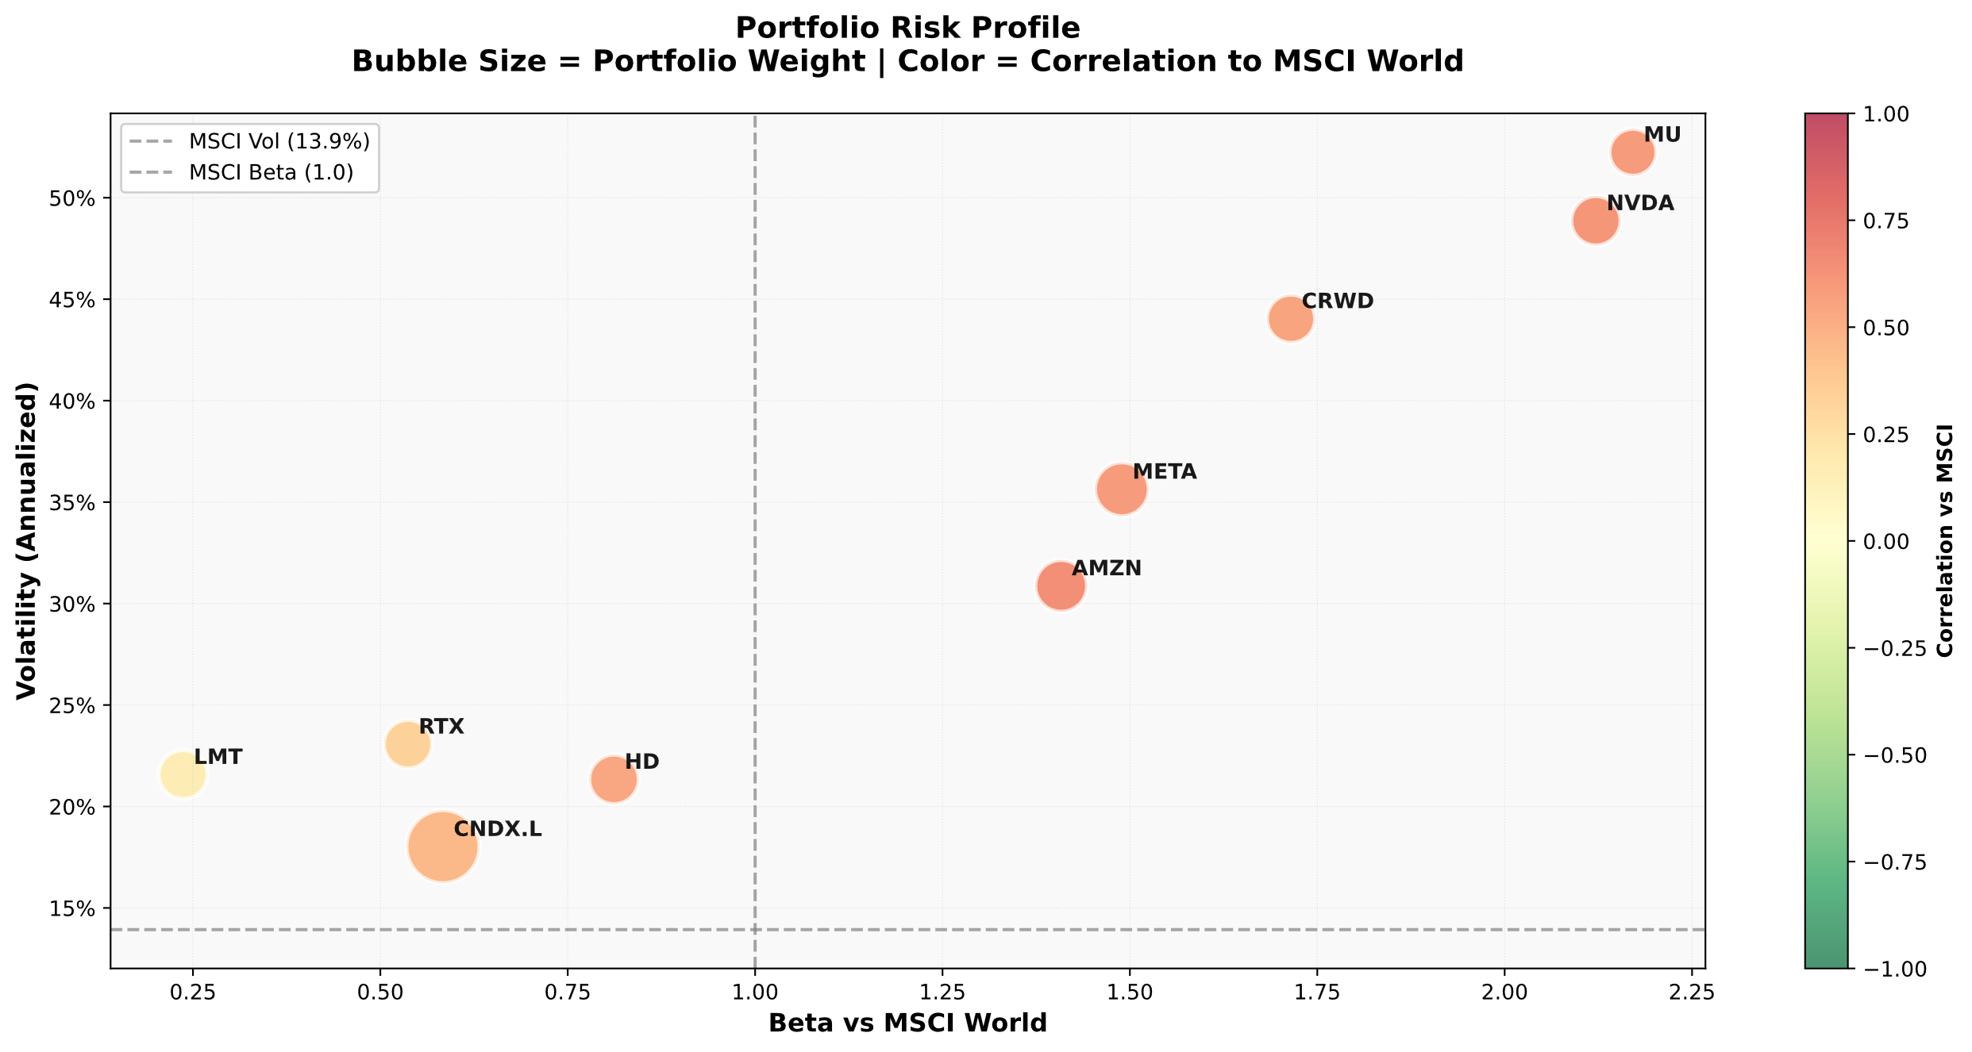
Phoenix Portfolio Risk Is Highly Concentrated in High-Beta Tech Exposure
Source: Prepared by the author using data from Yahoo Finance over the last 3 years.

Slide 3
Addressing Tech Concentration Through Thematic Diversification
Problem Identified
5 holdings with beta > 1.4
Concentrated tech volatility
Limited low beta exposure
Macro Themes from 2026 Outlooks
AI investment remains strong (1)
Infrastructure & energy demand rising (1)
Power availability is AI bottleneck (2)
U.S. natural gas pivotal globally (2)
Infrastructure build out accelerating (2)
Selection Filters
Beta < 1
Lower correlation to tech
Exposure to power / energy infrastructure
Catalyst within 6 months
Reasonable valuation
Most consistent themes across outlooks were energy infrastructure, power generation, and natural gas
Source: (1) J.P. Morgan Asset Management. 2026 Year-Ahead Investment Outlook: AI Lift and Economic Drift. November 2025. (2): BlackRock iShares. 2026 Thematic Outlook: Charting the Themes Impacting Markets. January 2026.

Slide 4
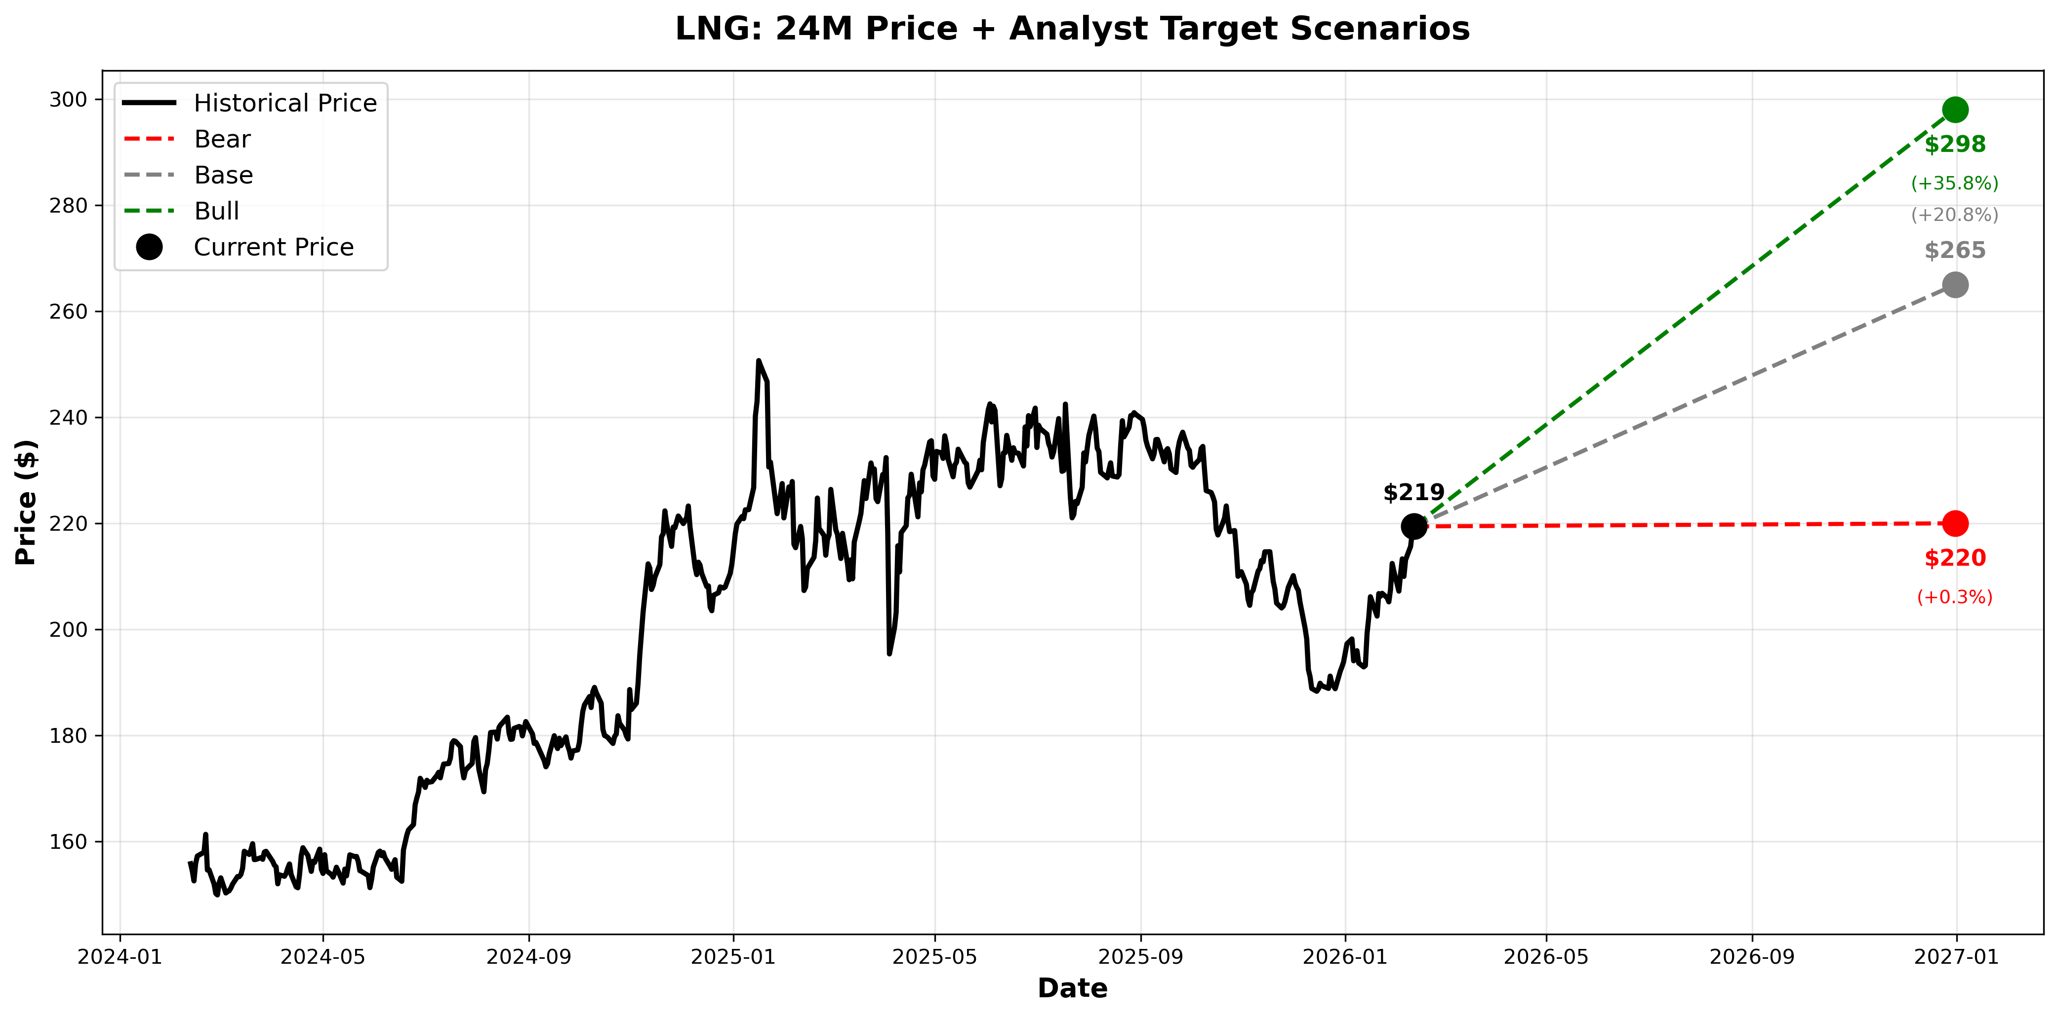

Initiate 5-8% Position in Cheniere Energy (LNG)
Structural LNG Infrastructure Exposure to Improve Portfolio Risk-Adjusted Returns
Source: Finviz; Yahoo Finance; TipRanks analyst consensus data (Feb 2026).

Slide 5
Cheniere Energy Is the Leading U.S. LNG Export Infrastructure Operator
It owns large industrial terminals that liquefy natural gas in the U.S. and ship it to utilities and energy companies worldwide under long-term contracts
What do they do?
Buy natural gas in the U.S. (priced at Henry Hub)
Cool it to -162°C to turn it into liquid (LNG)
Load it onto specialized ships
Export it to Europe and Asia
How they make money?
Long-term 15-20 year contracts
“Take or pay” structure
Customers pay fixed liquefaction fees
Limited dependence on short-term gas price moves
Who they sell to?
European utilities
Asian utilities
Energy majors
National oil companies
Why They’re a Leader?
Largest U.S. LNG exporter
Hard to replicate infrastructure
Ongoing capacity expansion
Long-term contracts already signed (reputation)
Source: Press Search, Cheniere Investor Relations 10Q Forms.

Slide 6
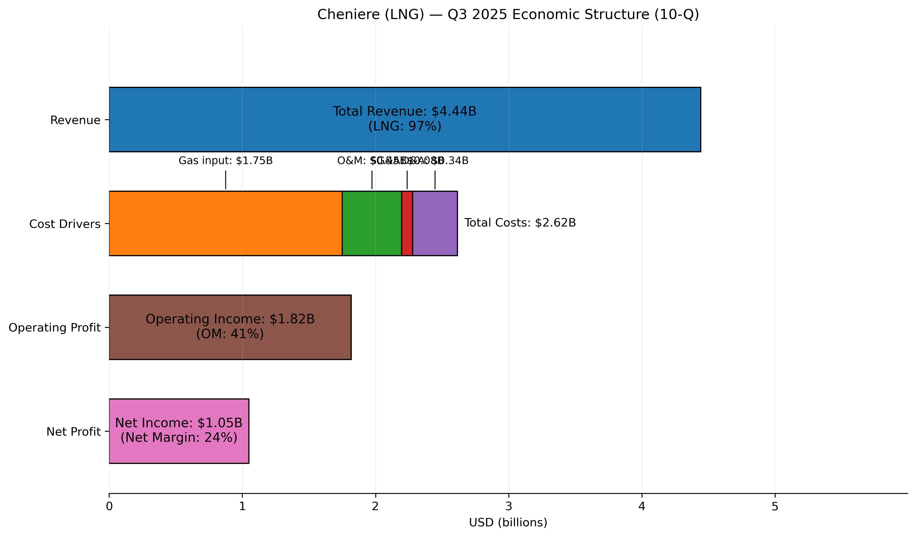
Cheniere Energy Is the Leading U.S. LNG Export Infrastructure Operator
It owns large industrial terminals that liquefy natural gas in the U.S. and ship it to utilities and energy companies worldwide under long-term contracts
Revenue Exposure:
Global LNG demand
Long-term contracted volumes
Cost Exposure:
Henry Hub gas price
Stability From:
15-20 year contracts
95% contracted capacity until 2030
Large-scale infrastructure
Source: Press Search, Cheniere Investor Relations 10Q Forms.

Slide 7
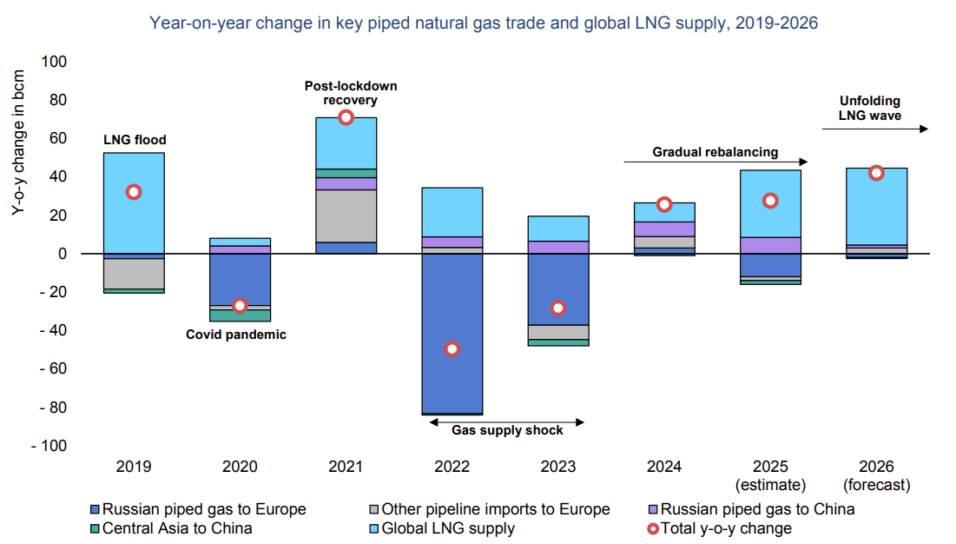
Global LNG Supply Wave + European Rewiring = Structural Tailwind for U.S. Exporters
EIA projects accelerating LNG supply growth in 2026 while Europe permanently reshapes its gas sourcing away from Russia.
Largest LNG supply build out since 2019 (per EIA)
Source: U.S. Energy Information Administration (EIA), Gas Market Report, Q1 2026.

Slide 8
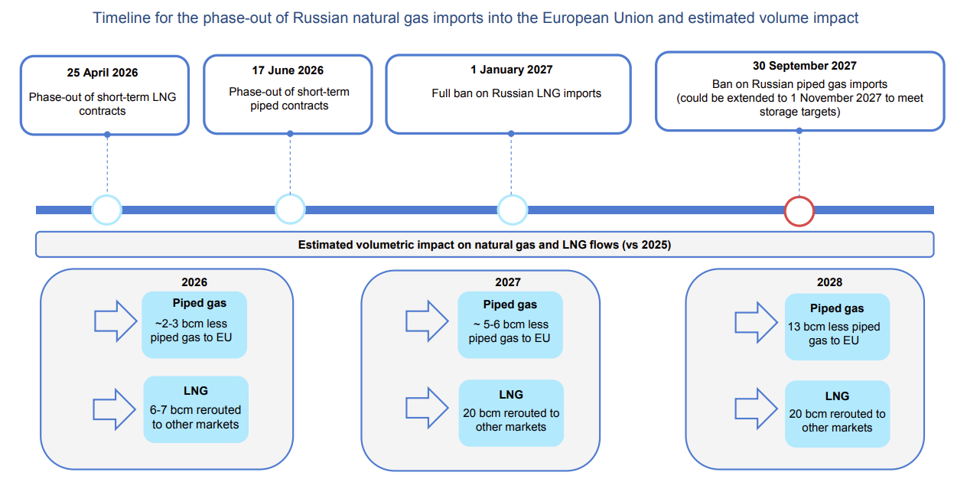
Global LNG Supply Wave + European Rewiring = Structural Tailwind for U.S. Exporters
EIA projects accelerating LNG supply growth in 2026 while Europe permanently reshapes its gas sourcing away from Russia.
Europe is structurally removing Russian gas.
That supply gap must be filled. U.S. LNG is the primary marginal supplier
Source: U.S. Energy Information Administration (EIA), Gas Market Report, Q1 2026.

Slide 9
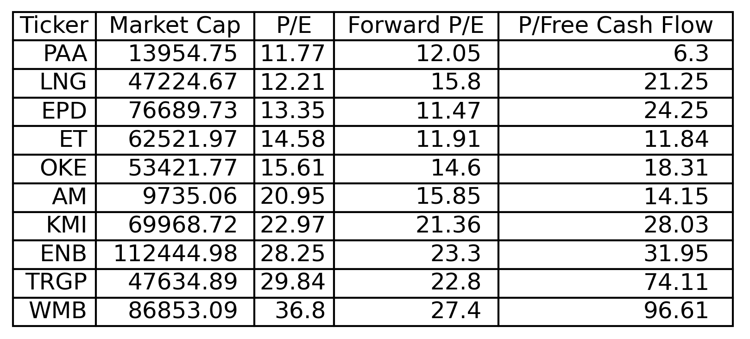
Attractive Relative Valuation Within LNG & Midstream Peers
Cheniere’s ~12x P/E compares favorably to peers trading 20-35x earnings.
Source: FinViz.

Slide 10
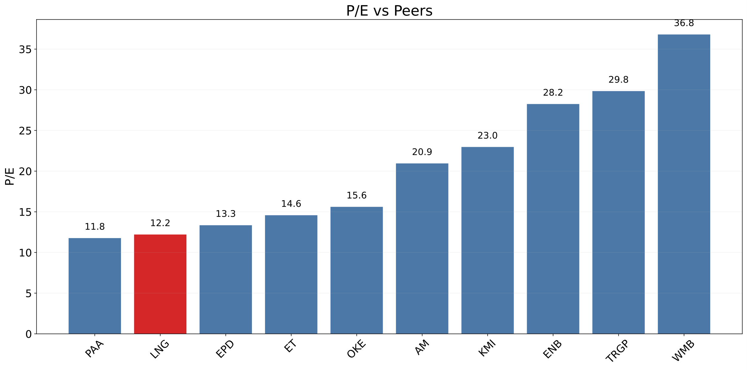
Attractive Relative Valuation Within LNG & Midstream Peers
Cheniere’s ~12x P/E compares favorably to peers trading 20-35x earnings.
Source: FinViz.

Slide 11
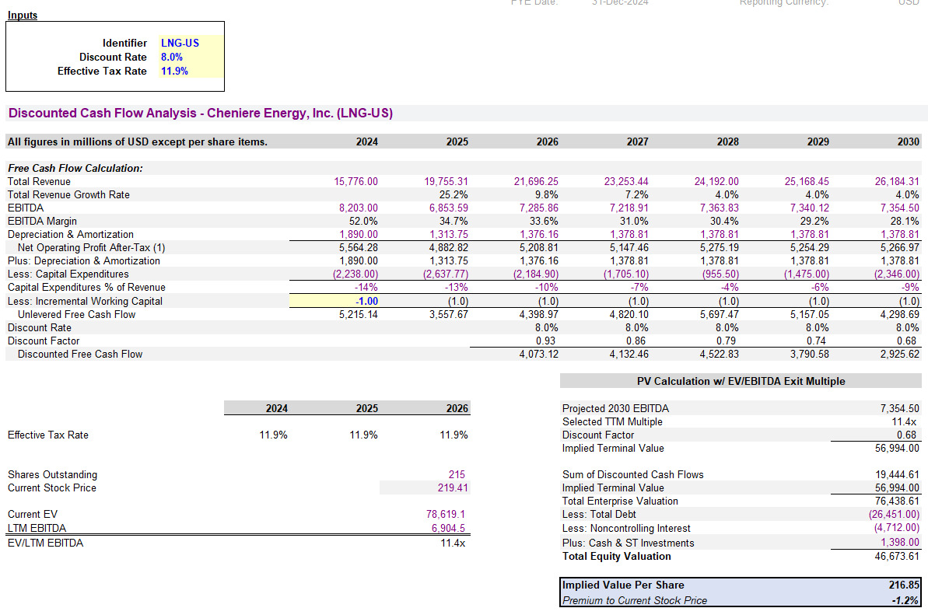
DCF Valuation
Even assuming margin normalization and a modest exit multiple, intrinsic value remains near current levels.
Source: Factset.

Slide 12
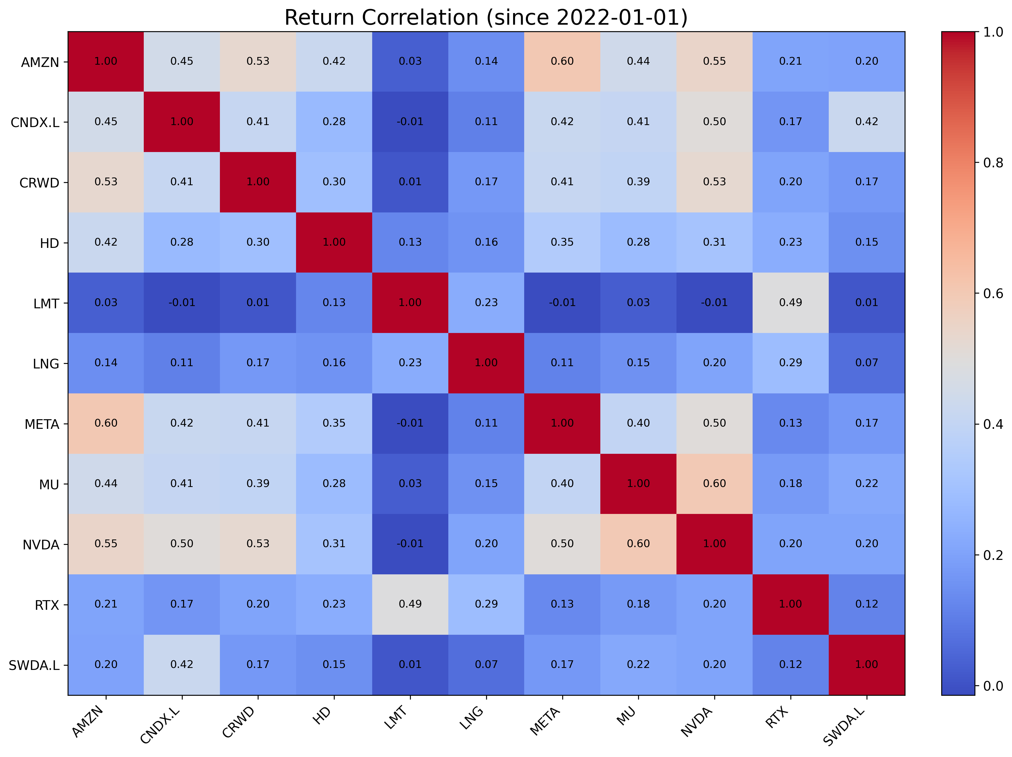
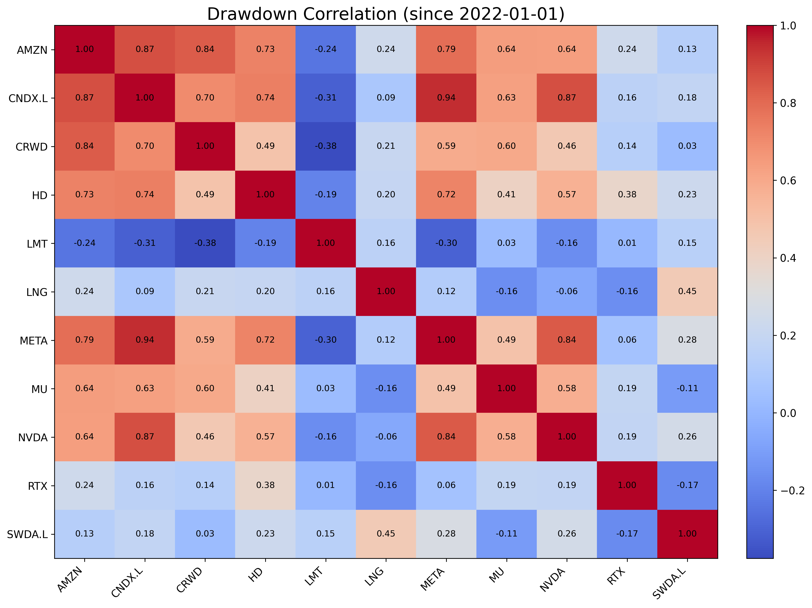
Strategic Diversification Through LNG: Low Correlation Unlocks Portfolio Resilience
LNG demonstrates independence from traditional tech and industrial holdings
Source: FinViz.

Slide 13
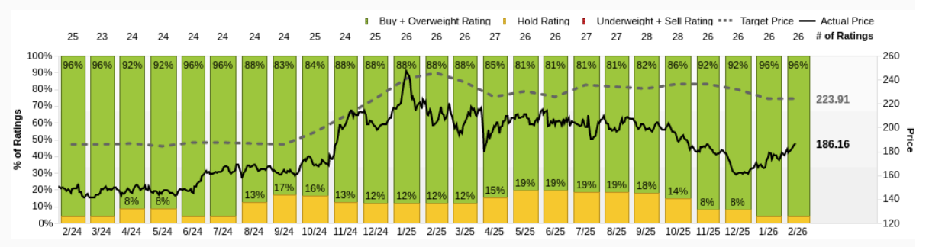
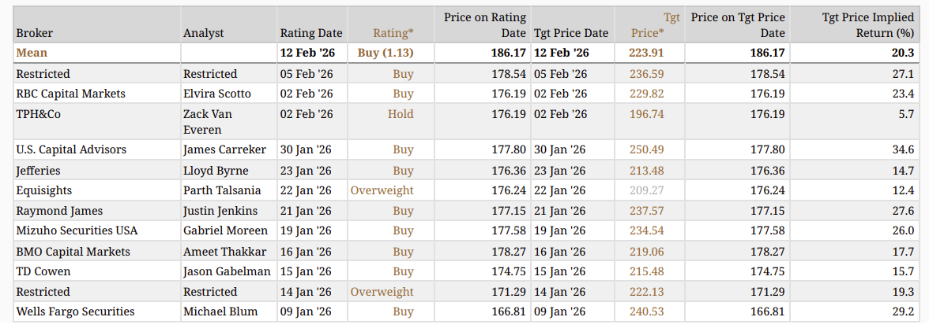
Target Prices & Consensus
Analyst Consensus Points to Strong Upside
AVG: 21.1%
Source: Factset.

Slide 14
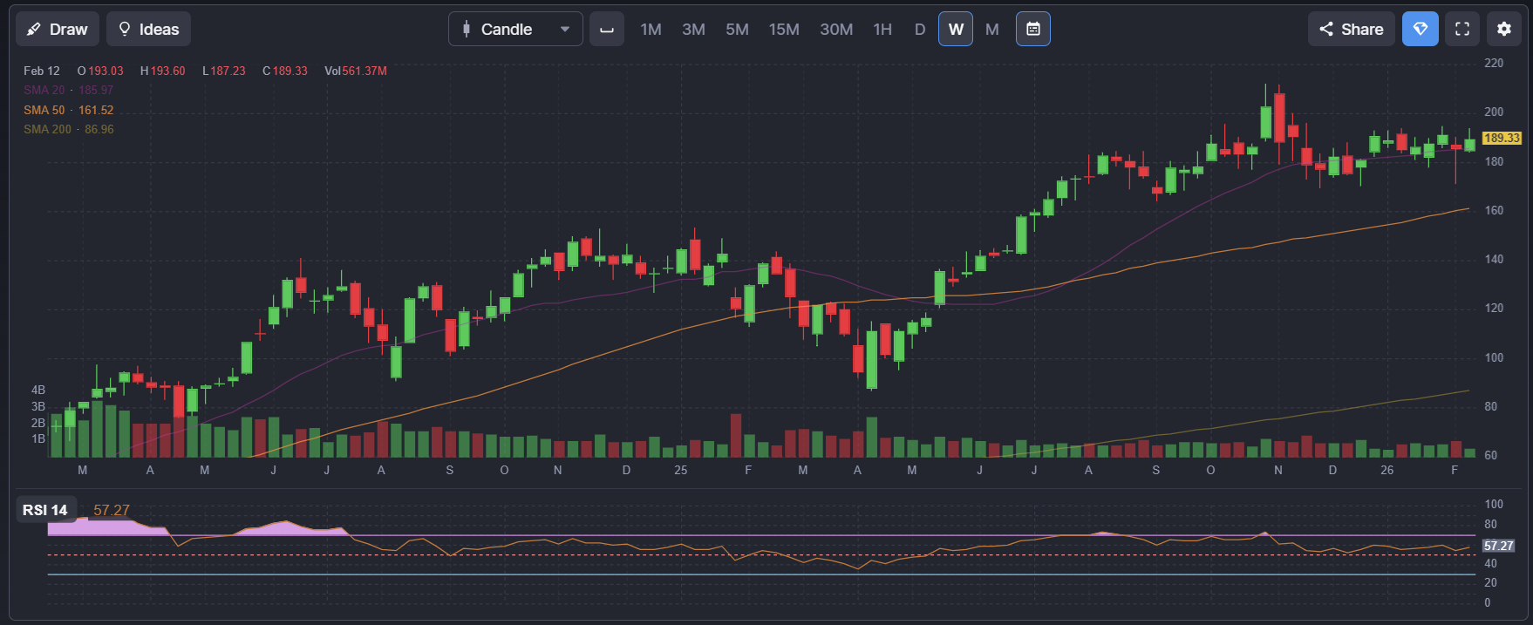
Technical Analysis
Source: FinViz.

Slide 15
Initiate 5-8% Position in Cheniere Energy (LNG)
Structural LNG Infrastructure Exposure to Improve Portfolio Risk-Adjusted Returns
Source: Finviz; Yahoo Finance; TipRanks analyst consensus data (Feb 2026).

Slide 16
Pros and Cons
Cheniere: Contracted Infrastructure Model with Commodity & Execution Risk
Pros
Long-Term Contracted Revenue
~95% of LNG production capacity contracted into mid-2030s
High revenue visibility
Scale & Market Leadership
Largest U.S. LNG exporter
Second-largest globally
Competitive moat
Infrastructure Barriers to Entry
Liquefaction terminals require:
Multi-year construction
Billions in capital
Regulatory approval
Strong Operating Cash Flow Supports:
Debt reduction
Buybacks
Dividends
Cons
Profitability exposed to compression in the spread between U.S. natural gas prices and global LNG pricing
High capital intensity and leverage increase sensitivity to interest rates and refinancing conditions
Execution risk related to Corpus Christi Stage 3 expansion and future capacity additions
Regulatory and export policy risk given U.S. LNG approvals are subject to federal oversight
Global economic slowdown could reduce LNG demand and pressure export volumes
Source: FinViz.

Slide 17
Appendix
Phoenix

Slide 18
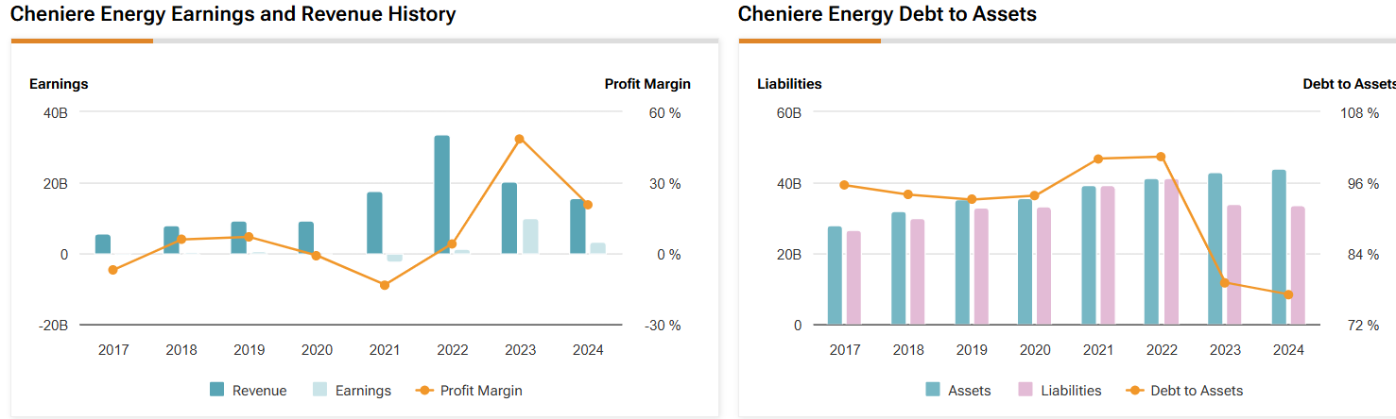
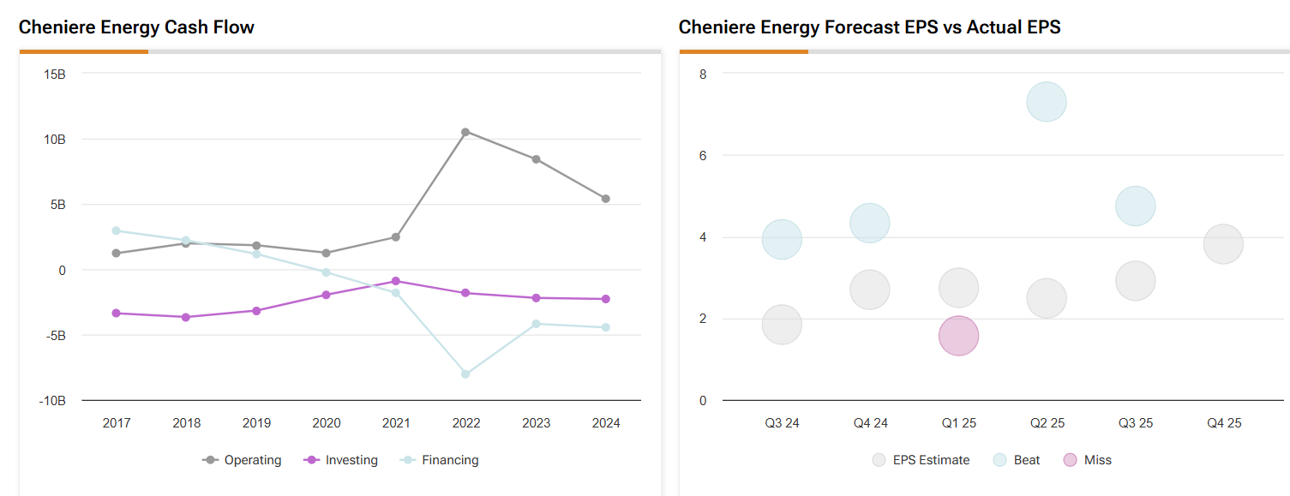
Financials
Source: TipRanks.

