Slide 1
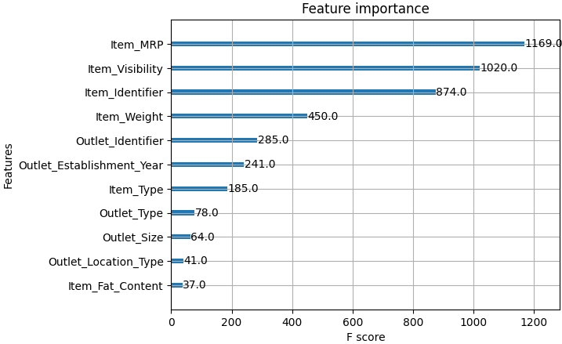
Sales Prediction
List Price (Item_MRP) and how much an item is visible to consumers in the grocery store (Item Visibility) has the most influence in predicting sales.

Slide 2
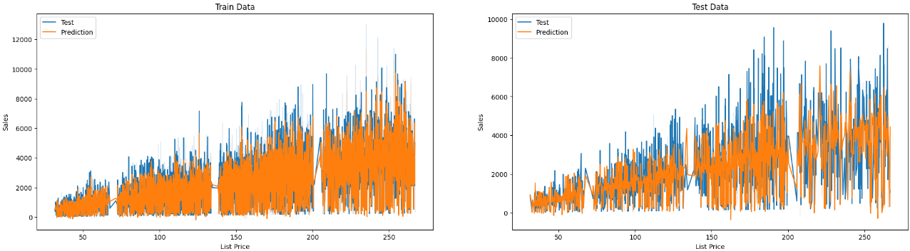
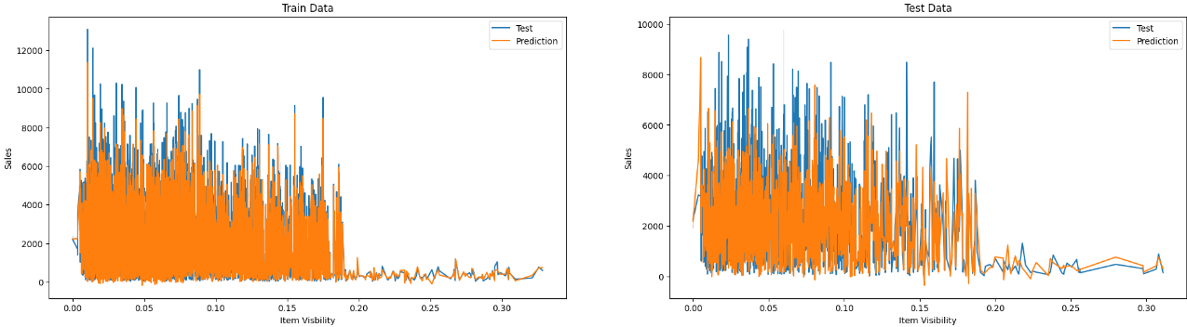


$R^{2}$ = 0.86
MSE = 390007.2
$R^{2}$ = 0.52
MSE = 1471566.31

