Slide 1

pymaze Challenge
Alejandro Munoz

Slide 2


Introduction
This presentation details the strategic improvements made to a Python-based maze game, addressing critical gameplay issues and improving user experience.
Objective: "To demonstrate a comprehensive approach to problem-solving and code refinement in game development."

Slide 3
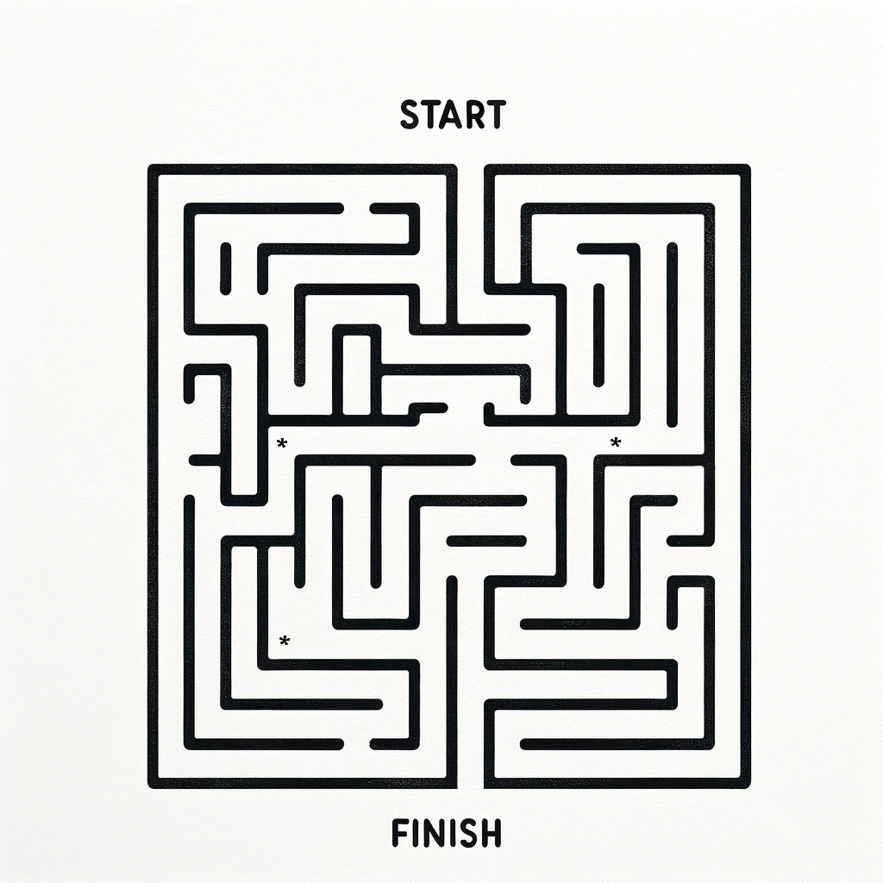
Basic Maze ruleS: One player has to navigate a maze to collect all the items, and then find the exit

Slide 4

Understanding the Challenge:
The original game lacked proper handling exit conditions, resulting in a disjointed gameplay experience.
Problem Statement: the game neither ended nor checked if all items had been collected.

Slide 5
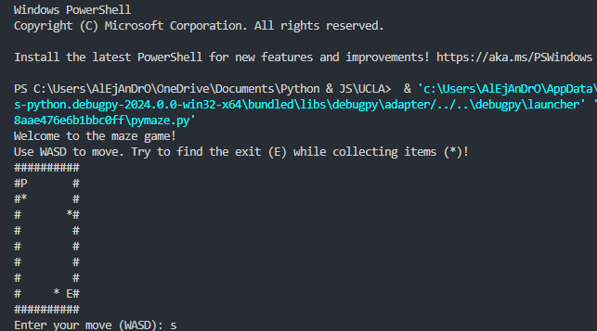
Starting the game:

Slide 6
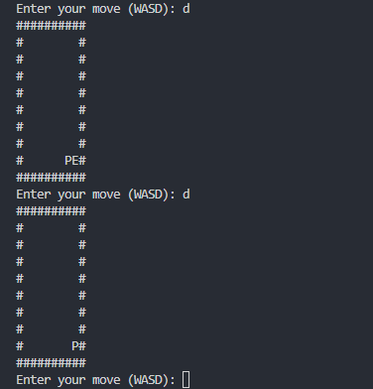
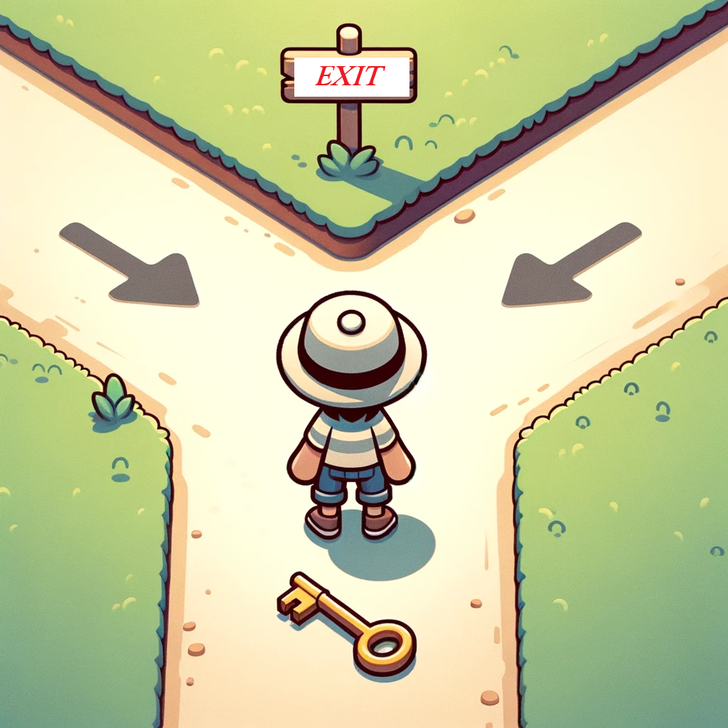
Collecting all items and getting to the exit (E):
Our game has a hiccup:
When you move to a new spot, it doesn't recognize the exit and unsuccessfully Exit the game when it finds ‘E’

Slide 7
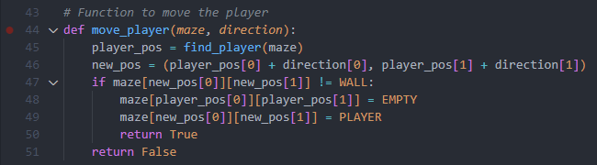
What's Going Wrong? The move_player() function only checked for walls (WALL) but did not handle other game elements like items (ITEM) or the exit (EXIT), leading to incomplete gameplay

Slide 8

What's Going Wrong? but also the main() function only did not properly handle the scenario when the player reaches the exit:
AFTER EACH MOVEMENT, THE GAME CHECKS IF THE PLAYER'S CURRENT POSITION IS THE EXIT
SINCE THE PLAYER'S MOVEMENT HAS ALREADY REPLACED THE EXIT SYMBOL WITH THE PLAYER SYMBOL, THE CONDITION IF MAZE[PLAYER_POS[0]][PLAYER_POS[1]] == EXIT: WILL NEVER BE TRUE

Slide 9
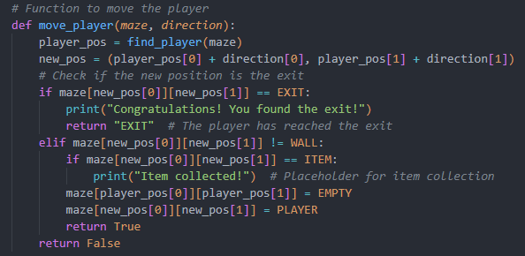
how to fix this issue? adjusting the move_player function to return a value that indicates if the player has reached the exit.

Slide 10
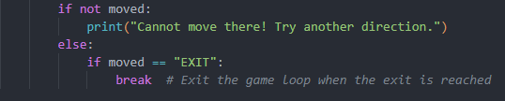
how to fix this issue? 2. adjusting the main() function to return a value that indicates if the player has reached the exit.

Slide 11
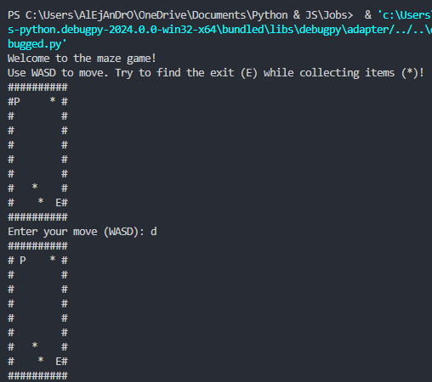
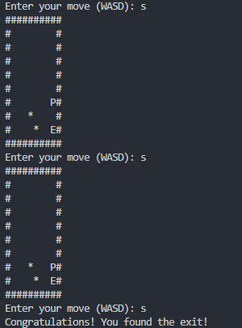
running the game with the updated code:

Slide 12
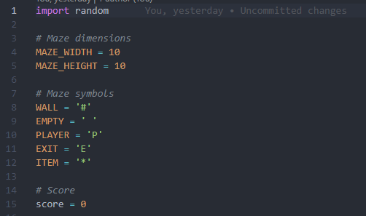
suggested improvements
since the original code did not track or display a score for collecting items, I decided to add that functionality:

Slide 13
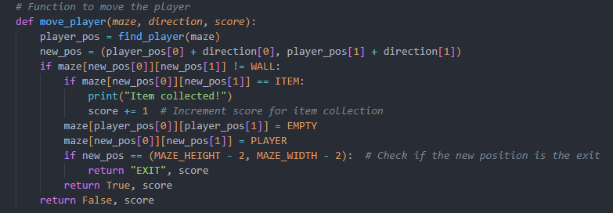
suggested improvements
since the original code did not track or display a score for collecting items, I decided to add that functionality:

Slide 14
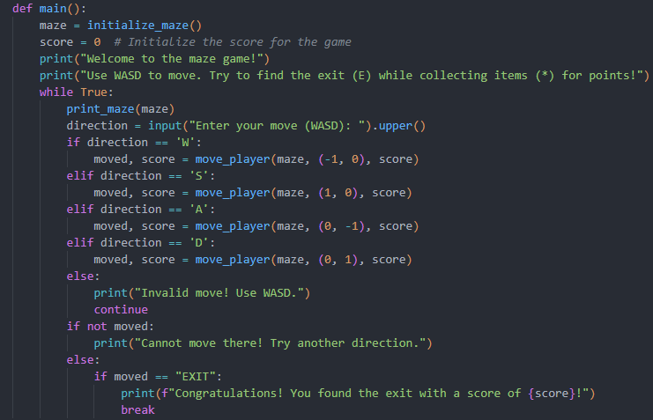
suggested improvements
since the original code did not track or display a score for collecting items, I decided to add that functionality:

Slide 15
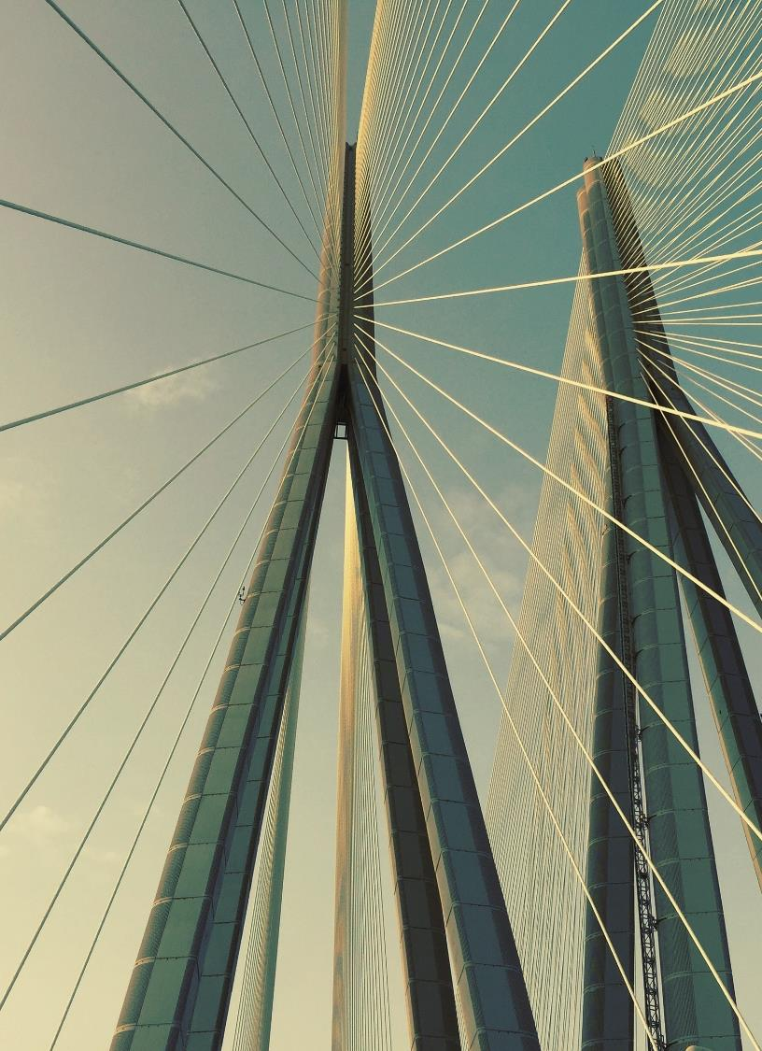
Thank you
Alejandro Munoz
almunozavila@gmail.com
Github: https://github.com/alej4ndro-cm/
LinkedIN: https://www.linkedin.com/feed/
YouTube Presentation Video: [Link]

