Slide 1
Apache Commons Net 3.5
Software Architecture Analysis
Program Overview · Diagrams · Design Patterns · Proposed Changes

Slide 2
Program Overview
What Apache Commons Net Is
Apache Commons Net is a Java networking library — not an application. It provides client-side implementations of 10+ internet protocols so that other Java programs can communicate over a network without reimplementing low-level socket and protocol logic.
Supported Protocols
FTP / FTPS
Upload & download files from FTP servers
SMTP / SMTPS
Send email
IMAP / IMAPS
Read email from a mail server
POP3 / POP3S
Retrieve email
NNTP
Read/post Usenet newsgroup articles
Telnet
Remote terminal sessions
NTP / Time
Synchronise clocks from a time server
Echo / Daytime
Basic TCP/UDP test services
Finger
Look up user info on a remote server
BSD r-commands
Legacy remote exec / login (rexec, rlogin)
CIDR / Subnet
IP address & subnet math utilities

Slide 3
Architecture Overview
Two transport bases, layered protocol stacks
Top-to-bottom = call depth from consumer to socket
Your Application
Protocol Clients (FTPClient · SMTPClient · IMAPClient · NNTPClient · TelnetClient · UDP Clients)
Protocol Command Bases (FTP · SMTP · IMAP · NNTP · Telnet)
SocketClient (abstract TCP base) | DatagramSocketClient (abstract UDP base)
Java Sockets (javax.net.SocketFactory / DatagramSocket)
Supporting systems: I/O Decorators · FTP Parsers · Observer Events · SSL Utilities

Slide 4
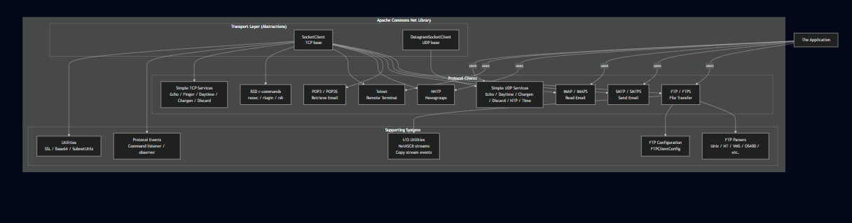
Conceptual Diagram
High-level system structure

Slide 5
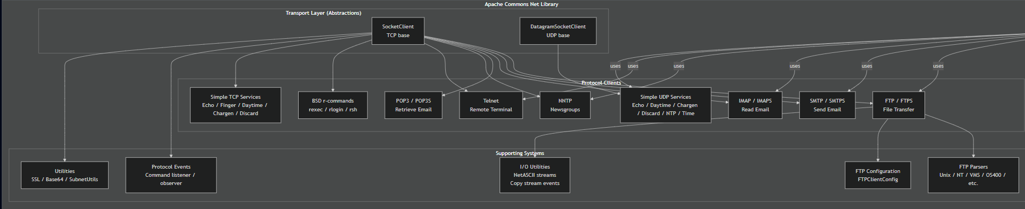
Conceptual Diagram
High-level system structure

Slide 6
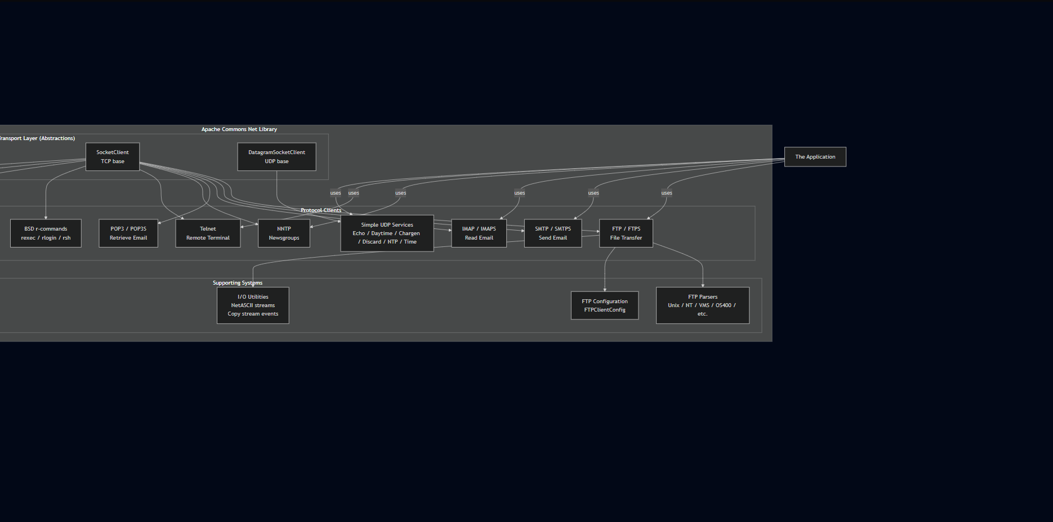
Conceptual Diagram
High-level system structure

Slide 7
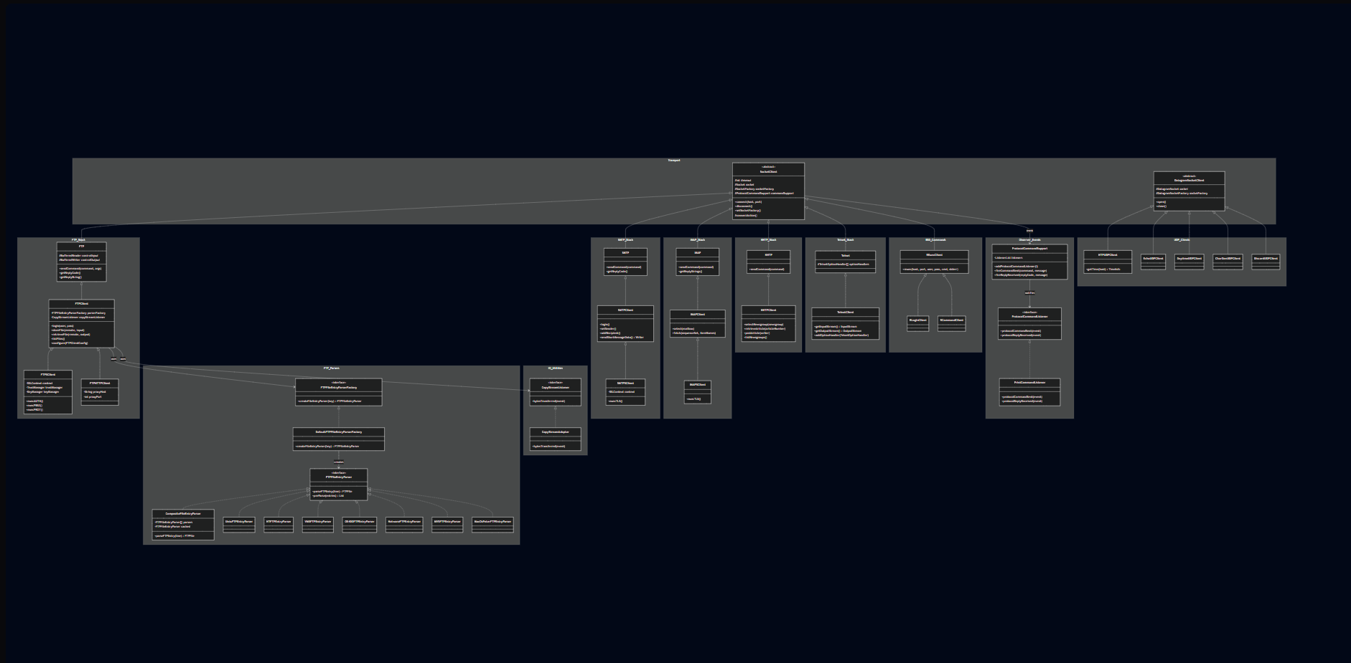
Concrete Diagram — Namespaces
Key classes per name

Slide 8
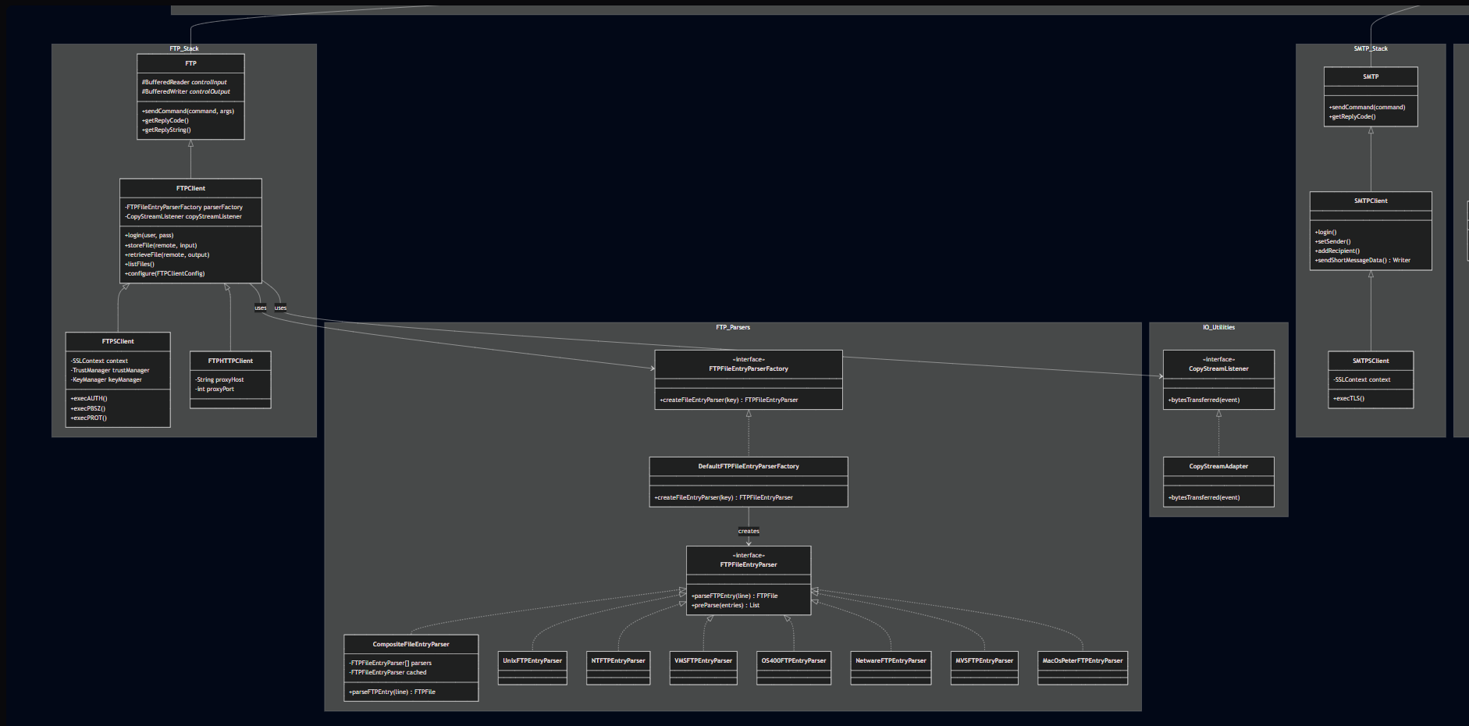
Concrete Diagram — Namespaces
Key classes per name

Slide 9
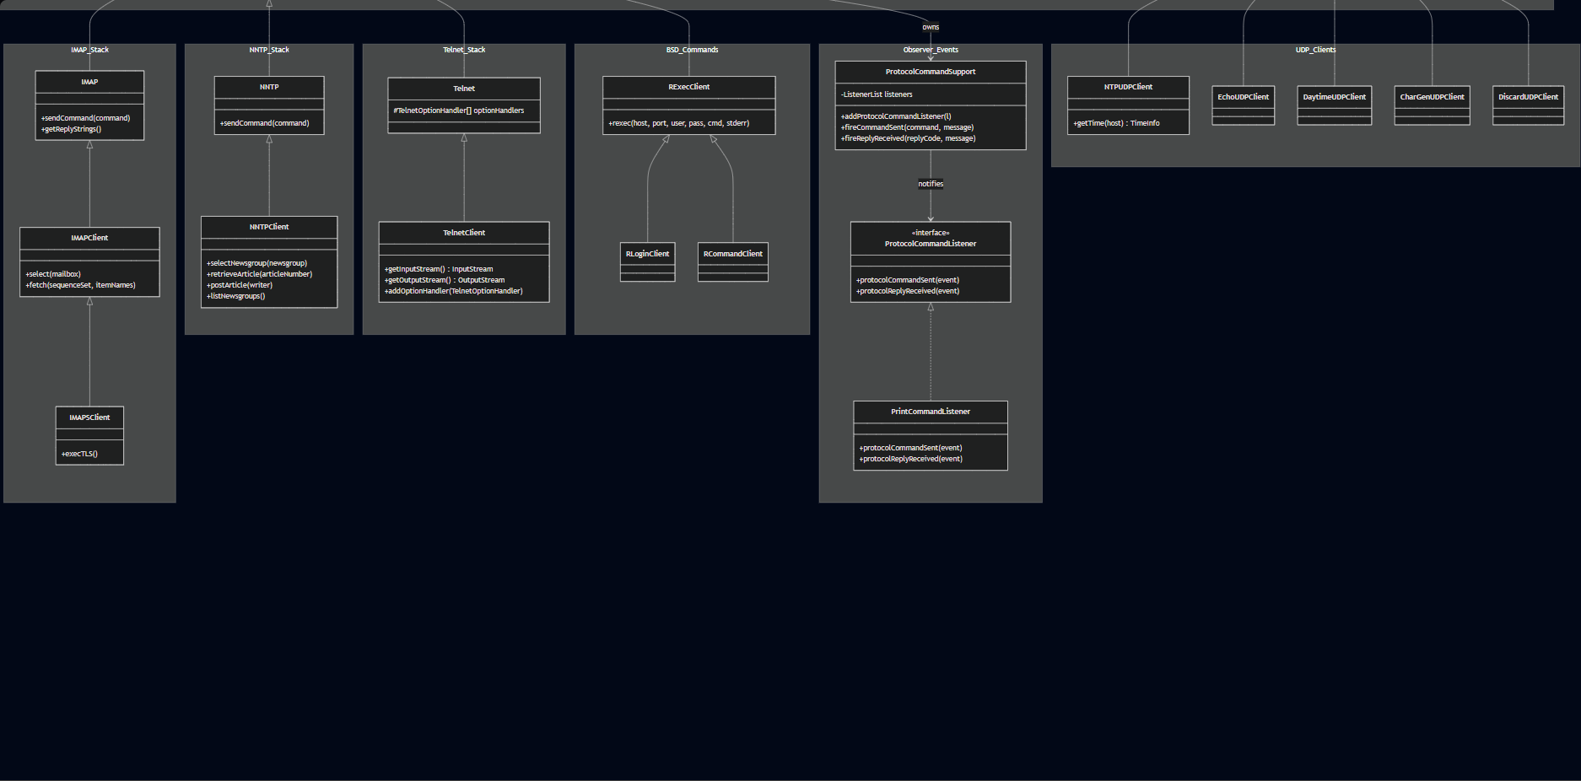
Concrete Diagram — Namespaces
Key classes per name

Slide 10
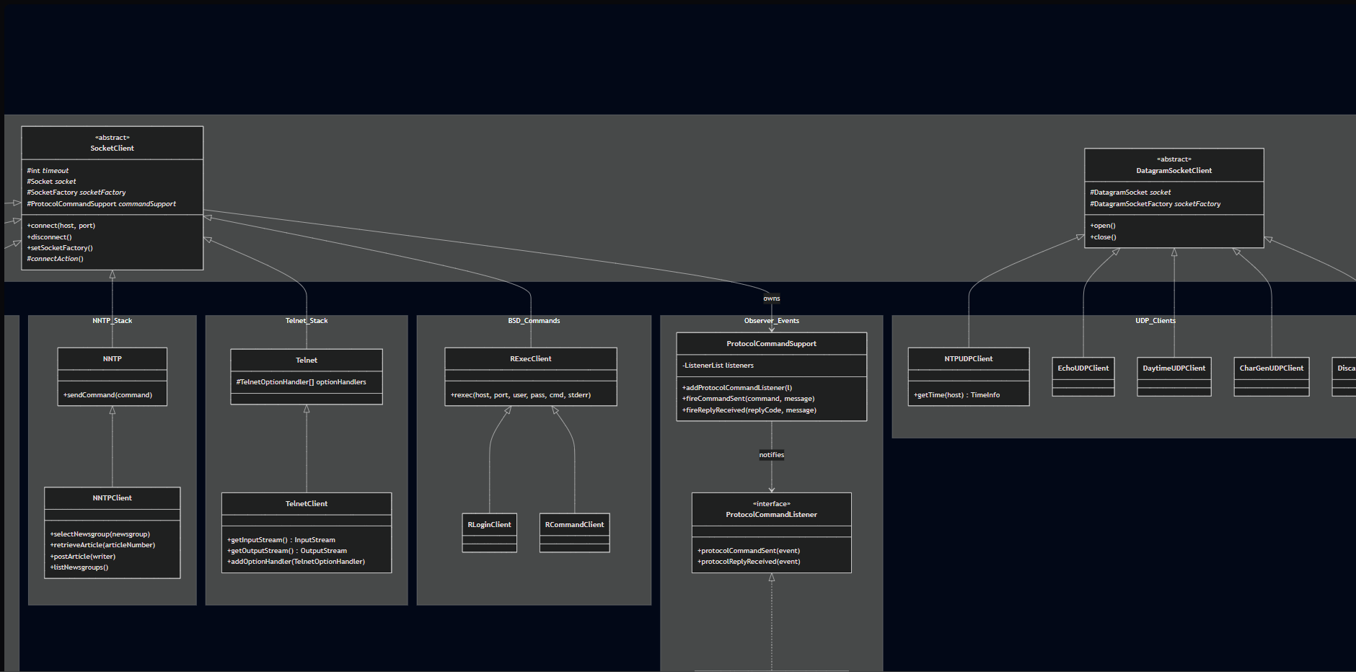
Concrete Diagram — Namespaces
Key classes per name

Slide 11
Design Patterns — Overview
10 patterns identified in the original codebase
Creational
• Factory — DefaultFTPFileEntryParserFactory
• Abstract Factory — FTPFileEntryParserFactory (interface)
Structural
• Adapter — CopyStreamAdapter
• Facade — FTPClient over FTP command layer
• Composite — CompositeFileEntryParser
• Decorator — NetASCII & Socket stream wrappers
Behavioral
• Strategy — FTPFileEntryParser implementations
• Observer — ProtocolCommandSupport / Listener
• Template — SocketClient._connectAction_()
• Iterator — ArticleIterator, NewsgroupIterator (NNTP)

Slide 12
Design Patterns — Creational
Factory
Abstract Factory
FTPClient calls createFileEntryParser(key) to get the right parser for the server's OS. The factory inspects the SYST response string and instantiates the correct parser without the client knowing which one it received. Key class: DefaultFTPFileEntryParserFactory
FTPFileEntryParserFactory (interface) defines the contract for all parser factories. FTPClient depends on the interface, not the concrete implementation — so users can inject a completely custom factory. Key class: FTPFileEntryParserFactory
Both patterns work together: Abstract Factory defines the contract; Factory is the concrete implementation selected at runtime based on the server's OS type.

Slide 13
Design Patterns — Structural
Adapter
Facade
CopyStreamAdapter
FTPClient
CopyStreamListener requires two bytesTransferred overloads. CopyStreamAdapter provides no-op defaults so callers only override the method they actually need.
FTP exposes raw RFC 959 commands. FTPClient hides multi-step sequences behind login(), storeFile(), retrieveFile(), listFiles() — masking reply codes, data channel setup, and mode negotiation.
Composite
Decorator
CompositeFileEntryParser
io package — stream wrappers
Holds an array of FTPFileEntryParser implementations. Tries each in order, caches the first match. The caller holds one parser reference and never knows it's a composite.
FromNetASCIIInputStream, ToNetASCIIOutputStream, SocketInputStream, DotTerminatedMessageReader / Writer — each wraps an existing stream and adds one behaviour without changing the interface.

Slide 14
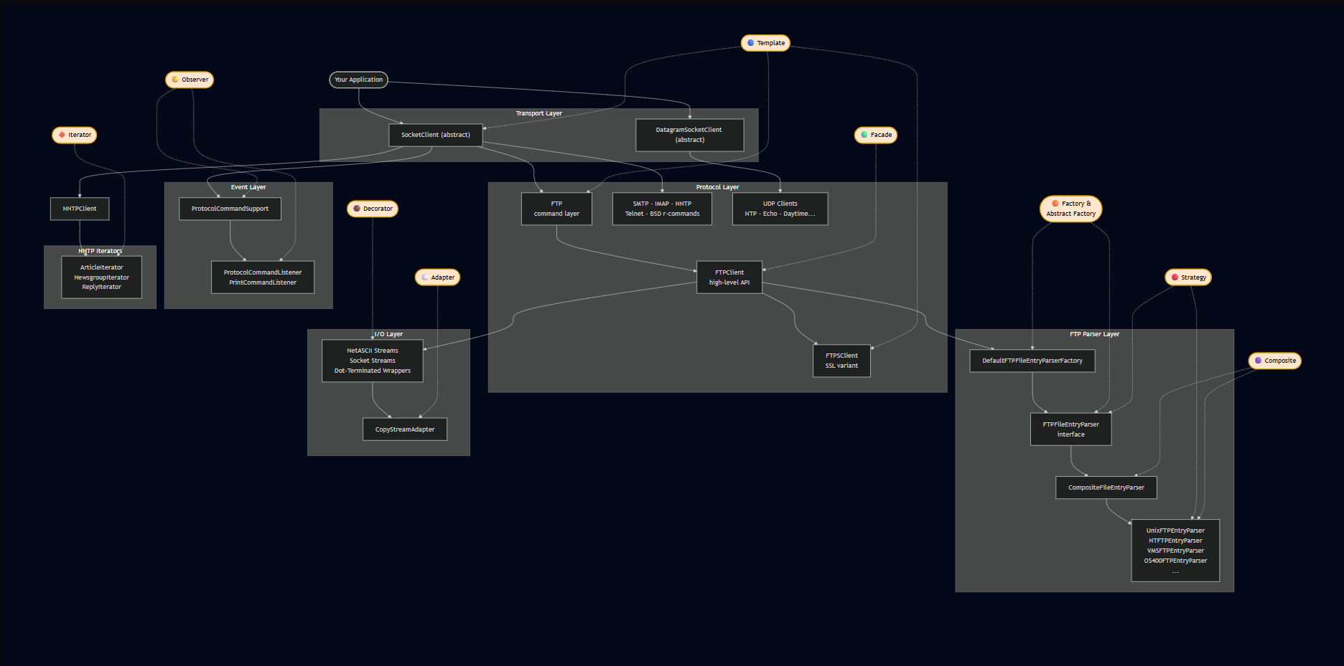
Pattern Flow Diagram
Where each pattern activates in the request flow

Slide 15
Design Patterns — Behavioral
Strategy
Observer
FTPFileEntryParser implementations
ProtocolCommandSupport / Listener
Each OS format (Unix, NT, VMS, OS/400…) is its own parser class. The correct one is selected at runtime and injected. FTPClient never hardcodes a format.
SocketClient owns ProtocolCommandSupport. Listeners register and receive events on every command sent/reply received. Enables logging via PrintCommandListener.
Template
Iterator
SocketClient._connectAction_()
NNTP — ArticleIterator, NewsgroupIterator
connect() defines the full connection algorithm. Subclasses override _connectAction_() to insert protocol-specific init (banner read, TLS handshake, etc.).
Implements java.util.Iterator<T> to wrap raw NNTP server strings and expose typed, traversable sequences of Article and NewsgroupInfo objects.

Slide 16
Files to Remove
Candidates identified before refactoring
Item
Risk
Reason
• ftp-client/ folder
None
Exact flat-package duplicate of src/main/java/.../ftp/ — nothing canonical lives here
• package-info.java files
Low
Javadoc descriptions only — no executable code; removal breaks Javadoc generation only
• examples/ directory
Low
Usage demos, not part of the library — removing has no impact on library behaviour
• Build config files
None
checkstyle.xml, findbugs-exclude-filter.xml, sonar files — CI tooling only
• bsd/ package
Low
rexec/rlogin/rsh — obsolete BSD protocols disabled on virtually all modern systems

Slide 17
Proposed Changes — Making Patterns Consistent
Observer Firing Incomplete
ProtocolCommandSupport exists on SocketClient but only FTP fires events. Wire fireCommandSent() and fireReplyReceived() into all protocol base classes.
Facade Boundary Blurry (non-FTP)
SMTPClient, IMAPClient, NNTPClient mix raw command logic with business logic. Enforce: base class = raw commands only; client class = high-level API only.
Factory + Strategy Only in FTP
Only FTP uses the Factory + Strategy parser abstraction. Apply an NNTPResponseParser interface + factory to NNTPClient for consistency.
SSL Variants Inconsistent
FTP/SMTP/IMAP/POP3 have SSL variants; NNTP and Telnet do not. Either add NNTPSClient & TelnetSClient or explicitly document the reason for not including these.

Slide 18
Proposed Changes — New Patterns After Deletion
Builder
FTPClientConfig
FTPClientConfig currently uses dozens of mutable setters — hard to use correctly. Introduce FTPClientConfig.Builder for immutable, fluent configuration: new FTPClientConfig.Builder().serverSystemKey("UNIX").serverTimeZoneId("UTC").build()
Singleton
Default Socket Factories
SocketClient and DatagramSocketClient hold raw static SocketFactory references. Formalize as a SocketFactoryProvider singleton with a controlled getInstance() method. Makes the factory lifecycle explicit and testable.
Bridge
Shared TLS Negotiation
FTPSClient, SMTPSClient, and IMAPSClient each duplicate TLS handshake logic. Introduce a TLSNegotiator abstraction (Bridge) so SSL clients hold a negotiator reference rather than embedding SSL code. ExplicitTLSNegotiator / ImplicitTLSNegotiator as impls.

Slide 19
Pattern Summary — Before & After
Pattern
Current Status
Proposed Action
Factory
Exists — FTP only
Extend to NNTP
✓
Abstract Factory
Exists — FTP only
Extend to NNTP
✓
Strategy
Exists — FTP parsers
Extend to NNTP responses
✓
Observer
Exists — partial
Wire all protocol bases
✓
Template
Consistent
No change needed
—
Facade
Exists — FTP cleanly
Enforce in SMTP/IMAP/NNTP
✓
Composite
Consistent
No change needed
—
Decorator
Consistent
No change needed
—
Adapter
Consistent
No change needed
—
Iterator
Consistent — NNTP
No change needed
—
Builder
Does not exist
Add for FTPClientConfig
NEW
Singleton
Does not exist
Add for socket factories
NEW
Bridge
Does not exist
Add for TLS negotiation
NEW

