Slide 1
Customer Sentiment and Themes in British Airways Online Reviews
May 2025 – by Alejandra Sevilla

Slide 2
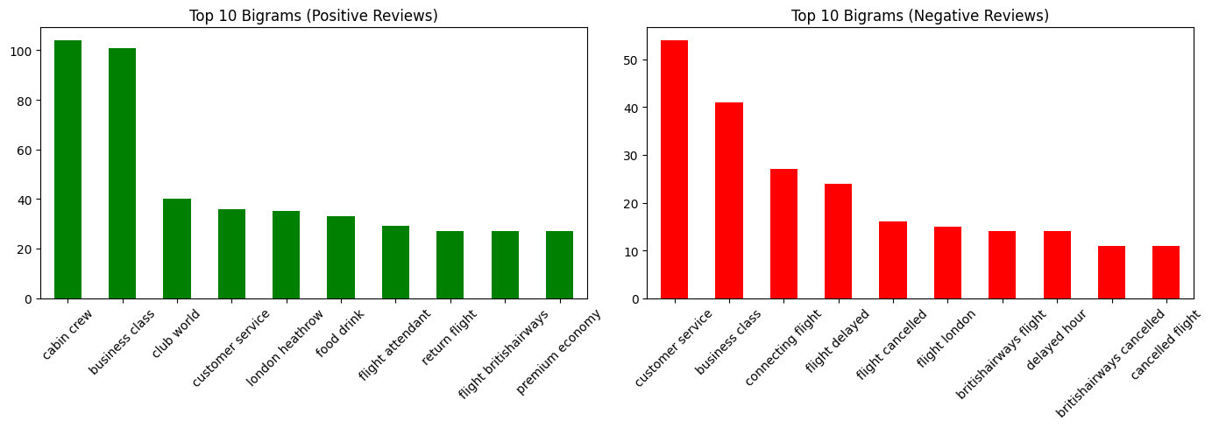
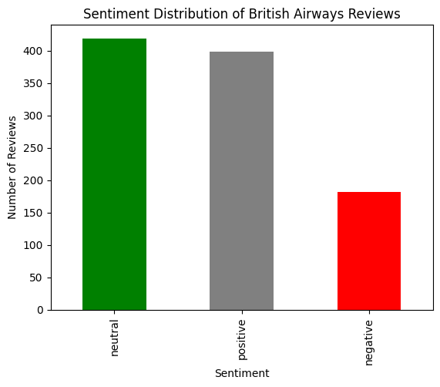
Customer Feedback Analysis – British Airways
Review Summary Metrics
1,000
Total Reviews
555
Average Review Length
7,082
Unique Words
34%|42%|24%
Sentiment (Positive/Neutral/Negative)
Key Themes from Topic Modeling
Summary of Key Findings
Theme | Top Words
Onboard Experience | crew, food, seating comfort
Delays & Service Issues | delay, hour, bag, airport
Flight Changes & Booking | cancellations, booking, told
Baggage & Travel Logistics | luggage, pram, child
Customer experience is the differentiator; most praise centers on crew, cabin comfort, and business class.
Operational breakdowns drive negativity, cancellations, delays, and poor rebooking communication dominate complaints.
Customer service is polarizing, it is mentioned in both positive and negative contexts, suggesting inconsistency.
Strategic focus should be on reinforcing the in-flight experience and fixing communication gaps during disruptions.

