Slide 1
Holiday Booking Prediction Model – Evaluation Summary
May 2025 – by Alejandra Sevilla

Slide 2
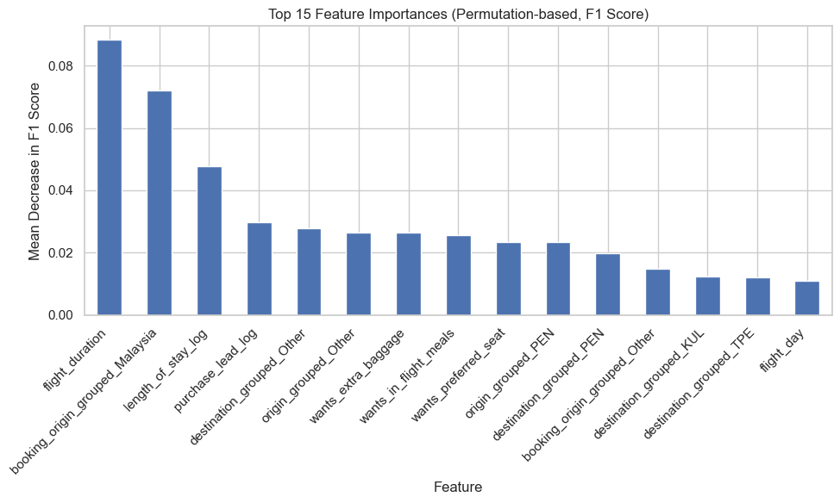
Holiday Booking Prediction Model – Evaluation Summary
Model Overview
Dataset: 50,000 bookings from British Airways customers
Goal: Predict booking completion using customer behavior and trip details
Model: Random Forest (class_weight = "balanced", threshold tuned)
Model Performance (Threshold = 20)
Metric | Value
Accuracy | 0.85
F1 Score | 0.43
Recall (Class 1) | 0.63
ROC AUC | 0.77
Lowering the threshold from 0.50 to 0.20 improved recall from 0.11 → 0.63
Business Insights
Flight duration is the strongest predictor → Longer trips show higher booking intent — prioritize these users for upselling (e.g., insurance, upgrades)
High conversion from Malaysia-based customers → Consider targeted promotions or localized UX for this market
Short lead times and longer stays signal urgency → Leverage this segment for time-sensitive offers or reminders
Add-on selections reflect booking commitment → Users who engage with baggage, meals, or seat options are more likely to convert — surface these early
Airport origin/destination clusters influence outcomes → Inform pricing or marketing strategies based on route-level behavior patterns
(top 10–15 features ranked by decrease in F1 when permuted)

