Slide 1
Investigating the Impact of Austin's Rapid Growth on Travis County and Surrounding Counties
Alejandro Davila, Christopher Hornung, Induja Mohandas,
Isac Ramos, and Shannon Lloyd

Slide 2
Introduction:
Crime Rates
School Performance
Population Counts
Median Incomes
Racial Distribution

Slide 3
Crime analysis starting point is Downtown Austin, TX
Top 5 Crimes
Family Disturbance
Burglary of Vehicle
Auto Theft
Theft
Criminal Mischief

Slide 4
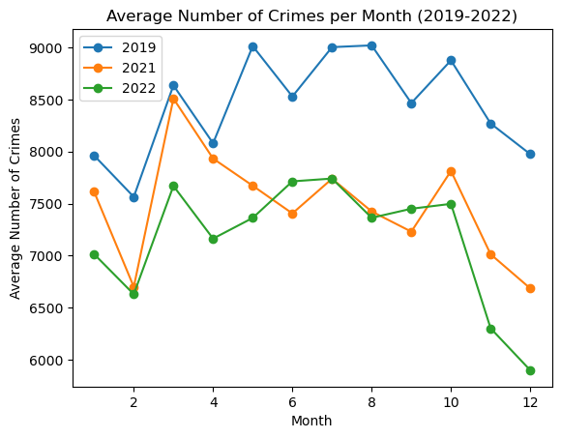
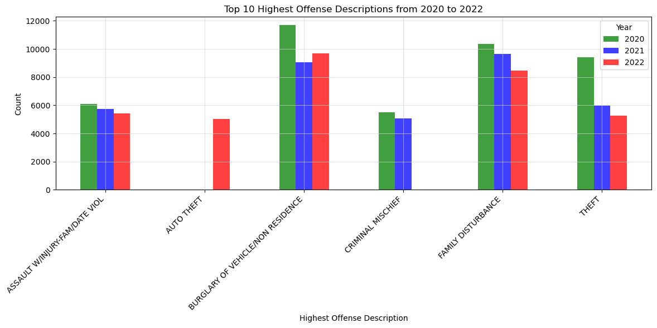
Average Number of Crimes per Month (2019-2022)

Slide 5
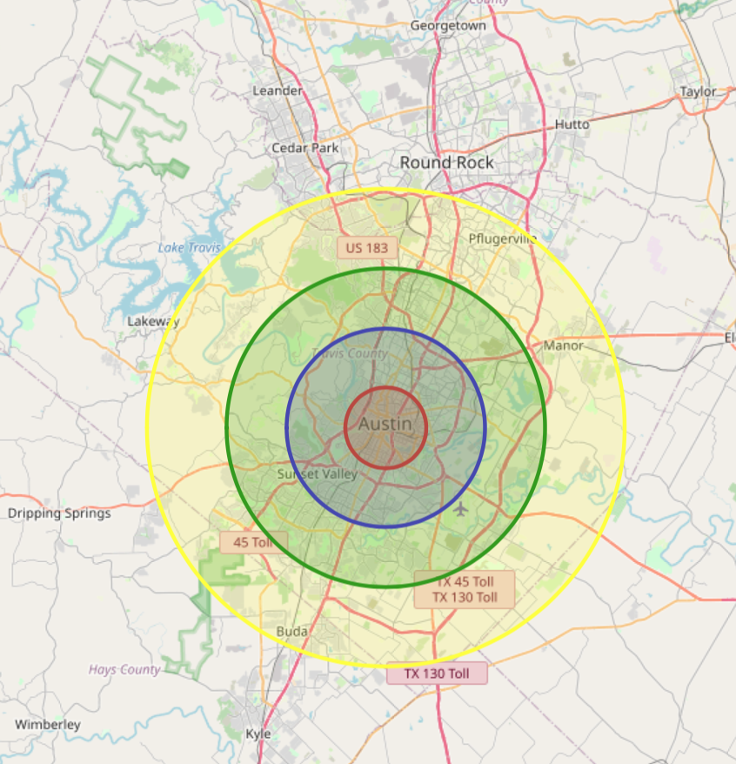
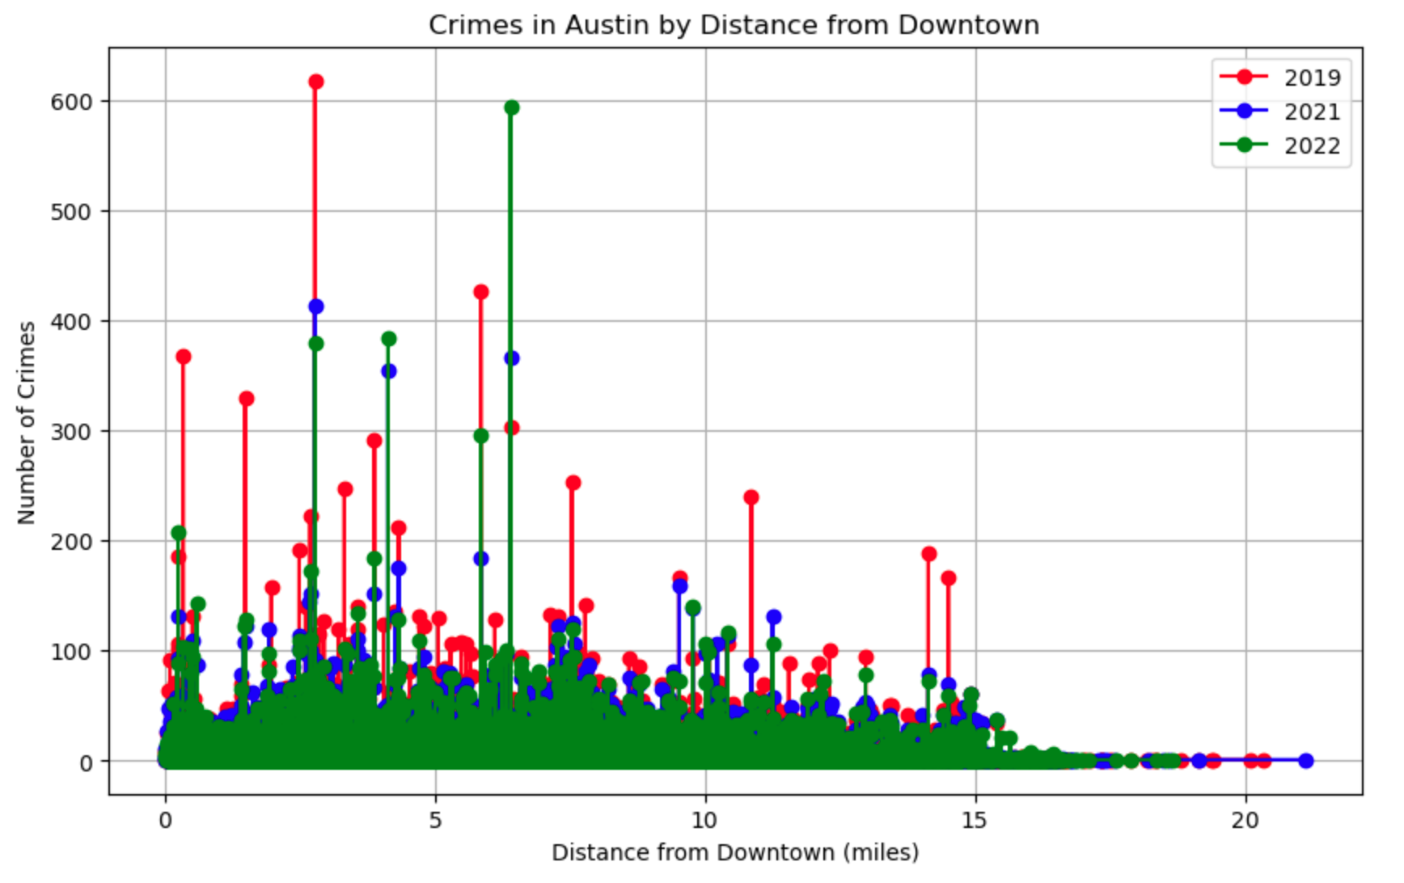
Crimes in Austin by Distance from Downtown

Slide 6
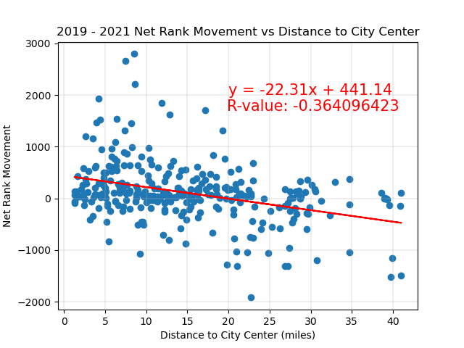
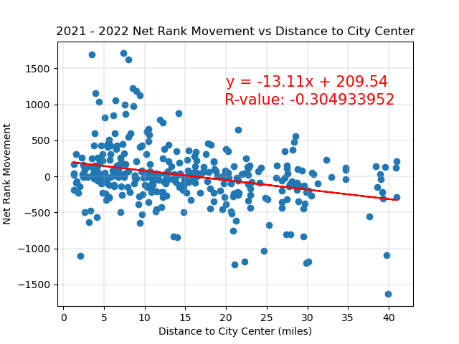
Schools: Net Rank Movement vs Distance to City

Slide 7
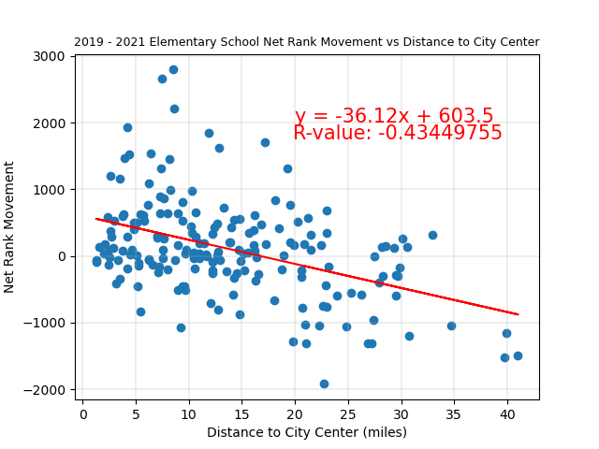
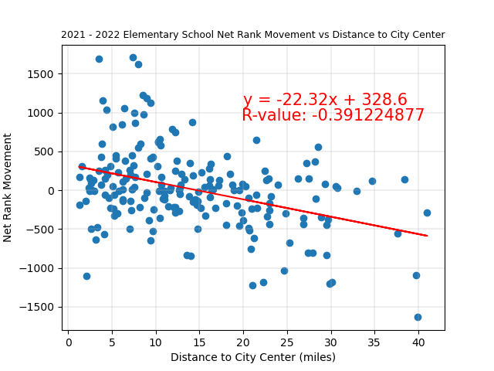
Schools: Net Rank Movement vs Distance to City (Elementary School)

Slide 8
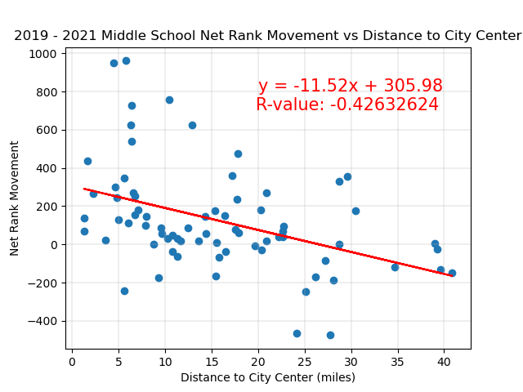
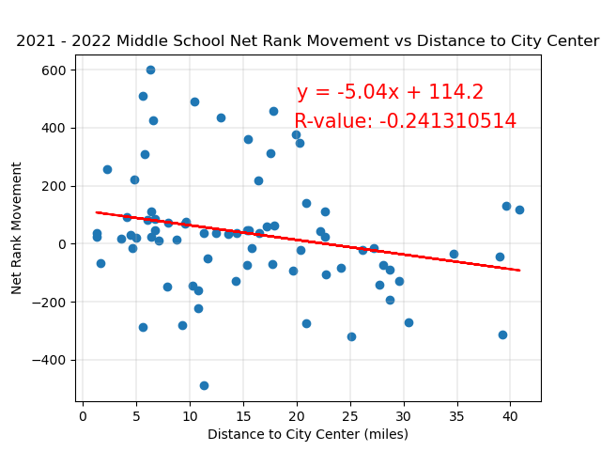
Schools: Net Rank Movement vs Distance to City (Middle School)

Slide 9
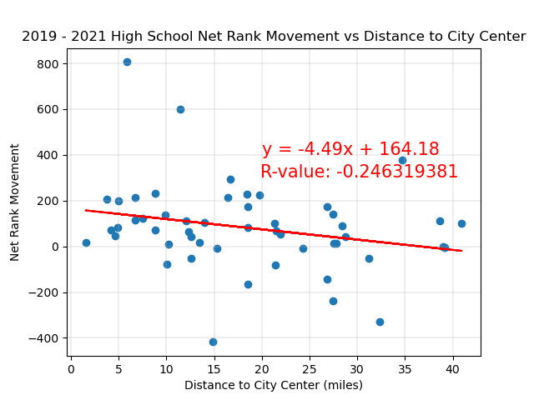
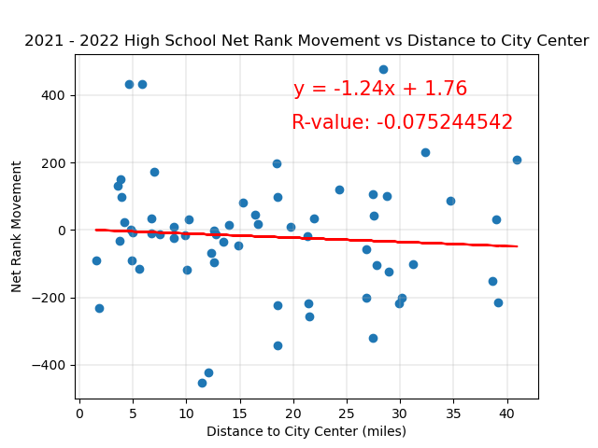
Schools: Net Rank Movement vs Distance to City (High School)

Slide 10
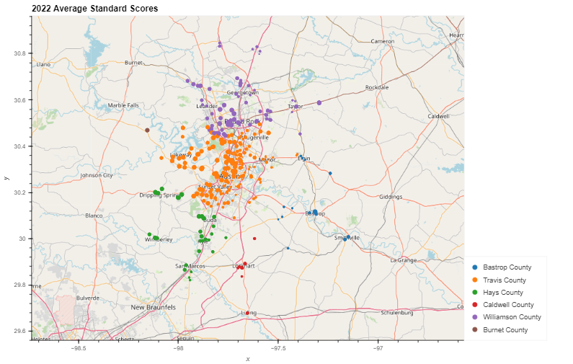

Slide 11
CENSUS METRICS
Population Counts
Median Incomes
Racial Distribution

Slide 12
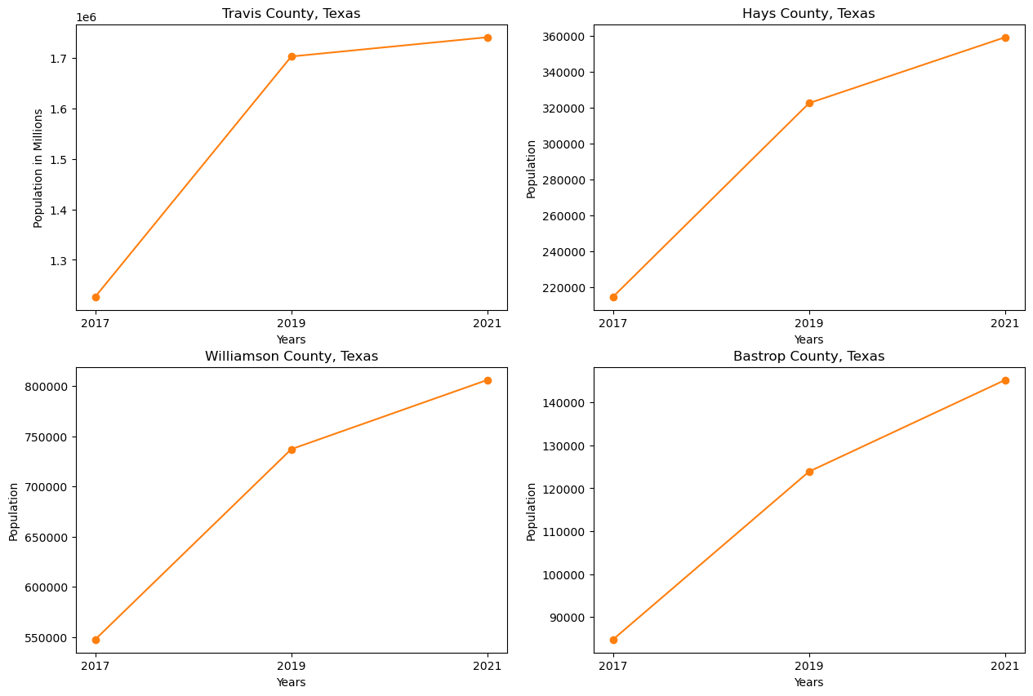
Population Counts

Slide 13
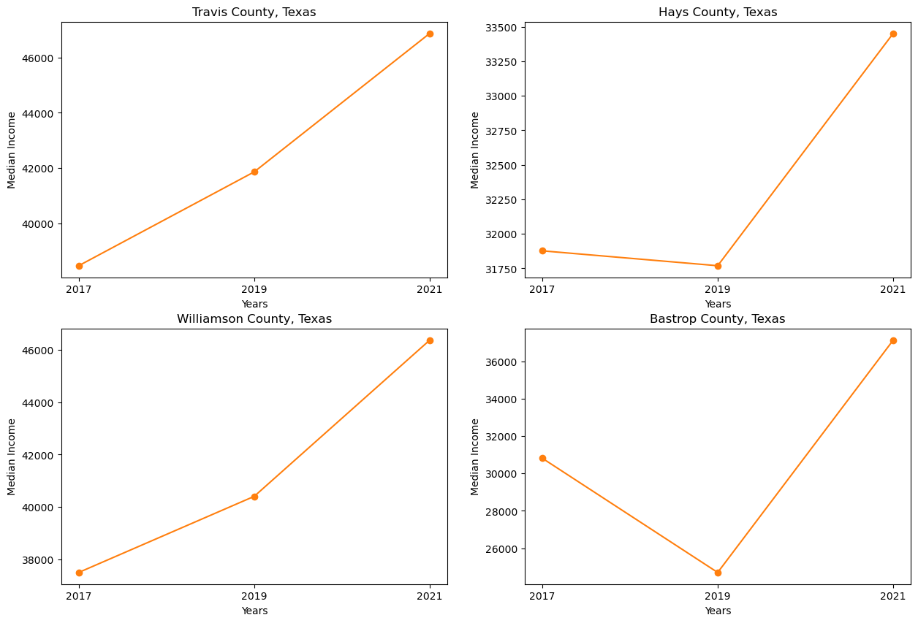
Median Incomes

Slide 14
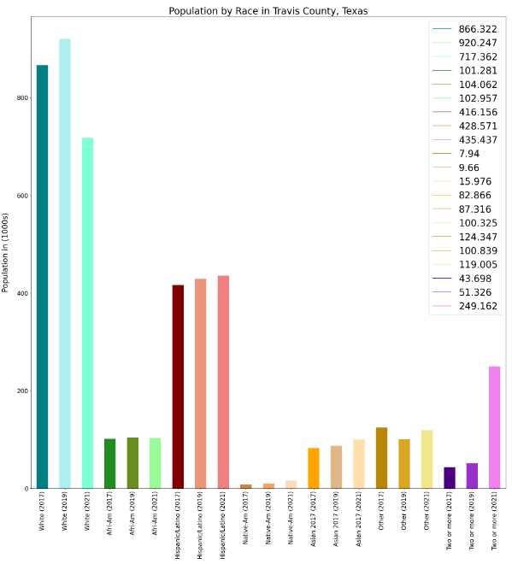
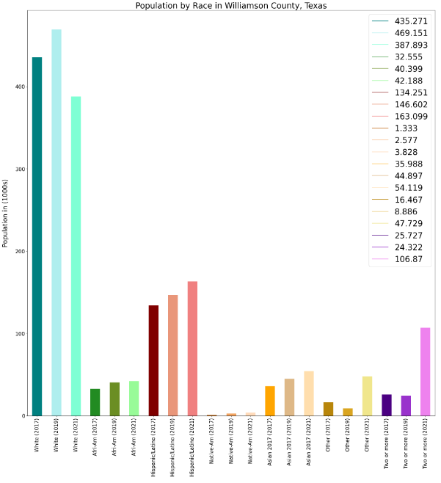
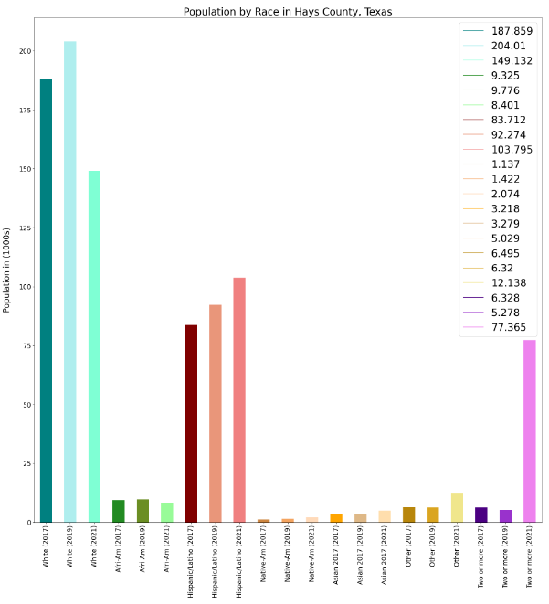
Racial Distribution

Slide 15
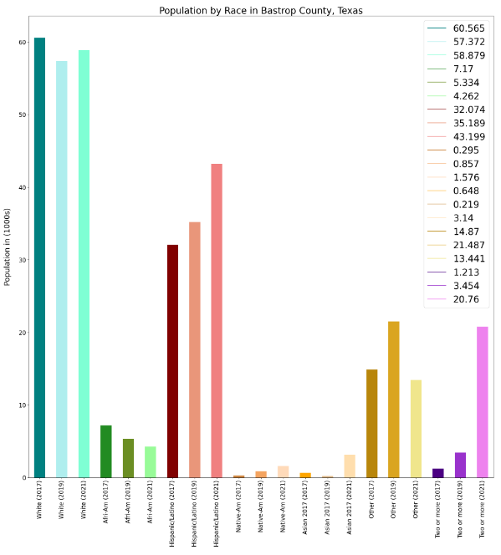
Racial Distribution (cont.)

Slide 16
Conclusion: All counties for each topic exhibited change during from 2017 to 2021
Crime: crime rates decreased in the areas that showed an increase in housing values
Schools: the correlation between school rankings and distance from the city center weakened over the examined period
Median Income: wage growth is occurring for all the counties and is increasing quickly for Hays and Bastrop which are currently less populous.
Population by Race: although these countries currently have a very homogenous population, they are changing and if the trend continues they will become more diverse
** Our findings are based on limited data, there may be other factors and confounding variables that we have not covered that may influence these trends.

