Slide 1









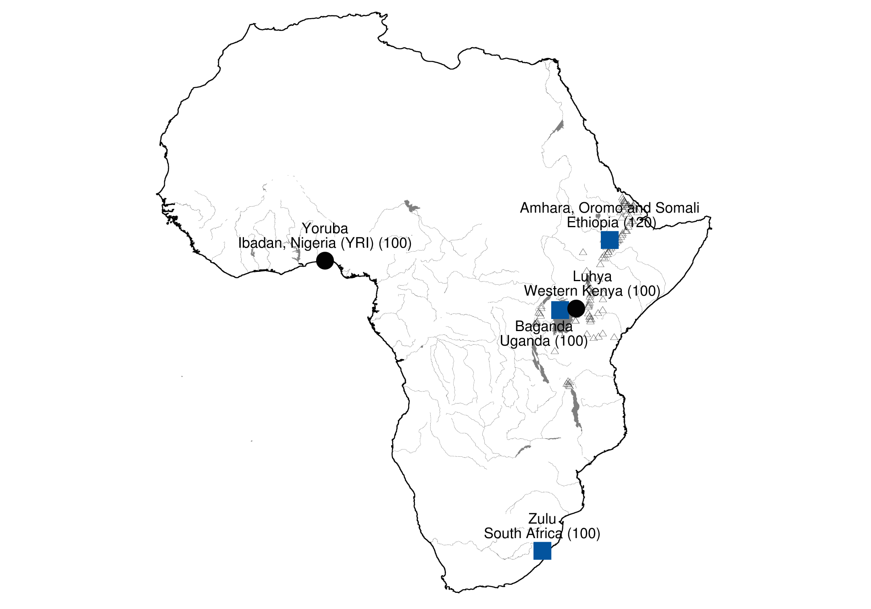
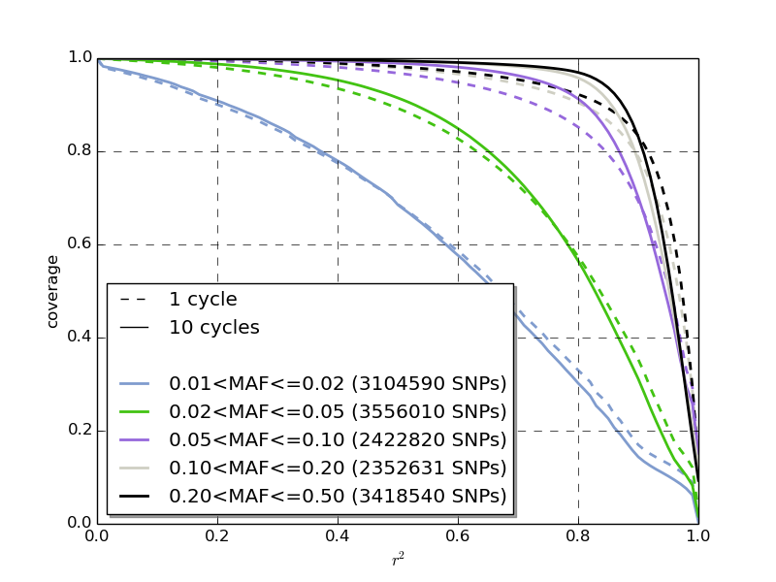
Generation of an African chip with the memory
efficient tagSNP selection algorithm RagTagger
and IMPUTE2
Tommy Carstensen¹, Deepti Gurdasani^{1,2} on behalf of the Genome Diversity in Africa Project (GDAP) Investigators
¹ Wellcome Trust Sanger Institute, Hinxton, Cambridgeshire, United Kingdom
² Department of Public Health and Primary Care, University of Cambridge, Cambridgeshire, United Kingdom
Summary
Methods
With next generation genotyping, and the decline in genotyping costs, it has now been possible to carry out large-scale dense genotyping across individuals for genome wide association studies. While these chip designs capture variation in European populations very well, their utility in capturing variation in more diverse African populations is unclear. Here we show that existing chip designs with imputation using large-scale sequencing panels can capture common variation well relative to low coverage sequencing designs. We also show marked improvement in imputation accuracy, even for common variation, with addition of a novel AGVP reference panel. We hypothesise that development of more efficient chip designs specific to African populations would complement the development of novel reference panels, and improve efficiency of variant capture by genotyping arrays even further. While existing chip designs have included African populations in the ascertainment set, European populations have dominated development of these arrays, and African populations in current reference panels are not representative of more differentiated population groups within Africa. Here, for the first time, we describe the development of such an array, ascertained on relatively large samples from distinct population groups across Africa. We describe an array that captures common genetic variation (MAF>5%) across 5 geographically distinct populations in Africa, including YRI, Zulu, Baganda, LWK and Ethiopia. In order to capture variation across all populations, we developed an in-house algorithm to maximise efficiency of such a chip by applying cycles of tagging and imputation, as has been described before.
Figure 4 – Dependence of overall coverage (i.e. SNPs imputed with an accuracy r²>0.8) on the number of cycles for SNPs in the entire MAF range.
Results
Using our tagging algorithm, we show that approximately 2.7 million SNPs are required to tag all common variation across the five African populations. With the most informative 1 million tagging SNPs identified using the tagging algorithm, we were able to tag more than 80% of common variation across 5 populations in Africa (figure 5).
Figure 1 – Map of Africa showing 4 Sub Saharan populations for which WGS at low coverage (4x-8x) was generated (blue squares) or publicly available (black circles).
Methods
For tagging, we used whole genome sequence (WGS) data generated through the African Genome Variation Project (320 samples sequenced at 4x coverage from Ugandans, Zulu in South Africa and Ethiopians) and phase 1 of 1000 Genomes (97 Luhya from Kenya and 88 Yoruba from Nigeria). To do a preliminary design of a continent specific SNP array we used a greedy pairwise tagging algorithm, RagTagger, which is similar to TAGster, but written to be computationally efficient and scalable across the whole genome. This algorithm we applied across half of the samples of the 5 populations and combined with imputation into a cyclical hybrid algorithm. The hybrid algorithm is described in figure 2. Pairwise greedy tagging was carried out across half of the samples of the 5 populations using a window size of 250kbp flanking each SNP, at an linkage disequilibrium (LD) threshold of 0.80 considering only variants with a MAF≥0.05. RagTagger was run in single population mode, but has an option to run in multi population mode.. A window size was chosen that is sufficiently large for all SNPs in LD with a tagging SNP to be within that window size (figure 3). Imputation was carried out with IMPUTE2 using the 1000G phase 1 haplotypes as a reference panel excluding half of the YRI and LWK samples used for calculation of LD and selection of tagging SNPs.
To examine efficiency of the genotype array, we carried out imputation using the tagging SNPs, and calculated the correlation between imputed genotypes and WGS genotypes. We calculated coverage across the genome as the proportion of common variants imputed with r2≥0.80 across all populations.
Figure 5 – The coverage obtained across the genome for variants at different allele frequencies for a hypothetical African genotype array with 1M tagging variants. Different allele frequency bins are depicted in different colours. The lines show the coverage that can be achieved by imputation at different r² thresholds. Coverage, here, is defined as the proportion of variants within an allele frequency captured above a pre-defined r² threshold (along the x axis) after imputation. The solid lines represent the coverage obtained with 1M variants selected using the hybrid tagging and imputation approach, while the broken lines represent the coverage obtained by using a simple pairwise tagging approach to capture 1M tagging variants. The hybrid method improves coverage obtained, particularly for common variation. Coverage for common variants (>5%) appears to be high at an r² threshold of 0.8 and above, with >80% of these variants accurately imputed.
Candidate SNPs: SNPs in the genome with MAF>5% across populations that can potentially be ‘tag SNPs’
Conclusions
Remove 'tag SNP' from candidate SNP set
Tagging and imputation
algorithm
We present the first preliminary exploration of a genotype array design to capture common variation across Africa. We show that while tagging common variation across Africa requires a reasonably large number of variants, even 1 million tagging variants can capture a substantial proportion of common genetic variation across African populations. Our findings suggest that designing a genotype array for large-scale GWAS in Africa is feasible, and can be made cost-effective so as to scale to large sample sizes. We have shown that hybrid approaches for design that include cyclical tagging and imputation further improves the efficiency of such an array.
'tag SNP': SNP tagging the greatest number of common SNPs at an r²>0.8 across all populations
'target SNPs' for each population:
Remaining SNPs that need to be tagged (Candidate SNPs - 'tag SNP' - 'tagged SNPs' in LD with 'tag SNP' at r²>0.8)
Threshold of tag SNP specified for single cycle reached
Remove well imputed SNPs from target SNPs
Acknowledgements
Continue cycling until threshold reached or no target SNPs left
Extract 'tag SNPs' and impute into these
African Partnership for Chronic Disease Research (APCDR) / Wellcome Trust Sanger Institute (WTSI) – Elizabeth Young, Eleftheria Zeggini, Inês Barosso, Manjinder S. Sandhu
WTSI – Human Genetics Informatics – Martin Pollard
WTSI – Deepti Gurdasani, Luca Pagani, Cristina Pomilla, Chris Tyler-Smith, Yali Xue
APCDR / Medical Research Council (MRC) Uganda – Pontiano Kaleebu, Anatoli Kamali, Janet Seeley
MRC Uganda – Gershim Asiki, Rebecca Nsubuga
Henry Stewart Group – Neil Bradman
University of Addis Ababa, Ethiopia – Endashaw Bekele
Nelson R Mandela School of Medicine, University of KwaZulu‐Natal, Durban, South Africa – Ayesha Motala, Fraser Pirie
1000 Genomes Project Consortium
Identify common SNPs imputed with an r²>0.8
Figure 2 – Flow chart for hybrid algorithm for selection of tag SNPs.
References
1) Design and coverage of high throughput genotyping arrays optimized for individuals of East Asian, African American, and Latino race/ethnicity using imputation and a novel hybrid SNP selection algorithm
Thomas Hoffmann et. al.
Genomics 98, 422-430 (2011)
2) TAGster: efficient selection of LD tag SNPs in single or multiple populations
Zongli Xu, Norman Kaplan, Jack Taylor
Bioinformatics 23, 3254-3255 (2007)
Availability
RagTagger can be downloaded from https://github.com/team149/tc9/tree/master/ragtagger
Figure 3 – Dependence on window size of the count of tag SNPs selected by the greedy pairwise LD algorithm, when the algorithm is allowed to run to completion; i.e. no SNPs left in the candidate set of SNPs, because all SNPs are either tagging SNPs or tagged SNPs tagged by the tagging SNPs.
Disclosure
Abstract not previously published.
Notes:
Width: 84.09
Height: 118.91
3.47cm left, 80.62 (84.09-3.47) right
3.47cm top
Text box width: 36.84 (84.09-3*3.47)/2 cm

