Slide 1
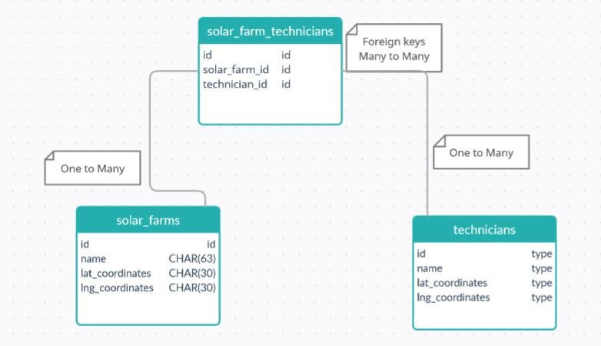
SQL
Relationships diagram

Slide 2
SQL
SELECT solar_farms.name as SolarName, technicians.name as TechnicianName, solar_farms.lat_coordinates as SolarLatitude, solar_farms.lng_coordinates as SolarLongitude, technicians.lat_coordinates as TechnicianLatitude, technicians.lng_coordinates as TechnicianLongitude FROM solar_farms JOIN solar_farms_technician ON solar_farms.id = solar_farms_technicians.solar_farm_id JOIN technicians ON solar_farms_technicians.technician_id = technicians.id * Inner Join, many queries in one using IN
Query

Slide 3
SQL
SELECT solar_farms.name as SolarName, technicians.name as TechnicianName, solar_farms.lat_coordinates as SolarLatitude, solar_farms.lng_coordinates as SolarLongitude, technicians.lat_coordinates as TechnicianLatitude, technicians.lng_coordinates as TechnicianLongitude FROM solar_farms, technicians, solar_farms_technicians WHERE solar_farms_technicians.ID_Post = solar_farms.ID AND solar_farms_technicians.ID_Category = technicians.ID ORDER BY solar_farms. name, technicians. name;
Query

