Slide 1
Performance Evaluation of Single Base Station ToA-AoA Localization in an LTE Testbed
Alejandro Blanco, Norbert Ludant, Pablo Jiménez Mateo, Zhenyu Shi, Yi Wang and Joerg Widmer

Slide 2
Motivation
The technology has rapidly evolved
→ Localization-based services are appealing
IoT application: Sensing and moving … (<10m)
Industry application: Robotic (<1m)
5G standard addresses really tight localization requirements → < 1m in 99%
Areas without 5G coverage
→ LTE meets some of the application
Good practical localization works for WiFi,
→ Not for LTE
Notes:
There were a lot of practical works in WiFi localization system but unfortunately not for LTE
I have to emphasize that there are a lot of practical works in a WiFi localization system in indoor but for LTE few studies with real hardware

Slide 3

Contribution
Performance assessment of a single base station LTE localization system
Why single base station?
Always coverage of at least 2/3 BS? → No
It is critical in small cell as well as indoor scenarios
No synchronization or clock errors of different BS
Localization error below 2m in median

Slide 4
LTE background. Sounding reference signal
Sounding reference signal is an uplink signal
It is a discrete time signal
Occupies almost the whole bandwidth → good time resolution
Is based on Zadoff-Chu sequences → The property of ideal cross correlation gives to the system robustness to multipath.

Slide 5
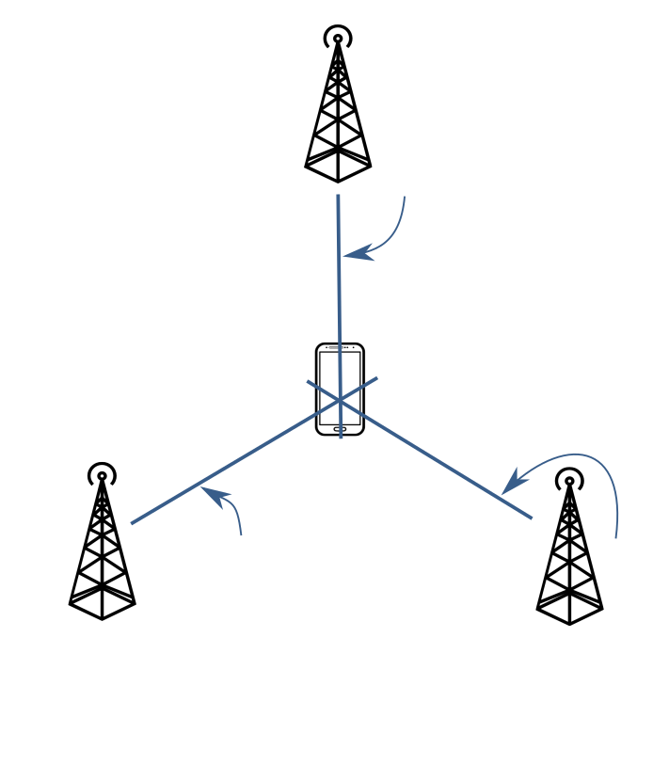
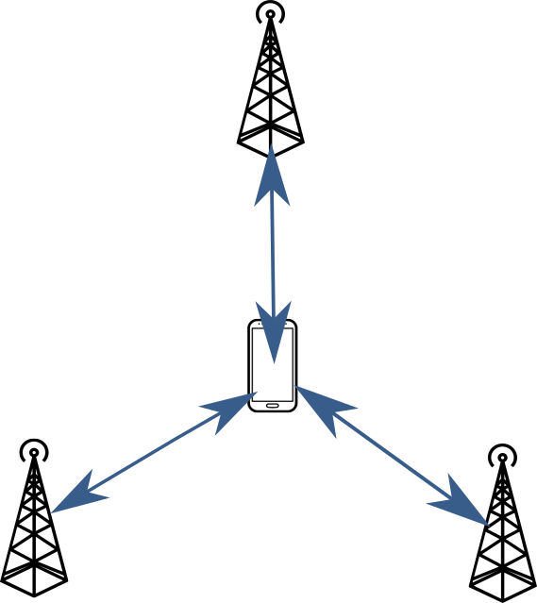






LTE background. Localization approaches
Several localization techniques are included:
Observed Time Difference Of Arrival (OTDOA)
Enhance Cell ID (ECID) techniques:
Time of Arrival (ToA) to get the distance
Angle of Arrival (AoA)
$$θ_{1}$$
$$d_{1}$$
$$θ_{3}$$
$$d_{2}$$
$$d_{3}$$
$$θ_{2}$$
Notes:
Observed Time Difference Of Arrival (OTDOA) requires several base station, this is why we are going to focus on the next one

Slide 6
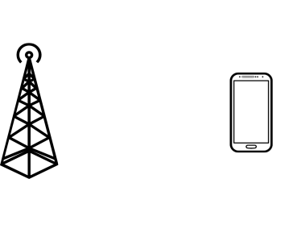
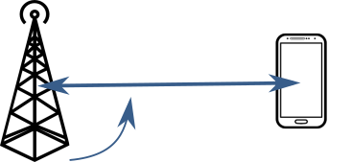
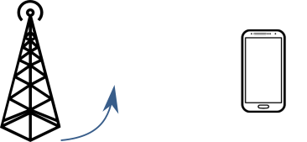


System description
The system uses angular and distance information measured on the BS side
Angle of Arrival (AoA) by MUltiple SIgnal Classification (MUSIC)
Distance by the Time of Arrival (ToA) using the Sounding Reference Signal (SRS)
$$d_{1}$$
$$θ_{1}$$
Notes:
Without any modification of the standard

Slide 7
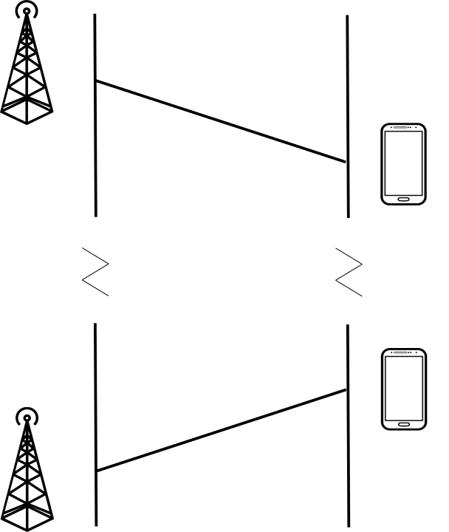

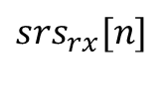

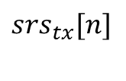


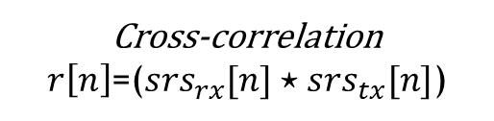




ToA estimation
Synchronization and SRS negotiation
BS
UE
$$ToA={(t}_{i}+2δ)$$
$$t_{0}$$
$$t_{0}+δ$$
Cross-correlation
$r\left[n\right]$=($srs_{rx}[n]⋆srs_{tx}[n]$)
SRS Transmission
$$2δ=argmax\left(\left|r\left[n\right]\right|\right)/BW$$
$$t_{i}+δ$$
$$t_{i}+2δ$$
$$srs_{tx}[n]$$
$$Distance=(2δ·c)/2$$
$$srs_{rx}[n]$$
Notes:
As long as the bandwidth increments the resolution increments too

Slide 8
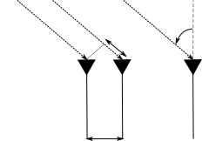
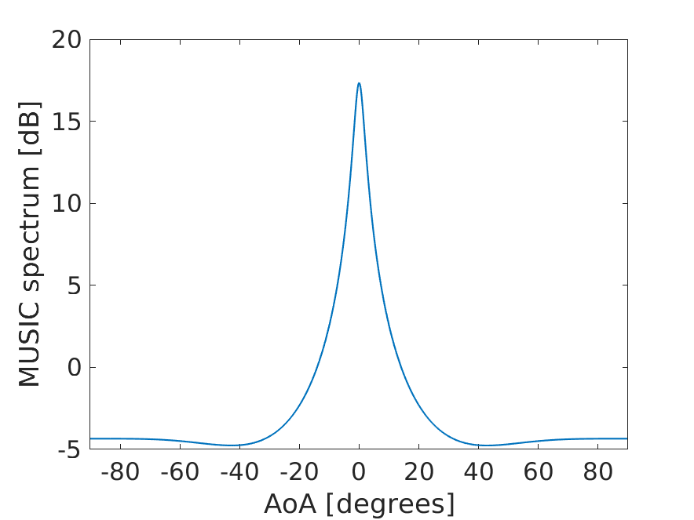
AoA estimation. MUSIC
Incident signal
θ
dsin(θ)
Correlation matrix
…
d
Antenna array
Eigen decomposition
Estimate the spectrum
Notes:
As long as number of antennas increases the accuracy increases because the is more information available

Slide 9
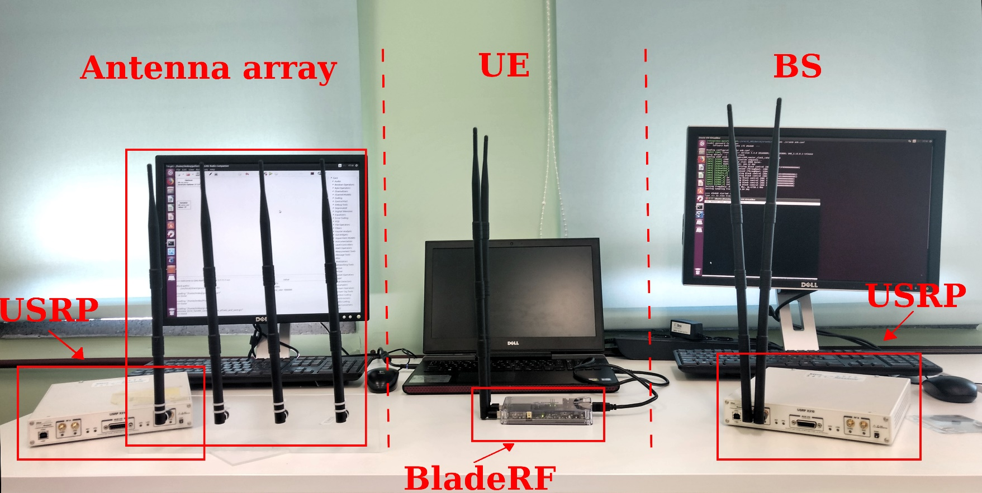
Implementation. The setup
We implemented a real LTE testbed with SDR.
srsLTE is the software chosen as an LTE emulator
Notes:
As srsLTE does not support 4x4 antennas, we implemented the functionality of the angle of arrival in gnuradio. This is why we need an extra USRP

Slide 10
Implementation. Scenarios
We carried out the measurements in two indoor scenarios:
Auditorium: 21x9m room without furniture, always Line Of Sight (LOS). 40 measurements points.
Office: 19x15m room with pieces of furniture and walls. Several areas with NLOS and multipath. 20 measurements point. Distinction between cases LOS and NLOS
100 SRS measurements per point with a 20MHz band
Notes:
For the SRS configuration, the periodicity goes from 2ms to 320ms. We fixed it to 10ms we believe that it is enough for moving object

Slide 11
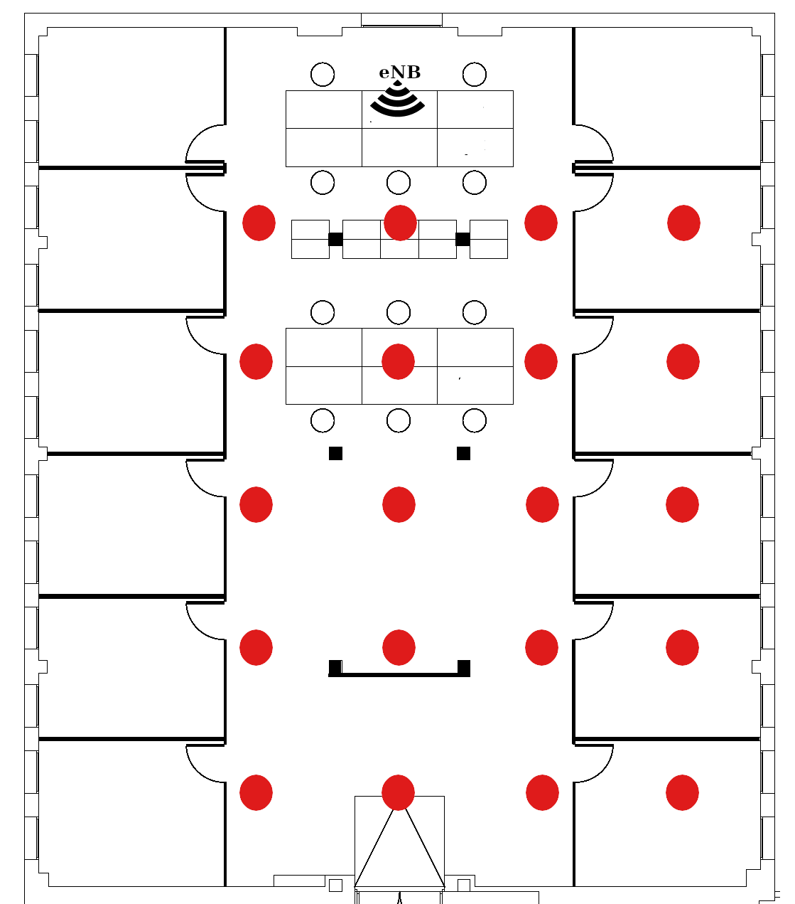
Implementation. Office Scenario

Slide 12
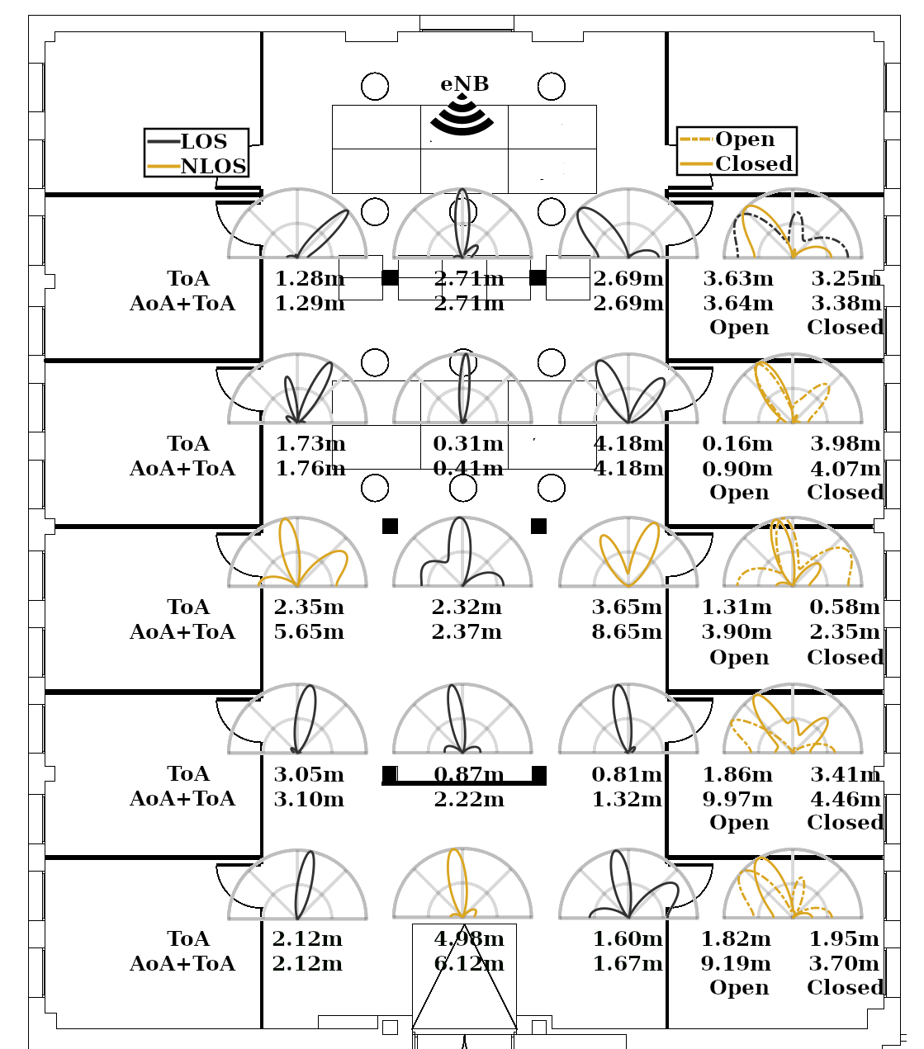
Further observations

Slide 13
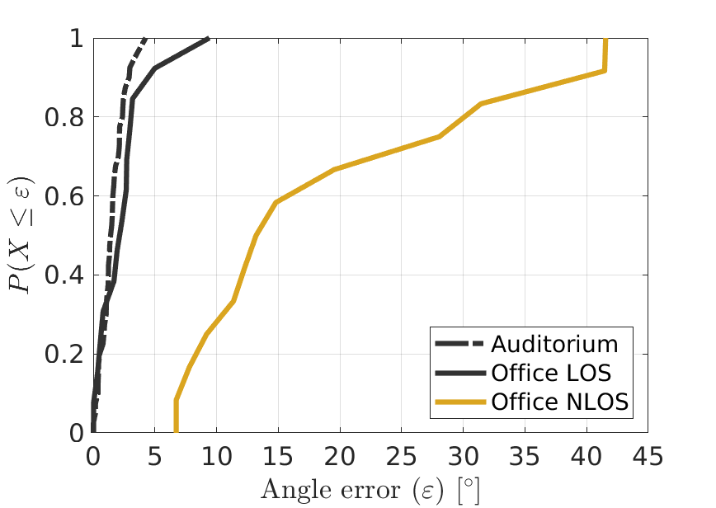
Results. AoA
In LOS cases, the AoA accuracy is really good, but for NLOS, the lack of direct path considerably degrades the performance.

Slide 14
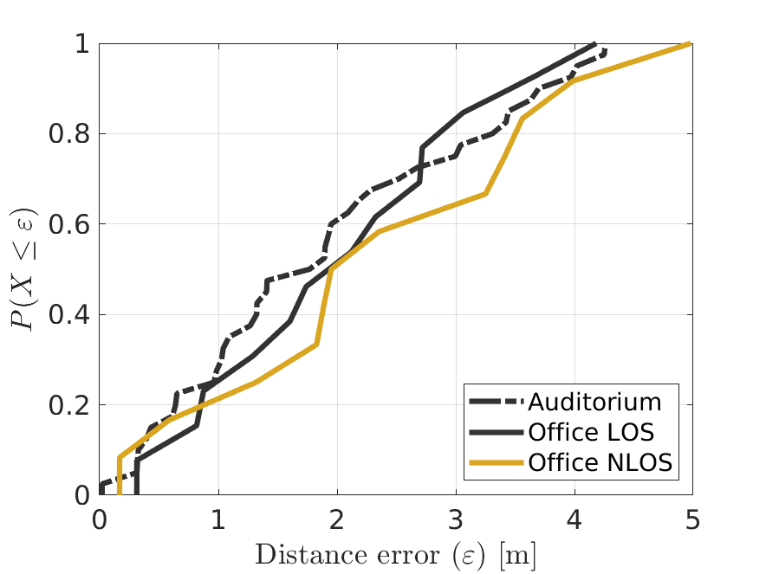
Results. ToA
The theoretical resolution is 8.25m
Averaging over the measurements, the system achieves better accuracy. 2m for 60%
Notes:
Random delays in the communication

Slide 15
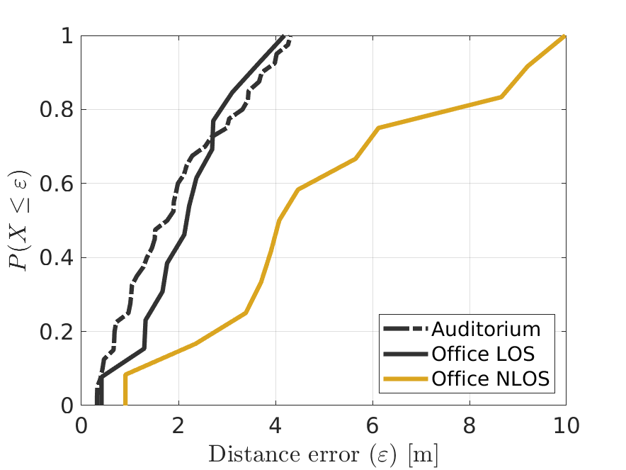
Results. Localization
The degradation in the AoA considerably reduces the accuracy of the NLOS office.
The system has up to 2m of error in the 60%

Slide 16
Conclusions
5G addresses tight localization requirements
Will be areas with only LTE coverage
An AoA-ToA LTE localization system can achieve an localization error below 2m and 5m in median for LOS and NLOS cases
It can meet many of the requirements of IoT and localization-based services

Slide 17

Thanks for your attention ☺
E-mail: alejandro.blanco@imdea.org

