Slide 1
Skin Disease Detection
Deep Learning · HAM10000 · EfficientNet-B2 + Grad-CAM
Pau Duran Mayol · Ana Enrech Montull · Alejandro Balboa Ruiz
UPF Deep Learning 2026

Slide 2
INTRODUCTION
INTRODUCTION
Project Overview
10,015
7
Build a deep learning system that classifies lesions as benign or malignant and provides visual explainability via Grad-CAM.
dermoscopic images
lesion classes
3
B2
EDA
Preproc.
Baseline
Transf. L.
Frontend
malignant classes
EfficientNet-B2
→
→
→
→
HAM10000 · Kaggle · Tschandl et al., 2018
Grad-CAM explainability
Heatmap overlay on model predictions

Slide 3
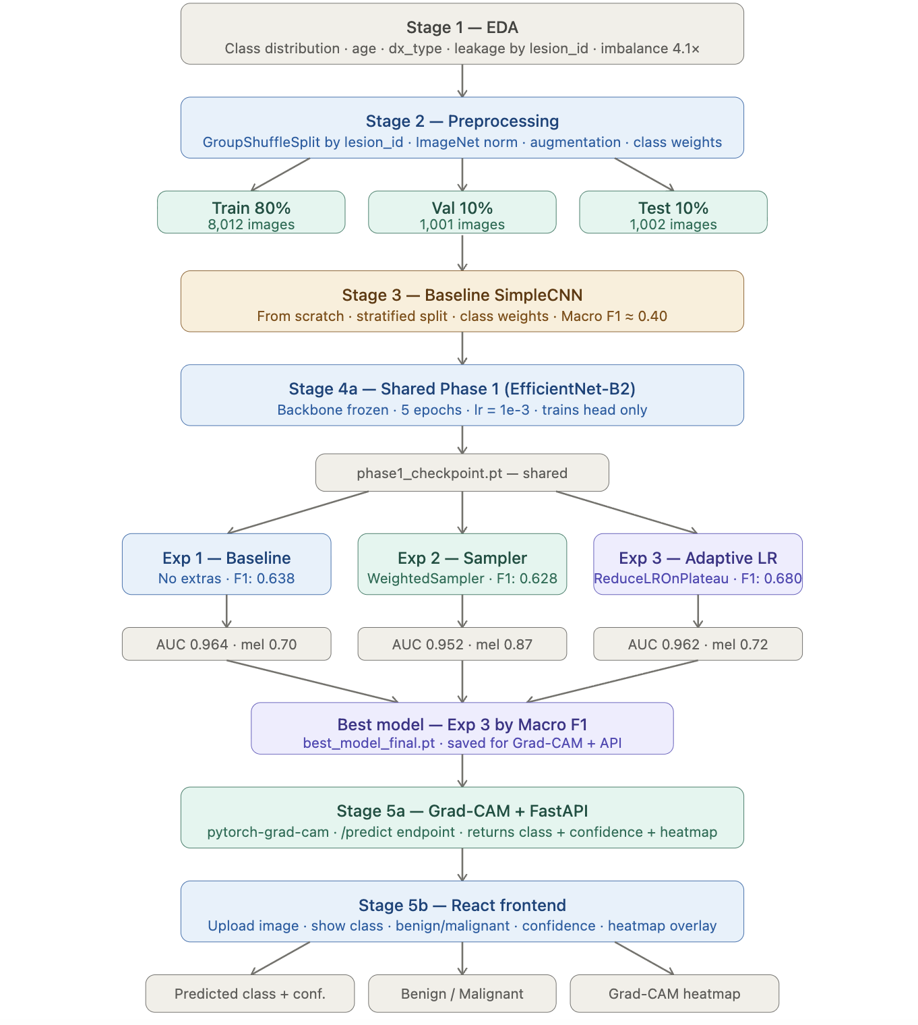
INTRODUCTION
Project Schema

Slide 4
EDA
Exploratory Data Analysis
Image distribution by skin lesion type
Nevus (nv)
6,705
Melanoma (mel)
1,113
Benign ker. (bkl)
1,099
BCC (bcc)
514
AKIEC
327
Vascular (vasc)
142
Dermatofibroma (df)
115
Benign
Malignant
Class imbalance
Nevus (nv) represents 67% of all images. Bening:malignant ratio = 4.1
Data leakage risk
7,470 unique lesions for 10,015 images. Fixed with GroupShuffleSplit by lesion_id.

Slide 5
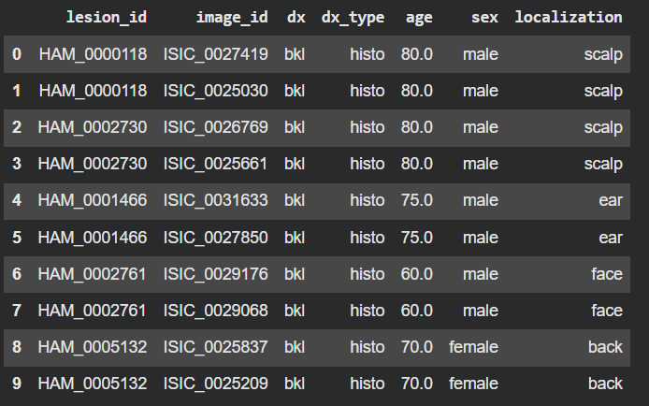
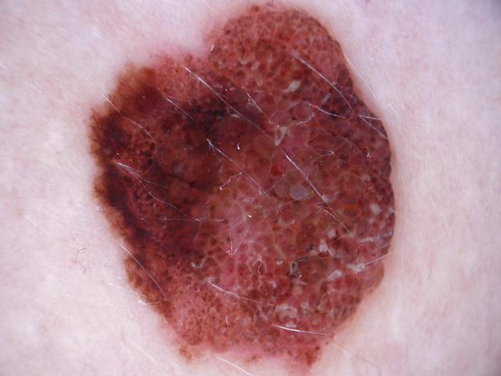
METHODOLOGY
Preprocessing
• Image loading and mapping w/ metadata
• Remove 2 corrupted images
• Resize to 224×224
• ImageNet normalization
• Data augmentation
Data Split
• Train 80% · Val 10% · Test 10%
• Stratified split
• Group by lesion_id (TL)

Slide 6
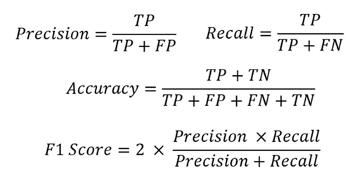
METHODOLOGY
Models Optimization and Metrics
Cross Entropy Loss function
Imbalance Management
Class weights: W_c = N/ (K * N_c)
Weighted Random Sampler: forces balanced batch sampling.
Metrics:
Macro F1-score (primary)
Accuracy
Precision / Recall
AUC-ROC

Slide 7
BASELINE SIMPLECNN

Slide 8
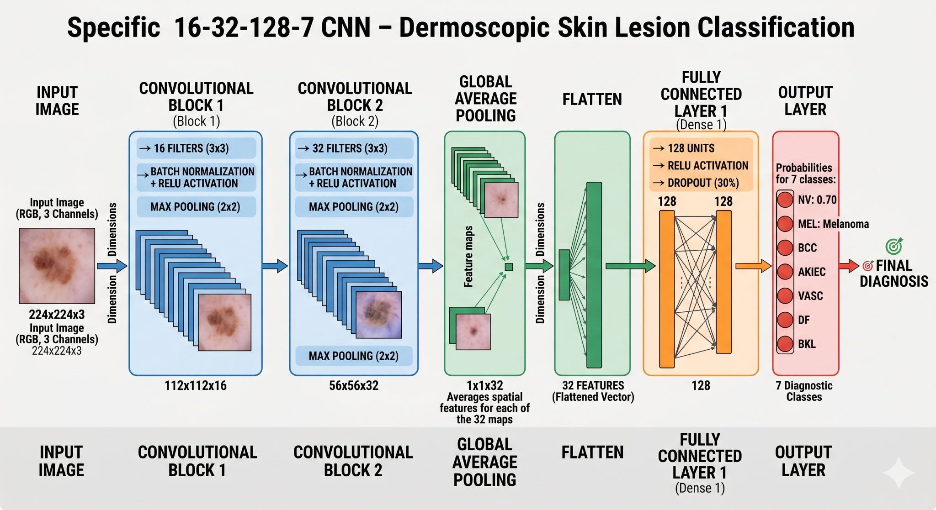
BASELINE
Architecture
Training considerations:
Data leakage assumed
Class weight
Adam optimizer
12 fixed epochs · no scheduler · no early stopping

Slide 9
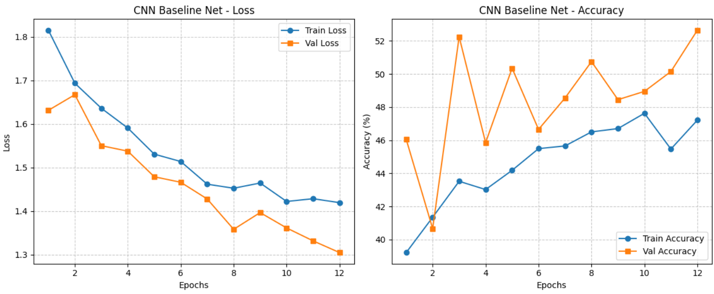
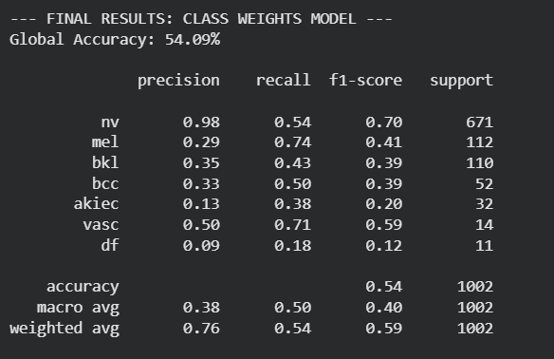
RESULTS
TRAINING CURVES:
TEST RESULTS:

Slide 10
TRANSFER LEARNING

Slide 11
TRANSFER LEARNING
Shared Phase 1 — Head-Only Warmup
Backbone
BACKBONE — FROZEN
Fully frozen — weights unchanged
MBConv Blocks 1–7
Conv Head
Training
AdaptiveAvgPool → 1408 features
Only the new 7-class head
↓
Config
NEW HEAD — TRAINABLE
5 epochs · lr = 1e-3 · Adam
Dropout (p=0.4)
Output
Linear 1408 → 512
phase1_checkpointed — shared across Exp 1, 2, 3
ReLU · Dropout (p=0.3)
Linear 512 → 7 classes
Why shared? All experiments start from the same checkpoint — differences in results come purely from the Phase 2 strategy, not from warmup variation.

Slide 12
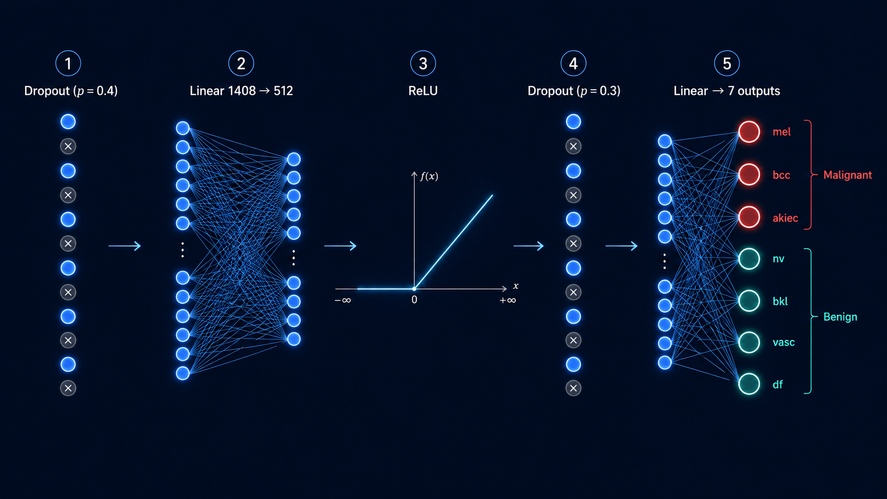

Slide 13
TRANSFER LEARNING
Experiment 1 — Baseline Fine-Tuning
Shared Phase 1: Backbone frozen · 5 epochs · lr = 1e-3 · head-only warmup
Experiment 1 Setup
EfficientNet-B2 Architecture
Backbone fully unfrozen for end-to-end fine-tuning.
15 epochs · Adam optimizer · lr = 1e-4 · weight_decay = 1e-5.
CrossEntropyLoss with class weights — penalizes minority class errors.
Backbone
EfficientNet-B2 (ImageNet)
Parameters
9.1M total
Trainable (Phase 2)
100% unfrozen
Input size
224 × 224 px
Head
Dropout → Linear(1408→512) → ReLU → Linear(512→7)
Optimizer
Adam · lr=1e-4 · wd=1e-5

Slide 14
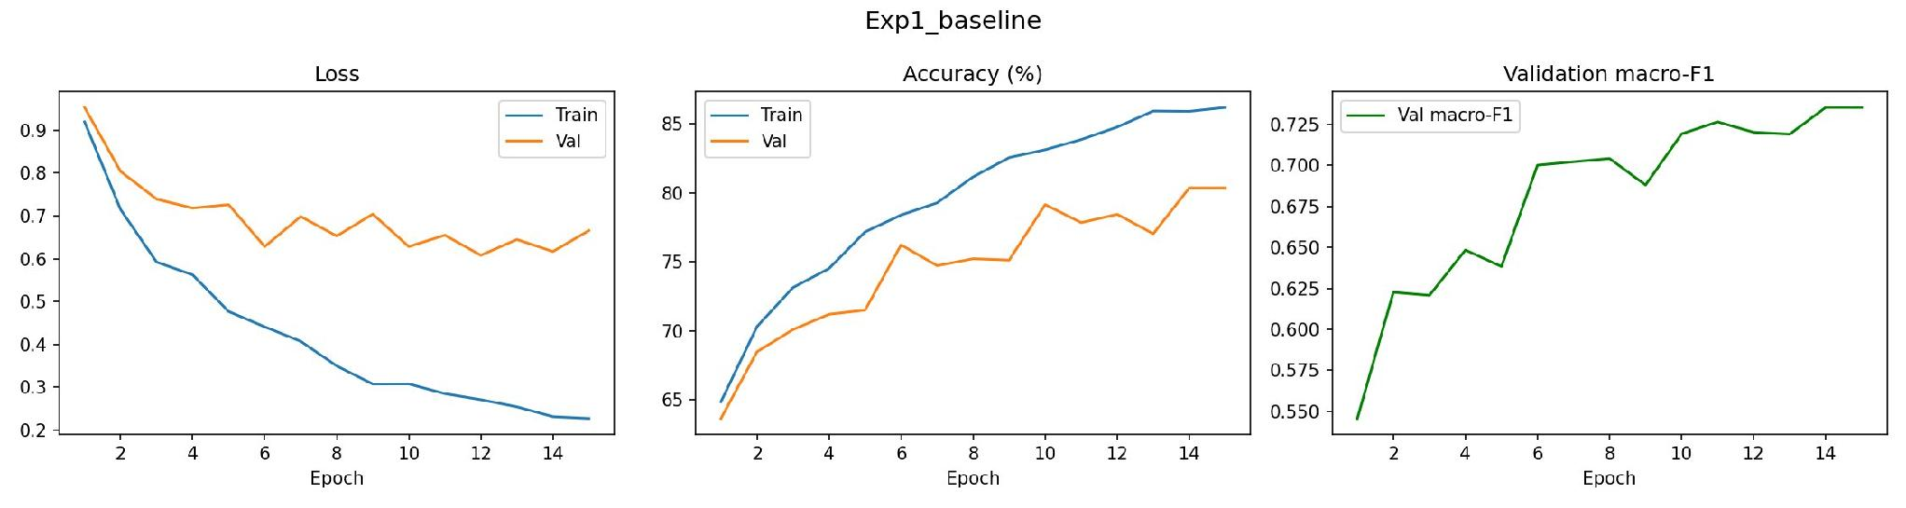
EXPERIMENT 1
Training Curves — Loss · Accuracy · Macro-F1
Loss
Accuracy
Macro-F1
Train ↓ 0.93→0.22 consistently. Val stabilizes 0.65 from epoch 5 — mild overfitting, controlled.
Train reaches 85%, val plateaus at 80% from epoch 8. 5-pt gap acceptable.
Grows 0.55→0.73 without plateauing. Model still improving at epoch 15.

Slide 15
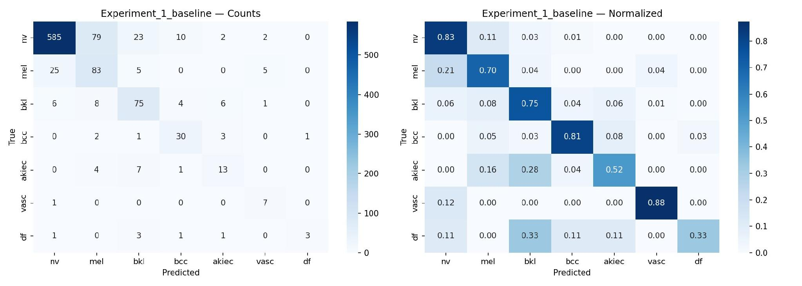
EXPERIMENT 1
Test Metrics — Experiment 1 Baseline
0.638
0.964
80%
0.703
Macro F1
AUC-ROC
Accuracy
Mel Recall
Malignant Class Recall
mel (Melanoma)
0.703
primary clinical risk.
bcc (Basal Cell Ca.)
0.811
Good — only 7 cases missed across all BCC test images.
akiec (Actinic Ker.)
0.520
Weakest malignant class — visual similarity with bkl.

Slide 16
EXPERIMENT 2
Experiment 2 — WeightedRandomSampler
Motivation: Exp 1 mel recall was 0.703 — 25 melanomas missed as benign. The hypothesis is that oversampling minority classes in each batch forces the model to pay more attention to rare malignant lesions.
What Changed vs Exp 1
WeightedRandomSampler — How It Works
Standard DataLoader → WeightedRandomSampler.
CrossEntropyLoss + class weights.
15 epochs
Without sampler
nv: ~21 imgs/batch · df: ~0
With sampler
All 7 classes ~4-5 imgs/batch
Effect
Model can't ignore rare classes
Trade-off
nv seen less → recall may drop
Combined with
class_weights in loss → double pressure on minorities

Slide 17
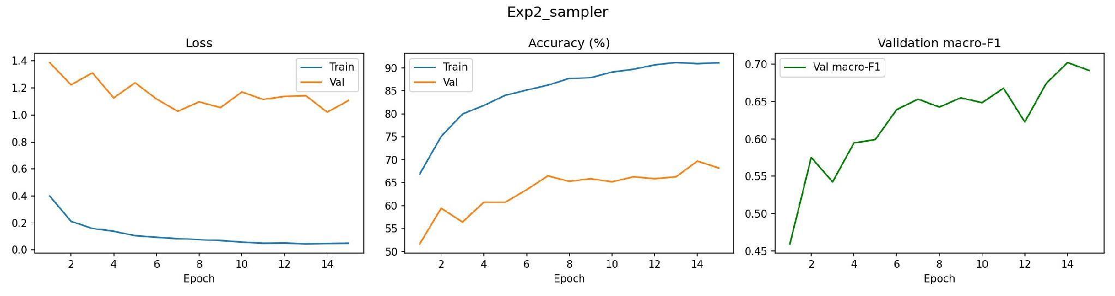
EXPERIMENT 2
Training Curves — Loss · Accuracy · Macro-F1
Loss
Accuracy
Macro-F1
Train collapses to ~0.05 — severe overfitting. Val stays at ~1.10 throughout. Gap is much larger than Exp 1.
Train reaches 91%, val only 69% — 22pt gap vs 5pt in Exp 1. Val starts at 51% due to batch imbalance mismatch.
Reaches 0.70 despite overfitting — sampler improves minority class learning even if val loss is high.

Slide 18
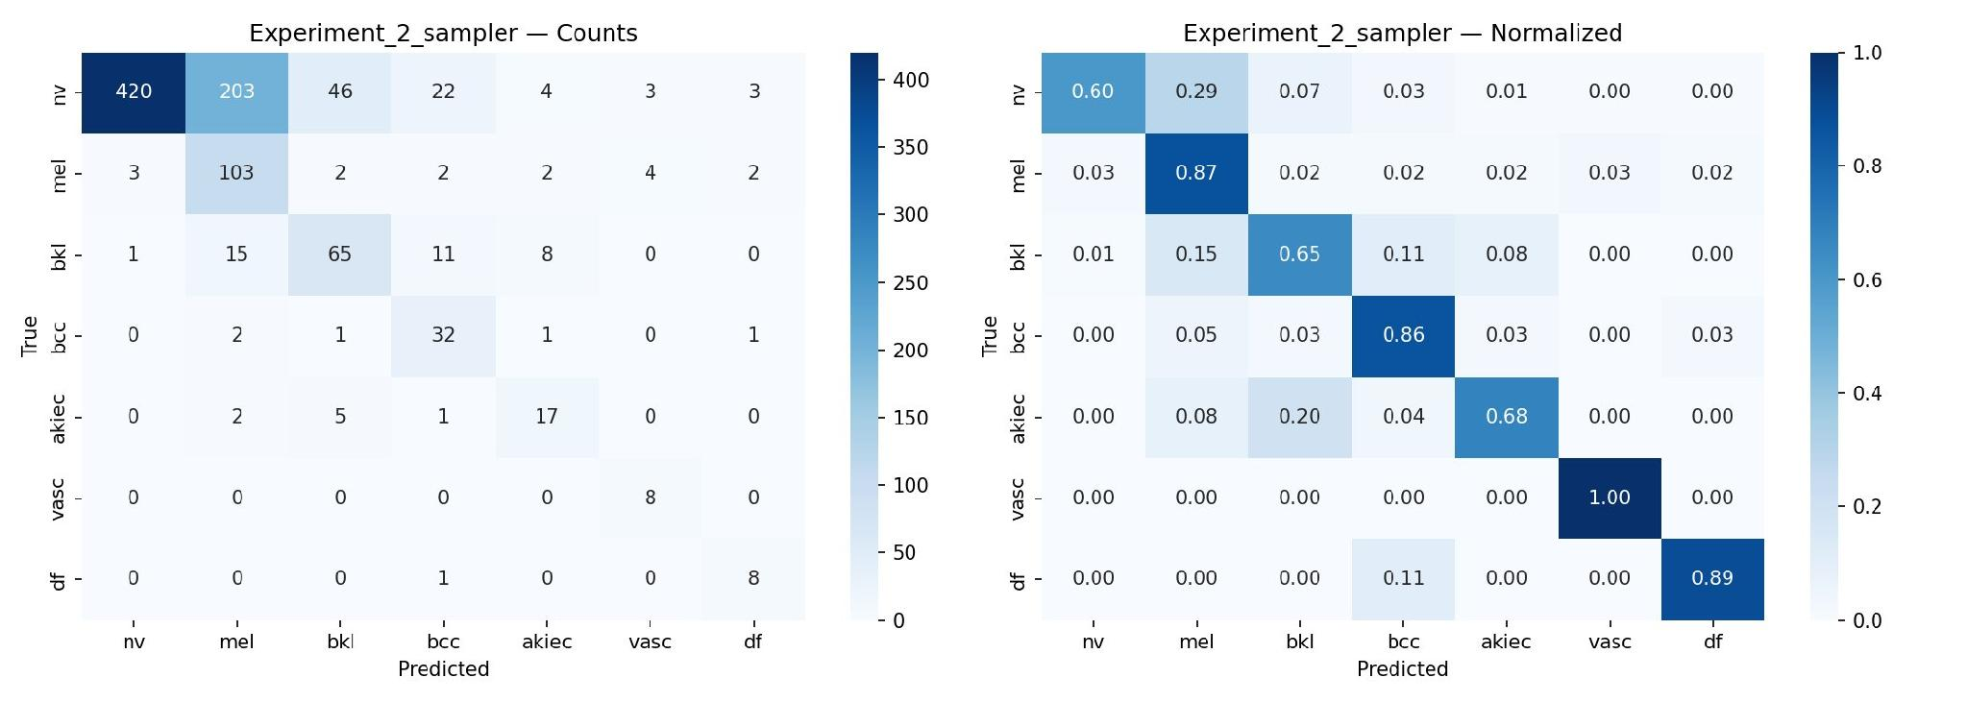
EXPERIMENT 2
Test Metrics — Experiment 2 Sampler
0.628
0.952
65%
0.873
Macro F1
AUC-ROC
Accuracy
Mel Recall
Malignant Class Recall
mel (Melanoma)
0.873
Only 3 melanomas missed vs 25 in Exp 1
bcc (Basal Cell Ca.)
0.865
Slight improvement from 0.811.
akiec (Actinic Ker.)
0.680
Up from 0.52 — gain despite persistent bkl confusion.

Slide 19
EXPERIMENT 3
Experiment 3 — Adaptive Learning Rate
Motivation: Exp 2 showed severe overfitting from the sampler. The hypothesis is that an adaptive scheduler can stabilize training convergence and help the model escape local minima without batch rebalancing.
What Changed vs Exp 1
ReduceLROnPlateau — How It Works
Standard DataLoader — no sampler (same as Exp 1).
Added ReduceLROnPlateau scheduler: patience=3, factor=0.5.
Automatically halves lr when val loss plateaus for 3 consecutive epochs.
15 epochs
Monitors
Validation loss each epoch
Patience
3 epochs without improvement
Action
lr = lr × 0.5 (halved)
Example
1e-4 → 5e-5 → 2.5e-5
Benefit
Avoids oscillation near convergence

Slide 20
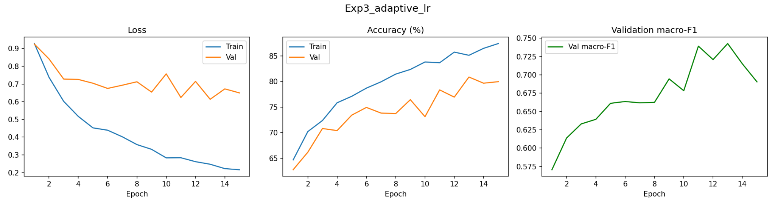
EXPERIMENT 3
Training Curves — Loss · Accuracy · Macro-F1
Loss
Accuracy
Macro-F1
Train ↓ 0.91→0.21. Val stabilizes ~0.65 — significant gap of ~0.44pt. Overfitting present but less severe than Exp 2. Oscillations from scheduler lr reductions.
Train 91%, val ~80% — 11pt gap. Similar to Exp 1 on val, confirming standard loader generalizes better than sampler.
Peaks at ~0.74 around epoch 11-12, then drops to 0.70. Peak-then-drop caused by aggressive lr reduction at that point.

Slide 21
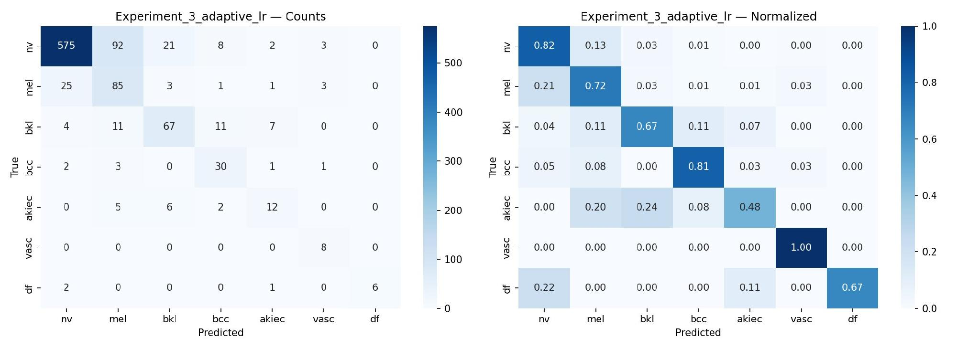
EXPERIMENT 3
Test Metrics — Experiment 3 Adaptive LR
0.680
0.962
78%
0.720
Macro F1
AUC-ROC
Accuracy
Mel Recall
Malignant Class Recall
mel (Melanoma)
0.720
Marginal improvement over Exp 1 — 25 melanomas still missed.
bcc (Basal Cell Ca.)
0.811
Identical to Exp 1 — scheduler has no effect on bcc detection.
akiec (Actinic Ker.)
0.480
Worst result across all three experiments — scheduler pushed model into poor minimum for this class.

Slide 22
DISCUSSION
Discussion & Conclusions
Key Findings
Limitations & Future Work
Strong class imbalance
Rare classes remain difficult
Single-centre dataset — geographic and demographic bias possible.
More data / synthetic augmentation
More consideration on malignant classes
• Transfer learning > CNN baseline
• Exp. 3 achieved best Macro F1 (0.68)
• Exp. 2 achieved best melanoma recall (0.87)
• AUC-ROC > 0.95 in all TL models
This system is a research prototype and does not replace clinical diagnosis by a certified dermatologist.

Slide 23

FRONTEND
Deployment FastAPI + Grad-CAM
Dataset: Multiple Skin Disease Detection and Classification
https://www.kaggle.com/datasets/pritpal2873/multiple-skin-disease-detection-and-classification
https://drive.google.com/file/d/1YjZMFwXMMI5gNZ_xo7VBbB9hhsLOb9I9/view?usp=sharing

Slide 24
Q & A
Thank you
Pau Duran Mayol · Ana Enrech Montull · Alejandro Balboa Ruiz
UPF Deep Learning 2026

